Slide 1
A Multi-Case Analysis of GLM Detection Efficiency in Alabama, Colorado and West Texas
Adam W. Clayton, Steven A. Rutledge and Kyle Hilburn
Colorado State University
GLM Workshop
8 September 2020

Slide 2
Recent GLM Validation Studies
Marchand et al. 2019
GOES-16 GLM achieves spec DE (~70%) in most locations except for High Plains
Zhang and Cummings 2020
GOES-16 GLM effectively detects long duration flashes with large flash areas
Reduced detection of short duration flashes with small flash areas
Brunner and Bitzer 2020
Satellite detection of optical emissions varies greatly with location in thunderstorm
Rutledge et al. 2020
GOES-16 DE varies depending on thunderstorm microphysics, flash size, and flash height. Argued that reduced DE is caused by optical attenuation due to cloud ice particles and cloud droplets. DE lowest in so-called “inverted” storms

Slide 3
COLMA
G16/17
2018-2019
NALMA
G16 2020
WTLMA
G16/17
2018-2019

Slide 4
Methodology
Only considered isolated convection within 100 km of LMA center
CSU Lighting, Environment, Aerosols, and Radar (CLEAR)
CLEAR was used to track isolated convection in each of the three regions
10 km² threshold employed for 35 dbz contour
20 km² threshold employed for 45 dbz contour
Minimum 10 source threshold used for COLMA and WTLMA
5 source threshold for NALMA
NLDN flashes < 15 kA were considered intra-cloud and removed from the CG count
ABI data used to estimate cloud water/cloud ice path (CTWP); radar used to estimate precipitation ice water path (IWP); radar also used to estimate graupel and hail echo volumes
Notes:
I thought we abandoned the AF-IWP and used IWP from the melting level upwards?

Slide 5
Case Date | Region | Time of Cell | Hail report | Wind report | Tornado report | Average DE(%)
20190715 | CO | 20:00-23:05 UTC | Yes | No | No | 2.38
20190712 | CO | 1900-2100 UTC | No | No | No | 2.48
20190701 | CO | 20:12-00:13 UTC | Yes | No | No | 4.33
20180729 | CO | 19-2230 UTC | Yes | Yes | Yes | 4.81
20190705 | CO | 02:56-04:14 UTC | Yes | No | No | 5
20190520 | WT | 20:29-22:21 UTC | Yes | Yes | No | 5.14
20190620 | CO | 20:37-23:22 UTC | No | No | No | 5.55
20190704 | CO | 01:43-03:26 UTC | Yes | No | No | 5.72
20190911 | CO | 22:08-00:08 UTC | Yes | No | No | 7.02
20190625 | WT | 1:09-02:57 UTC | No | No | No | 7.69
20180619 | CO | 18-2130 UTC | Yes | No | Yes | 8.95
20190523 | WT | 23:00-02:47 UTC | Yes | No | No | 10.25
20190526 | CO | 21:30-23:00 UTC | Yes | Yes | Yes | 11.4
20180807 | CO | 22:24-01:54 UTC | No | No | No | 12
20190608 | CO | 22:13-00:19 UTC | Yes | No | No | 12.23
20190524 | WT | 00:34-3:55 UTC | No | No | No | 12.55
20190525 | WT | 20:35-21:36 UTC | No | No | No | 13.13
20180618 | CO | 0-2:30 UTC | Yes | No | No | 14.08
20180605 | WT | 23:06-02:15 UTC | No | Yes | No | 17.54
20190614 | WT | 00:59-3:10 UTC | Yes | No | No | 18.76
20200524 | AL | 01:05-2:30 UTC | No | No | No | 20.87
20190505 | WT | 20:20-21:56 UTC | No | No | No | 23
20180517 | WT | 22:03-23:27 UTC | No | No | No | 23.04
20180520 | WT | 0220-0430 UTC | No | No | No | 23.28
20180601 | WT | 23:29-00:30 UTC | No | No | No | 25.17
20200408 | AL | 2140-2340 UTC | Yes | Yes | No | 26.8
20200523 | AL | 00:35-01:45 UTC | No | No | No | 32.63
20200603 | AL | 20:25-2150 UTC | No | No | No | 34.93
20200629 | AL | 17:35-18:15 UTC | No | No | No | 35.88
20200627 | AL | 22:50-23:50 UTC | No | No | No | 43.69
20190323 | WT | 00:31-04:57 UTC | Yes | No | No | 46.21
20190423 | WT | 01:15-2:10 UTC | No | No | No | 46.36
20200704 | AL | 17:50-19:02 UTC | No | No | No | 49.2
20200517 | AL | 19:40-21:10 UTC | No | No | No | 59.03
Cases are ranked from lowest
to highest average Detection
Efficiency
There is a tendency for more
of the low DE cases to be
severe, mainly hail
Notes:
In talking about this table. I would call the audience’s attention that the table is ranked from lowest to highest average DE and you can see that there are more “red” (severe) on the low DE end compared to the higher DE end.

Slide 6
Location of VHF sources are high and flash area is large
GLM flashes, groups, and events well correlated to LMA flash rate
GLM DE mostly meets specs for this case
Cloud top water path is very small implying negligible optical attenuation

Slide 7
Relatively low flash rate storm by Colorado standards
Flash area is very small <10 km²
GLM correlated to LMA
GLM flash rate is an order of magnitude less than LMA flash rate
GLM DE is less than 10 percent for this storm
CTWP larger than in high DE Alabama case
Low DE caused by small
(dim) flashes and
attenuation due to
appreciable CTWP

Slide 8
Low VHF source location and small flash areas = anomalous storm
Higher count of +CG flashes
especially early in time series consistent with
inverted storm
DE is low for most of time series; DE increases with flash area (size)
CTWP larger than the high DE Alabama case; role of optical attenuation again evident in explaining low DE

Slide 9
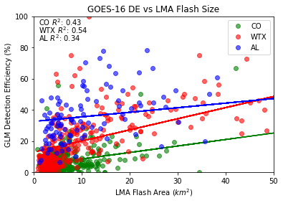
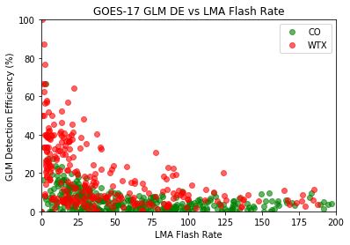
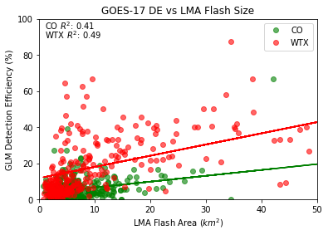
LMA FR above 50 fl s⁻¹ then GLM DE < 50%
For a given flash size the DE is different for the three regions!

Slide 10
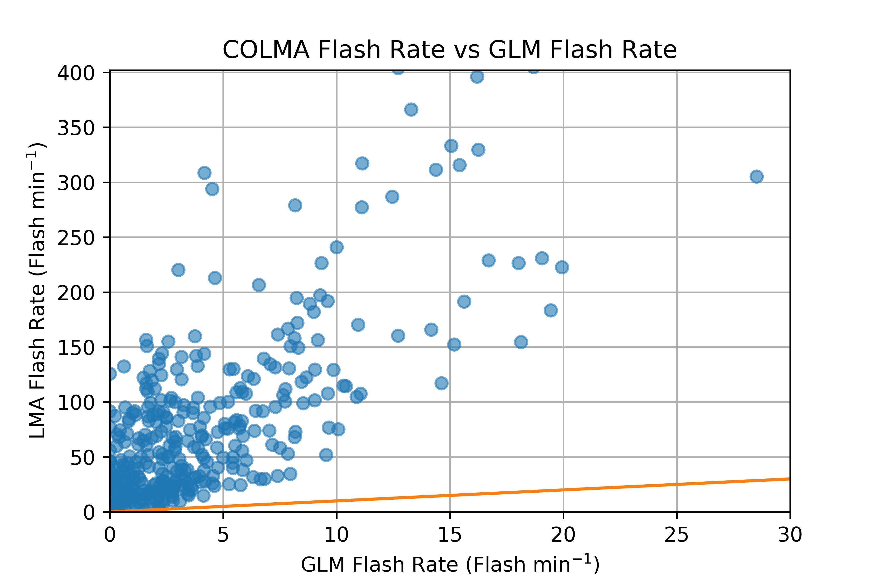
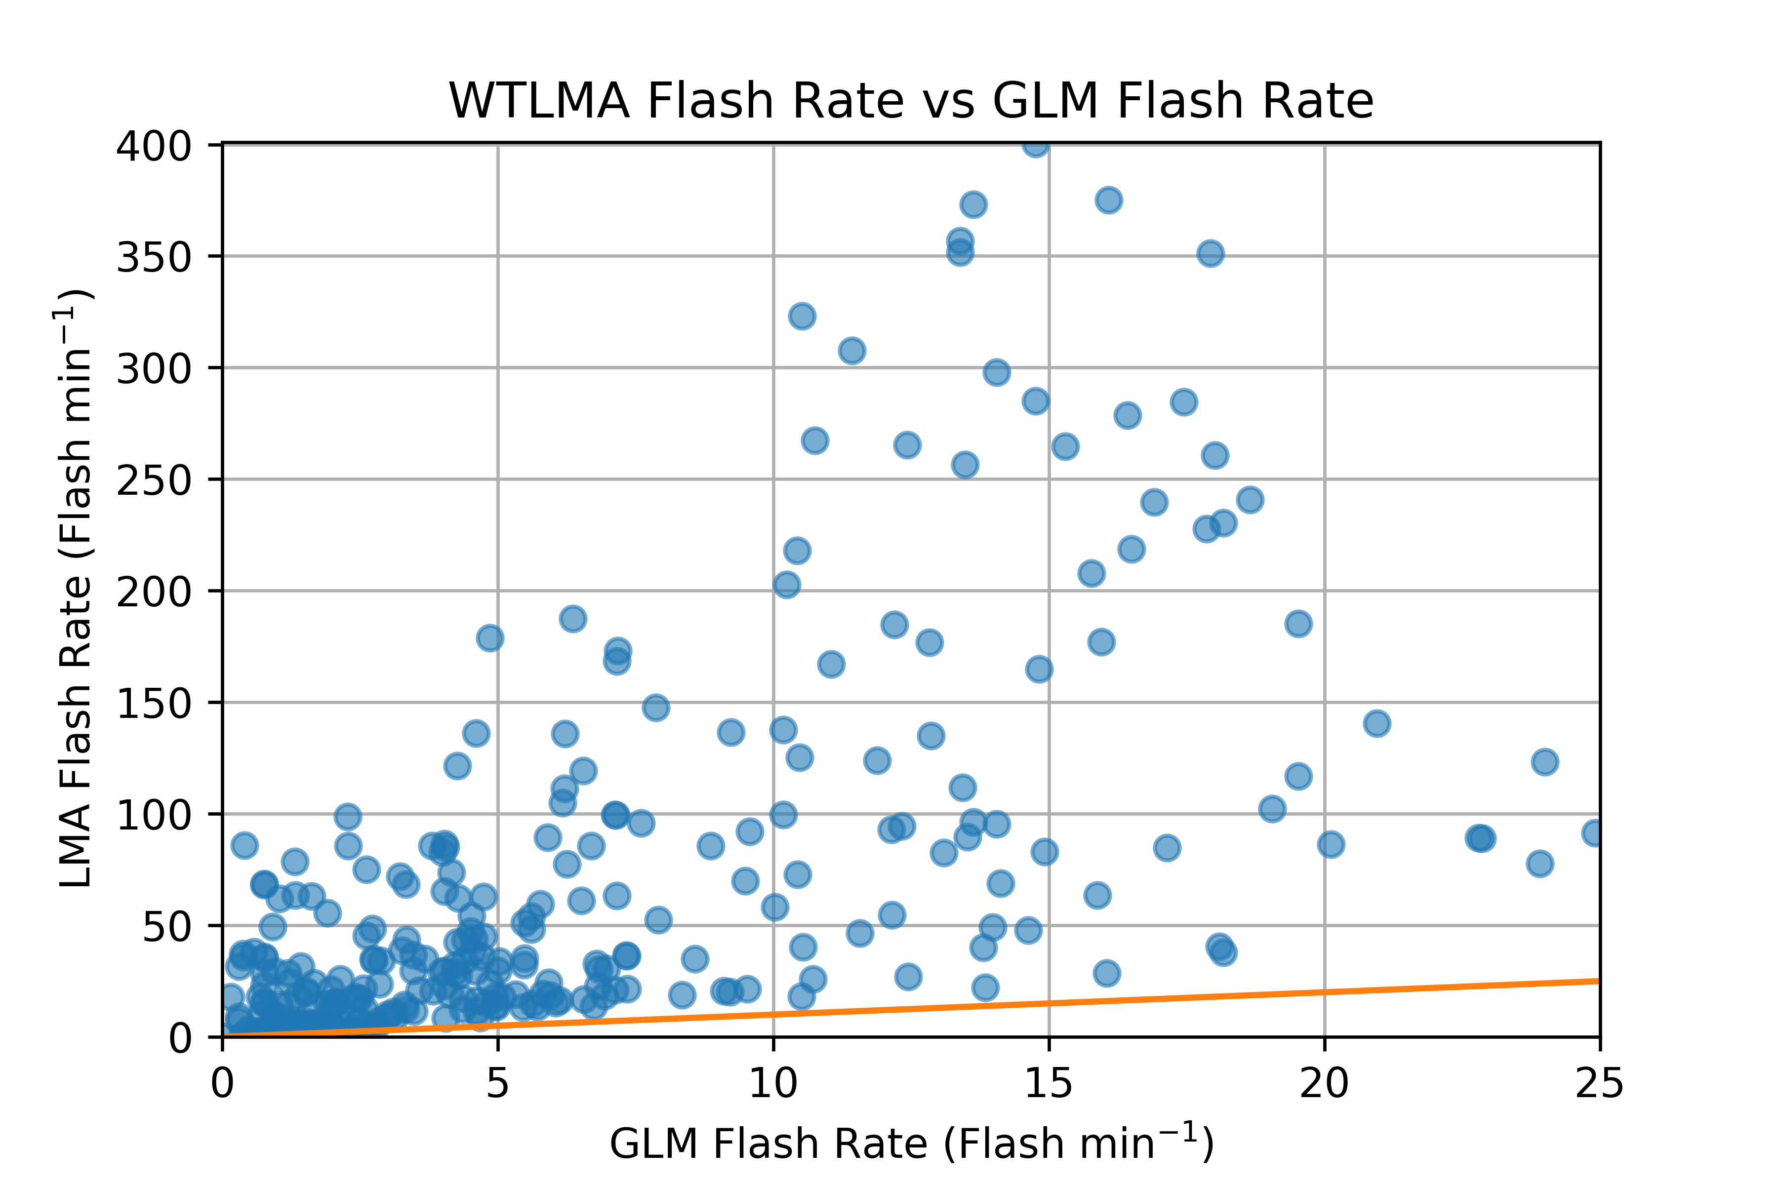
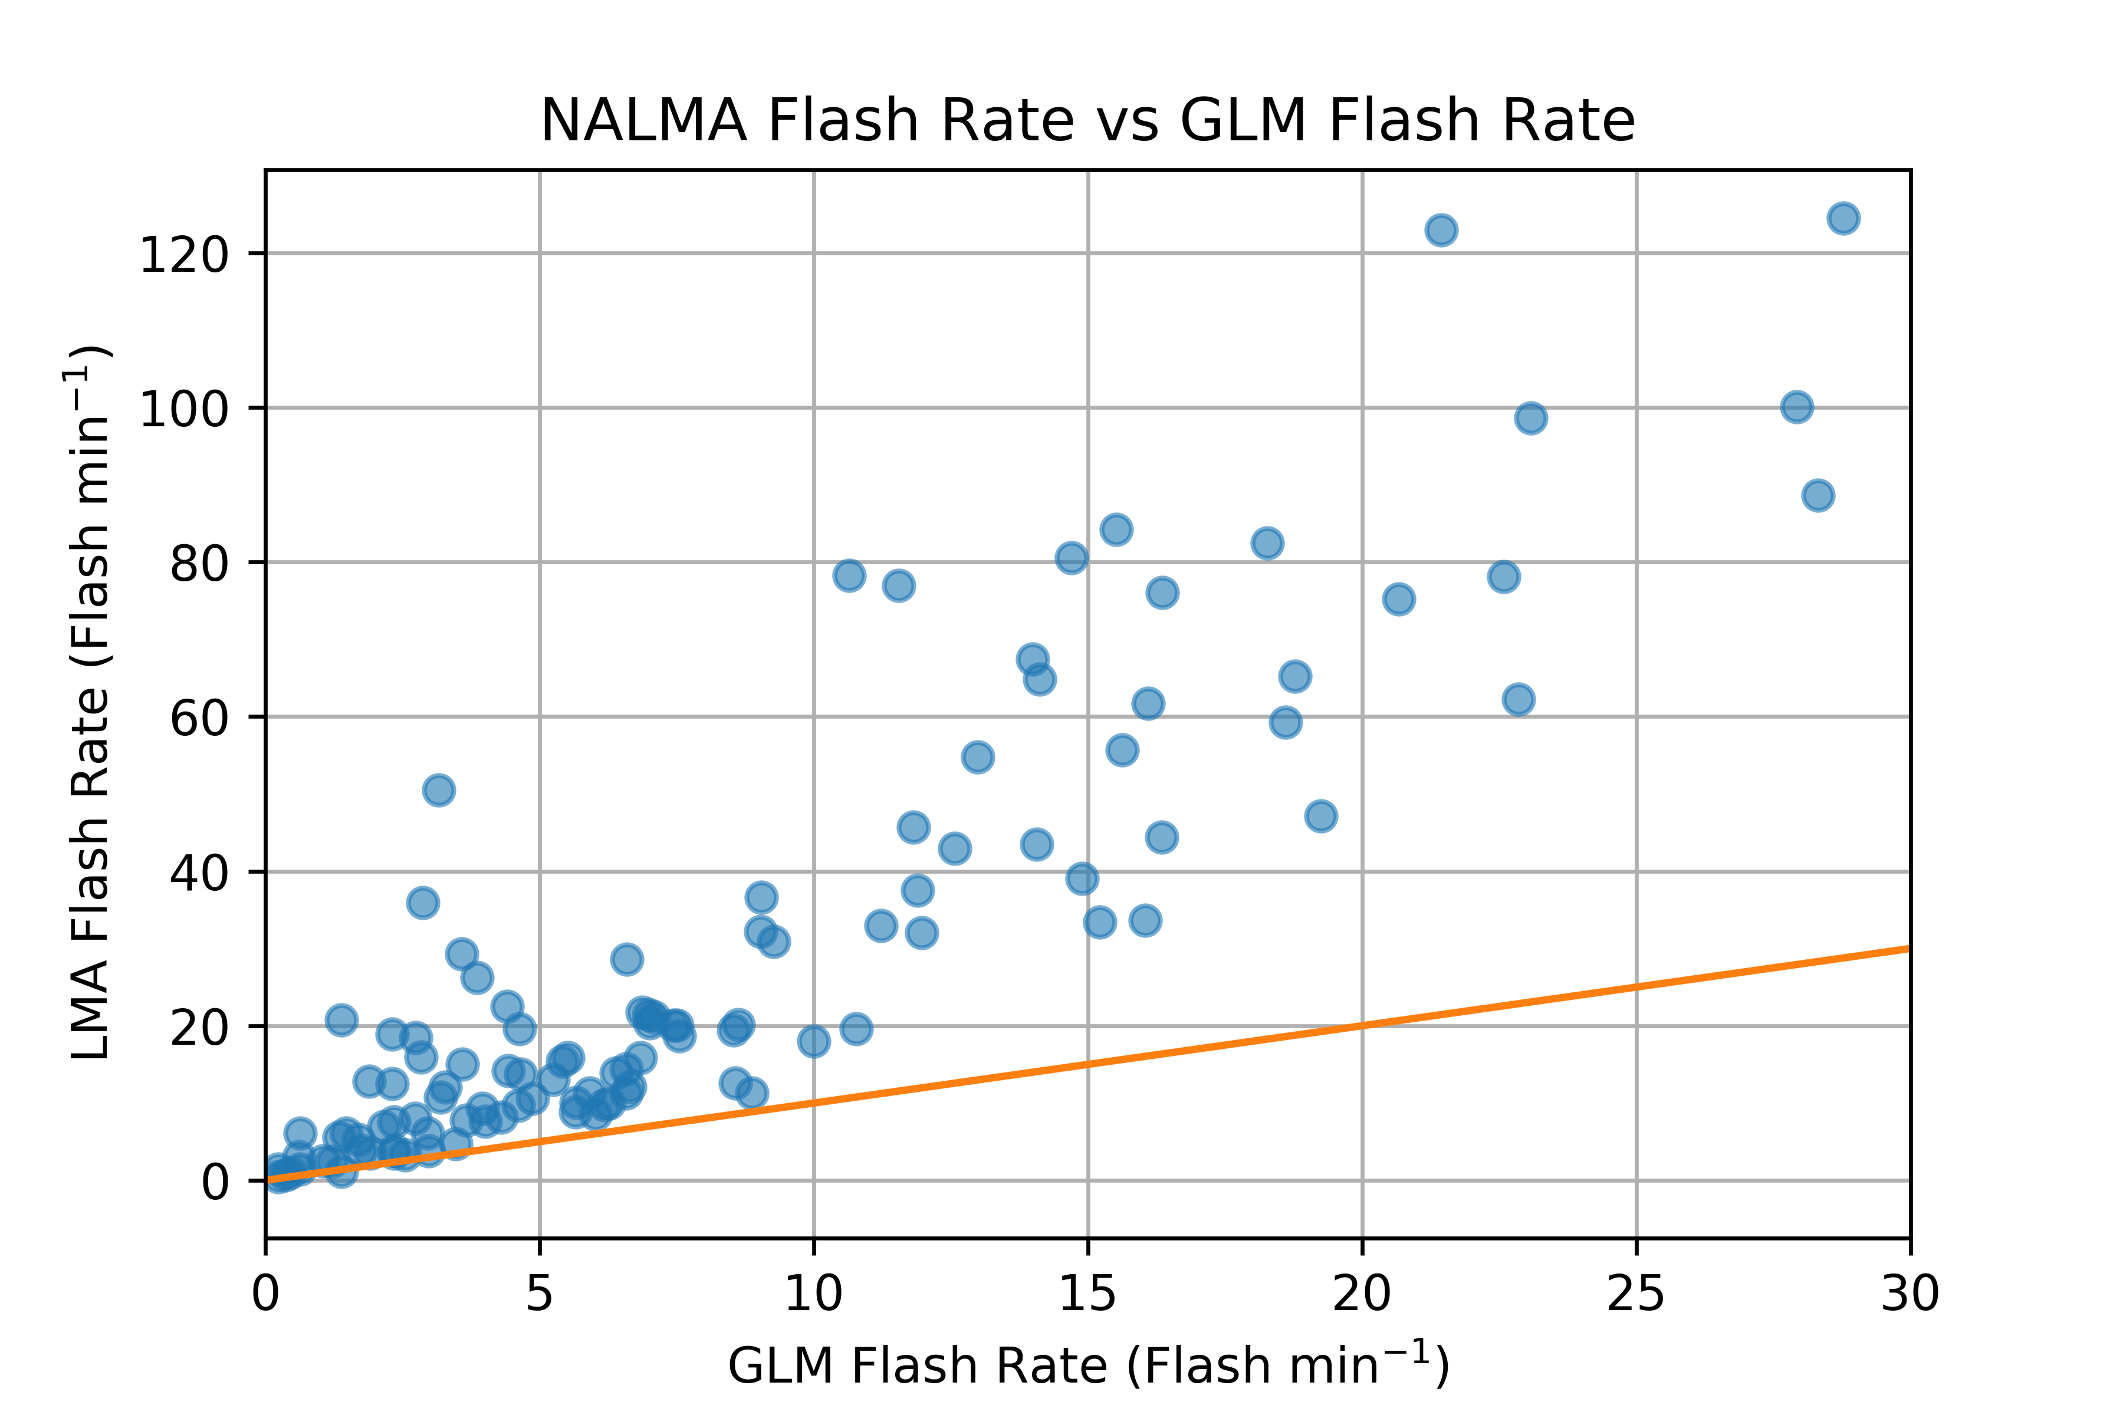
Orange line is the line of equal flashes for LMA and GLM
Largest discrepancy is in Colorado followed by West Texas and North Alabama

Slide 11
Conclusions
Analyzed 34 isolated thunderstorms in Alabama, Colorado, and West Texas
For a given flash area, the GLM DE varies greatly over the three regions
Combination of low flash heights, small flash areas, cloud water path and GLM FOV act to reduce GLM DE
Thunderstorms that produce severe hail are more likely to have a low DE
Questions?

