Slide 1
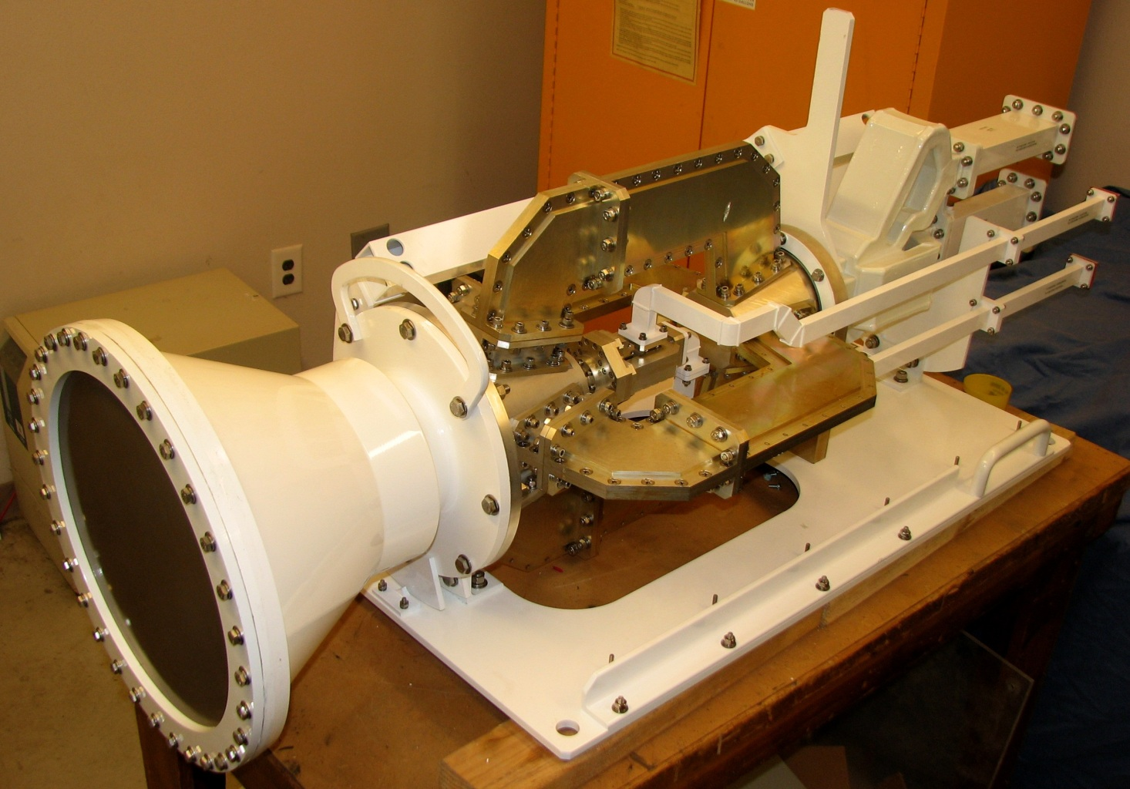
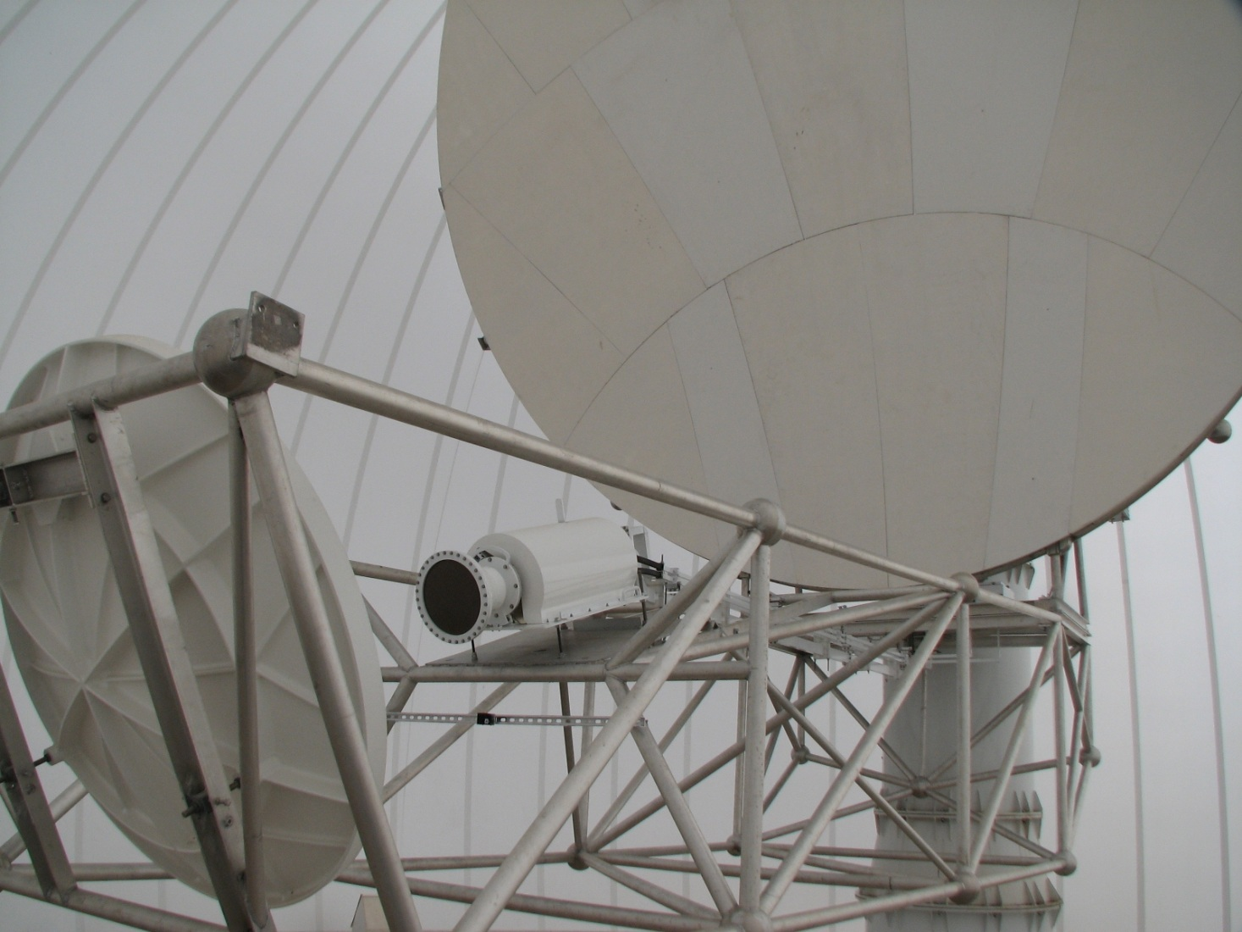
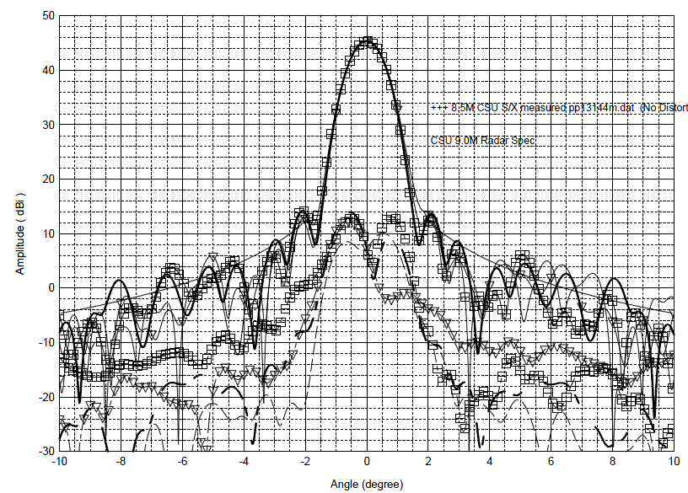
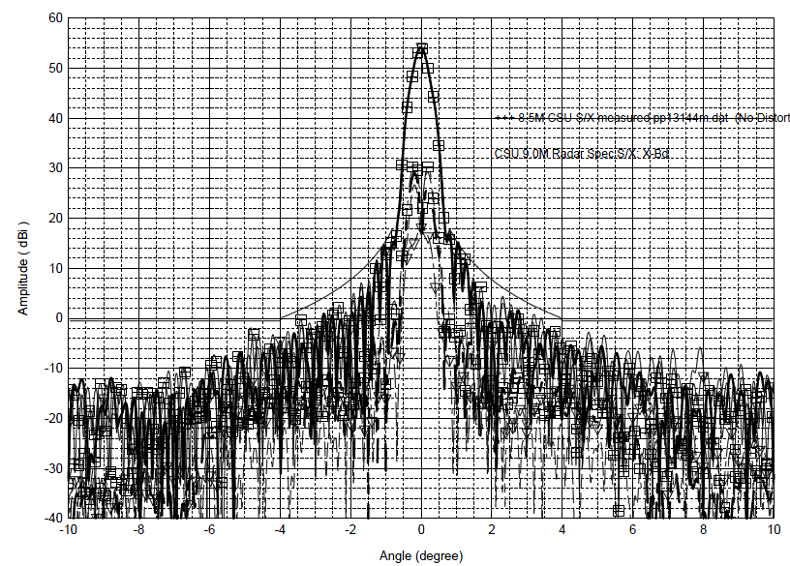
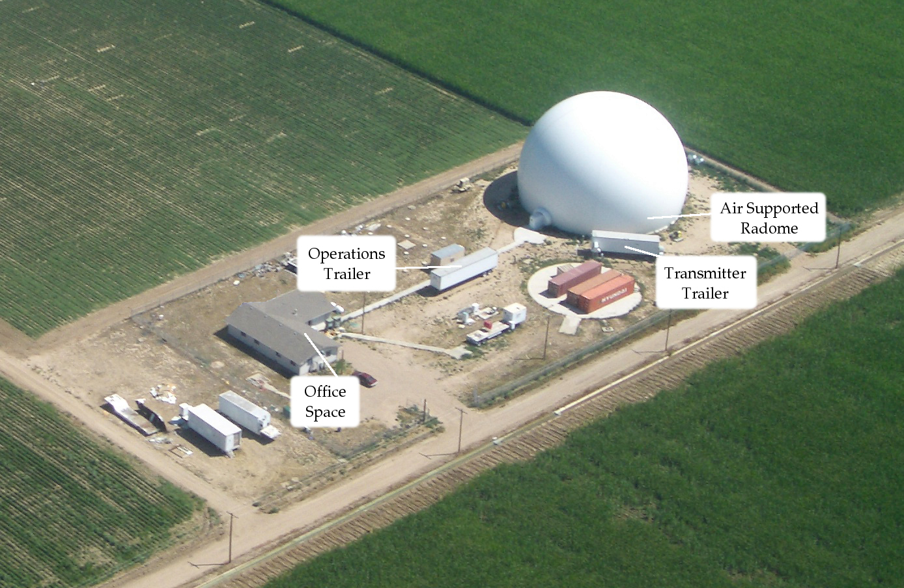
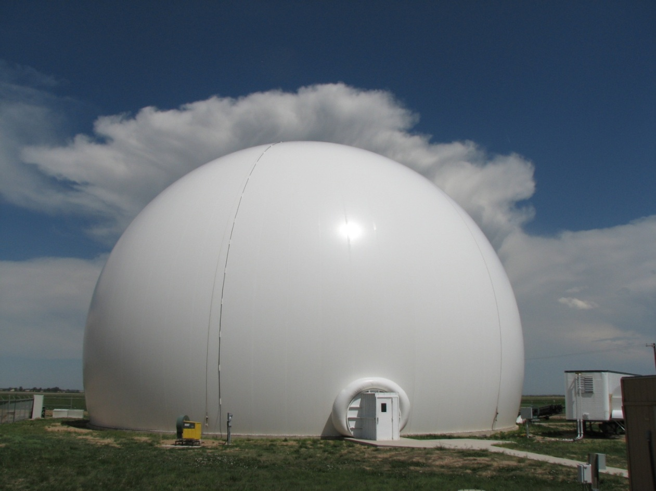
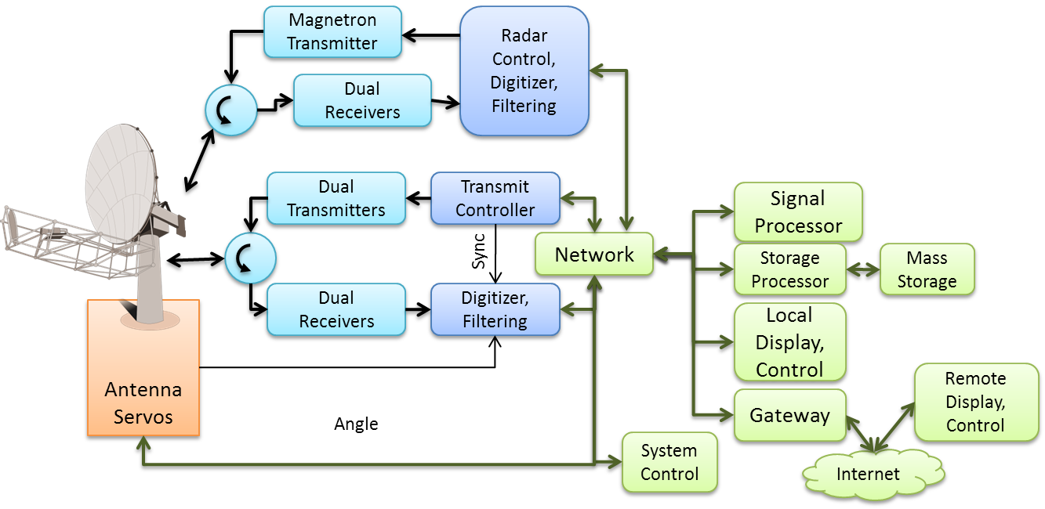
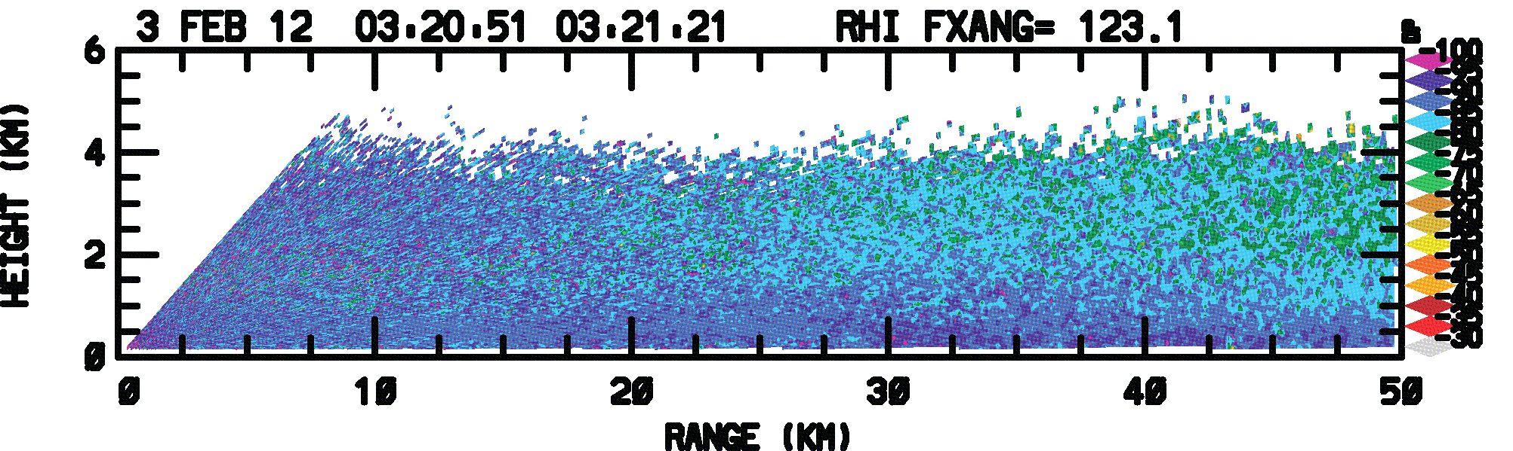
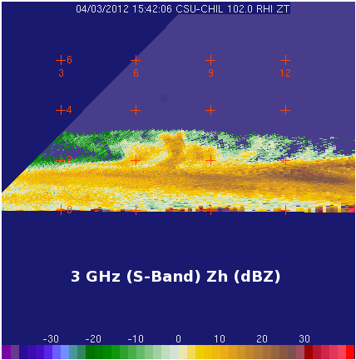
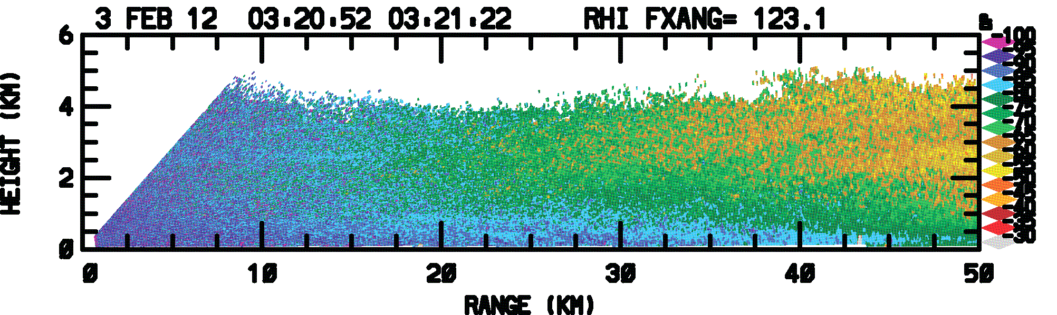
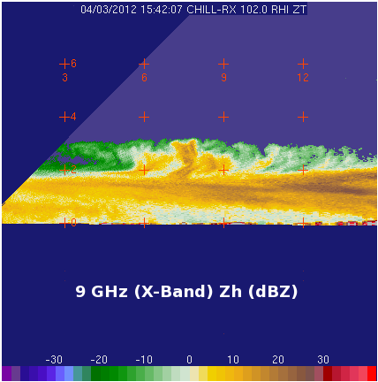
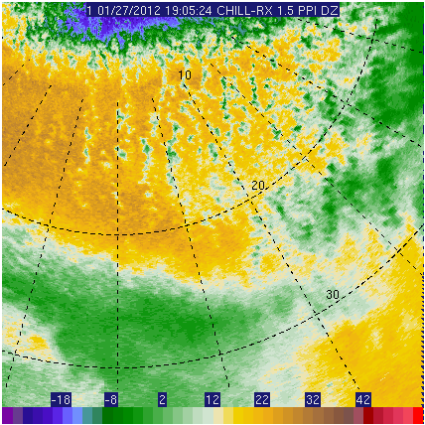
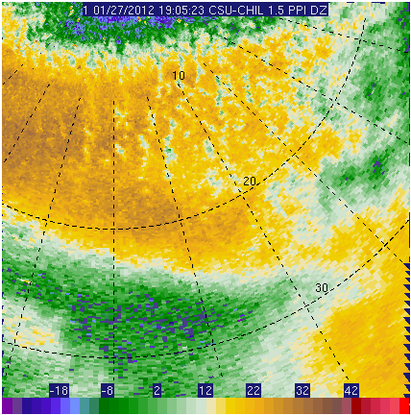
X-Band Addition to CSU-CHILL Radar facility
V. Chandrasekar, V.N. Bringi, S.A. Rutledge, D. Brunkow, F. Junyent, M. Galvez, P. Kennedy, J. George, R.Bowie
About the CSU-CHILL Radar
Radar Specifications
Dual-wavelength antenna
The CSU-CHILL National Weather Radar Facility, located in Greeley, CO, is an advanced, transportable dual-polarized, dual-wavelength (S- and X-band) weather radar system. The facility is funded by the National Science Foundation and Colorado State University, and is hosted by the Departments of Atmospheric Science and Electrical and Computer Engineering.
Features
Dual offset, dual-wavelength low sidelobe Gregorian antenna system
Easy-to-use, remotely accessible radar control interface
Polarization-agile dual-Klystron 1 MW transmitter at S-band
Simultaneous-transmit 25 kW Magnetron transmitter at X-band
Dual-channel software-defined digital-IF receiver
Flexible signal processor, customizable to project needs
Comprehensive calibration subsystem
VCHILL Real-time control and distribution of radar data
X-Band Addition
In 2012, a dual-wavelength feed assembly and X-band transmit/receive subsystem were added to the radar system
The dual-wavelength system expands the measurement capability of the radar to observe the full lifecycle of precipitation
This poster presents the technical description of the dual-wavelength feed, the X-band addition and some preliminary dual-wavelength measurements from this new addition
Parameter | S-band | X-band
Antenna
Type | 8.5 meter dual-offset Gregorian parabolic reflector,
Feed Type | Scalar, symmetric OMT
Gain | 43 dBi | 53 dBi
Beam Width | 1 degree | 0.3 degree
Max Sidelobe (one-way) | < -27 dB | < -36 dB
Peak cross-pol | < -43 dB | < -23 dB
Scan type | PPI (360°, sector), RHI, Fixed pointing, Vertically pointing
Max. Slew Rate | 18 degrees/sec
Transmitters
Operating Frequency | 2.725 GHz | 9.41 GHz +/- 30 MHz
Type | Dual Klystron | Magnetron
Peak power | 1 MW (per polarization) | 25 kW
Transmit Mode (s) | Single-pol, Simultaneous, Alternating | Simultaneous
Max. Duty Cycle | 0.16 % | 0.16 %
Max. PRF | 1.25 kHz | 2 kHz
Receivers
Sensitivity | -10 dBz at 30 km | -10 dBz at 30 km
Noise Figure | 3.4 dB | < 4.5 dB
Dynamic Range | 80 dB | 90 dB
Range Resolution | 30 – 150 m | 1.2 – 192 m
Signal Processing and Products
Processing Modes | Pulse Pair, Spectral Clutter Filter, Second Trip Suppression
Polarization Processing | Hydrometeor ID, attenuation correction, K_{DP} estimation
Data Products | Z, Z_{DR}, V, W, ρ_{HV}, NCP, ϕ_{DP}, K_{DP,} SNR
The CSU-CHILL radar features a unique dual offset-feed antenna with dual-wavelength capability
Features
Three feed horn options available (Dual wavelength, 10 cm and 3 cm)
Beam width of 1.0 degree at 10 cm (S-band), 0.3 degree at 3 cm (X-band)
Symmetric OMT design, with LDR limit exceeds 40 dB
Low sidelobe levels improve clutter rejection at low elevation sweeps
Flexible antenna controller supports sector scans and RHIs
Dual-wavelength Feed Assembly
Dual Reflector Assembly
CSU-CHILL Radar Site
Air-supported Radome
S-band Antenna Pattern
X-band Antenna Pattern
Block Diagram
Example Dual-Wavelength Measurements with the CSU-CHILL radar
S-band
S-band
X-band
X-band
Propagation phase at X-band has three times more sensitivity than at S-band. This is useful when measuring phidp gradients in winter storm and light rain cases, where the phase shifts at S-band are low, and cause errors in slope estimation. This extends phase-based rain-rate estimation to low rain rates (less than 3 mm/hr), and allows observation of regions of oriented ice crystals.
The block diagram shows how the S- and X-band systems are integrated
S-band T/R, digital receiver located in radar van
X-band T/R, digital receiver mounted behind the antenna
Higher angular resolution at X-band shows enhanced detail of fine structures in winter data
This facility is sponsored by NSF cooperative agreement no: AGS1138116
Differential Propagation Phase in Ice
Dual-wavelength measurements in snow

