Slide 1
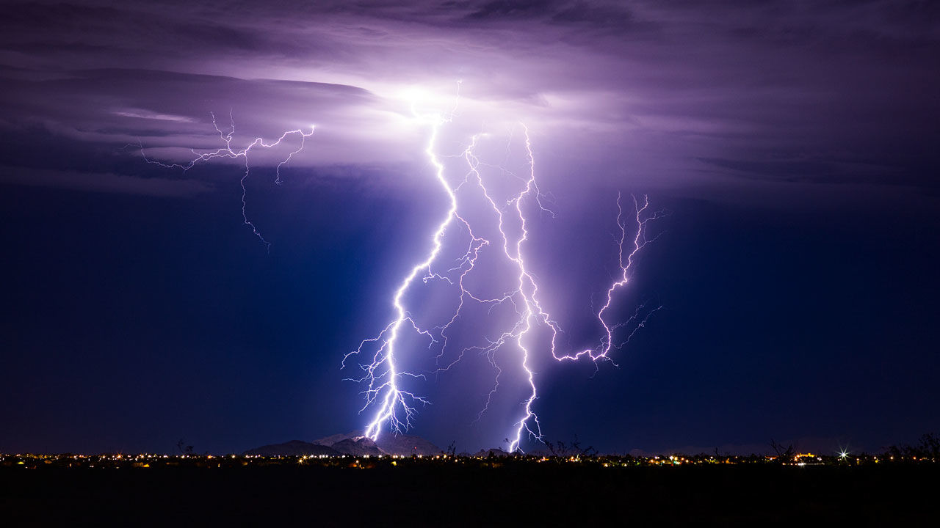
Atmospheric electricity: From Ben Franklin to Steve Rutledge
Prof. Steven Rutledge
Dept. of Atmospheric Science
Colorado State University
Ft. Collins CO

Slide 2

First of all, sorry for the ancient picture on the seminar announcement!

Slide 3
Outline
Franklin’s work
Tropical and mid-latitude lightning research
Cloud electrification basics
Storm scale observations including GLM
Global lightning parameterizations
Conclusions

Slide 4
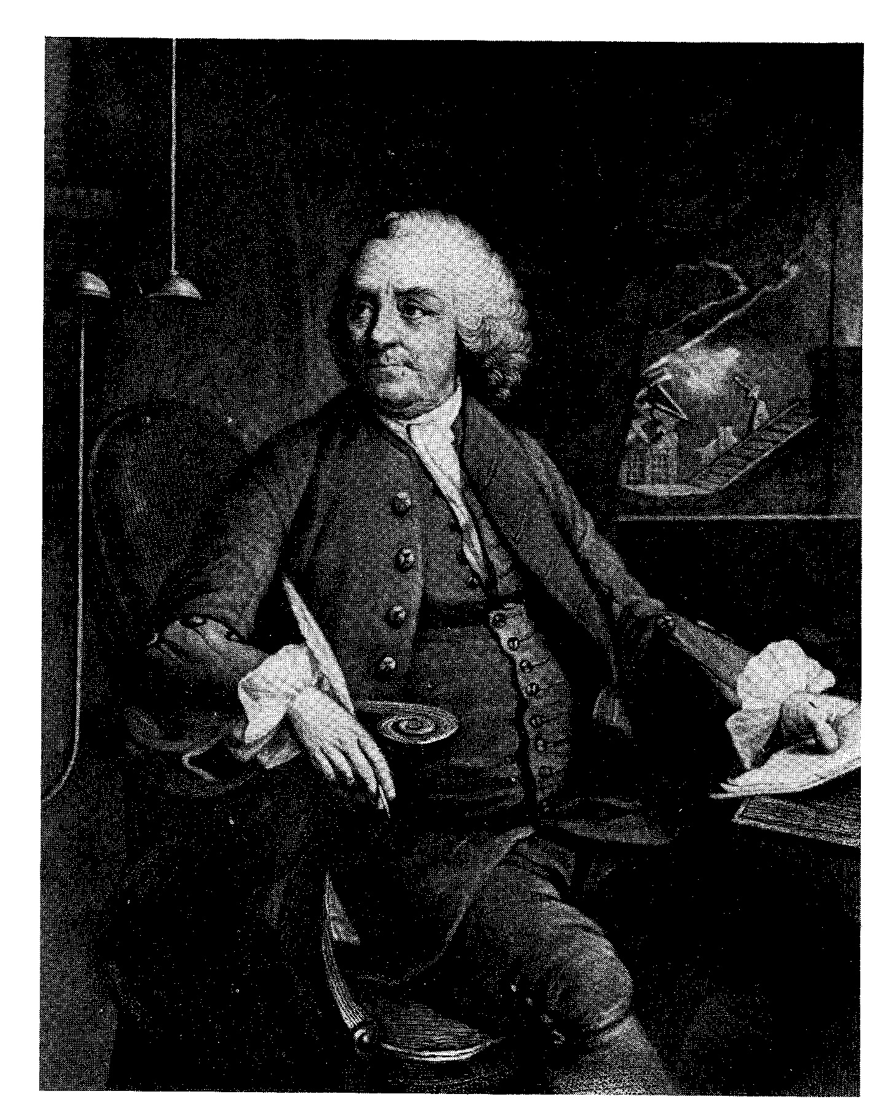
Ben Franklin, circa 1750
The science of atmospheric
electricity began with Franklin’s
early experiments

Slide 5
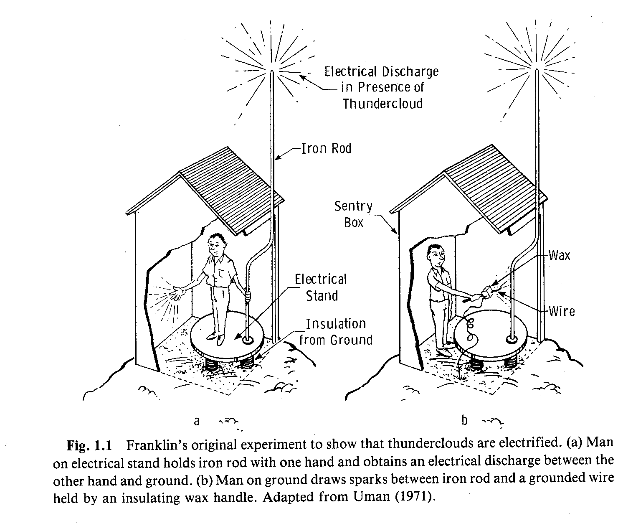
The sentry box experiment
Uman (1987)

Slide 6
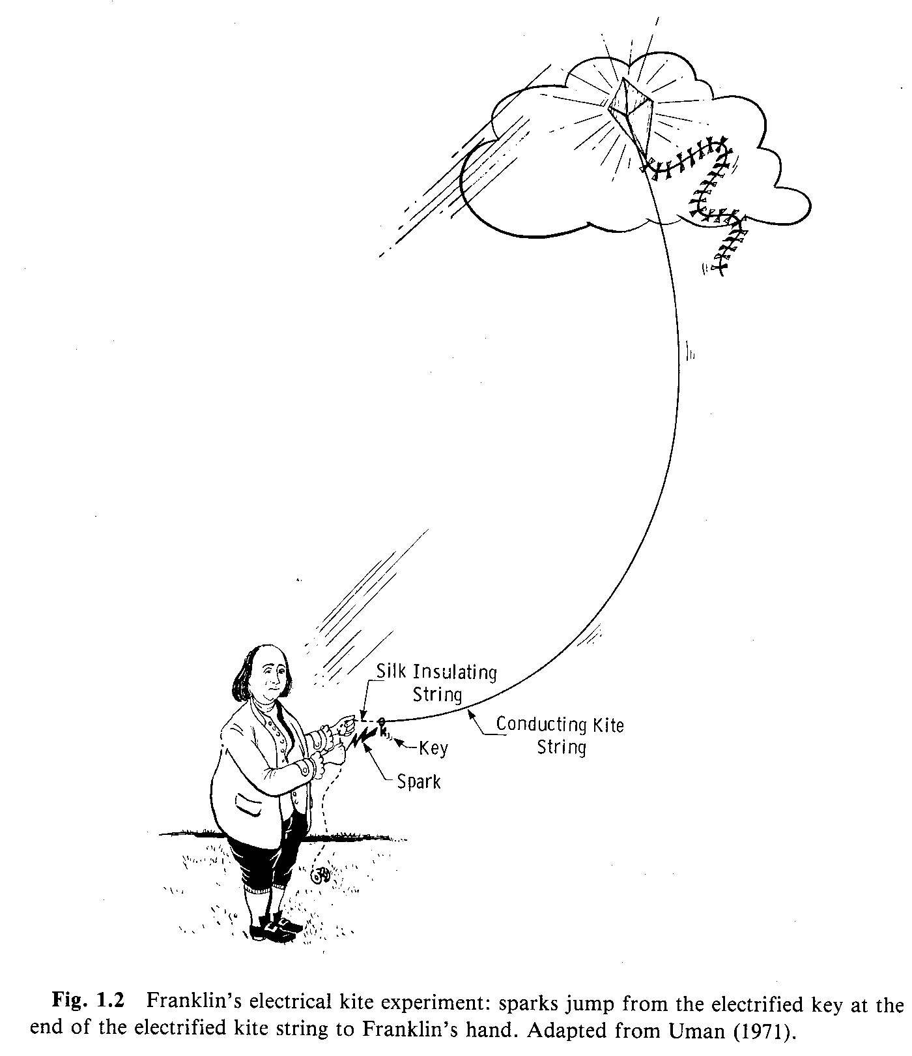
The most famous kite ever flown…
Franklin devised this experiment to more
directly determine that clouds were indeed electrified---a source of electricity, or the flow of an electrical current
The electron was discovered over 100 years later!
Typical lightning flash has
10-100 kA of current,
or ~ 10²³⁻²⁴ electrons/sec
Uman (1987)

Slide 7
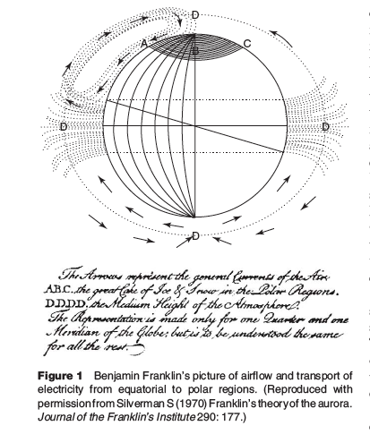
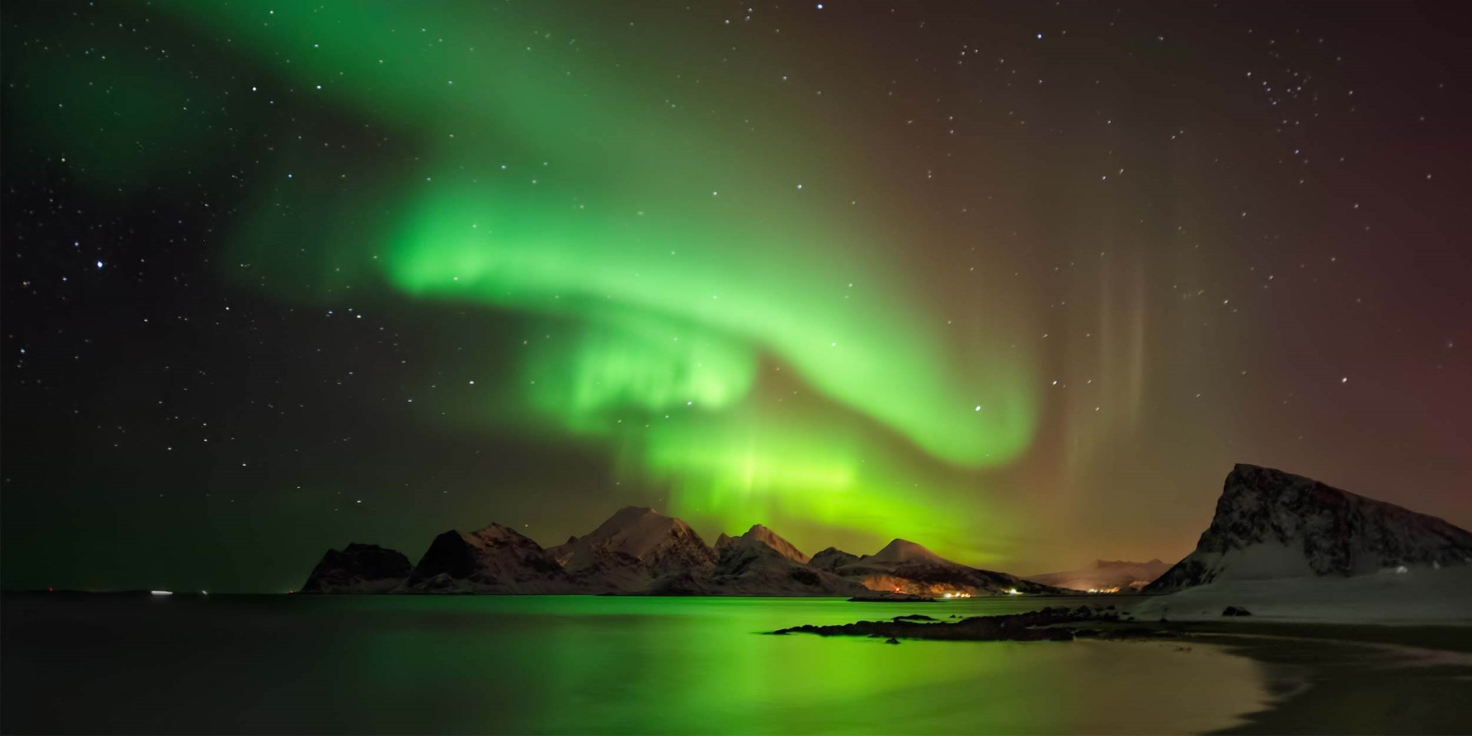
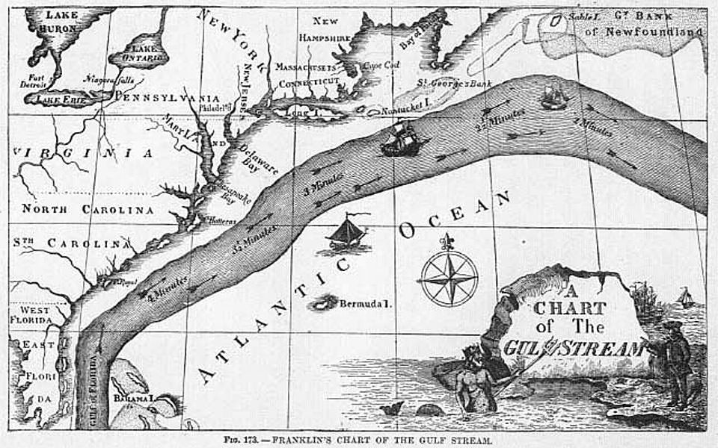
Ben Franklin’s view of the global flow of moist,
electrified air. Presented to the Royal Academy of
Sciences in Paris in 1779. Warm moist air ascends
over the tropics and descends at the poles. He
argued that the cloudy air delivered charge to the
Polar ice caps where it accumulated until breakdown
of the upper atmosphere occurred in the form of
the Aurora Borealis/Aurora Australis.
E. R. Williams: Global Electrical
Circuit, Elsevier
The Gulf Stream
by Ben Franklin;
2 crossings of the
Atlantic!

Slide 8
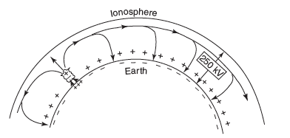
The (DC) Global Circuit
100 years after Franklin’s pioneering work…
Lord Kelvin developed the theory
of electrostatic potential, necessary for
understanding the concept of a global circuit. He
also put forward the concept of the Earth and
upper atmosphere forming a giant spherical
capacitor—the Kelvin capacitor
The Wilson model of the Global Circuit
C. T. R. Wilson followed Lord Kelvin’s
work and deduced that thunderstorms
contain positive charge aloft with negative
charge closer to cloud base
In 1920, Wilson formulated his
hypothesis for the global electrical
circuit: thunderstorms are “batteries”
that drive positive charge upward to the
conductive ionosphere and drive negative
downward to the Earth’s surface carried on
precipitation and also by lightning which
lowers predominantly negative charge
A downward directed fair weather electric
field characterizes the global circuit
~ 120 V/m at the Earth’s surface
Potential (voltage) difference between
Earth’s surface and conducting atmosphere
above is about 300,000 V

Slide 9
Some fun fair weather field facts..
Global flash rate is 40-50 s⁻¹
Ohms Law applies in the form J=σE where J is the current density. J~2x10⁻¹² A/m²
The current flowing in the global circuit is then J•Area_{Earth} or 1400A.
The columnar resistance is ~200 Ohms owing to a leaky dielectric in the spherical capacitor? R=V/I, ~200 Ohms.
Capacitance of the concentric spherical capacitor is 1 Farad
E field would rapidly decrease if global thunderstorm activity ceased. Time constant τ=RC=200s. (τ=RC=ε/g)
Power in the global circuit, P=V x I, ~ 4 x 10⁸ W

Slide 10
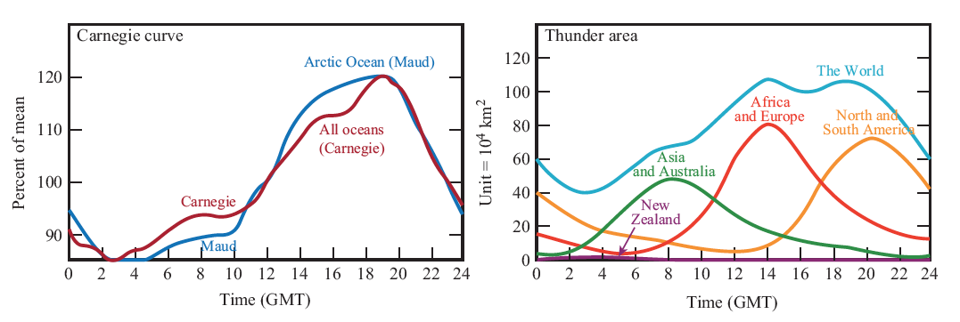
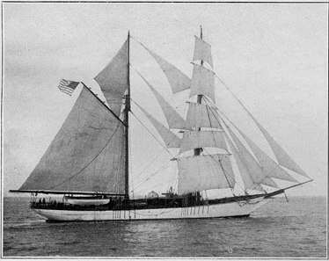
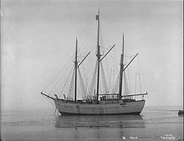
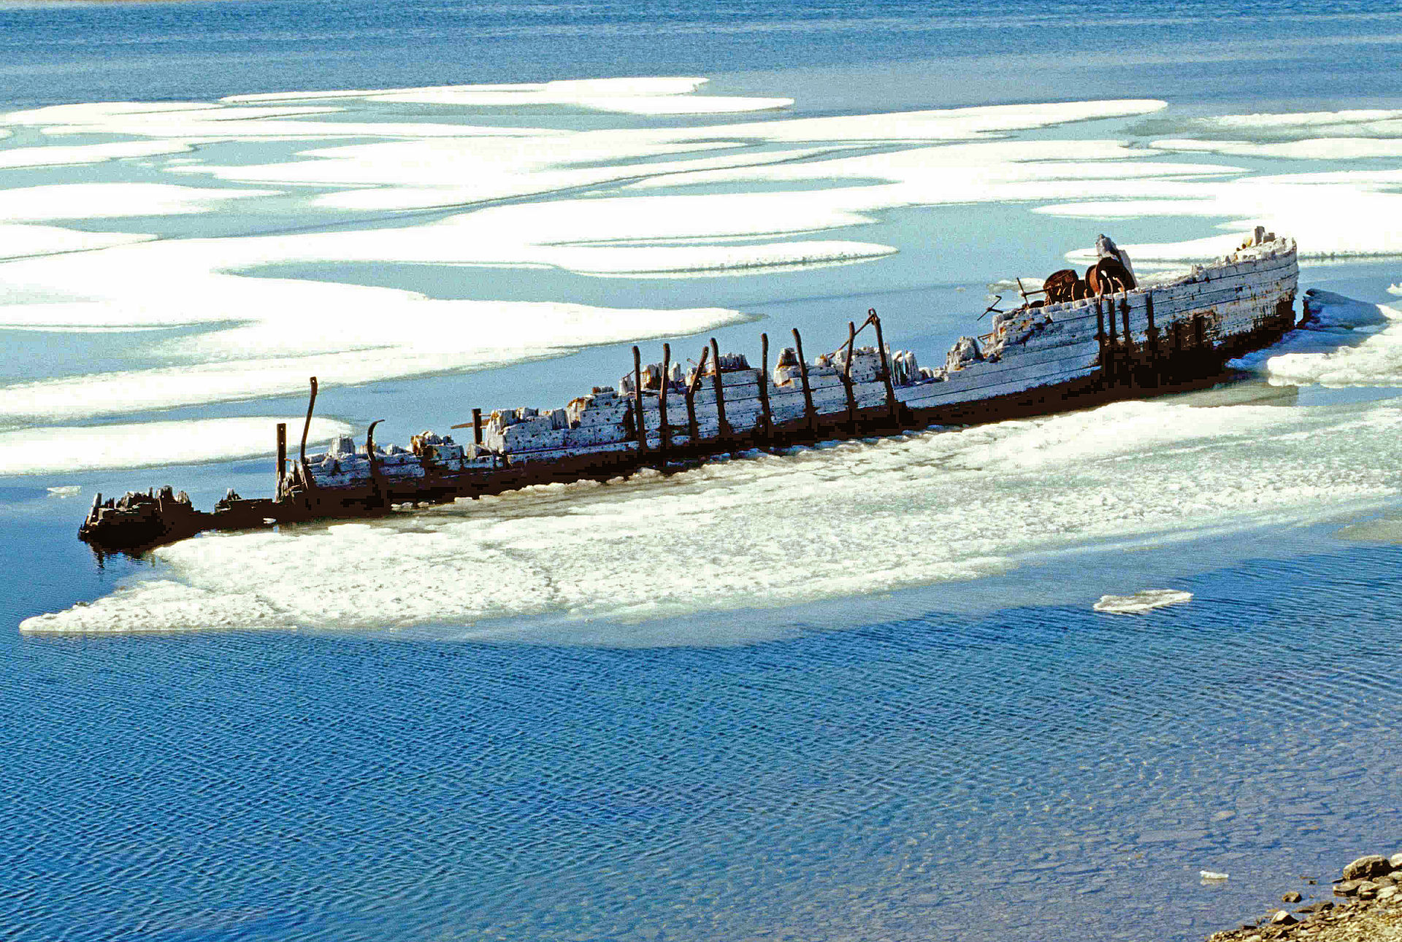
C. T. R. Wilson motivated the need for global observations of E_{fair} and diurnal variability
Diurnal variation of “fair weather” E field advanced by F. J. W. Whipple
Closely tied to diurnal variation of thunder area
“Thunder day” was an early measure of global thunderstorm activity, well before we had regional or global lightning measurements
Carnegie Institution of Washington DC
Seven cruises (1909-1929)
Carnegie was destroyed in fuel explosion in Samoa (1929)
Maud was frozen into Arctic ice and destroyed (1930)
Carnegie
Maud

Slide 11
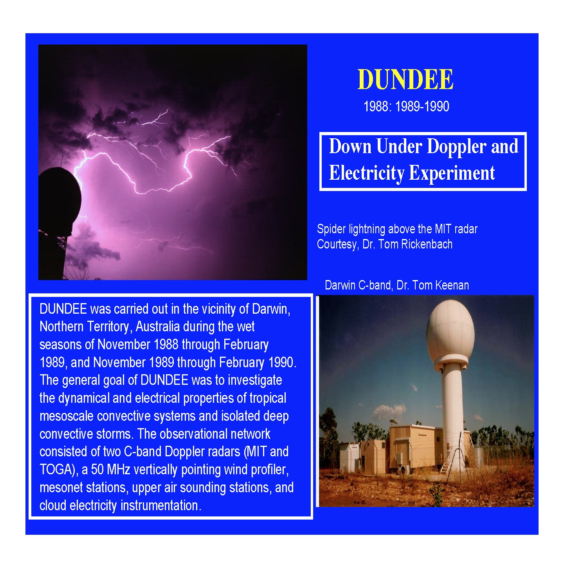
My journey’s into atmospheric electricity

Slide 12
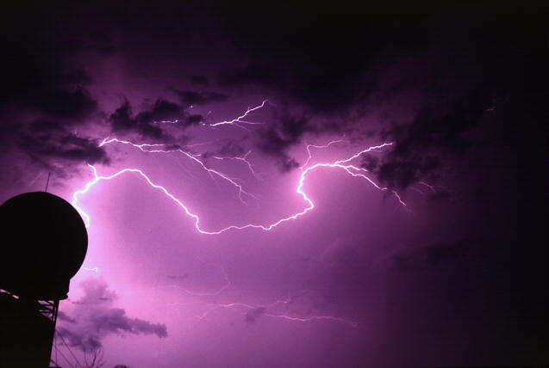
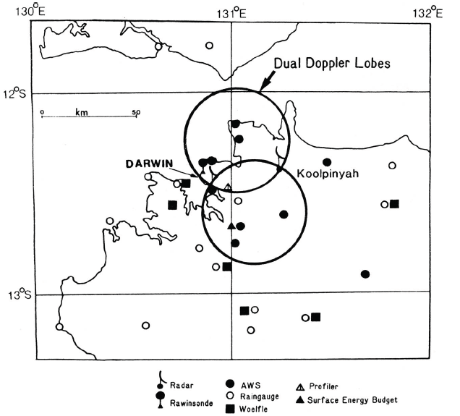
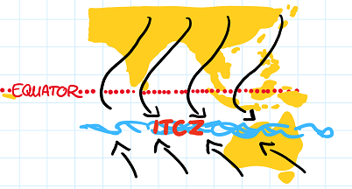
Down Under Doppler and Electricity Experiment
1989-1990 and 1990-1991 wet seasons in Darwin
Rutledge et al. (1992, BAMS)
Monsoon
trough

Slide 13

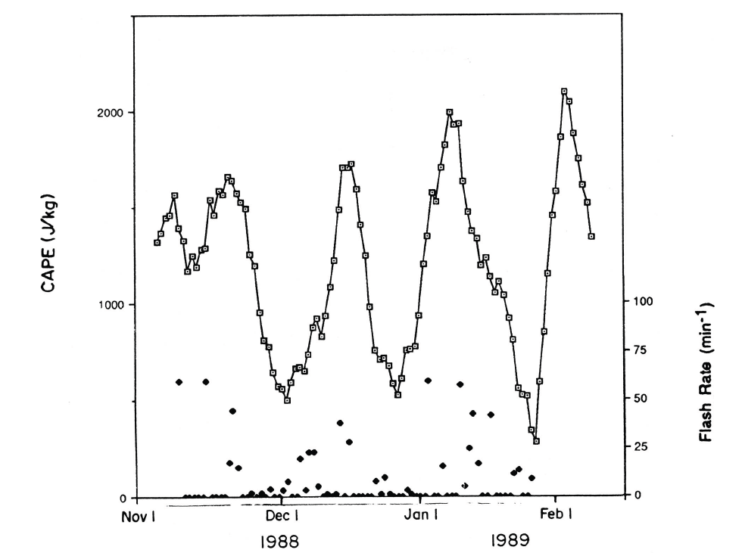
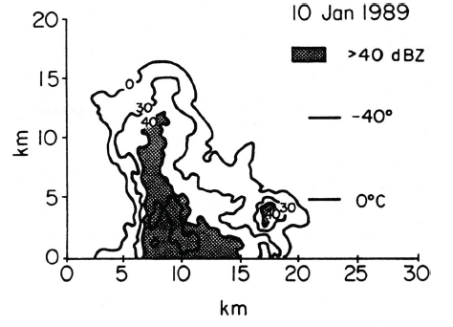
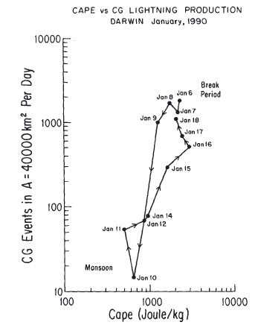
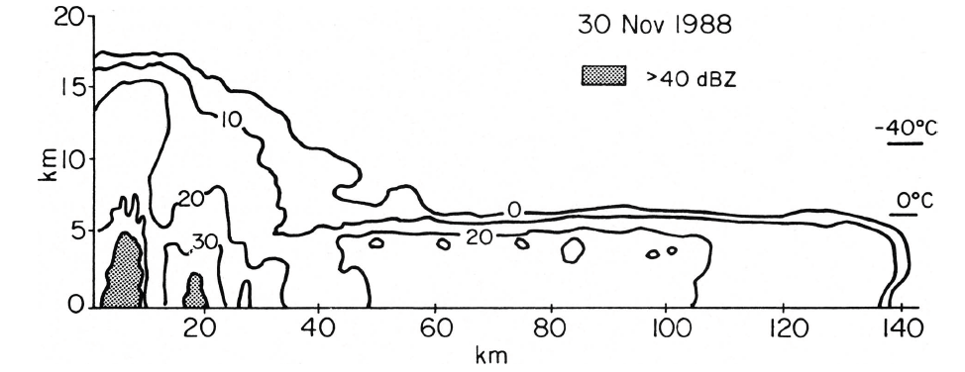
Rutledge et al. (1992)
M~D³ (Mixed phase mass)
Z~D⁶
At balance level, V_{T}=W
V_{T}~D^{1/2}
Therefore:
Z_{e}~CAPE⁶ and M~CAPE³
Two fold increase in CAPE is an 8-fold increase in M
Two fold increase in CAPE is an 18 dB increase in Z
Basic relationship
between CAPE
and flash rate
MONSOON PERIODS
Break
event
Break events
Monsoon events
Williams et al. (1992)
Monsoon event

Slide 14
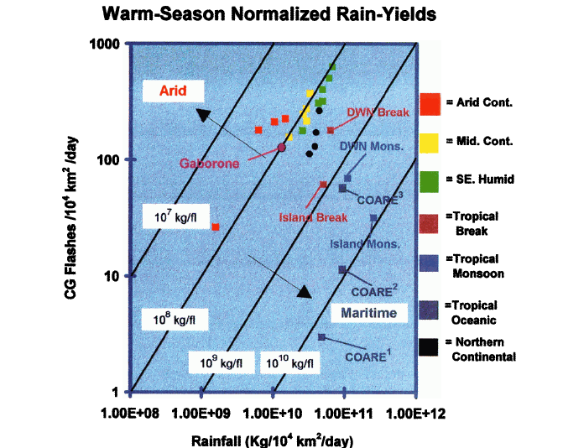
DUNDEE led to the rain
yield work by
Petersen and Rutledge (1998)
Rain mass flux (kg) vs. CG
lightning flash density,
monthly averages over areas
O(10⁵) km²
Potential for rain yield to tell
us how global convection may
be changing due to changes in
instability and aerosol loading
Ice microphysics
High cloud bases
High CCN
Warm rain microphysics
Low cloud bases
Low CCN

Slide 15
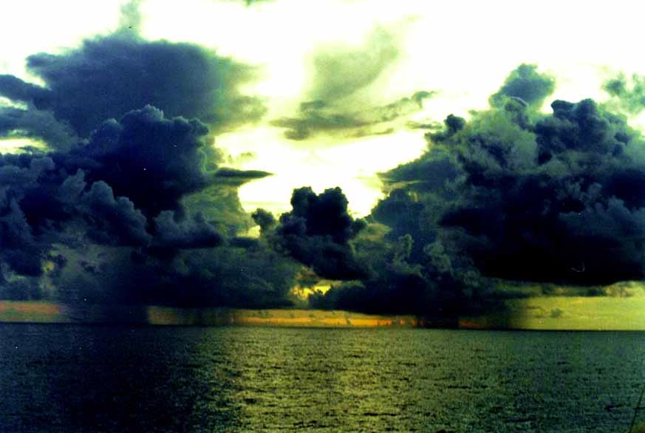
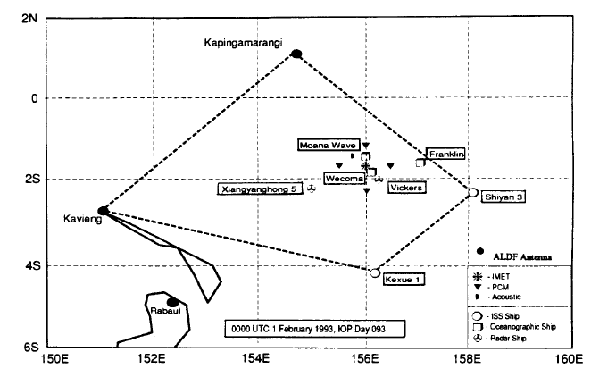
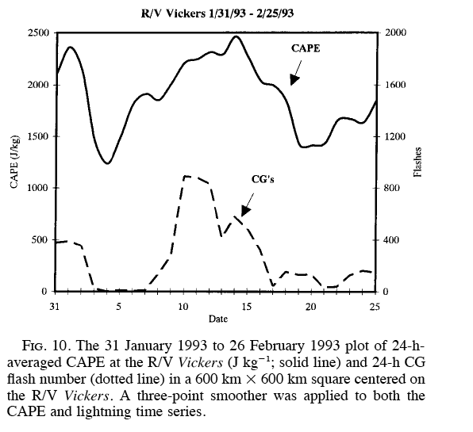
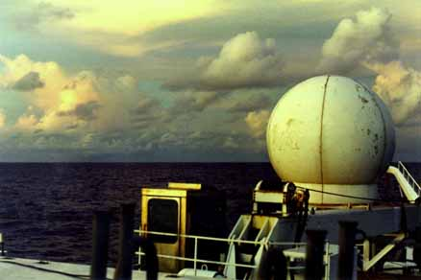
TOGA COARE 1992-93
ALDF Antenna locations (R. Orville)
As in DUNDEE, a
relationship
between CAPE
and lightning
flash rate was found
Petersen, Rutledge and Orville (1996)

Slide 16
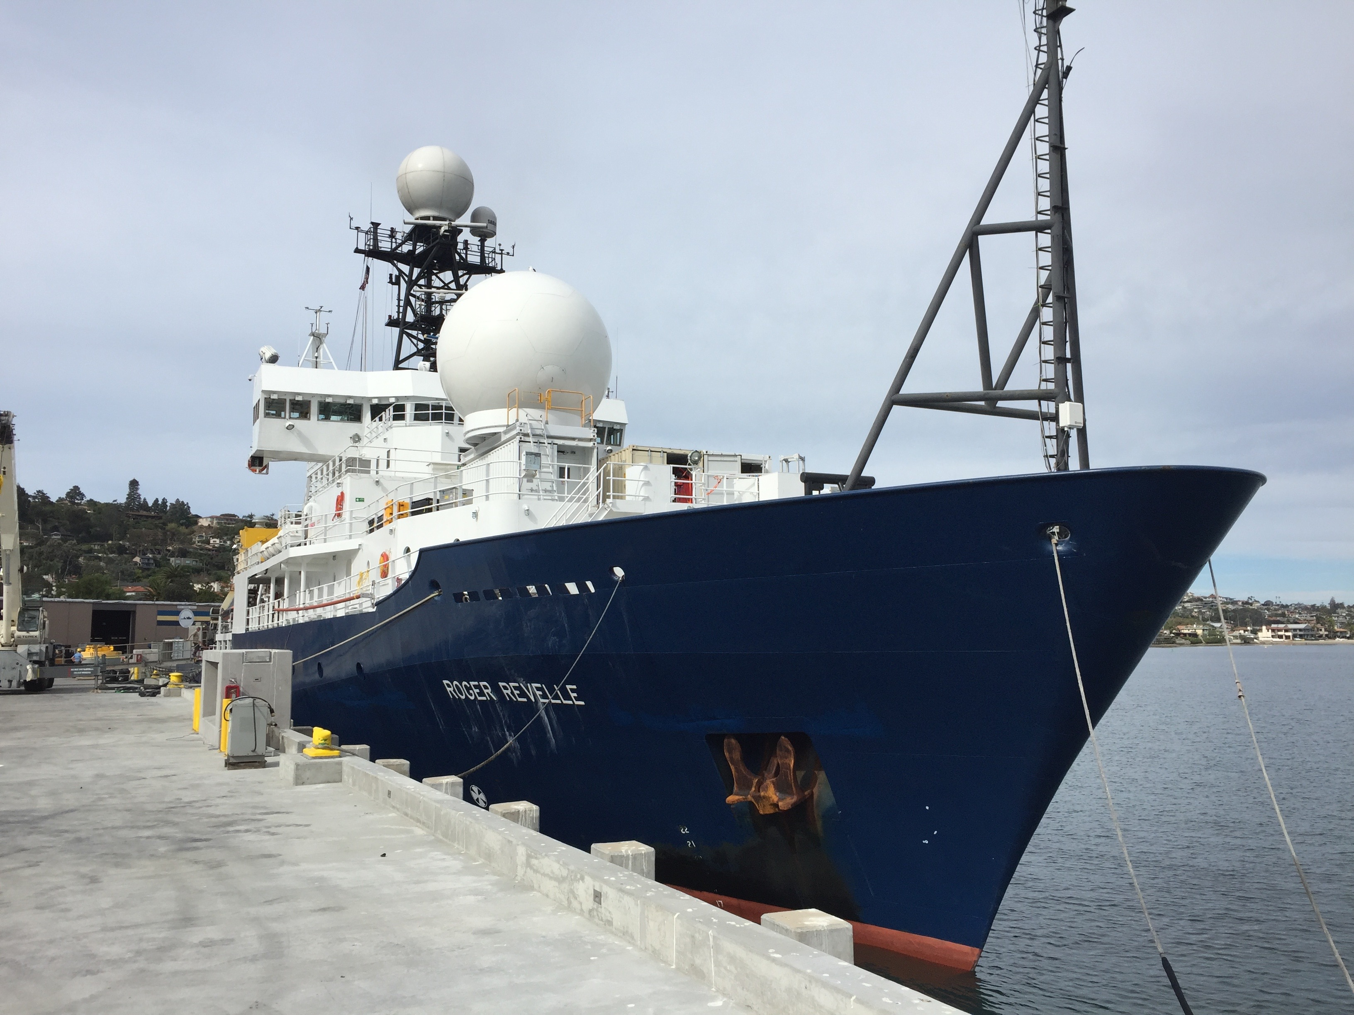
Fast forward to 2017, 35 years after TOGA COARE…
Bigger ship!
Better radar!
CSU SEA-POL
5 cm
Doppler, polarimetric

Slide 17
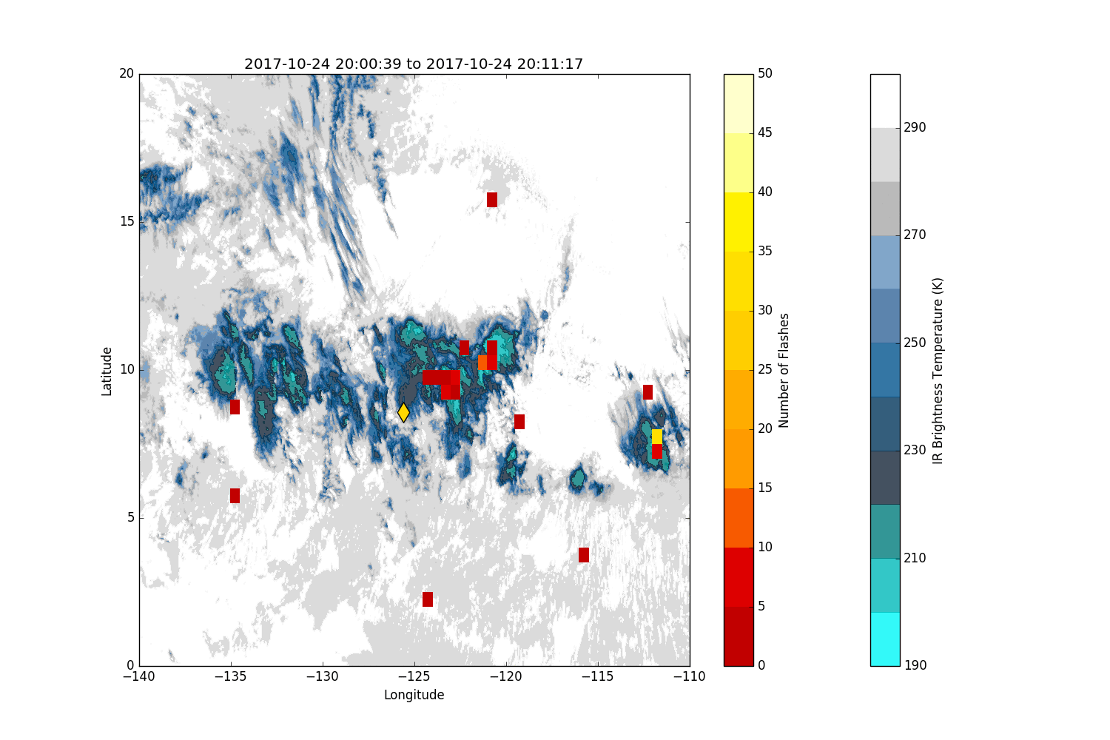
Lightning flashes from GOES-16
Geostationary Lightning Mapper
Flashes are per 15 minute intervals
Generally lightning is co-located with cold cloud; some spurious flashes in areas with no cold cloud; appear to be confined
to daylight hours (sun glint off ocean)
Satellite based lightning observations useful for locating intense oceanic convection

Slide 18
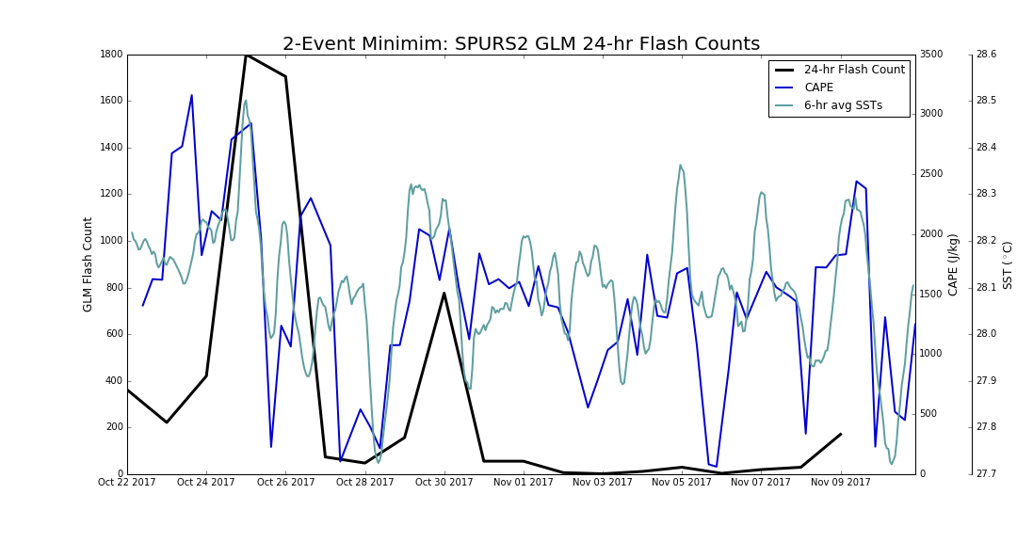
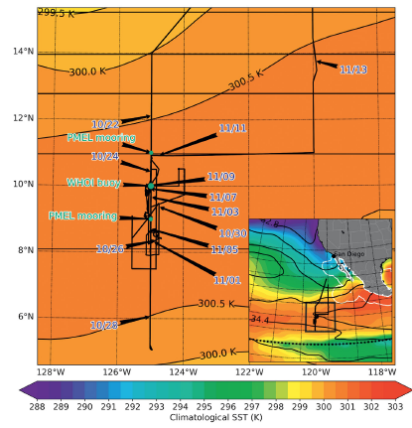
SPURS CAPE, SST time series; Rutledge et al. (2019), BAMS
CAPE computed from 4 per day
soundings from R/V Roger Revelle
GLM lightning for 5x5 deg box
centered on the Revelle
Lightning for CAPE exceeding
1500 J/kg
> 1500 J/kg
Radar observations (shown later)
Radar observations (shown later)

Slide 19
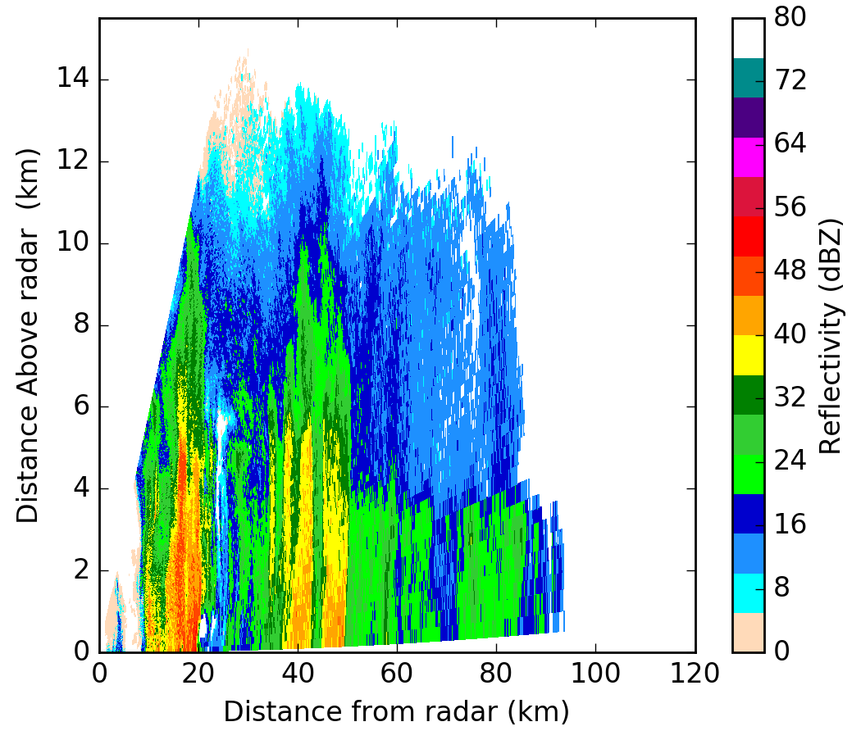
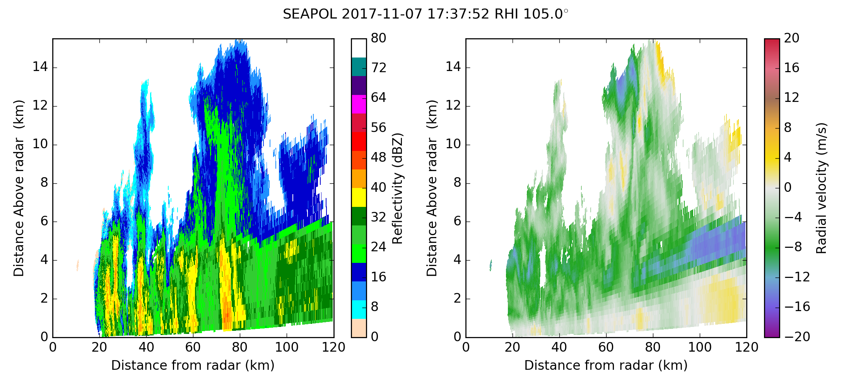
0332 UTC; 25 October 2017
Lightning is probable when 35 dBZ extends to
-10°C or colder (6 km from 0300 Z sounding;
2500 J/kg CAPE); mixed phase microphysics
Non-lightning example
CAPE < 750 J/kg
Lightning producing example
Evidently higher CAPE values lead to sufficient vertical motions to loft raindrops into mixed phase region and drive mixed phase microphysics
DOES INSTABILITY ALONE EXPLAIN VARIABILITY IN FLASH RATES?

Slide 20
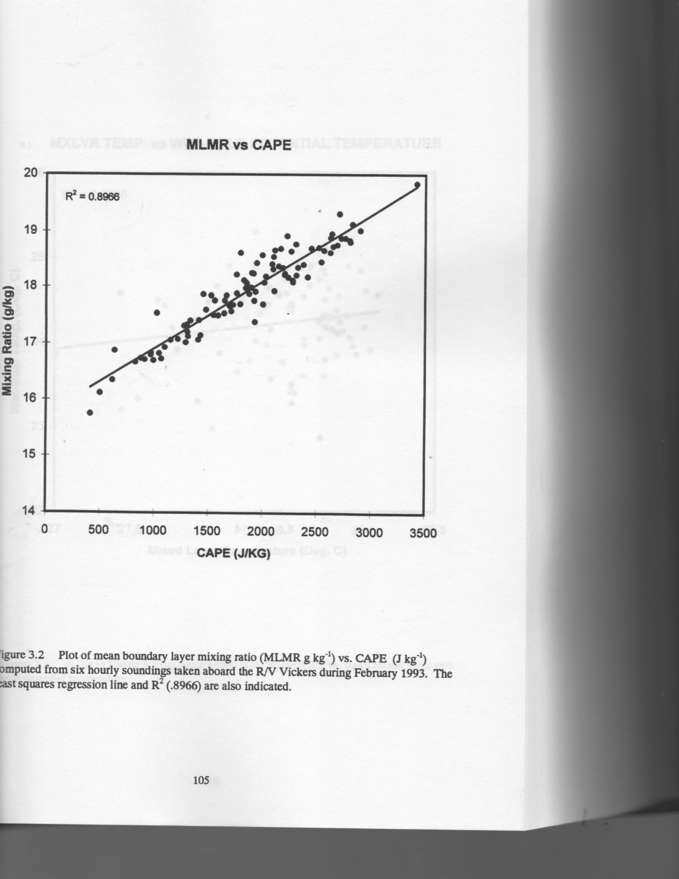
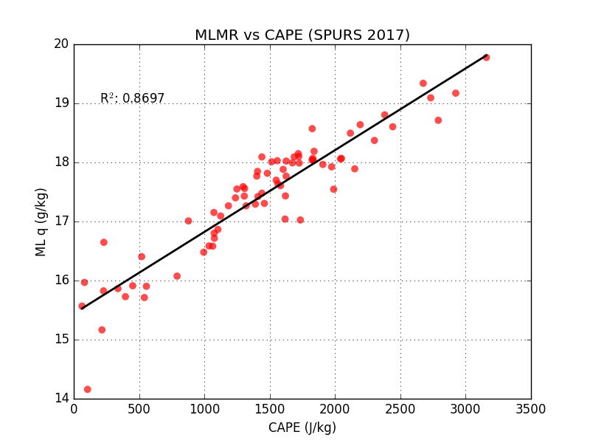
SPURS-2
TOGA COARE
Petersen (1997)
SPURS-2 2017
Relationship between MLMR (g/kg) and CAPE (J/kg) very close between W. and E. tropical Pacific; reflects underlying SST’s, which are similar in the two basins
Emphasizes relationship between BL moisture and CAPE and therefore, convective intensity
DOES INSTABILITY ALONE EXPLAIN VARIABILITY IN FLASH RATES?

Slide 21
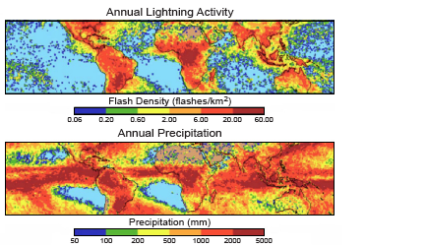
Examine land-ocean lightning contrast…
Christian
et al.
LIS observations
Lightning loves land!
Three tropical
chimneys;
South America
Africa
Maritime Continent
TRMM
observations
What is the basis for this
sharp land-ocean contrast
in lightning flash rate?

Slide 22
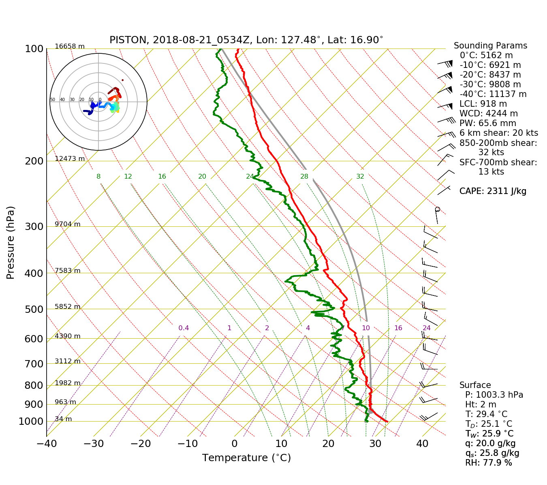
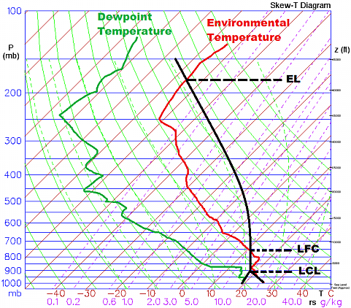
CAPE; integrated thermal buoyancy
Three key variables needed to explain land-ocean contrast in lightning
Warm cloud depth
Freezing level height - Cloud base height
CBH ~ T_{a}-T_{d}
T_{a}-T_{d} differences between tropics and mid-latitudes?
CCN
Tropical oceanic convection; moderate to high CAPE (narrow thermal buoyancy), low CBH (deep WCD) and low CCN
Tropical continental convection; moderate
to high CAPE (wide thermal buoyancy),
high CBH (shallow WCD) and high CCN
Parcel
is far from the
environmental
temperature
profile
Sensible
heating of land
surface

Slide 23
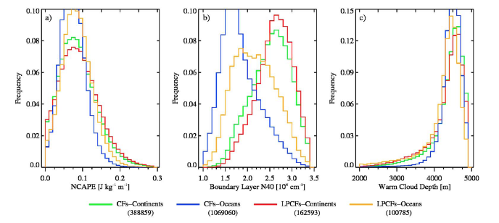
NCAPE
CCN
Warm Cloud Depth
Stolz, Rutledge and Pierce
(2014) JGR
ERA-Interim, TRMM PR/LIS,
GEOS-Chem merger
High NCAPE tail over land: NCAPE better represents instability in tropics compared
to CAPE
High CCN over land
Shift to lower WCD’s over land
How do CCN concentrations and warm cloud depth play into the problem?

Slide 24
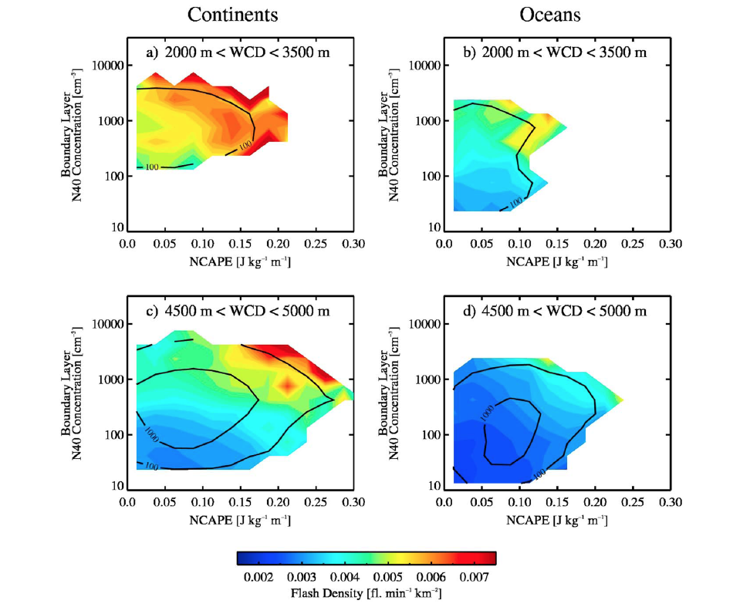
Stolz, Rutledge and Pierce (2014)
JGR-Atmospheres
Shallow WCD
These figures sum up the
CAPE, CCN, Warm Cloud Depth
interdependence
Deep WCD
Land-based convection with shallow WCD’s: high flash rates achievable for high CCN even with modest
CAPE; when CCN concentrations are low, higher CAPE must be present to promote significant flash rates
Land-based convection with deep WCD’s: high flash rates only apparent when CCN concentrations
are high and CAPE is high
Ocean flash rates restricted due to reduced CAPE (shape of CAPE) and low CCN— deep WCD does its
thing and makes warm rain, robbing the mixed phase of condensate
So full variability of lightning in tropical convection needs interplay of CAPE, CCN and WCD

Slide 25
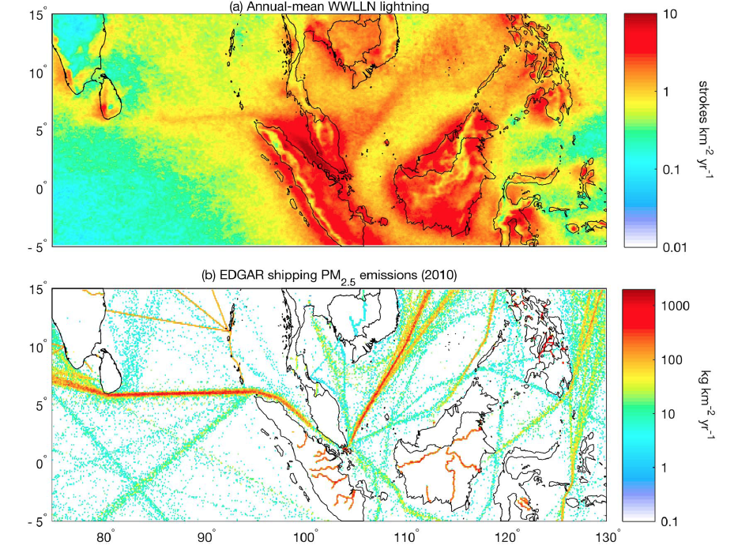
Enhanced
lightning
over shipping
lanes
Direct evidence
of CCN
invigoration
Thorton et al.
2017 GRL
This result suggests there must be a lot of convection in the tropics that
could be “invigorated” by increased pollution levels—how will this play out?

Slide 26
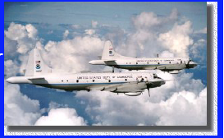
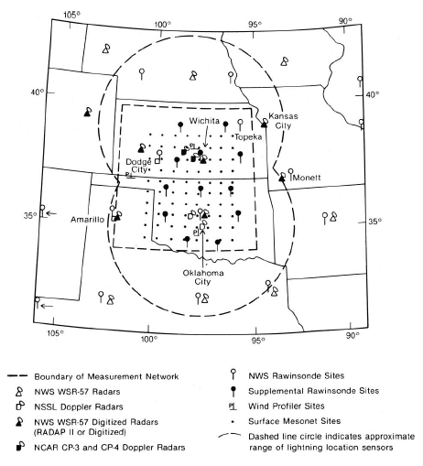
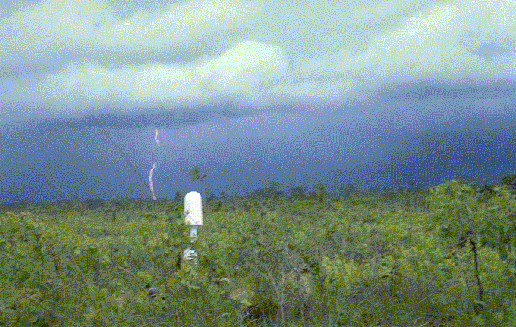
My journey through atmospheric electricity…
Started with PRE-STORM in 1985
Seven LLP stations deployed by NSSL
during PRE-STORM
Cunning (1986)

Slide 27
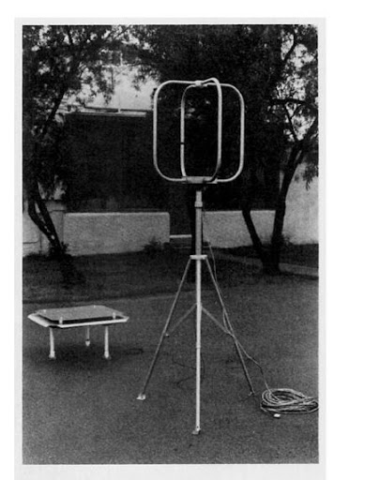
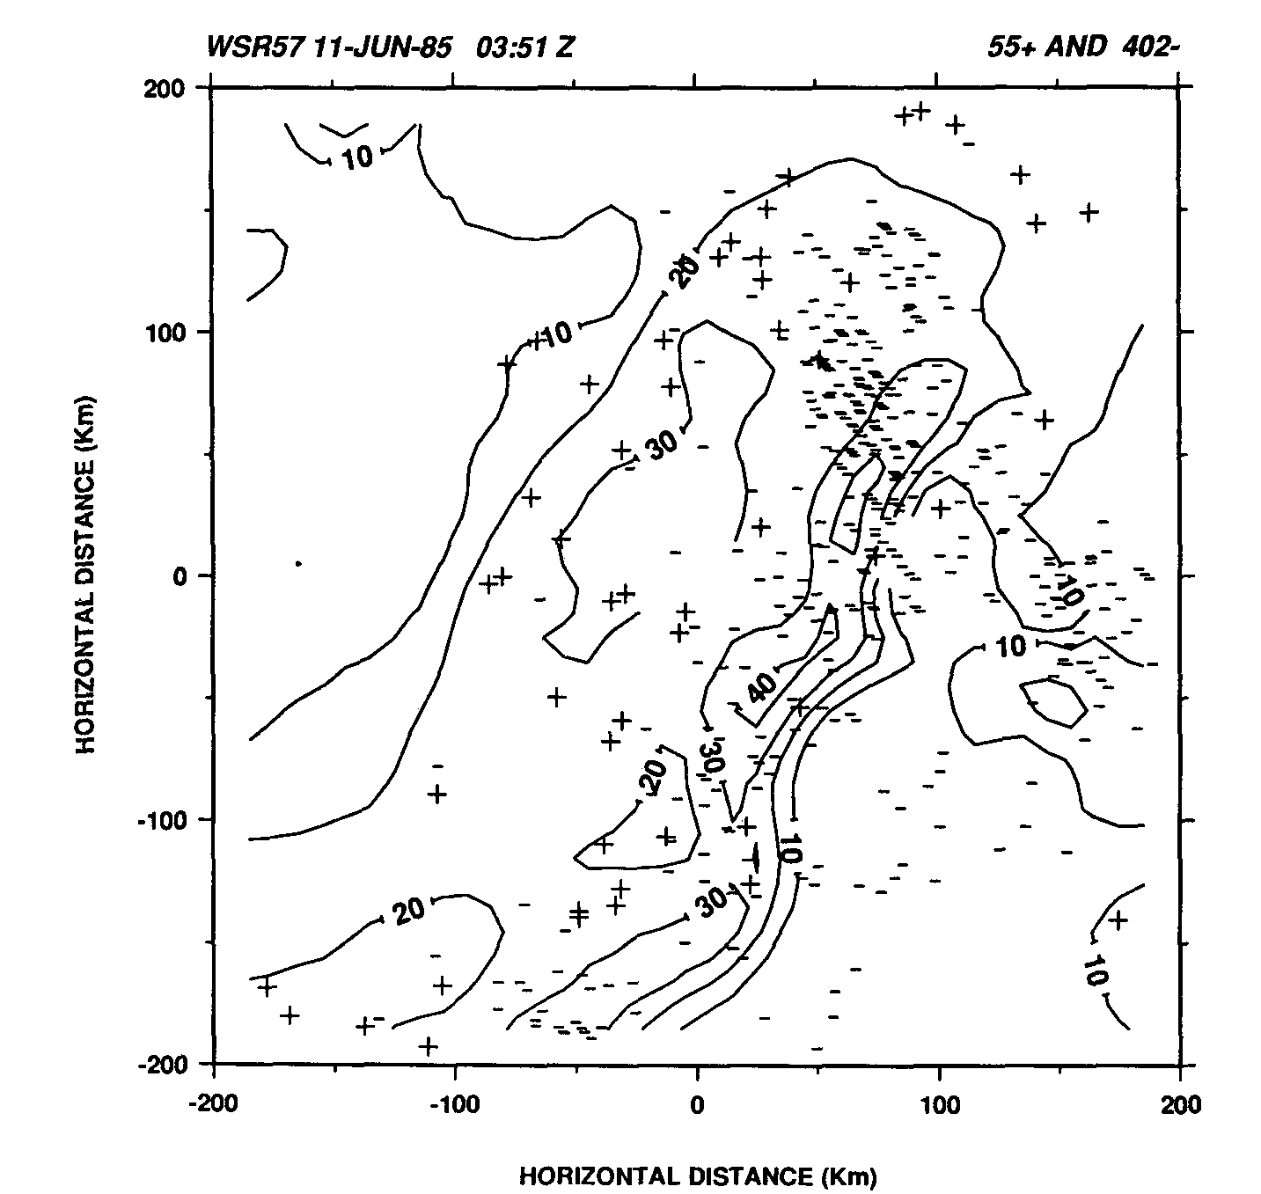
Bipolar CG lightning pattern
found in MCSs
Positive
CG’s in
trailing
stratiform
region
Rutledge and
MacGorman
(1988)
LLP station based on cross loop antennas. By Faraday’s
Law, magnetic field from lightning flash induces current
in the loops. Direction determined by the ratio of current
induced in each loop. Polarity determined by direction
of E field. Peak current also measured. Multiple stations
used to determine location of flash.

Slide 28
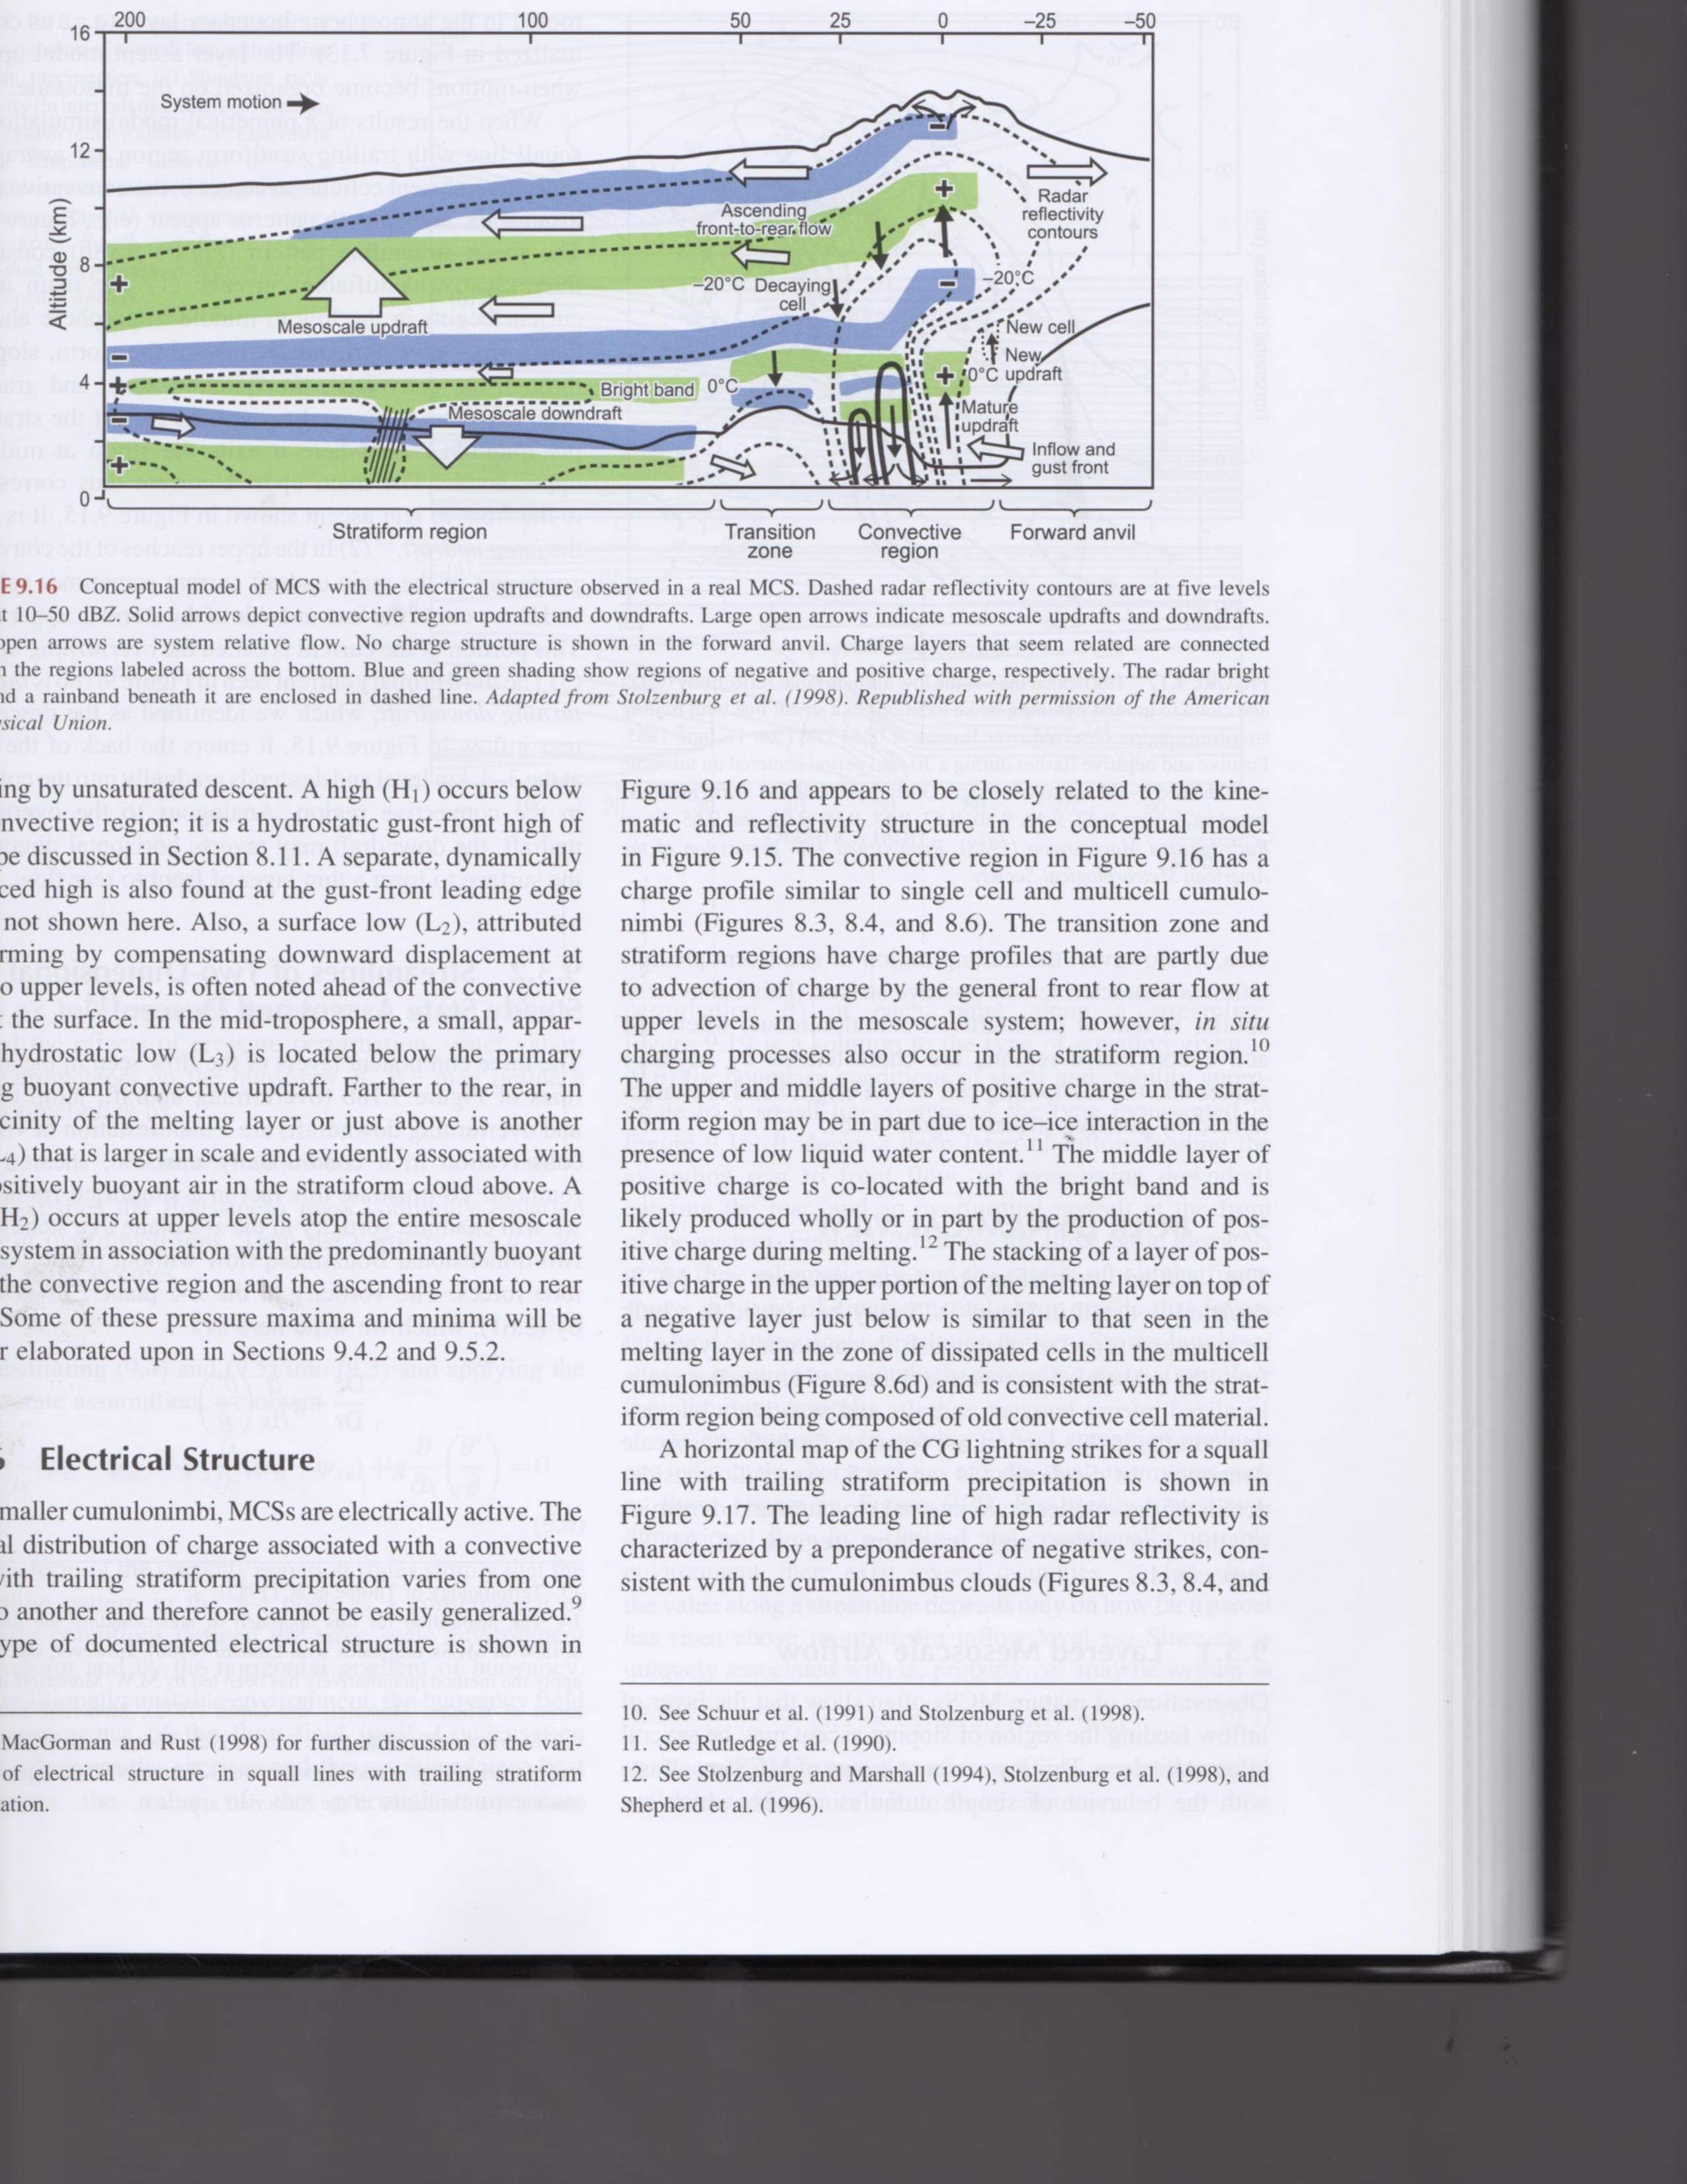
From Houze (2014)
Cloud Dynamics
2nd Edition
Adapted from
Stolzenburg et al.
(1998)
+
Multiple charge layers observed in trailing stratiform region.
Stratiform positive charge via a combination of advection from convective line and in-situ charging afforded by low supercooled liquid water contents generated by mesoscale updraft; precipitation-sized ice particles charge positively under these conditions.
Modeling studies (Schuur and Rutledge, 2000) found that 70% of the total charge in a MCS stratiform region is generated by in-situ charging, with the remaining 30% advected from the convective line. Hence quite similar to the water budget findings for this situation.
By virtue of their large areas and modest charge concentrations, we now know that MCS stratiform regions contain large amounts of electrical charge leading to massive positive cloud-to-ground lightning flashes (>100 kA).
Flashes in excess of 600 km in length within trailing stratiform regions have now been mapped by LMA and also observed by GLM---leading to a host of interesting high altitude lightning

Slide 29
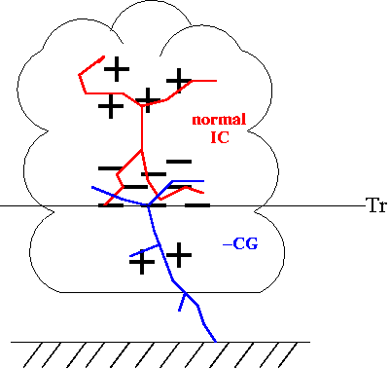
Cloud electrification
Starting with Mason, Moore and Vonnegut
Any theory for electrification must explain these
electrical characteristics of thunderstorms:
Strong electrification not observed unless cloud
extends well above the freezing level
Highly electrified regions contain ice and supercooled
water droplets
Charge generation process closely tied to
development of precipitation in the form of graupel
The first lightning flash develops 10-20 minutes after
the appearance of precipitation particles of radar-
detectable size (first echo)
The location of charge centers in strongly tied to
temperature, not height (negative charge between
-15 and -25°C, positive charge above)
So-called normal tripole
charge structure

Slide 30
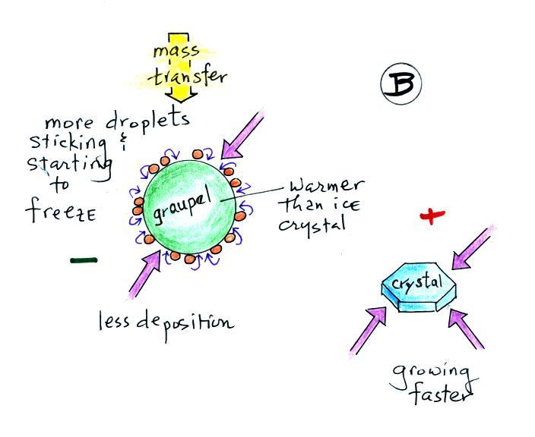
Non-inductive charging involves collisions between large and small ice particles in
presence of supercooled water droplets. Reynolds et al. (1957)
Example: Negative charging of graupel
Larger graupel particle in sublimational growth
at moderate supercooled LWC’s
Later studies suggest role of a
quasi-liquid layer (QLL) on the
surface of ice particles and the
existence of a so-called
electrical double layer in the QLL
Baker and Dash (1994)
Courtesy:
Chuck
Weidman
U. of Arizona
- - - - - - - OUTWARD
+ + + + + + + + INWARD
Positive
charge
carried
upward
Graupel particle has thinner QLL
compared to ice crystal, so graupel
acquires negative charge upon contact
Leads to negative charge on precipitating ice particles

Slide 31
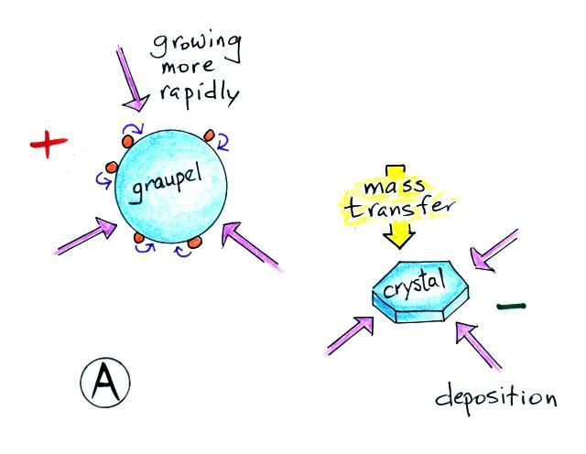
Example: Positive charging of graupel or snow pellets
Graupel particle in depositional growth
at low supercooled LWC’s; integral to stratiform region charging
Courtesy:
Chuck
Weidman
U. of Arizona
Graupel has thicker QLL, negative charge
transferred to ice crystals
Negative
charge
carried
upward
Leads to positive charge on precipitating ice particles

Slide 32
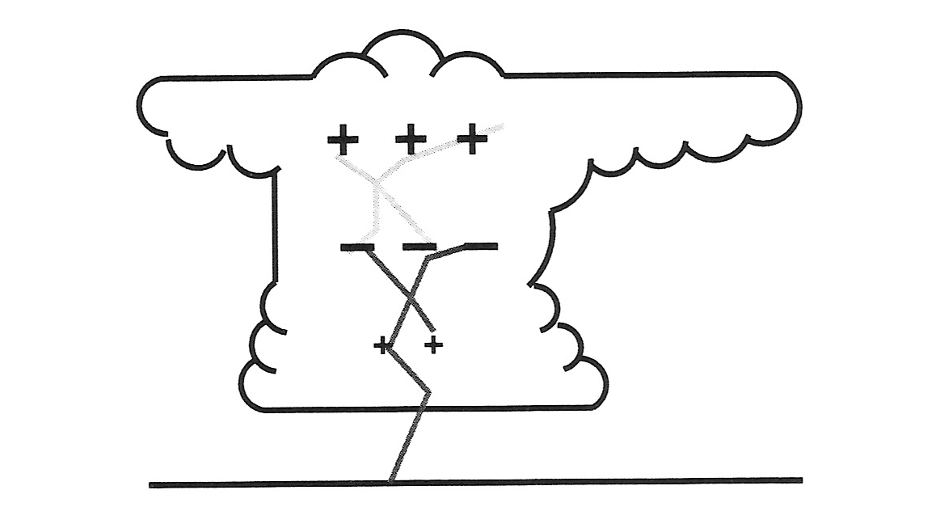
The Tripole Charge Structure
The “normal” tripole storm
Breakdown field ~ 10⁵ Vm⁻¹
Intracloud lightning
IC/CG ratio ~ 4:1 (globally)
Cloud-to-ground lightning
Tessendorf (2009)

Slide 33
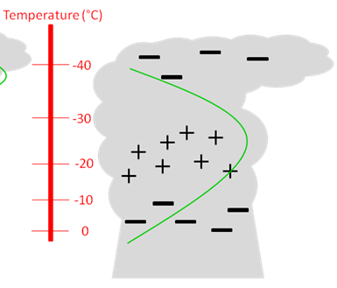

There are deviations from “normal” polarity…
“inverted” charge structure
Inverted charge structure with positive
charge situated in the mid levels
Where do these storms occur and
what processes lead to the inverted
charge structure?
Another
anomalous
charge
structure;
“inverted” dipole
Characteristic of
low precipitation
supercells
Courtesy: C. Weidman

Slide 34


Slide 35


Slide 36

Lightning Mapping;
VHF radio emissions
from lightning
+
+
+
Vertical distribution of sources
+
+
+
+
-
-
-
-
-
LMA time-of-arrival technique
-
-
-
-
t₃
+
+
+
+
+
+
+
VHF radiation α dI/dt
E field
t₁
t₂
Radio antenna
Cell antenna
Solar panel
Main processor
Ground

Slide 37
LMA operation
Network of radio antennas with GPS timing
Detects sources within ~ 60-66 MHz band
  Unused local television band
  Wavelength ~ 2 meters
Time of arrival (TOA) from 6 or more stations
  Redundant equations, higher accuracy
  Intersection of hyperbolas
VHF radiation produced by lightning channel propagation
Data transmitted over cell networks to get near real time lightning data

Slide 38

Fuchs et al. 2015
Positive charge layer;
inverted polarity storm
Positive charge layer;
normal storm polarity

Slide 39


Breakdown of stratified charge layer model in and near strong updrafts
Flash size and flash rate inversely correlated
Charge separation and electrical breakdown linked to turbulent
eddies
Bruning and MacGorman (2013)
Strong updraft cores can be lightning free
“Lightning hole”
Lang et al. (2004)

Slide 40


Slide 41



STEPS nailed the inverted dipole, and the mid level origin of the positive cloud to ground flashes; strong updrafts promote large cloud water contents and positive charge on graupel

Slide 42


Annual CG flash density
“Positive” storms are found in the W. and N.
Great Plains-often severe
Intersection of high CAPE and reduced warm
cloud depth, equivalent to high cloud base
heights (Williams 2005)
Promotes high supercooled liquid
water contents, “superlative liquid water
contents”, leading to positive charge on graupel
(Lang and Rutledge 2004; Fuchs et al. 2018)
The high cloud base heights also imply broad cloud
parcels which effectively reduce entrainment and
promote high supercooled water contents
% positive
CBH
CAPE
CBH
Zajac and Rutledge (2000)

Slide 43




Positive charging of the rimer (graupel) at high SLW content is still a mystery…
However, droplet concentration seems to be an important component
Avila and Pereyra (2000)
Jayaratne, 2014. In, The Lightning Flash
Rimed surface stays in
a depositional state owed to
freezing of small droplets
High Park fire
June 2012
Gold +
Blue -

Slide 44

Ammonium in Rainwater—when ammonia enters water (like cloud drops)—surface EPA sites
Considerably increase in NH₄⁺ across Northern Plains from 1985 to 2016; driven by increase
in ammonia (NH₃) from
surface?????
Also increase in other locations (e.g., E NC, SE PA)
From Max Marchand,
unpublished

Slide 45

The Geostationary Lightning Mapper!!
Comparison to LMA for individual storms
Charge-coupled
device (CCD)
8 km pixel size
at nadir, 14 km at
limb
777.4 nm wavelength
Designed detection efficiency is 70%

Slide 46


Austral summer
Spring Equinox
Over ocean flashes are nearly two
times brighter than over land flashes?
Boreal summer
Rudlosky et al. (2018)

Slide 47


Normal polarity storm
Anomalous polarity storm
Rutledge et al. (2020)

Slide 48


Thought initially that
precipitation particles,
especially large hail might
reduce DE via scattering
But this is not the case…
Rather, reduced DE is caused by cloud scattering
by small ice crystals and water droplets
Optical depth is L/f where L is some cloud depth and
f is mean free path of a photon; f is small due to high concentration of cloud particles; cloud particles
contain more surface area than larger precipitation
particles due to much larger concentrations
CTWP estimated from ABI, based on optical depth and cloud top particle size

Slide 49

Anomalous storms have low flash heights and very large flash rates
The high flash rates correspond to compact flash sizes (Bruning and MacGorman, 2013)
Low flash heights imply large cloud water/ice paths and multiple in-cloud scattering reducing
optical emission from cloud top; compact flashes have reduced radiant energy, so small
flashes are not very bright to begin with…this combined effect leads to a gross reduction in
detection efficiency
It remains an issue to determine how important this reduced DE is to
the use of GLM in the operational setting…
Lightning “jump”
Schultz et al. (2009)

Slide 50

Transient Luminous Events—TLE’s
Courtesy Walt Lyons

Slide 51
Global lightning parameterizations
Maybe the biggest reason we care about global lightning is the role of lightning
in atmospheric chemistry
Lightning is the largest natural source of NOx
NOx plays a big role in producing upper tropospheric ozone which acts as a
greenhouse gas
Global models rely on empirical parameterizations to include lightning
At least three parameterizations have been developed
Price and Rind (1992) FR ~ H^{x} where H= convective cloud top height; x varies
between land and ocean x_{land} > x_{ocean}
Finney et al. (2014) FR ~ vertical ice mass flux in mid-troposphere, 440 hPa
Stolz et al. (2017 FR ~ A*NCAPE + B*CCN – C*WCD + D*SHEAR – E*RH where the
coefficients vary according to Land vs. Ocean
A quick look at comparisons…

Slide 52



Stolz et al. (2021)
JGR-Atmospheres
Cloud top height scheme under predicts low to moderate flash rate storms and over predicts high flash rate storms, especially over land
Mass flux and multivariable schemes do fairly well over land but over predict moderate flash rate storms over ocean

Slide 53

Conclusions
CAPE, CCN and WCD importance for understanding land vs. ocean flash rates
Details of non-inductive charging remain elusive
Incredible advances in space based lightning observations
Sensitivity of tropical convection to increasing aerosol/CCN concentrations?
Biggest impact of lightning may be through atmospheric chemistry, NOx_{lightning}➔UT ozone
How will the global flash rate change in our future climate?

Slide 54


