Slide 1
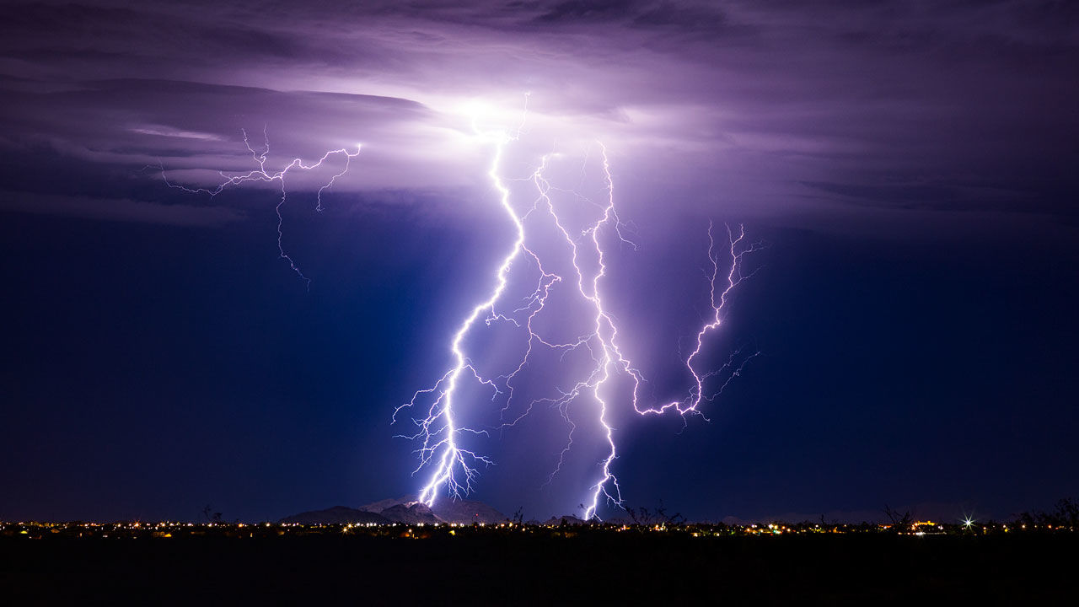
Atmospheric electrification, lightning and convection: A tutorial
Prof. Steven Rutledge
Dept. of Atmospheric Science
Colorado State University
Ft. Collins CO

Slide 2

First of all, sorry for the ancient picture I sent to JPL!!

Slide 3
Outline
A little history
The global circuit
Land-ocean contrast in lightning
Cloud electrification
Storm scale observations
Lightning parameterizations
Conclusions

Slide 4
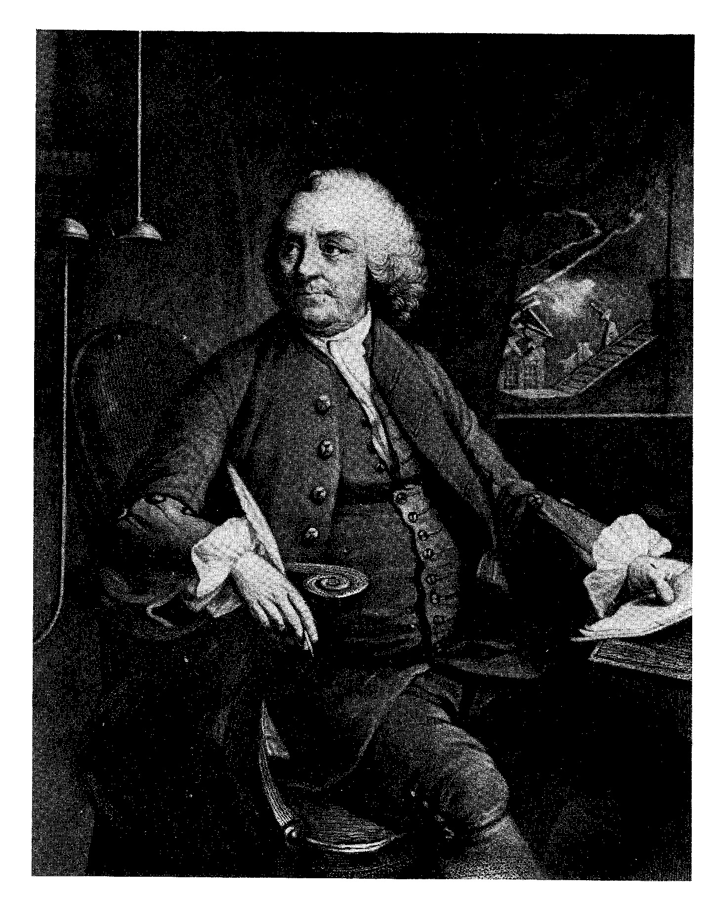
I. A little history…
Ben Franklin, circa 1750
The science of atmospheric
electricity began with Franklin’s
early experiments

Slide 5
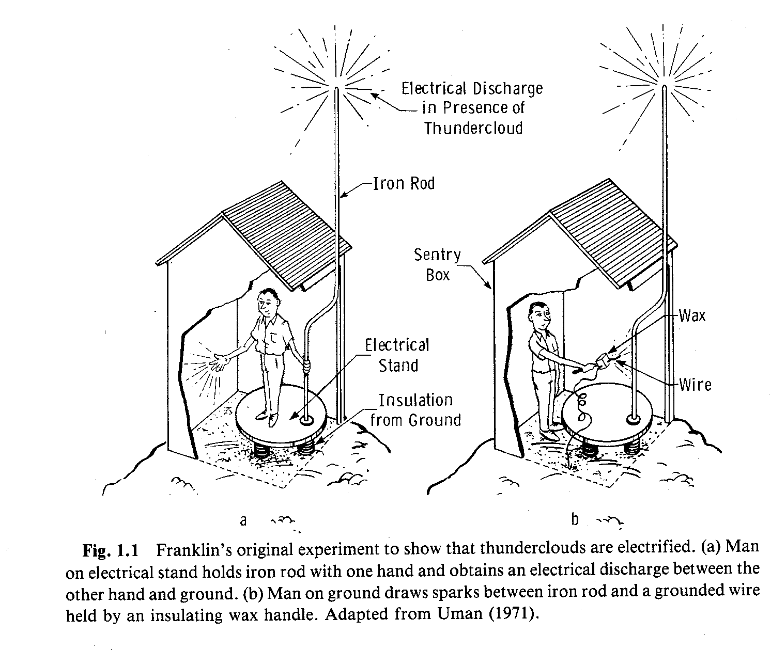
The sentry box experiment
Uman (1987)

Slide 6
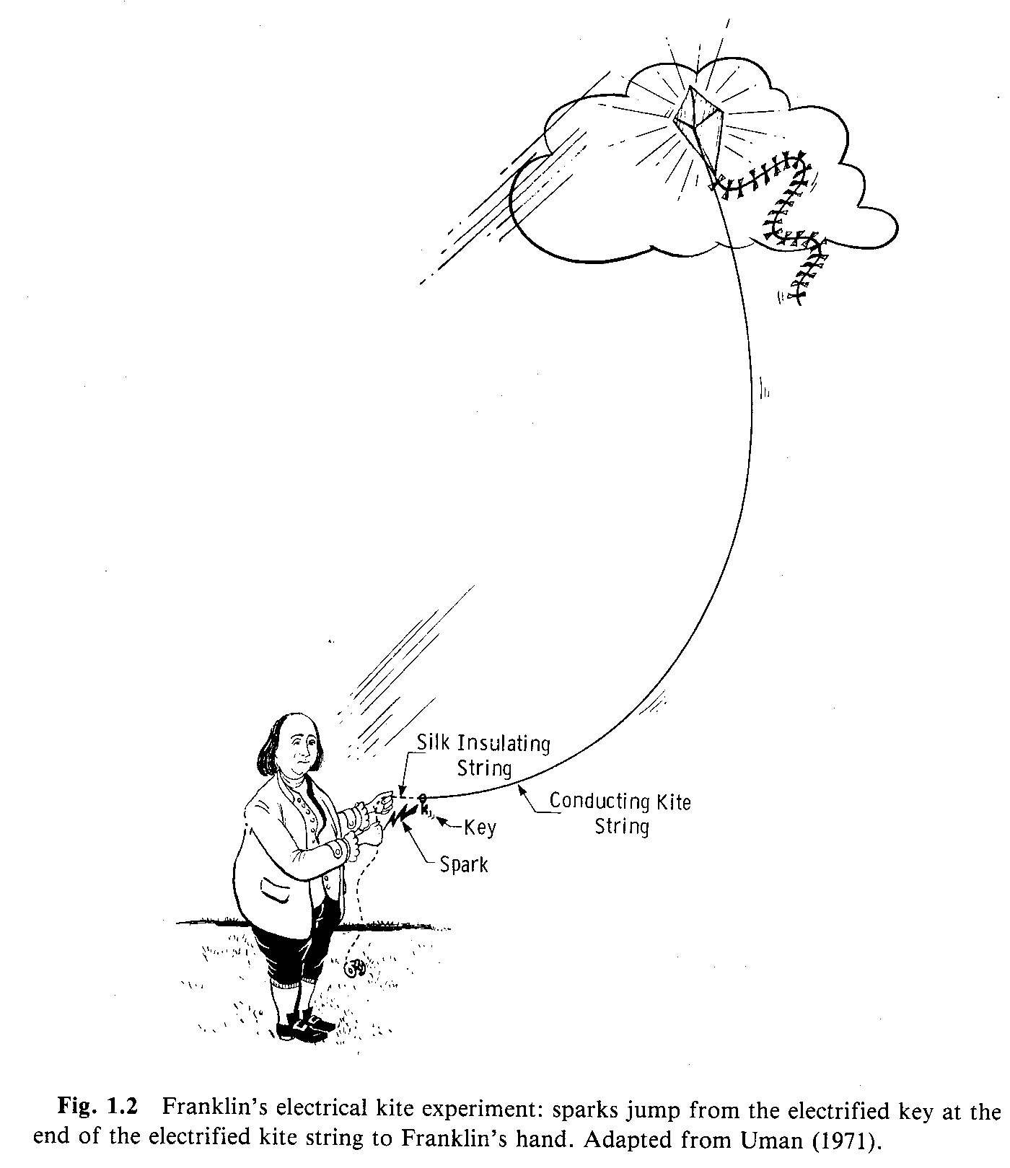
The most famous kite ever flown…
Franklin devised this experiment to more directly determine that clouds were indeed electrified---a source of electricity, or the flow of an electrical current
The electron was discovered over 100 years later!
Typical lightning flash has
20 kA of current, or ~ 10²³ electrons/sec
Uman (1987)

Slide 7
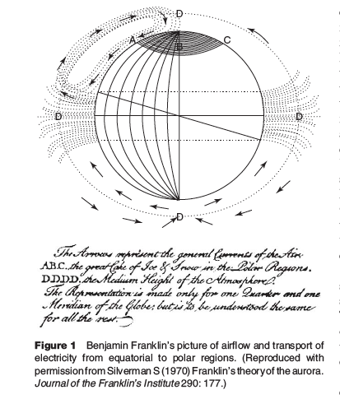
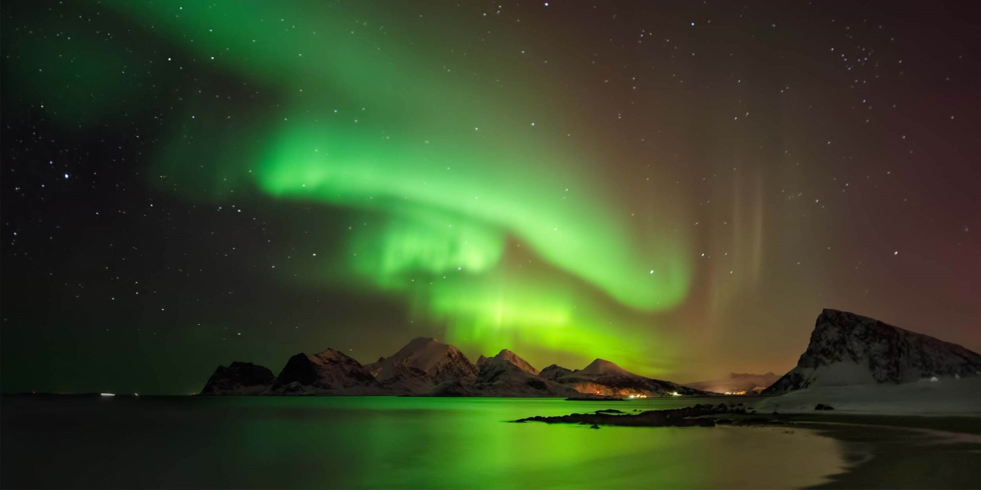
Ben Franklin even had a view of the global
circulation of moist, electrified air. Presented
to the Royal Academy of Sciences in Paris in
1779. Warm moist air ascends over the tropics
and descends at the poles. He argued that the
cloudy air delivered charge to the polar
ice caps where it accumulated until breakdown
of the upper atmosphere occurred in the form
of the Aurora Borealis/Aurora Australis.
This idea is of course flawed but nonetheless
interesting.
E. R. Williams: Global Electrical
Circuit, Elsevier

Slide 8
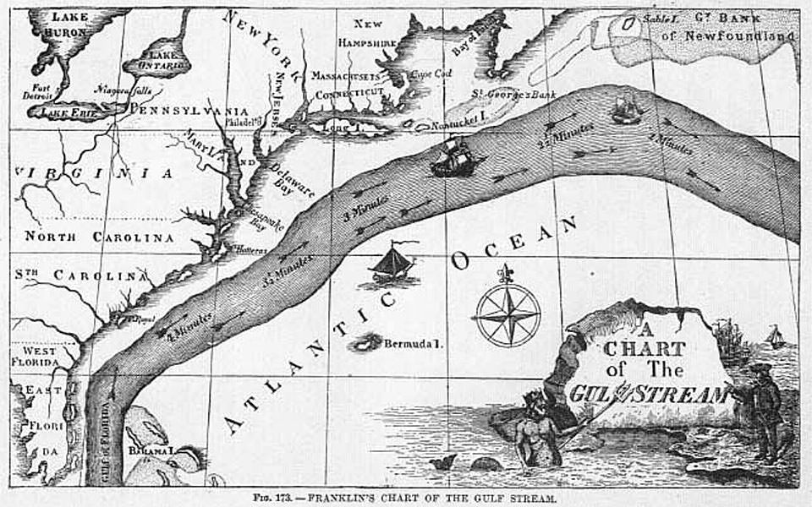
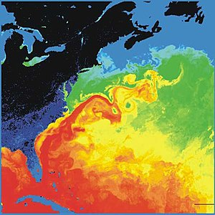
Ben Franklin’s Gulf Stream map, 1786. Based on two crossings of the Atlantic and placing
thermometers in the water along the way.
A modern day satellite image

Slide 9
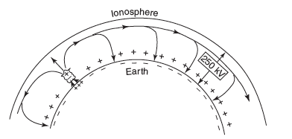
II. The (DC) Global Circuit
100 years after Franklin’s pioneering work…
Lord Kelvin developed the theory of electrostatic
potential, necessary for understanding the concept
of a global circuit. He also put forward the concept
of the Earth and upper atmosphere forming a giant
spherical capacitor—the Kelvin capacitor
The Wilson model of the Global Circuit
250-300 kV
C. T. R. Wilson followed Lord Kelvin’s
work and deduced that thunderstorms
contain positive charge aloft with negative
charge closer to cloud base
A downward directed fair weather electric
field characterizes the global circuit
In 1920, Wilson formulated his hypothesis for the
global electrical circuit: thunderstorms are “batteries”
that drives positive charge upwards towards the
highly conductive ionosphere and lowers negative
charge to the Earth’s surface
The downward flux of negative charge is driven by
precipitation and lightning (lightning lowers
predominantly negative charge)
Nobel Prize in Physics, 1927. Invention of the cloud
chamber.
+
--
1
2
--------------------------------------

Slide 10
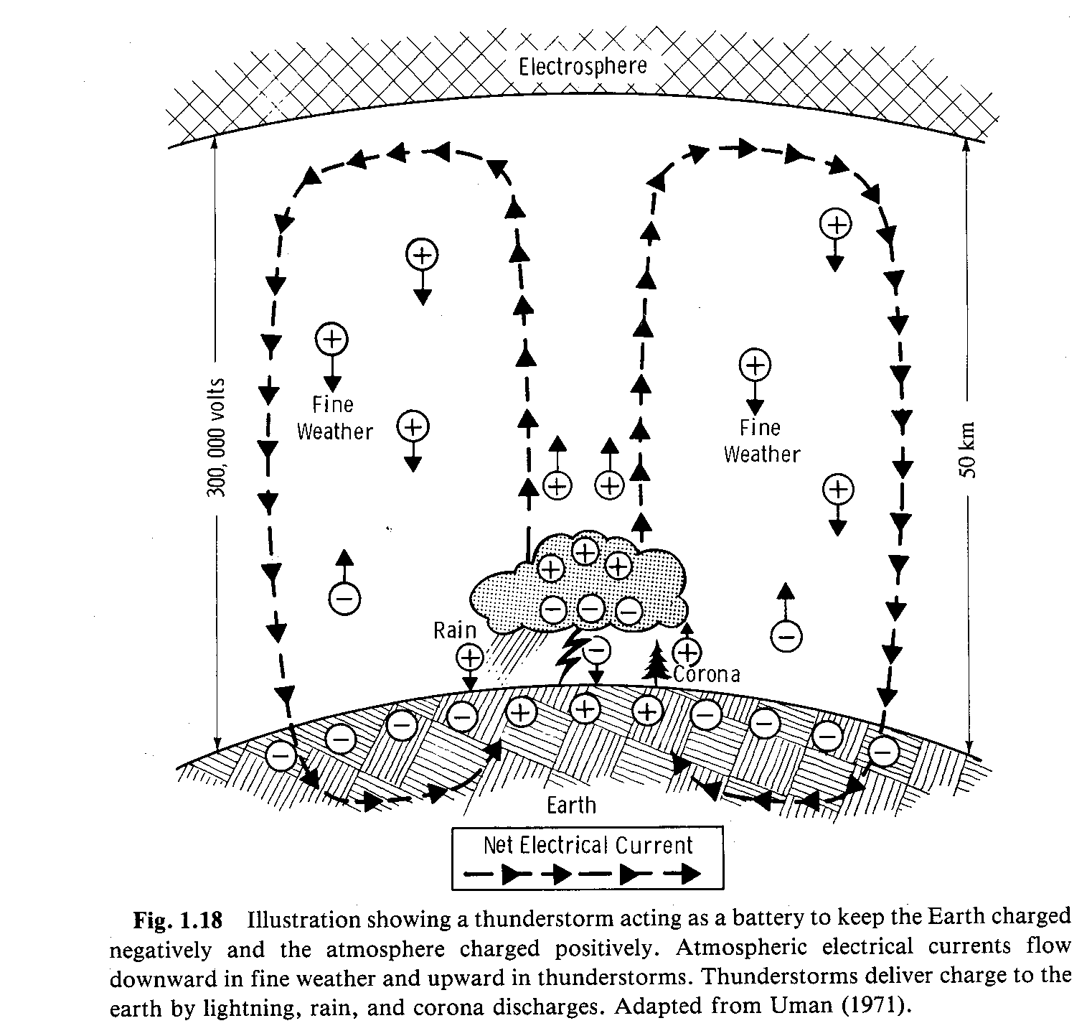
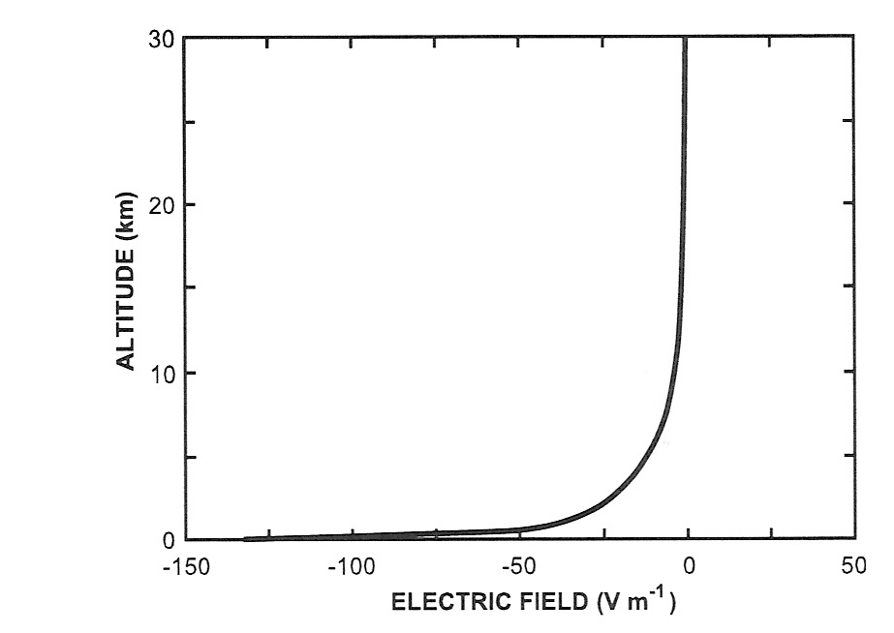
The “DC”
Global Circuit
Why is the upper plate of the capacitor well
below the ionosphere?
J = σE where J is current
density and σ is conductivity
J is constant with height
E
σ
Highly conductive
upper atmosphere, σ
increases exponentially
with height
Uman (1987)
MacGorman and Rust (1998)
The Electrical Nature of Storms
So we live along the bottom part of a
concentric spherical capacitor
How is the ionospheric potential
measured?

Slide 11
Some fair weather E field facts..
Global flash rate is 40-50 s⁻¹
The current flowing in the global circuit is 1400A. (I = J/σ)
The columnar resistance is ~200 Ohms owing to a leaky dielectric in the spherical capacitor? R=V/I, ~200 Ohms. (V = 300,000 volts)
Capacitance of the concentric spherical capacitor is 1 Farad
E field would rapidly decrease if global thunderstorm activity ceased. Time constant τ=RC=200s. (τ=RC=ε/g)
Power in the global circuit, P=V x I, ~ 4 x 10⁸ W
Power per unit area is therefore ~ 10⁻⁶ Wm⁻² which pales in comparison to the solar constant of 1380 Wm⁻².

Slide 12
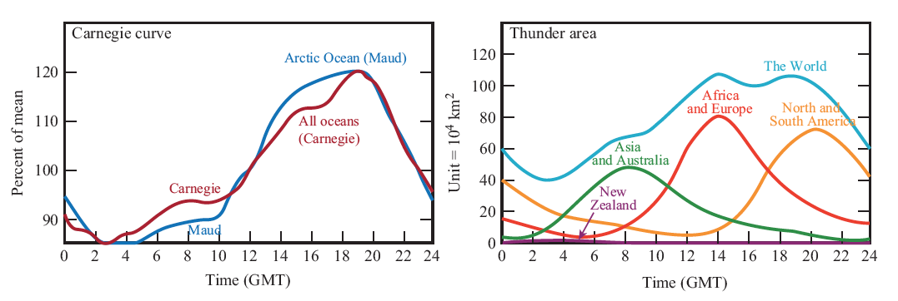
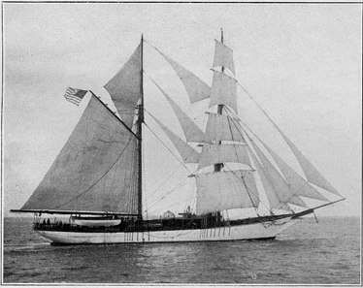
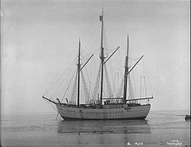
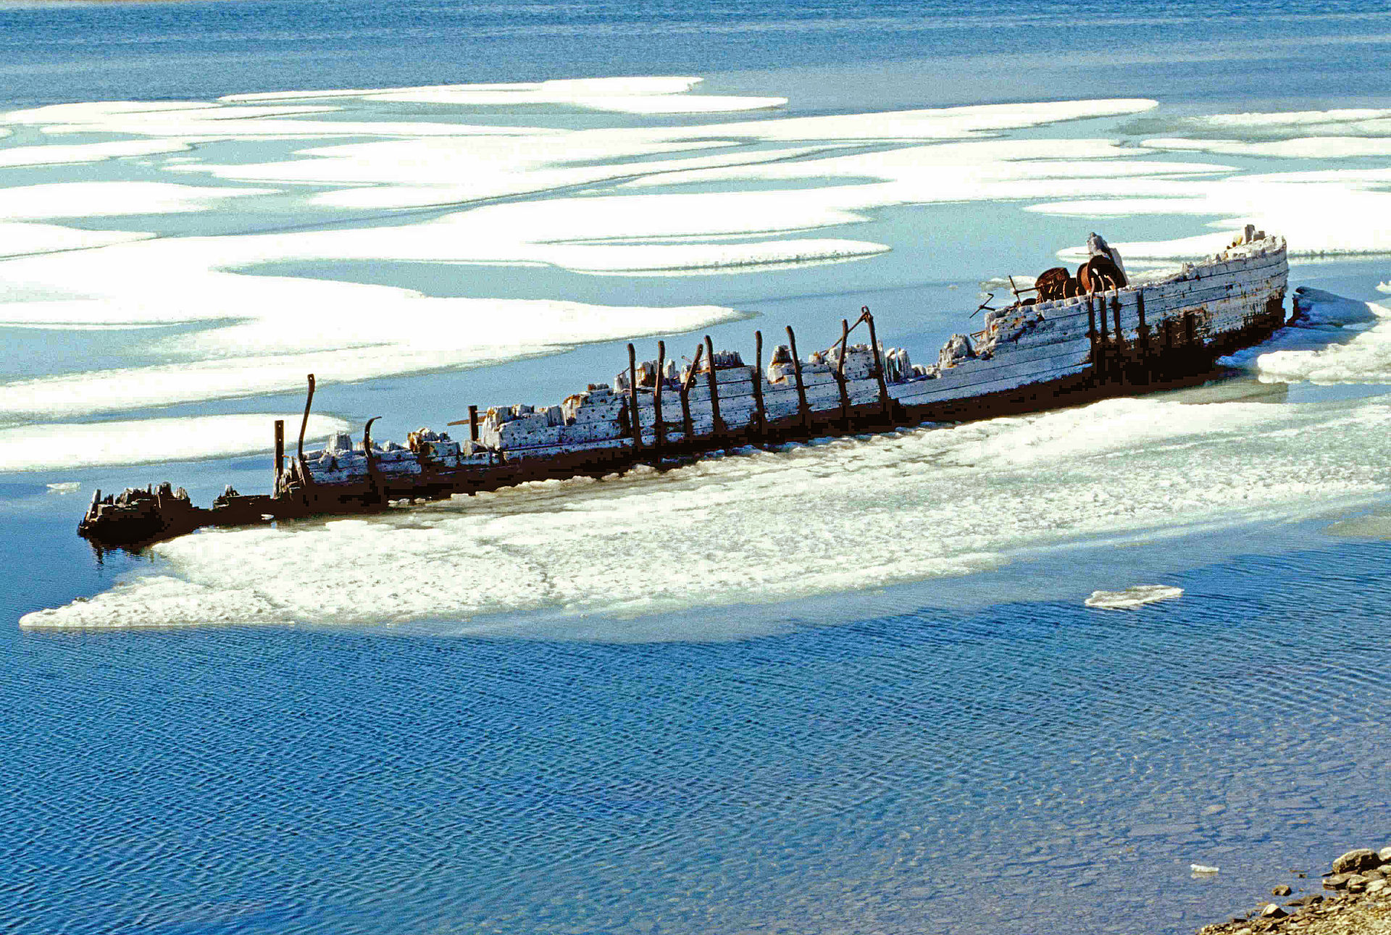
C. T. R. Wilson motivated the need for global observations of E_{fair} and diurnal variability
Diurnal variation of “fair weather” E field advanced by F. J. W. Whipple
Closely tied to diurnal variation of thunder area
“Thunder day” was an early measure of global thunderstorm activity, well before we had regional or global lightning measurements
Carnegie Institution of Washington DC
Seven cruises (1909-1929)
Carnegie was destroyed in fuel explosion in Samoa (1929)
Maud was frozen into Arctic ice and destroyed (1930)
Carnegie
Maud

Slide 13
Fair weather E field
There is something curious about the shape of the Carnegie curve vs. the shape of the
thunderday curve?
The Americas dominate the Carnegie curve despite the peak in thunder days
(and lightning) over Africa. Africa is the clear winner in terms of lightning.
Williams (2009) and others argued that electrified shower clouds over the Americas
contribute to the global circuit. Electrified shower clouds are non-lightning producing clouds.

Slide 14
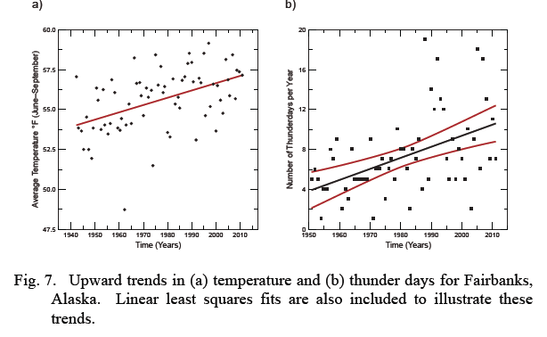
It is tempting to think of the global circuit (fair weather E field) as a mechanism to monitor global warming…
The basis for this is that warming will increase convection leading to more lightning and therefore an upward trend in the magnitude of the fair weather E field…
However the record of the global circuit strength is too sporadic to be useful as is global
coverage of lightning
It has been shown that global lightning responds to semi-annual (hemispheric) temperature changes with a sensitivity ~10% per 1 deg. C of warming
Aerosols also strongly influence the measurement of E_{fair.} Increasing pollution will increase E_{fair}.
Warming
Thunder days
Williams and
Guha (2019)

Slide 15
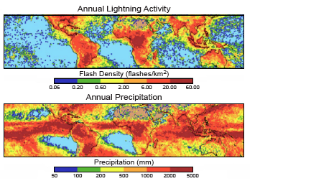
III. Land-ocean lightning contrast?
Lightning loves land!
Christian
et al.
LIS observations
Three tropical
chimneys;
South America
Africa
Maritime Continent
TRMM
observations
What is the basis for the sharp land-ocean contrast in lightning flash rate?

Slide 16
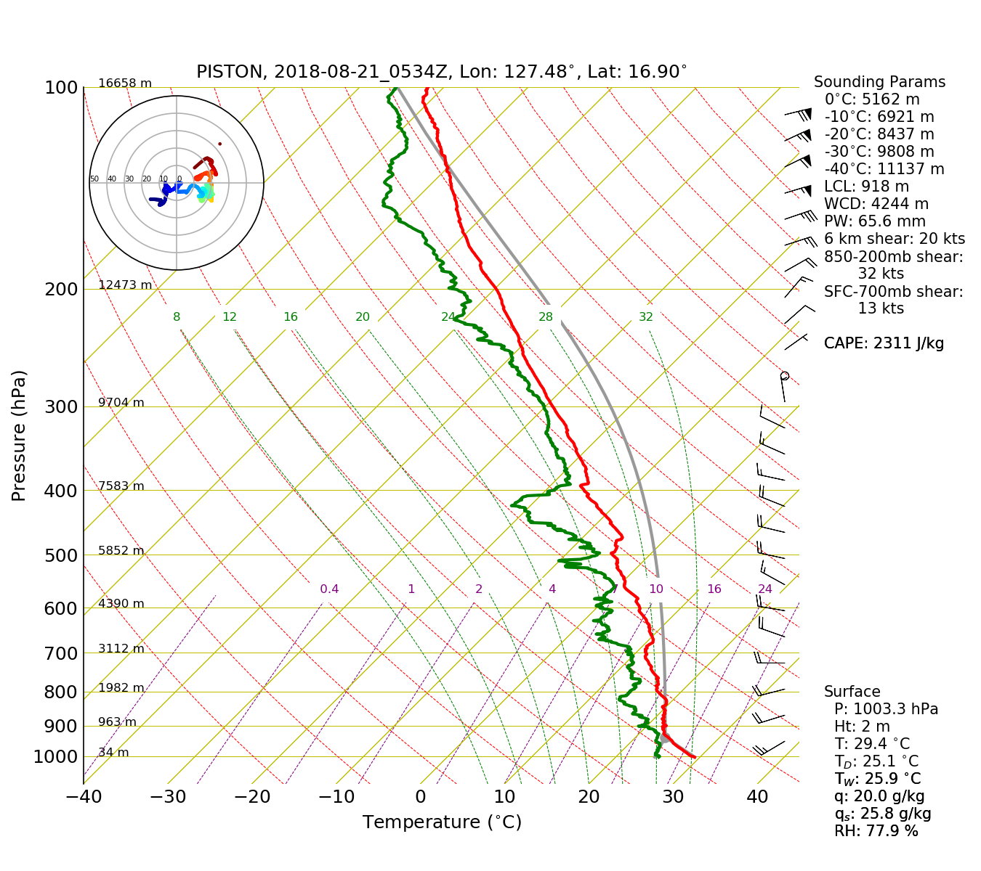
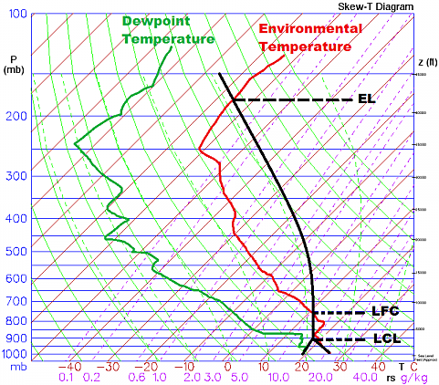
CAPE; integrated thermal buoyancy
Land-ocean contrast in lightning, a
fascinating
study in itself
Warm cloud depth
Freezing level height - Cloud base height
CBH ~ T_{surface}-T_{dew}
T_{a}-T_{d} differences between tropics and mid-latitudes?
CCN
Tropical oceanic convection; moderate to high CAPE (narrow thermal buoyancy), low CBH (deep WCD) and low CCN.
Easy for coalescence produced drops to exceed updrafts and fallout.
Tropical continental convection; moderate
to high CAPE (wide thermal buoyancy),
high CBH (shallow WCD) and high CCN. Coalescence
is suppressed, condensate lofted into mixed phase
region to enable ice based precipitation.
Parcel
is far from the
environmental
temperature
profile
Sensible
heating of land
surface

Slide 17
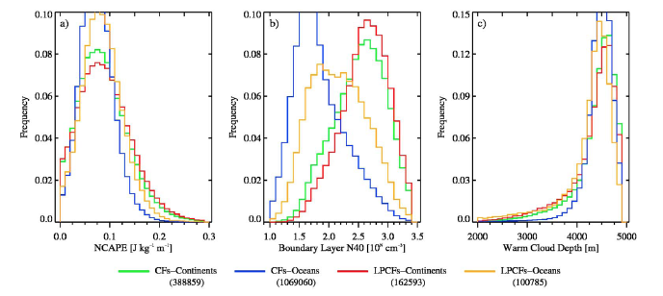
NCAPE
CCN
Warm Cloud Depth
A global (tropical) look at
instability, CCN and WCD
Stolz, Rutledge and Pierce
(2014) JGR
ERA-Interim, TRMM PR/LIS,
GEOS-Chem merger
NCAPE = CAPE/depth of the instability; CAPE is vertically integrated thermal buoyancy
g [T_{cloud} – T_{env}]/T_{env}
High NCAPE tail over land
Higher CCN concentrations over land (anthropogenic sources)
Shift to shallower WCD’s over land, equivalent to greater cloud base heights

Slide 18
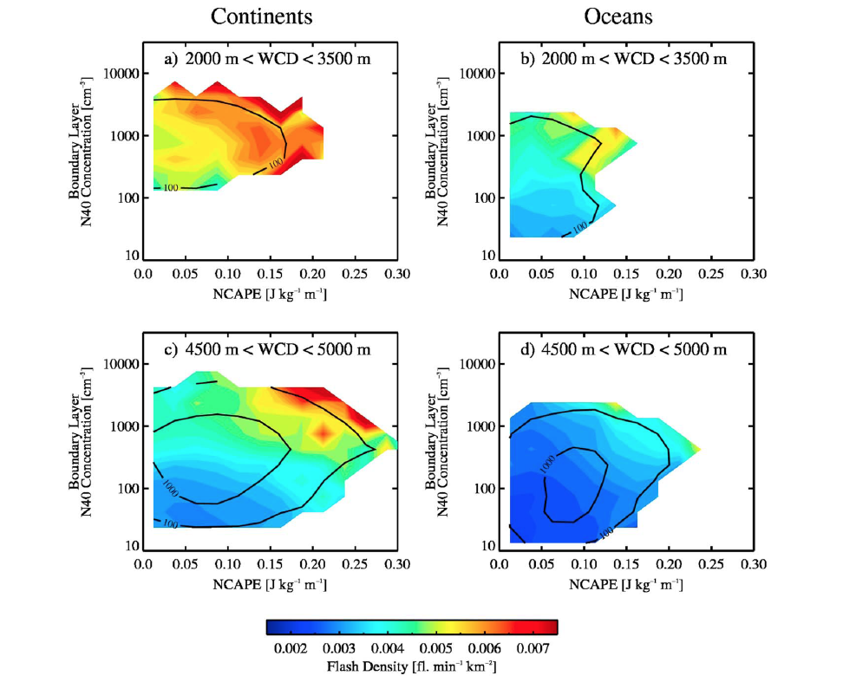
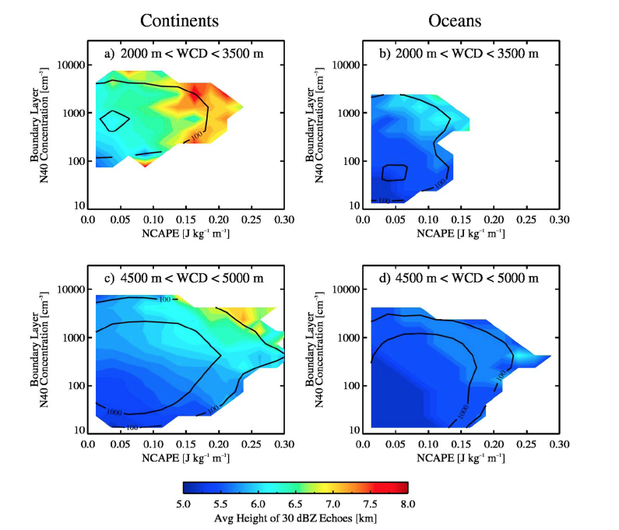
Stolz, Rutledge and Pierce (2014)
JGR-Atmospheres
These figures sum up the
CAPE, CCN, Warm Cloud Depth
interdependence
Angled lines show the interplay between
instability and CCN
30 dBZ heights from TRMM PR
Convection with shallow WCD’s has enhanced lightning even with reduced CCN concentrations
Convection with deep WCD’s produce lightning only for very high CCN concentrations—especially over land.
Oceanic convection has lots of instability but they are starved for CCN.
Most intense storms have
shallower WCDs

Slide 19
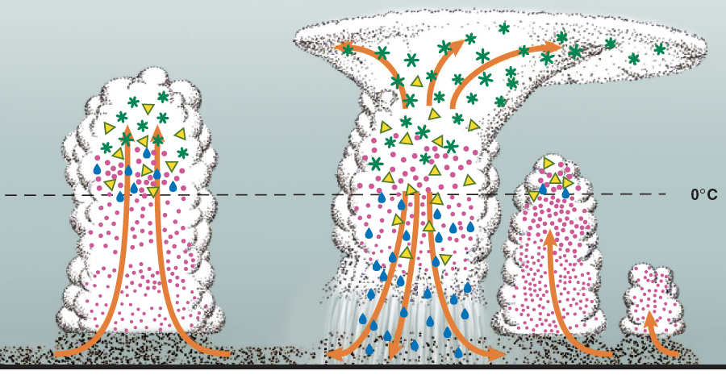
From Rosenfeld et al. (2008) Science
Tropical convection
“Skinny” thermal buoyancy
Low CCN concentrations
Deep warm cloud depth
Coalescence operates to
produce warm rain, and mixed
phase is “wimpy”
Continental convection
“Wide” thermal buoyancy
High CCN concentrations
Reduced warm cloud depth
Coalescence is suppressed
leading to robust mixed phase
microphysics
electrification

Slide 20
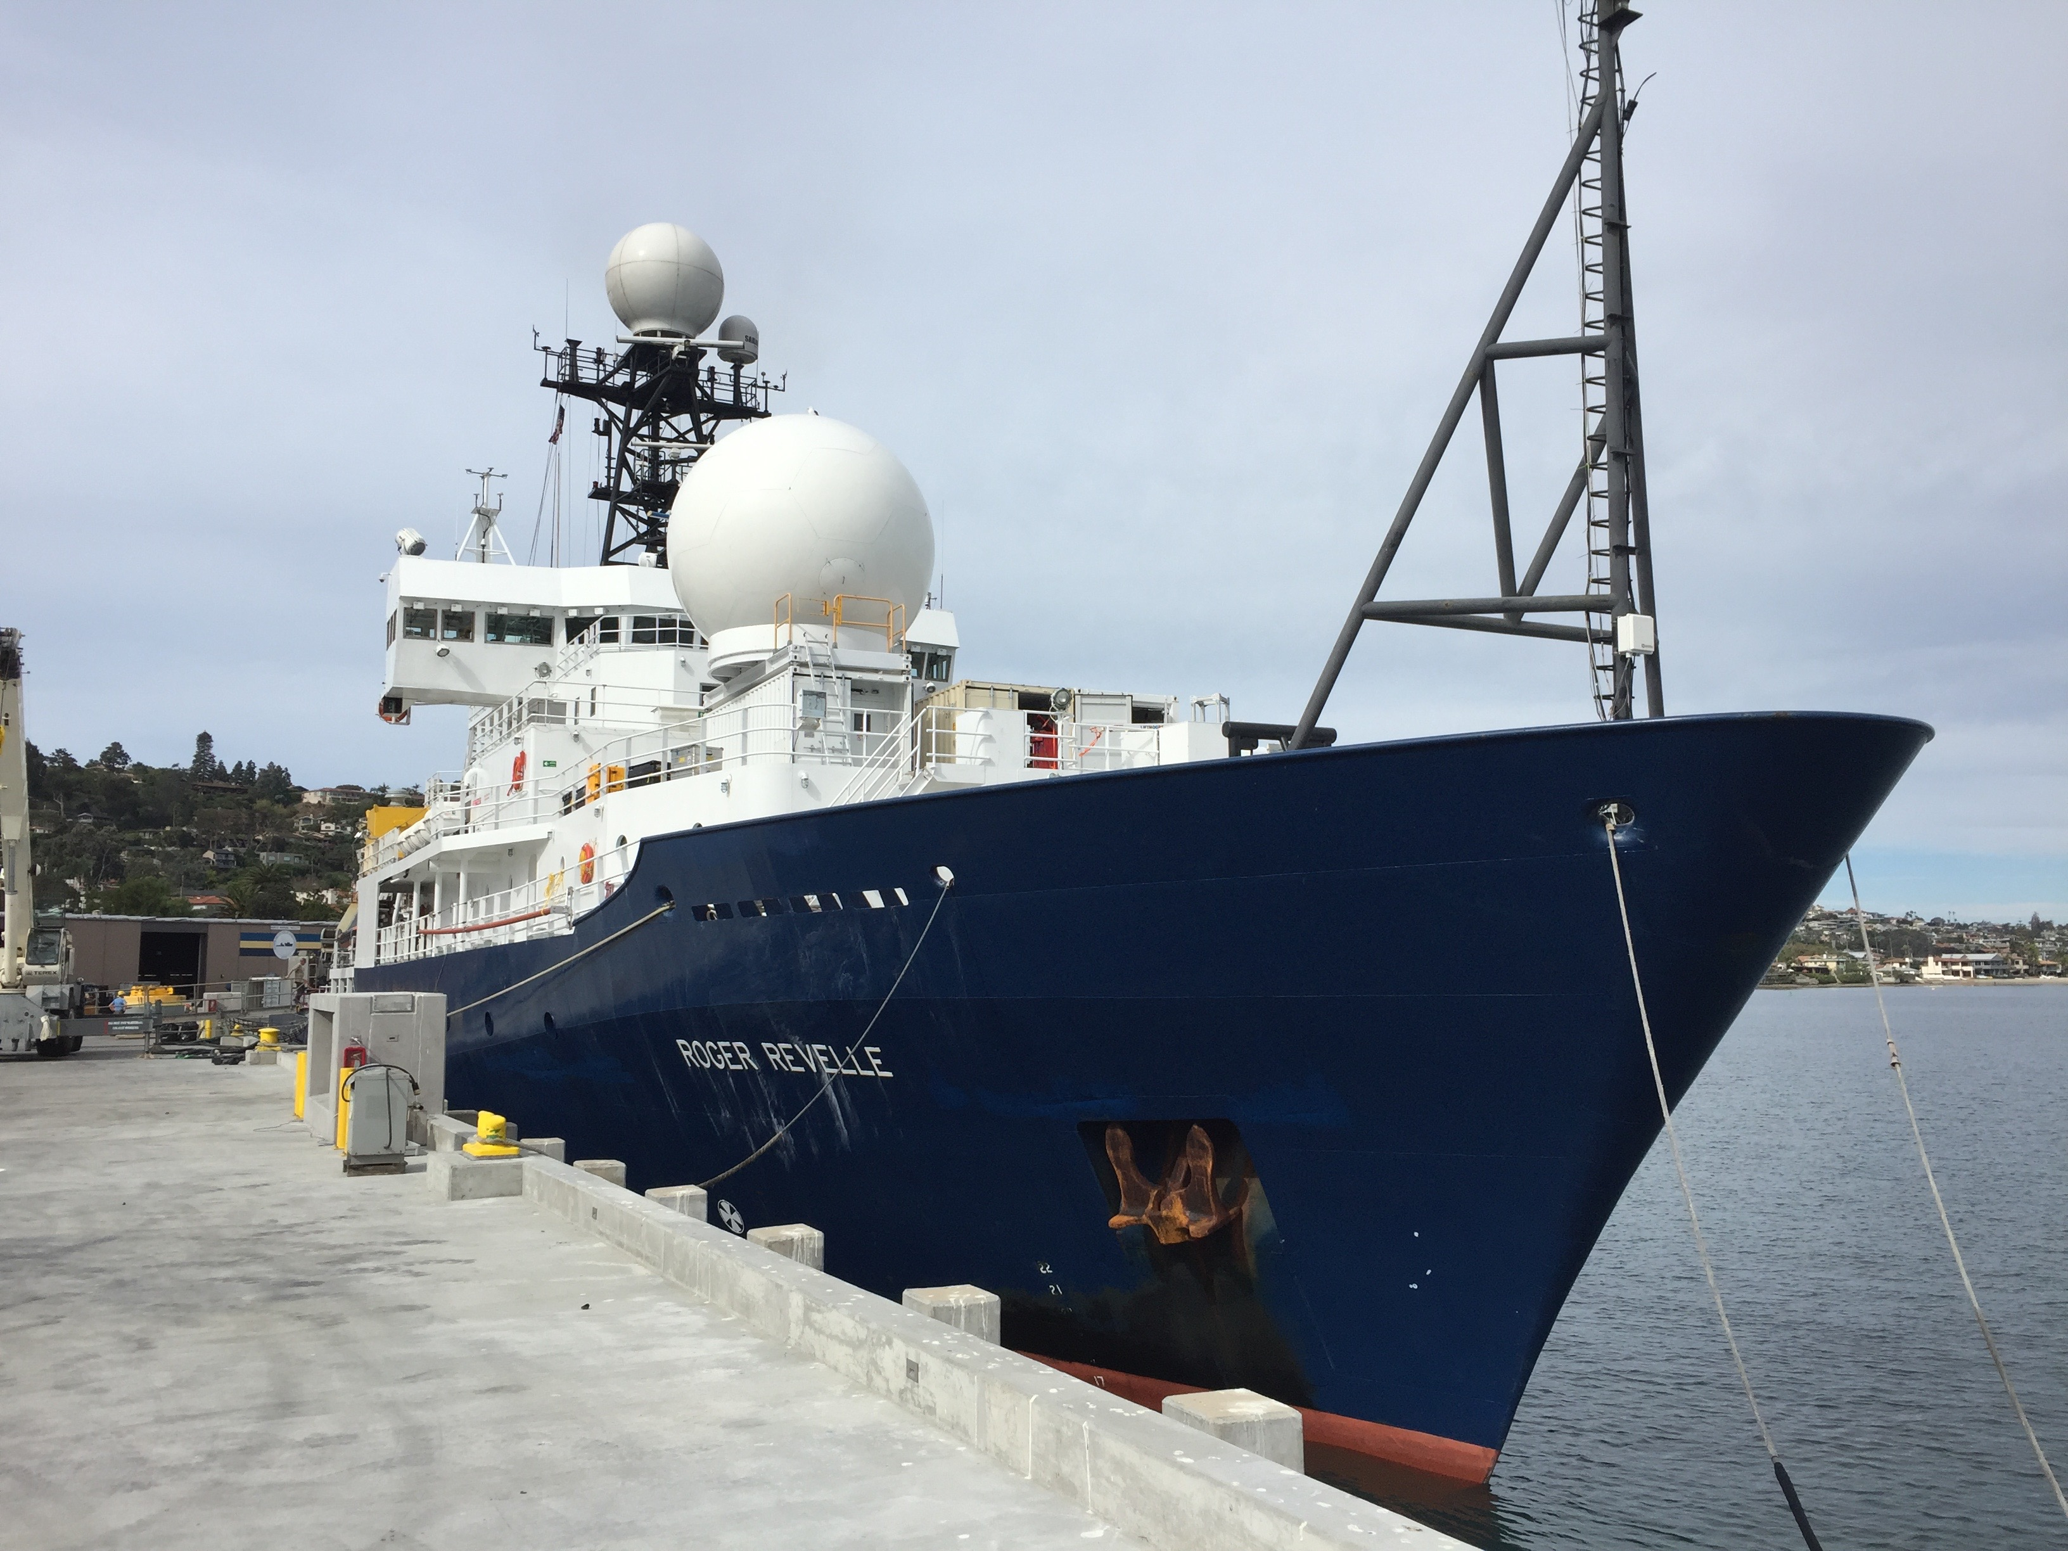
Lets go look at tropical convection…

Slide 21
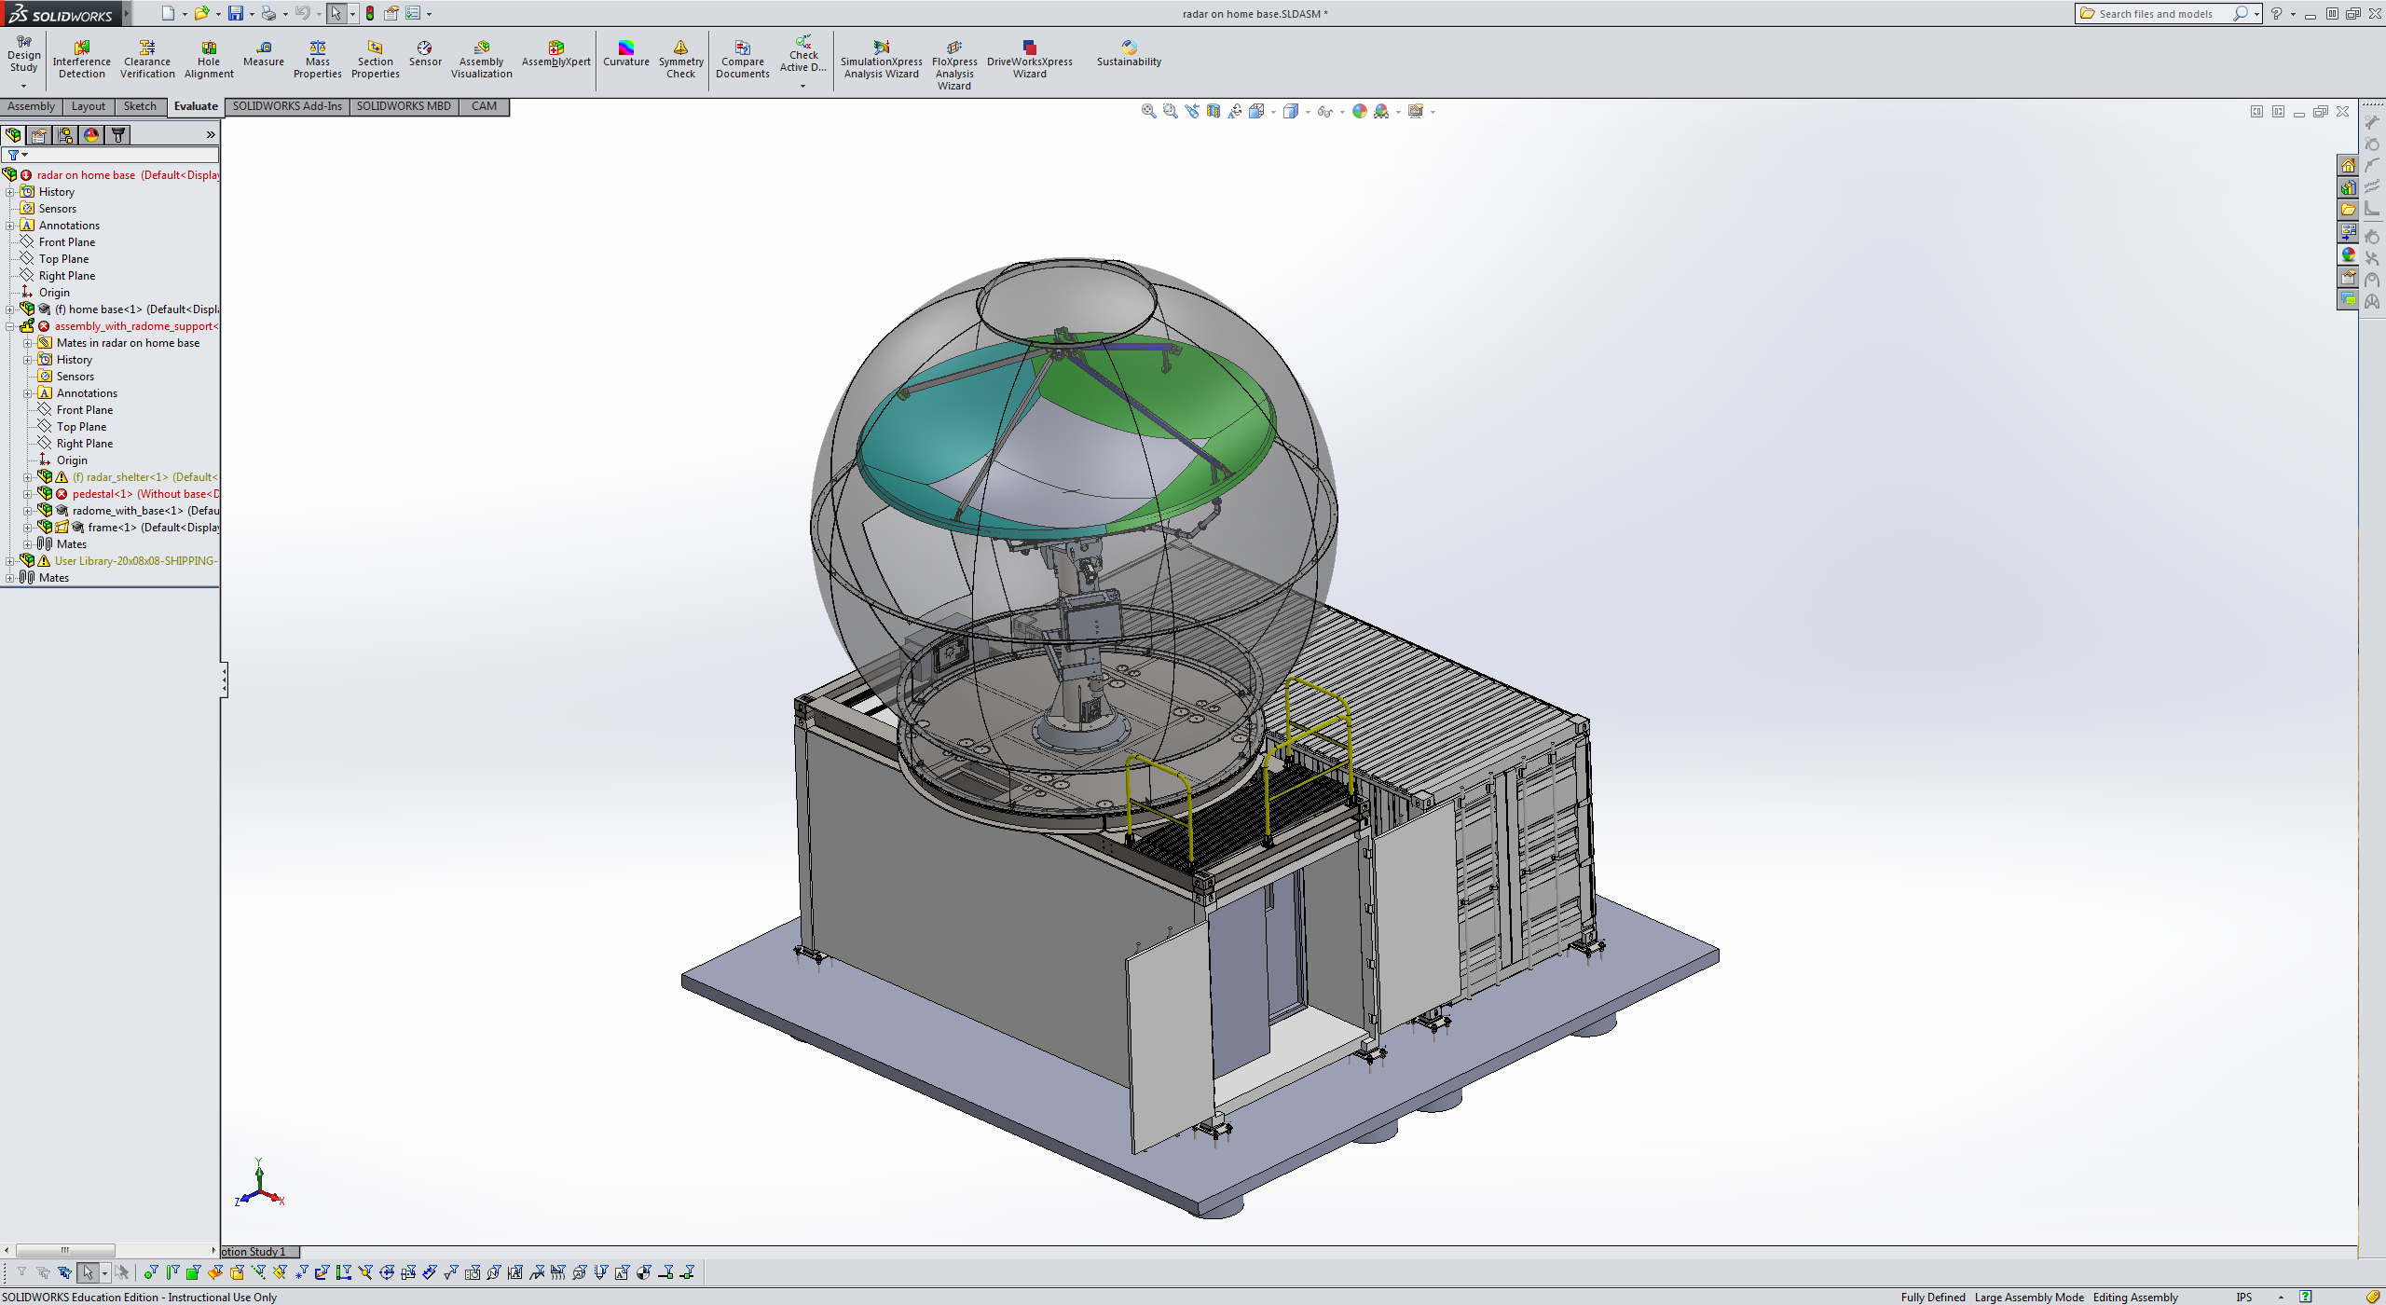
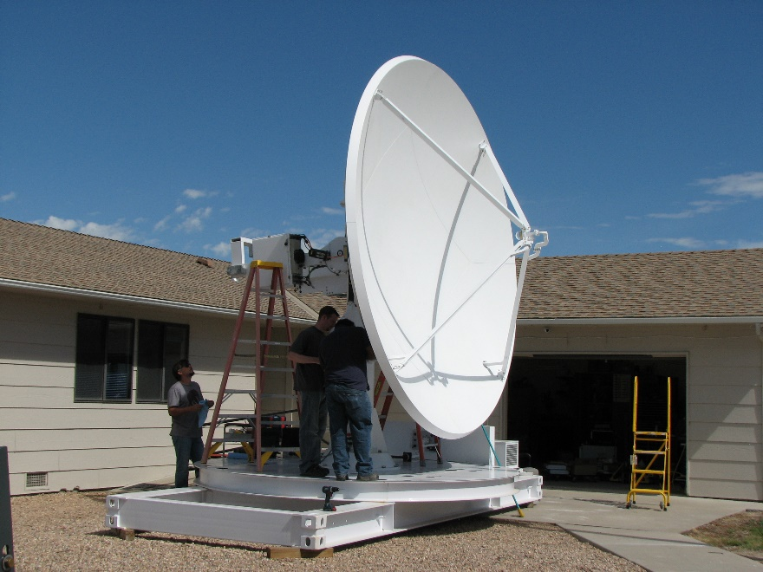
Lets go look at tropical convection…
SEA-POL installed on the forward 02 deck of the
R/V Roger Revelle for the SPURS-2 deployment, Oct-Nov 2017 (2018 on RV Thomas Thompson and 2019 on RV
Sally Ride)
Provides a 250-300 degree scanning sector centered on bow of the ship
High
performance
antenna
designed for
polarimetric
observations
Antenna stabilized for
ship motions

Slide 22
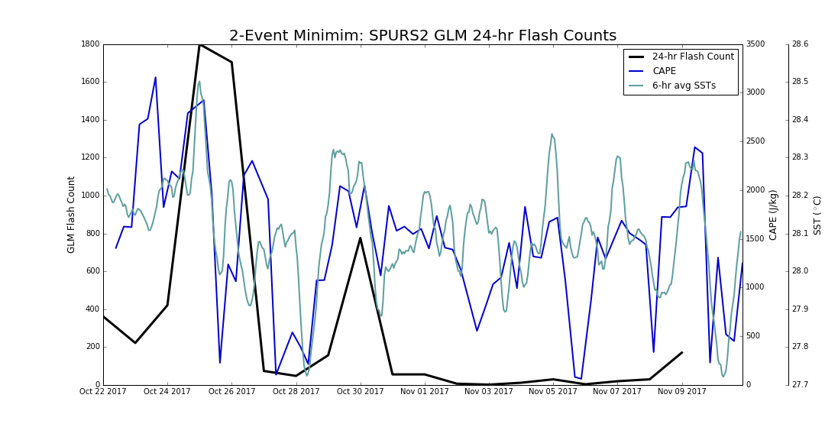
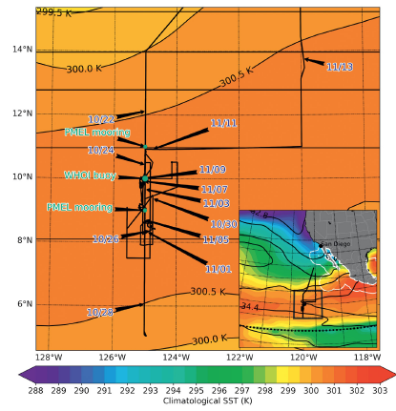
Take a look at flash rate and CAPE….
SPURS CAPE, SST time series
> 1500 J/kg
CAPE computed from 4 per day soundings from R/V Roger Revelle
Lightning when CAPE exceeds ~1500 J/kg
Radar observations
Radar observations
Rutledge et al. 2019 BAMS

Slide 23
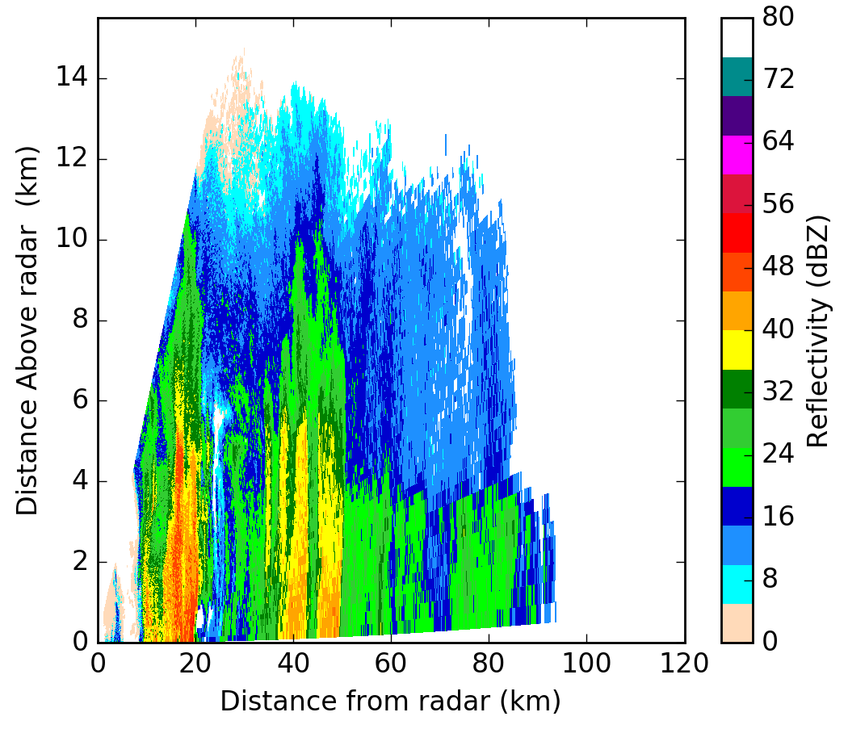
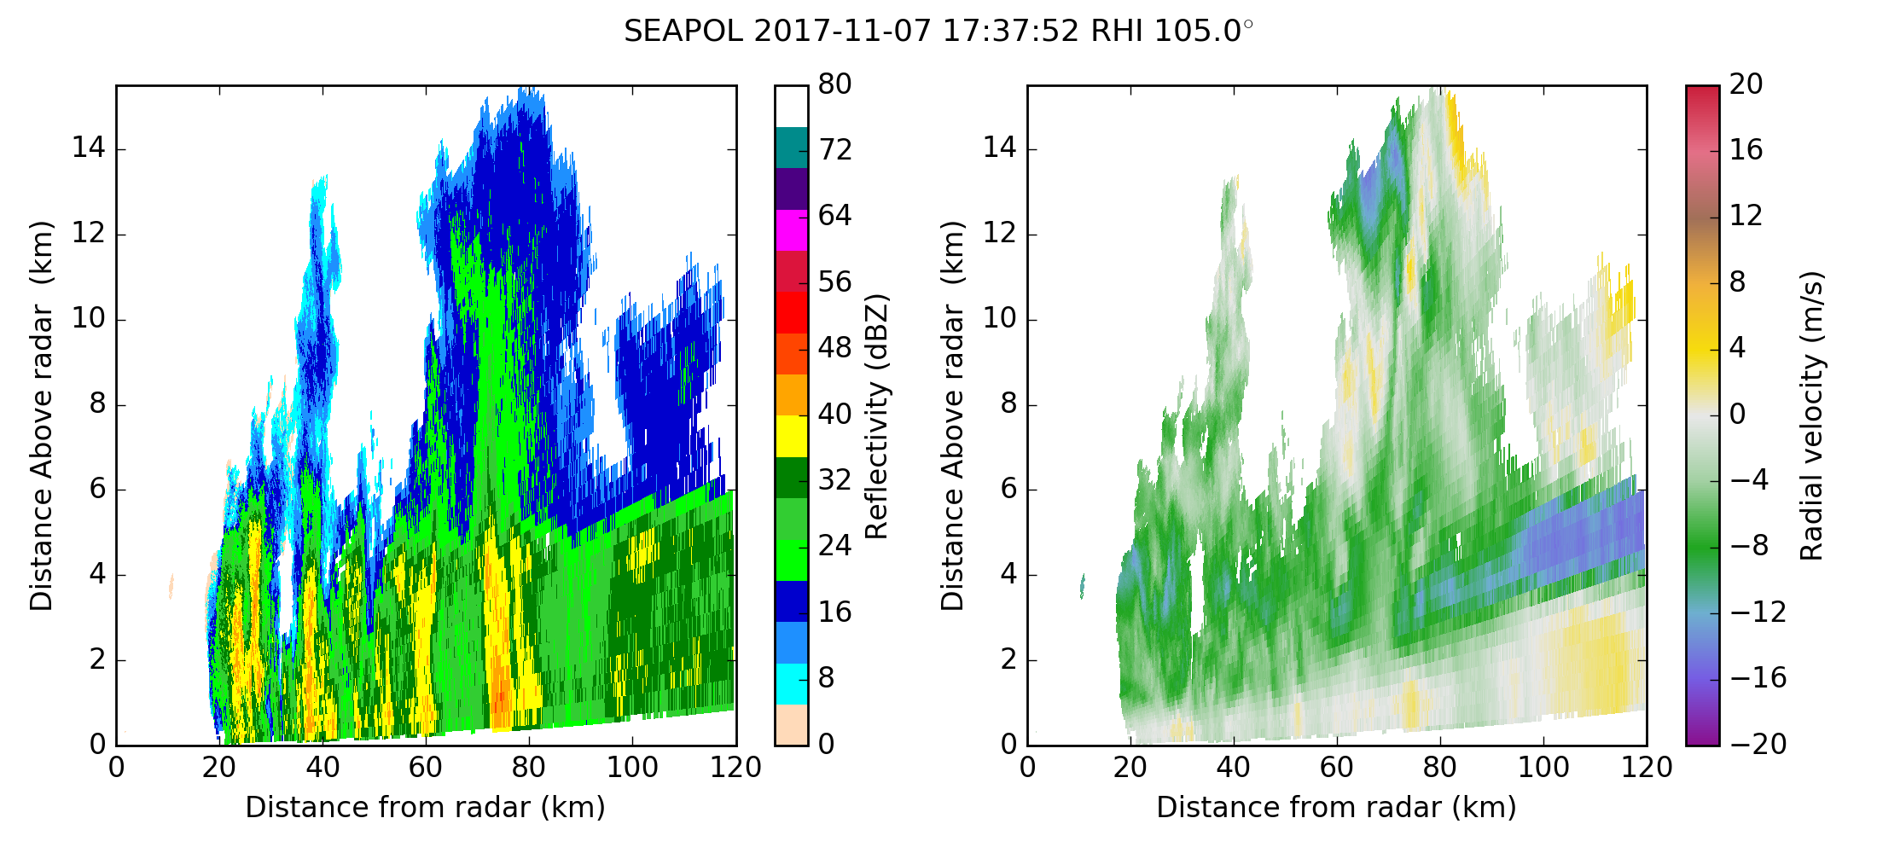
0332 UTC; 25 October 2017
Lightning is probable when 35 dBZ extends to
-10°C or colder (6 km from 0300 Z sounding;
2500 J/kg CAPE); mixed phase microphysics
Non-lightning example
CAPE < 750 J/kg
0° C
Lightning producing example
Assuming CCN concentrations were pristine and invariant, evidently higher CAPE values lead to sufficient vertical motions to loft raindrops into mixed phase region

Slide 24
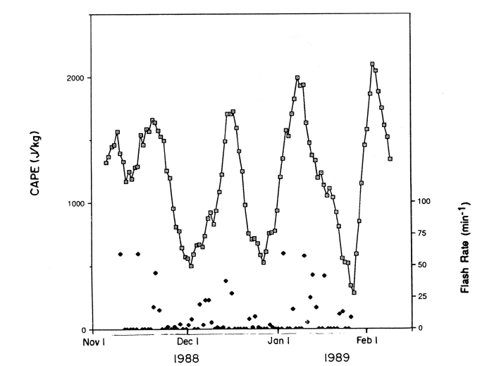
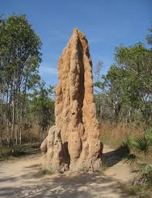
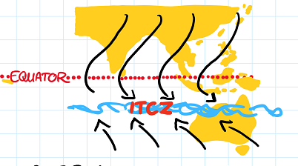

Importance of CAPE…
Simple scaling argument
M~D³ (Mixed phase mass)
Z~D⁶
At balance level, V_{T}=W
V_{T}~D^{1/2}
Therefore:
Z_{e}~CAPE⁶ and M~CAPE³
Two fold increase in CAPE
is an 18 dB increase in Z
Two fold increase in CAPE
is an 8-fold increase in M
Robust ice phase in tropical continental and mid-latitude convection sets the stage for electrification leading to lightning
Darwin Australia time series
Rutledge et al. (1992)
Difficult to deconvolve
effects of CAPE and
CCN!

Slide 25
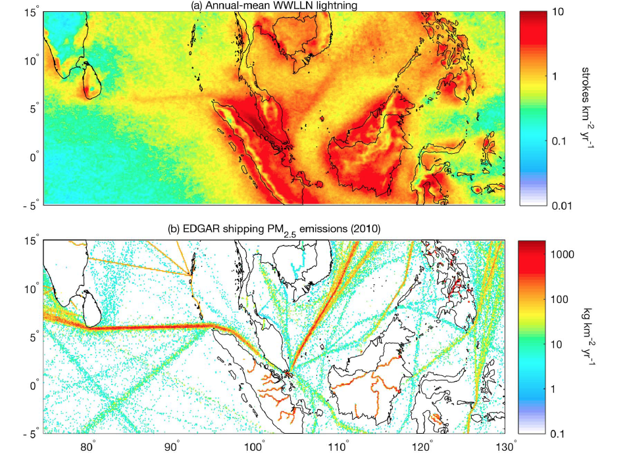
Strong land-ocean
lightning contrast
Enhanced lightning
over shipping
lanes
Direct evidence
of CCN invigoration
But no CAPE
measurements!
< 2.5 microns
Thorton et al.
2017 GRL
This result suggests there must be a lot of convection in the tropics that
could be “invigorated” by increased pollution levels—how will this play out?

Slide 26
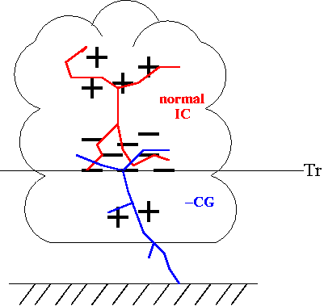
IV. Cloud electrification
Starting with Mason, Moore and Vonnegut
Any theory for electrification must explain these
electrical characteristics of thunderstorms:
Strong electrification observed when cloud extends well
above the freezing level
Highly electrified regions contain iceparticles and supercooled
water droplets
Charge generation process closely tied to development
of precipitation in the form of graupel
The first lightning flash develops 10-20 minutes after
the appearance of precipitation particles of radar-
detectable size (first echo)
The location of charge centers in strongly tied to temperature,
not height (negative charge between -15 and -25°C, positive charge above)
So-called normal tripole
charge structure

Slide 27
Basic concepts
Cloud electrification
Convective charging Collisional charging
Inductive charging Non-inductive charging

Slide 28
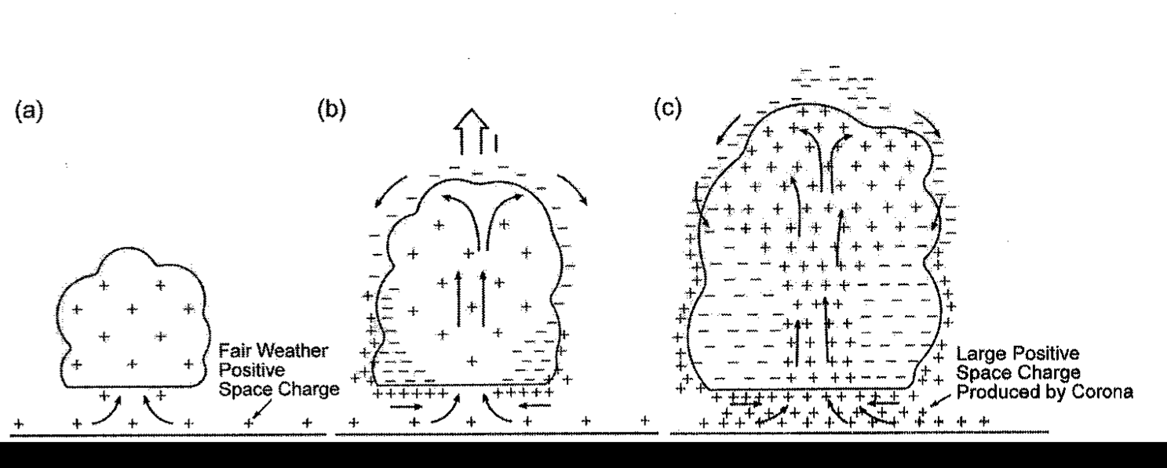
Convective charging occurs when atmospheric ions are
transported by cloud motions
Grenet (1947), Vonnegut (1953), Vonnegut and Moore (1958)
+
--
Positive ions
released by corona
discharge at Earth
surface
Positive charge carried
aloft by updraft, negative
ions attracted to cloud
edges where downdrafts
transport negative ions
towards surface
This increases corona
discharge of positive ions
causing a feedback process,
strengthening the E field

Slide 29
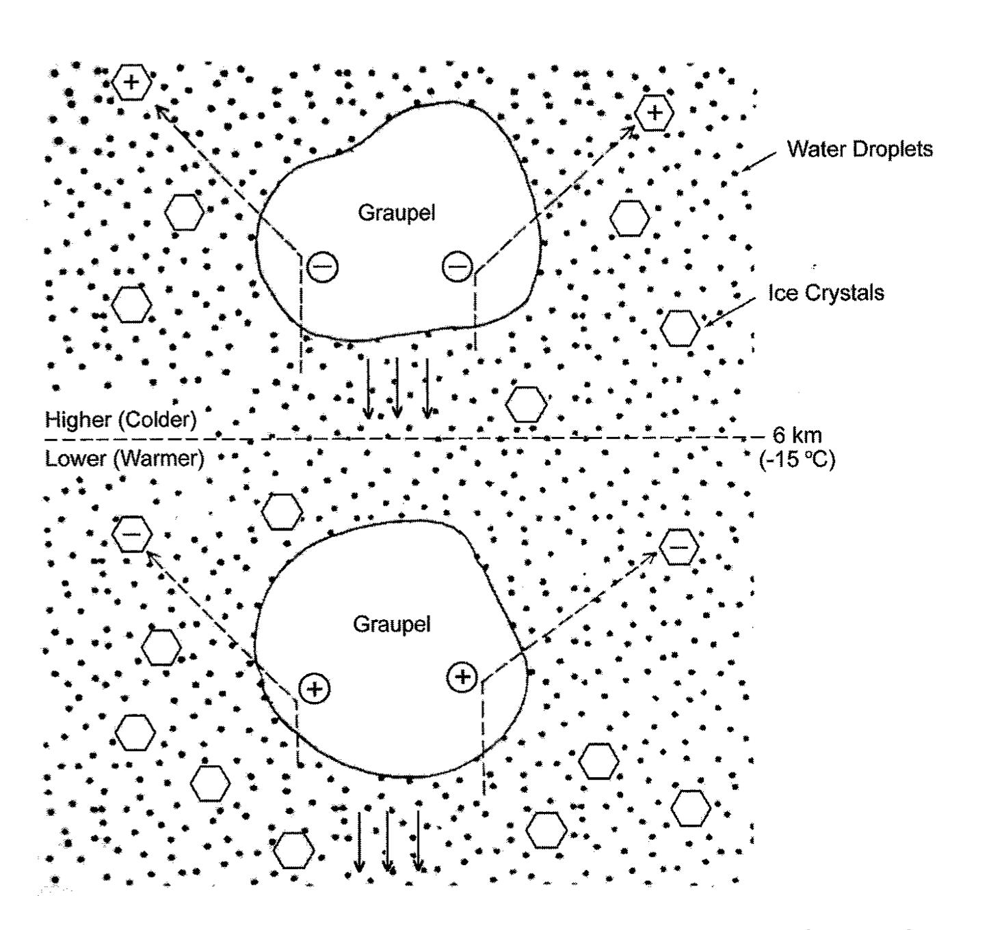
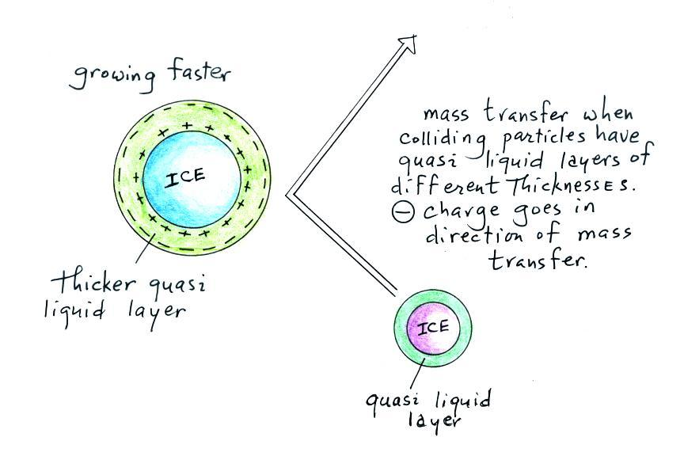
Non-inductive charging-charge separation occurs
when graupel collides with smaller ice crystals in
the presence of supercooled water droplets
Later studies offered the
role of a quasi-liquid
layer (QLL) on the surface of
ice particles and the existence
of a so-called electrical double
layer in the QLL (from Fletcher)
Baker and Dash (1994)
T_{reversal}
VAPOR
-- -- -- --
H⁺
H⁺
QLL obtains net negative
charge
O²⁻
ICE
Reynolds et al. (1957)
Particle with thinner QLL
acquires net negative charge
C. Weidman, U. of Arizona

Slide 30
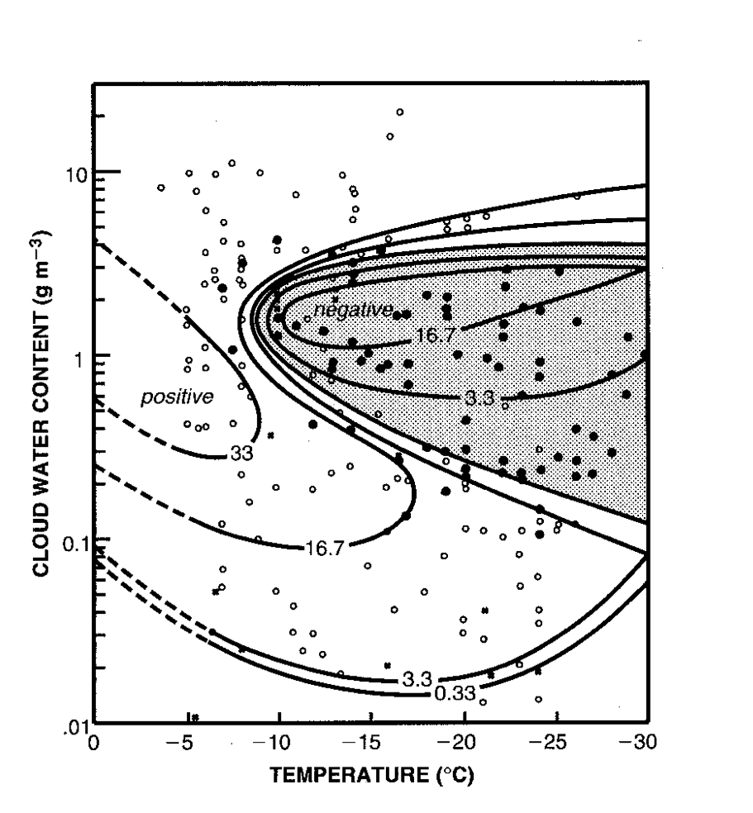
Takahashi, 1978, J. Atmos. Sci. Famous whirling rod experiment
Three distinct charge regions
found! Negative charging to
graupel for temperatures
colder than -10 C over modest
to substantial liquid water
contents. Positive charging to
graupel at very low and
extremely high liquid water
contents.
Sign of charge transfer function
of LWC, rime accretion rate,
ambient temperature, droplet
size and…
Controversy about charging
mechanism at high SLW contents!
More on this later…
Contours: charge separated
per collision (fC)

Slide 31
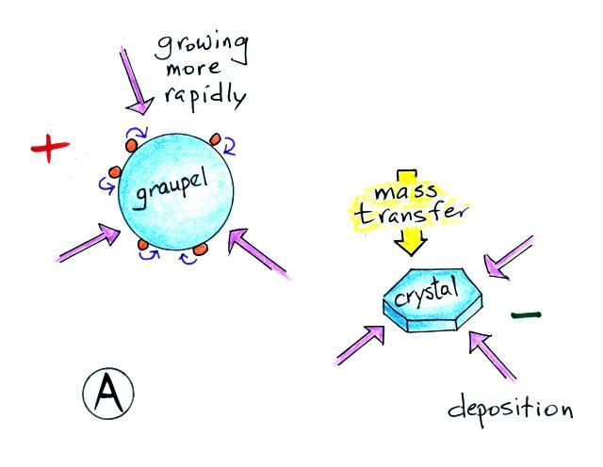
How does QLL theory fit with Takahashi’s results?
Example: Positive charging of graupel
At low liquid water contents, both graupel and ice
crystals are growing by deposition. Since dm/dt ~ radius,
graupel is growing faster and has a thicker QLL.
Negative
charge
carried
upward
Courtesy: C. Weidman
U. of Arizona
Leads to positive charge lower in cloud

Slide 32
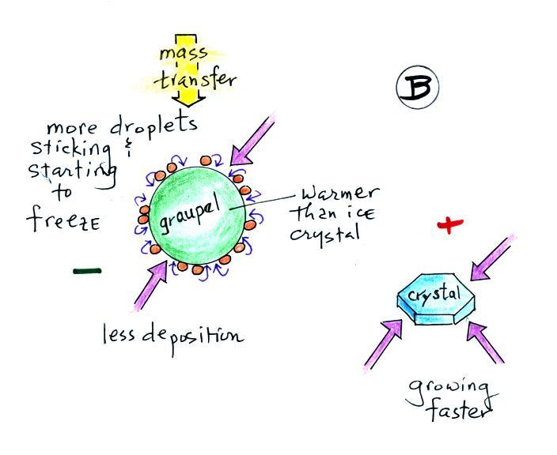
Example: Negative charging of graupel
Larger graupel particle in sublimational growth
at moderate supercooled LWC; graupel gains mass
by riming while losing mass by sublimation
Positive
charge
carried
upward
Courtesy:
C. Weidman
U. of Arizona
A complete theory
for cloud electrification
remains elusive!
Leads to negative charge lower in cloud

Slide 33
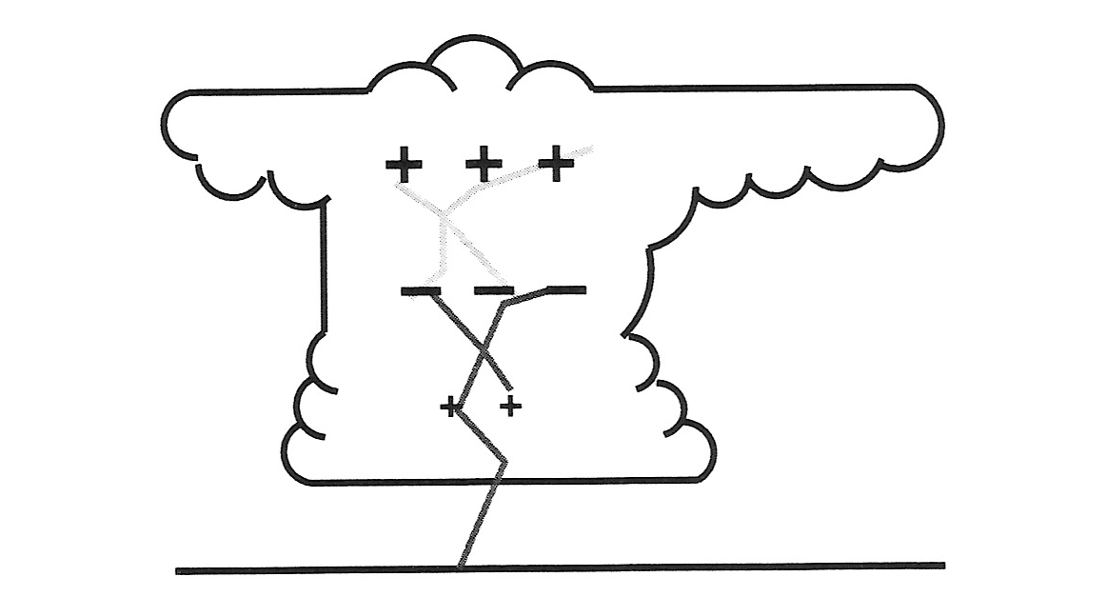
V. Storm scale observations
The “normal” tripole storm
Breakdown field ~ 10⁵ Vm⁻¹
Intracloud lightning
IC/CG ratio ~ 4:1 (globally)
Cloud-to-ground lightning
Tessendorf (2009)

Slide 34
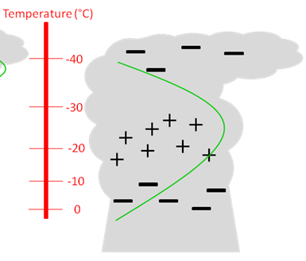
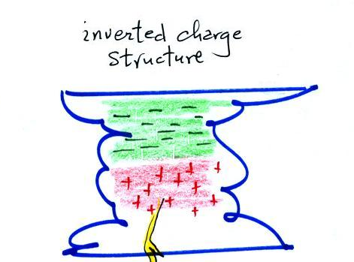
There are deviations from “normal” polarity…
“inverted” charge structure
Inverted charge structure with positive
charge situated in the mid levels
Where do these storms occur and
what processes lead to the inverted
charge structure?
Another
anomalous
charge
structure;
“inverted” dipole
Characteristic of
low precipitation
supercells
Courtesy: C. Weidman

Slide 35
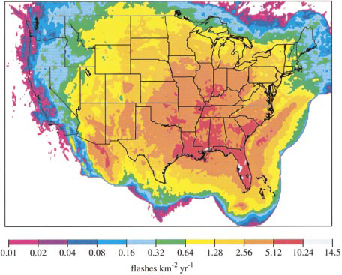
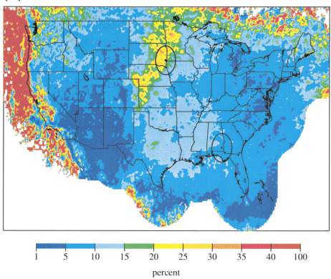
Annual CG flash density
“Positive” storms are found in the W. and N.
Great Plains-often severe
Intersection of high CAPE and reduced warm
cloud depth, equivalent to high cloud base
heights (Williams 2005)
Promotes high supercooled liquid
water contents, “superlative liquid water
contents”, leading to positive charge on graupel
For inverted storms, warm cloud residence
time is far too short to produce
precipitation-sized drops (Fuchs et al. 2018)
The high cloud base heights also imply broad cloud
parcels which effectively reduce entrainment
% positive
CBH
CAPE
CBH
Zajac and Rutledge (2000)

Slide 36
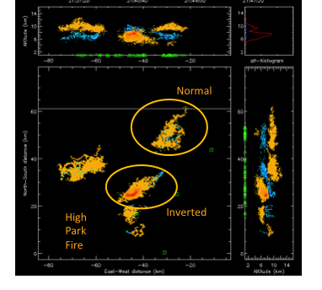
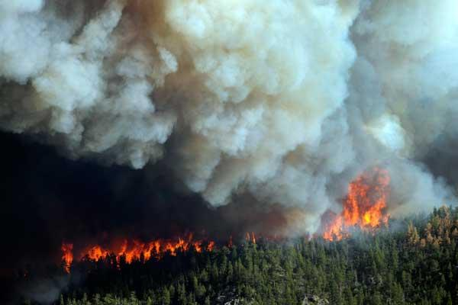
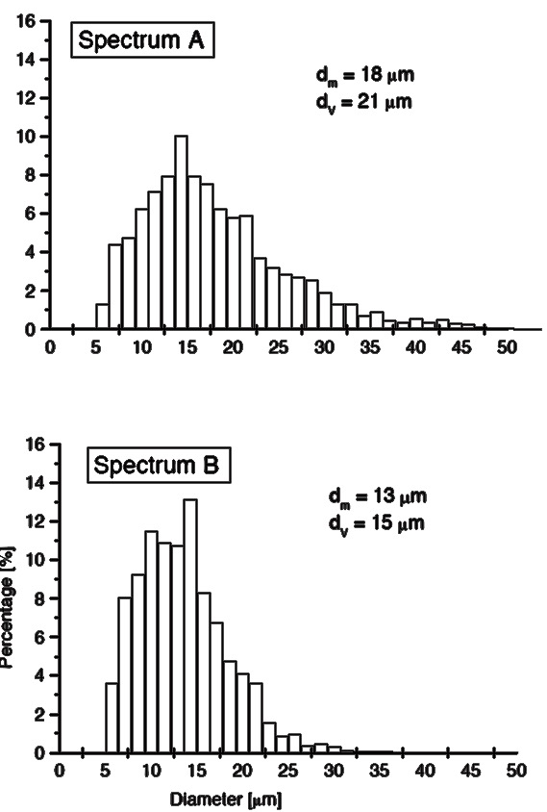
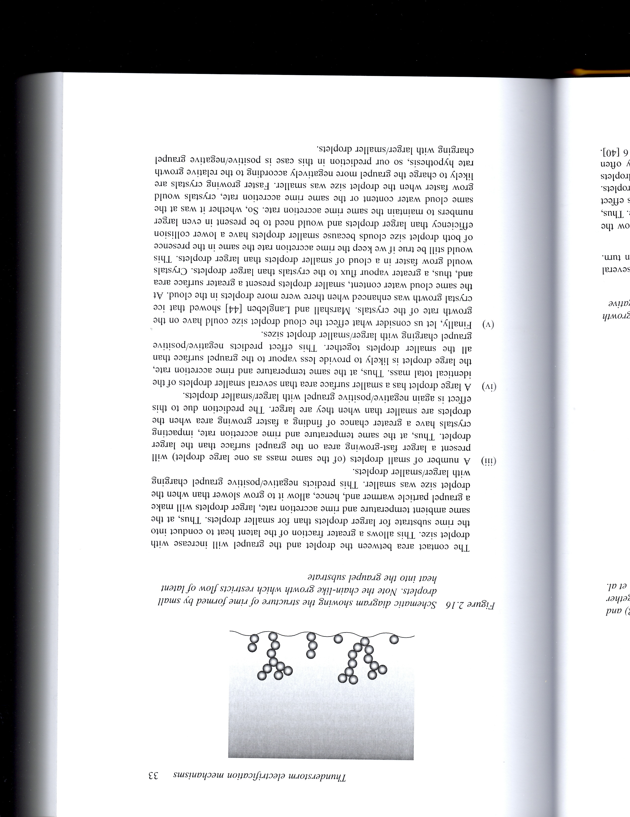
Positive charging of the rimer (graupel) at high SLW content is still a mystery…
However, droplet concentration seems to be an important component
Gold +
Blue -
High Park fire in CO, June 2012
CCN impact on storm charge structure?
Rimed surface stays in
a depositional state owed to
freezing of small droplets
Avila and Pereyra (2000)
Jayaratne, 2014. In, The Lightning Flash

Slide 37

Ammonium in Rainwater—when ammonia enters water (like cloud drops)—surface EPA sites
Considerably increase in NH₄⁺ across Northern Plains from 1985 to 2016; driven by increase
in ammonia (NH₃) from
surface?????
Also increase in other locations (e.g., E NC, SE PA)
From Max Marchand,
unpublished

Slide 38

Dual-Doppler derived updraft statistics
Fuchs et al. 2018
Strong, broad updrafts in inverted storms
Environment for high supercooled liquid water contents
Positive charge on rimer (graupel)

Slide 39

LMA time-of-arrival technique
+
+
+
Vertical distribution of sources
+
+
+
+
A cool way to map
lightning channels!
-
-
-
-
-
-
-
-
-
t₃
+
+
+
+
+
+
+
VHF radiation α dI/dt
E field
t₁
t₂
Radio antenna
Cell antenna
Solar panel
Main processor
Ground

Slide 40

Fuchs et al. 2015
Positive charge layer;
inverted polarity storm
Positive charge layer;
normal storm polarity

Slide 41
LMA operation
Network of radio antennas with GPS timing
Detects sources within ~ 60-66 MHz band
  Unused local television band
  Wavelength ~ 2 meters
Time of arrival (TOA) from 6 or more stations
  Redundant equations, higher accuracy
  Intersection of hyperbolas
VHF radiation produced by lightning channel propagation
Data transmitted over cell networks to get near real time lightning data

Slide 42

Northeast Colorado LMA
Installed late 2011,
continuous operation since then
Total of 16 stations
http://lightning.nmt.edu/colma/

Slide 43


Breakdown of stratified charge layer model in and near strong updrafts
Flash size and flash rate inversely correlated
Charge separation and electrical breakdown linked to turbulent
eddies
Bruning and MacGorman (2013)
Strong updraft cores can be lightning free
“Lightning hole”
Lang et al. (2004)

Slide 44

The Geostationary Lightning Mapper!!
Comparison to LMA for individual storms
Charge-coupled
device (CCD)
8 km pixel size
at nadir, 14 km at
limb
777.4 nm wavelength
Designed detection efficiency is 70%

Slide 45


Austral summer
Spring Equinox
Over ocean flashes are nearly two
times brighter than over land flashes?
Boreal summer
Rudlosky et al. (2018)

Slide 46


Normal polarity storm
Anomalous polarity storm
Rutledge et al. (2020)

Slide 47


Thought initially that
precipitation particles,
especially large hail might
reduce DE via scattering
But this is not the case…
Rather, reduced DE is caused by cloud scattering
by small ice crystals and water droplets
Optical depth is L/f where L is some cloud depth and
f is mean free path of a photon; f is small due to high concentration of cloud particles; cloud particles
contain more surface area than larger precipitation
particles due to much larger concentrations
CTWP estimated from ABI, based on optical depth and cloud top particle size

Slide 48

Anomalous storms have low flash heights, very large flash rates
and therefore compact flashes
Low flash heights imply large cloud water/ice paths and multiple
in-cloud scattering reducing optical emission from cloud top; compact
flashes have low radiant energy, so small flashes are not very bright
to begin with
It remains an issue to determine how important this reduced DE is to
the use of GLM in the operational setting…
Lightning “jump”
Schultz et al. (2009)

Slide 49

Transient Luminous Events—TLE’s
Courtesy Walt Lyons

Slide 50

Sprites triggered by intense positive cloud-to-ground
lightning flashes in trailing stratiform region
From Houze (2014)
Cloud Dynamics
2nd Edition
Adapted from
Stolzenburg et al.
(1998)
Multiple charge layers observed in trailing stratiform region.
Stratiform charge via a combination of advection from convective line and in-situ charging afforded by low supercooled liquid water contents generated by mesoscale updraft; precipitation-sized ice particles charge positively under these conditions.
Modeling studies (Schuur and Rutledge, 2000) found that 70% of the total charge in a MCS stratiform region is generated by in-situ charging, with the remaining 30% advected from the convective line. Hence quite similar to the water budget findings for this situation.
By virtue of their large areas and modest charge concentrations, we now know that MCS stratiform regions contain large amounts of electrical charge leading to massive positive cloud-to-ground lightning flashes (>100 kA).
Flashes in excess of 600 km in length within trailing stratiform regions have now been mapped by LMA and also observed by GLM

Slide 51
VI. Global lightning parameterizations
Maybe the biggest reason we care about global lightning is the role of lightning
in atmospheric chemistry
Lightning is the largest natural source of NOx
NOx plays a big role in producing upper tropospheric ozone which acts as a
greenhouse gas
Global models rely on empirical parameterizations to include lightning
At least three parameterizations have been developed
Price and Rind (1992) FR ~ H^{x} where x varies between land and ocean x_{land} > x_{ocean}
Finney et al. (2014) FR ~ vertical ice mass flux in mid-troposphere, 440 hPa
Stolz et al. (2017 FR ~ A*NCAPE + B*CCN – C*WCD + D*SHEAR – E*RH where the
coefficients vary according to Land vs. Ocean
A quick look at comparisons…

Slide 52



Stolz et al. (2020)
Cloud top height scheme under predicts low to moderate flash rate storms and over predicts high flash rate storms, especially over land
Mass flux and multivariable schemes do fairly well over land but over predict moderate flash rate storms over ocean

Slide 53

VII. Conclusions
Strong connections between kinematics, microphysics and electrification
Details of non-inductive charging remain elusive
Incredible advances in space based lightning observations
How will the global flash rate change in future climate scenarios?
Sensitivity of tropical convection to increasing aerosol/CCN concentrations?
Biggest impact of lightning may be through atmospheric chemistry, NOx_{lightning}➔UT ozone
Much more work needed regarding global model lightning parameterizations

Slide 54


