Slide 1
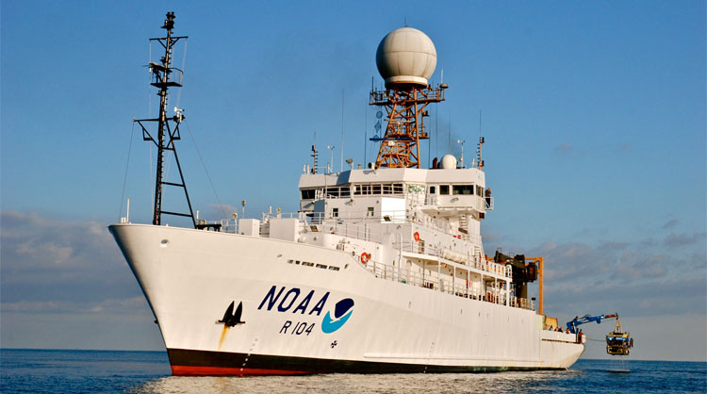
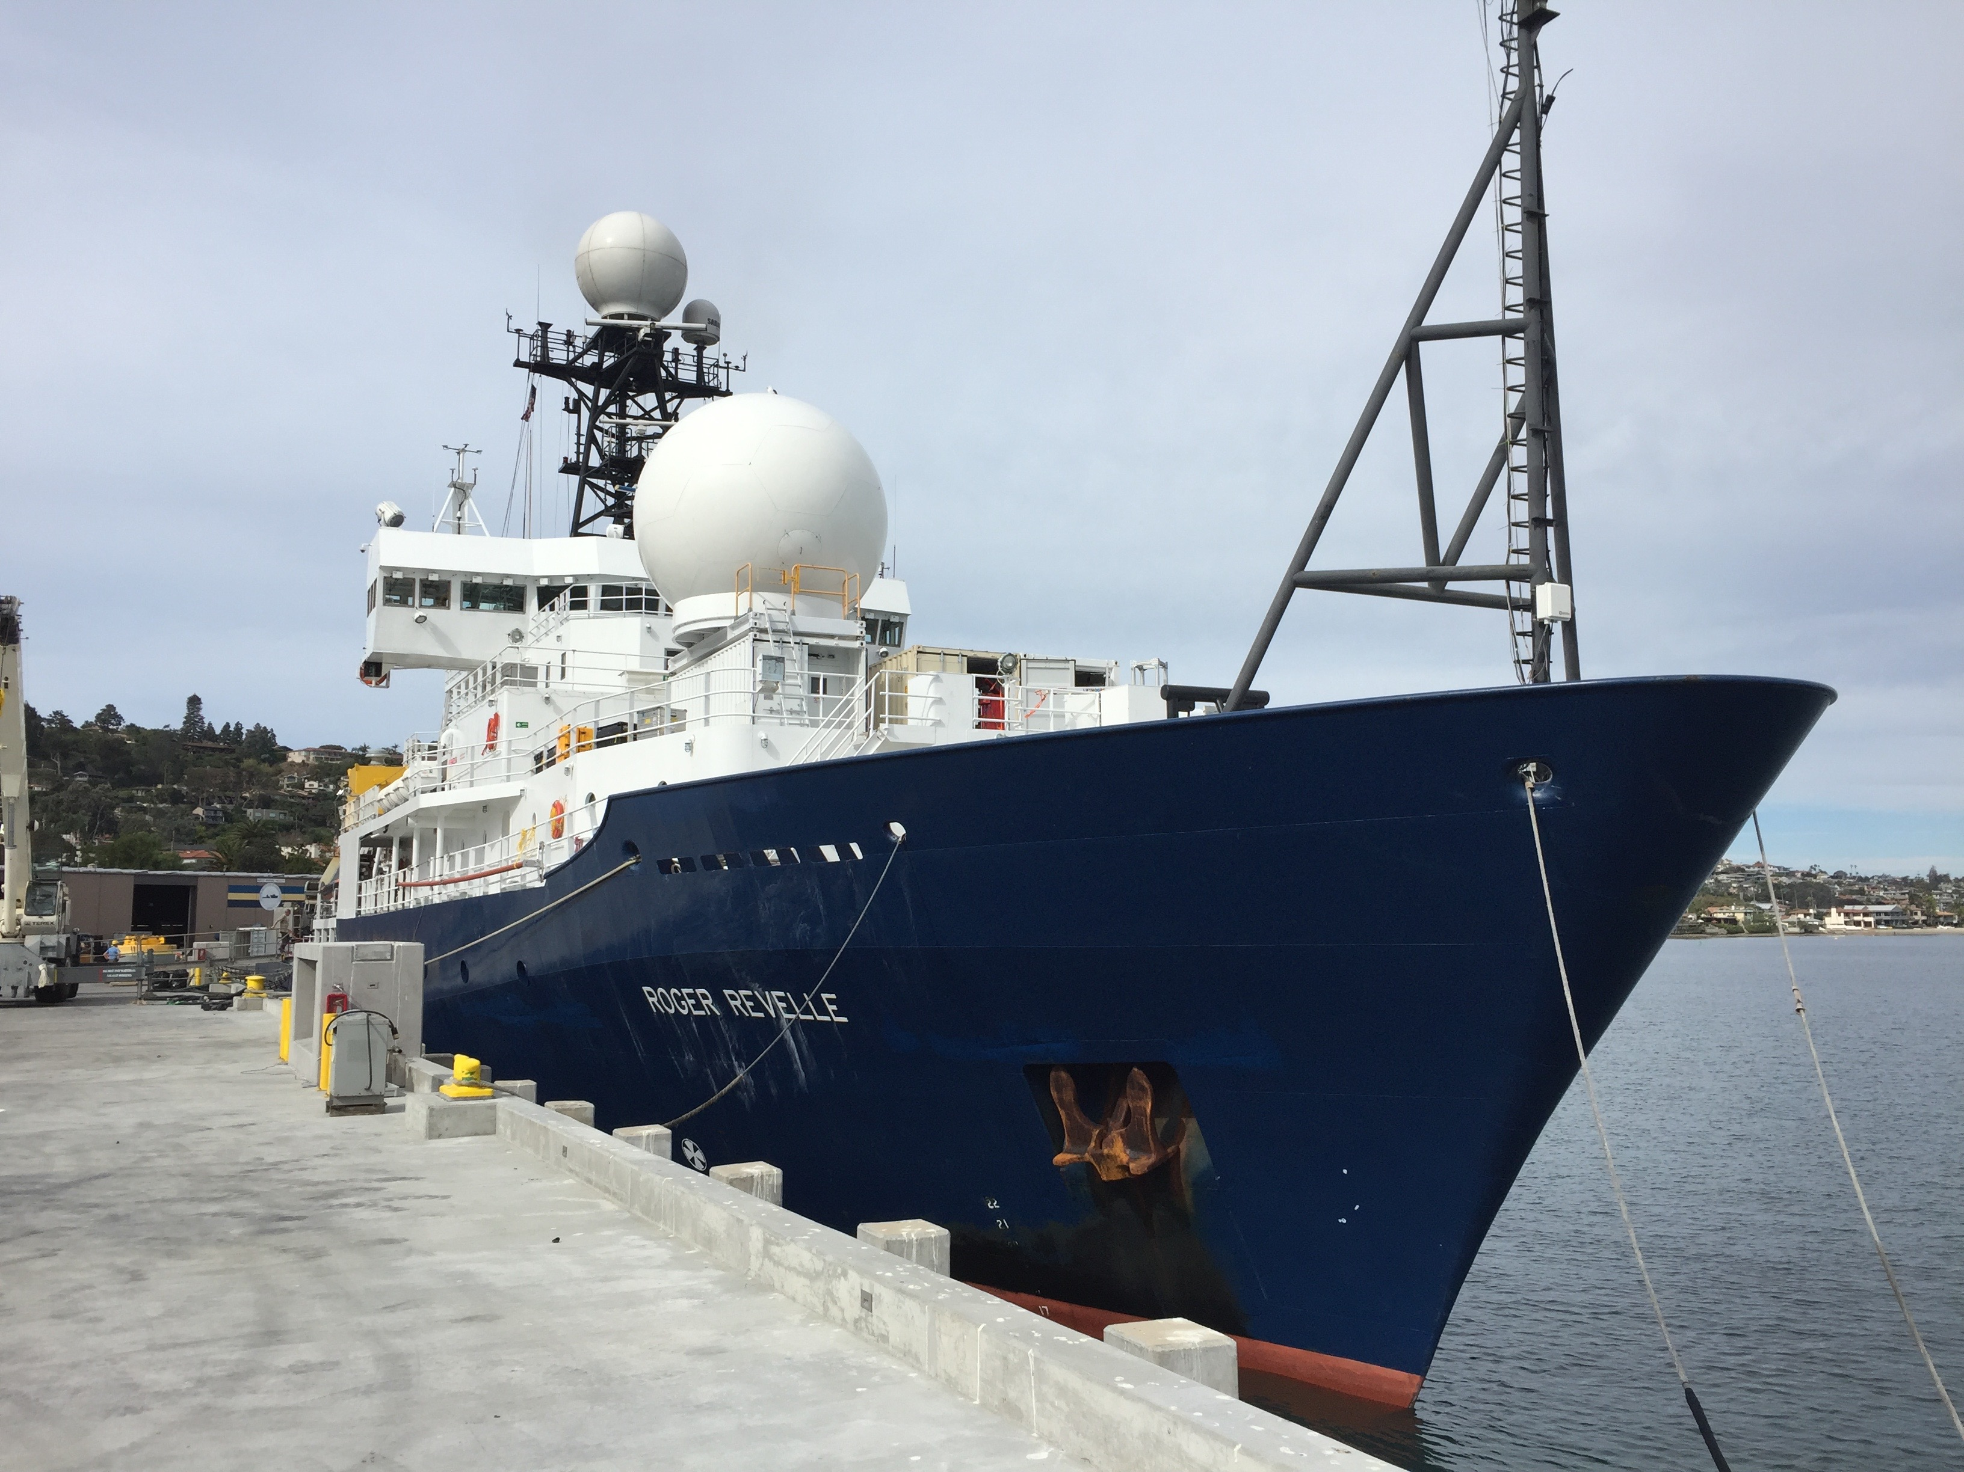
Ship-based Polarimetric Radar Observations of Convection in the E. Pacific ITCZ
Courtesy: NOAA
Steven A. Rutledge, Brody Fuchs, Jim George*, Francesc Junyent*, V. Chandrasekar*, Matt Brothers
and Weixin Xu
Department of Atmospheric Science
*Department of Electrical and Computer Engineering
Colorado State University
rutledge@atmos.colostate.edu
AMS Dave Raymond Symposium; Paper 2.4
Courtesy: S. Rutledge

Slide 2
SEA-POL (SEA-going POL-arimetric), a new asset for studying convection over the oceans…….
SEA-POL is a new, 5 cm Doppler polarimetric radar
engineered to support ship-based deployments
The radar development was made possible by NOAA’s
donation of the former R/V Ronald Brown radar to
CSU; financial support was provided by the NSF through
a MRI grant (August 2015)
SEA-POL used the transmitter and positioner (pedestal)
from the Brown’s C-band Doppler radar; all other
components were new acquisitions
SEA-POL is highly modular, using a standard sized
seatainer for housing the radar and antenna mounting
Ships in 3 seatainers for deployments
SEA-POL is a new resource for the U.S. research
community; built in response to a stated need for an
ocean-going polarimetric radar
Ronald Brown C-band radar supported KWAJEX, TEPPS, JASMINE, EPIC , VOCALS and other projects

Slide 3
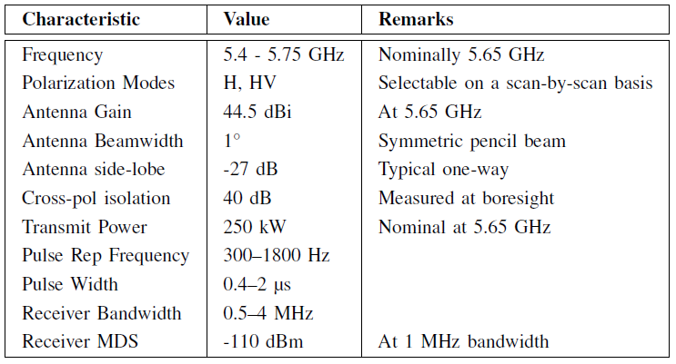
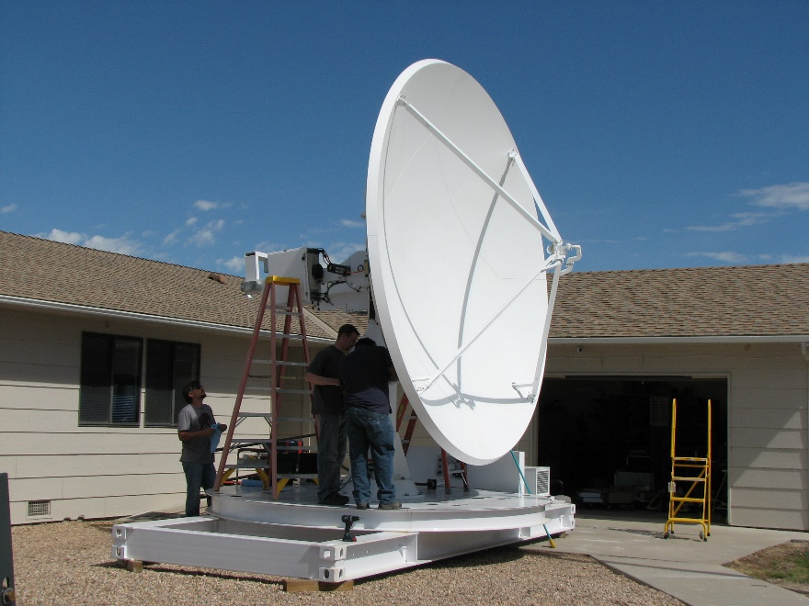
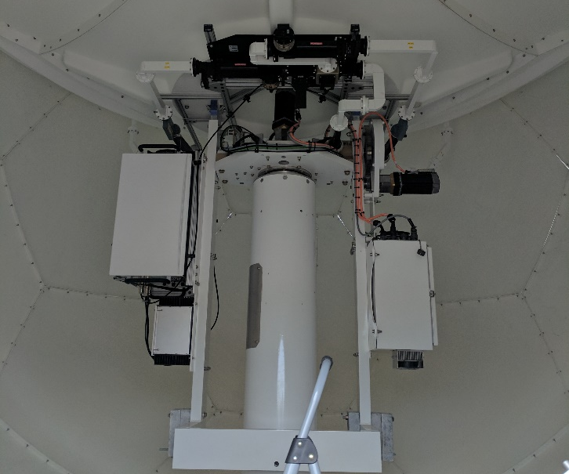
SEA-POL installed on the forward 02 deck of the R/V Roger Revelle
for the SPURS-2 deployment, Oct-Nov 2017
Provides a 240 degree scanning sector centered on bow of the ship
Very economical installation compared to mast mounted antenna
(can be operated on many different ships with ease)
Allows antenna and receiver system to be serviced at sea
Courtesy: S. Rutledge
Ship and
ground-based
operations
Courtesy: P. Kennedy
High
performance
antenna
designed for
polarimetric
observations
Antenna pedestal with receiver and
motion sensing equipment

Slide 4
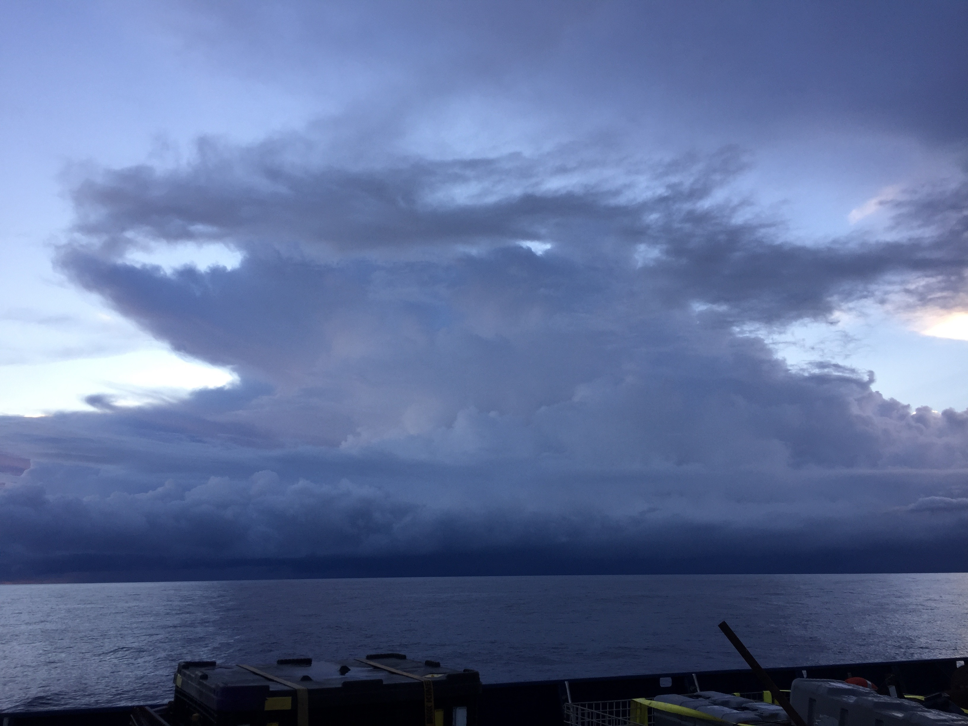
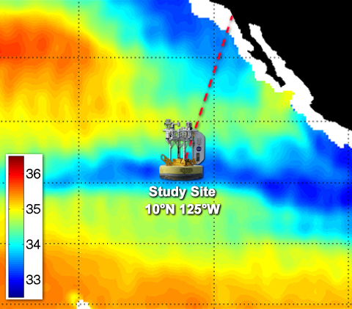
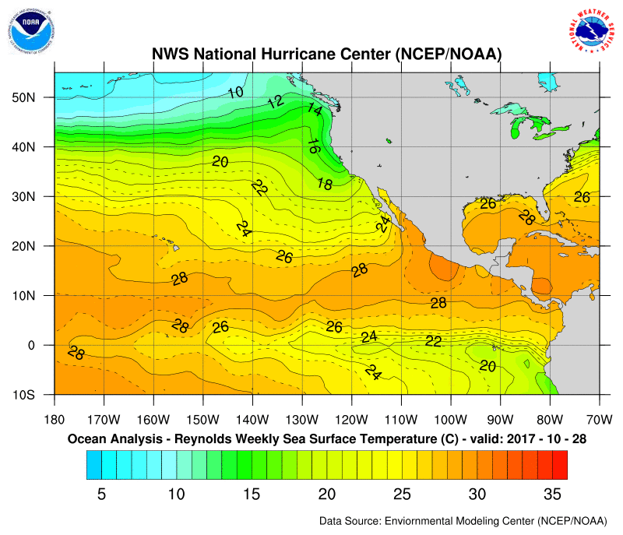
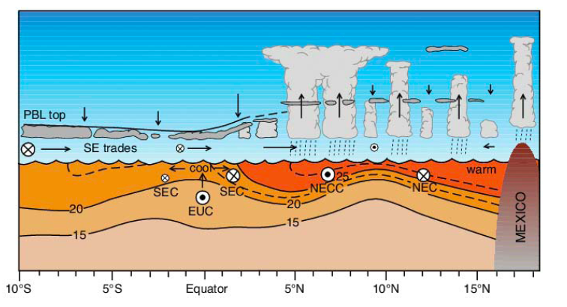
Courtesy of S. Rutledge
SPURS-2 cruise
R/V Roger Revelle
16 October – 17 November 2017
Afforded opportunity to examine radar structure of tropical convection; main emphasis in SPURS-2 was to study the fate of freshwater rain puddles on the upper ocean
Courtesy: E. Lindstrom
Raymond et al. (2004)
EPIC 2001 “line”
Center of SPURS-2 domain
TEPPS-1997
8N-125W
Tropical E. Pacific
Process Study
EPIC 2001 examined air-sea fluxes and convection
in the region of sharp cross-equatorial SST gradients

Slide 5
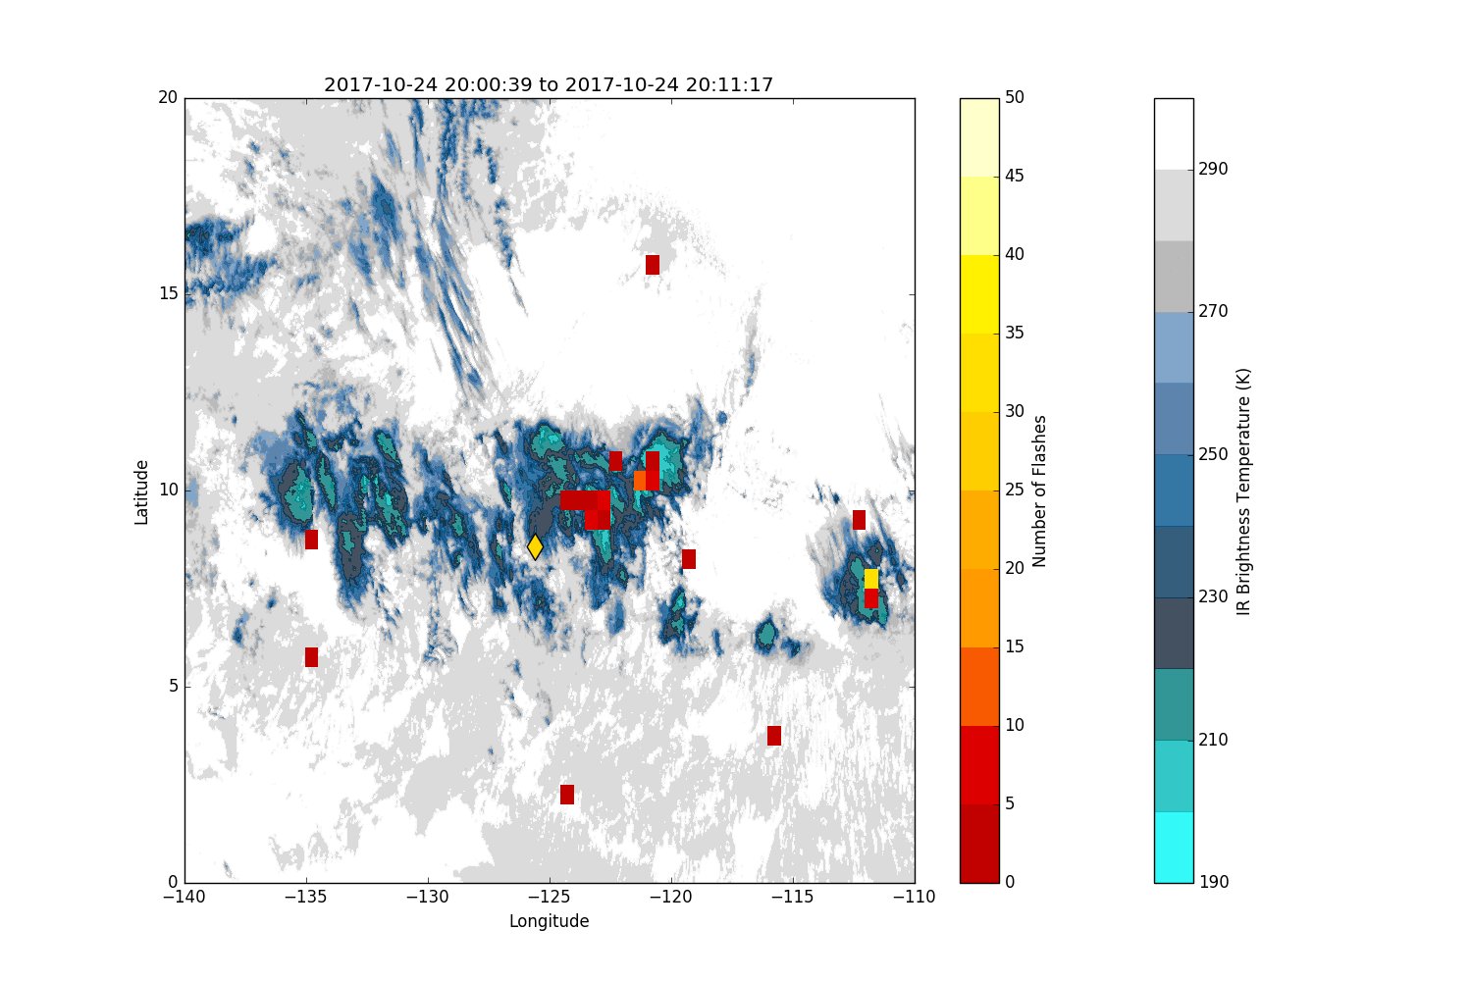
Lightning flashes from GOES-16
Geostationary Lightning Mapper
Flashes are per 15 minute intervals
Generally lightning is co-located with
cold cloud; some spurious flashes in areas
with no cold cloud; appear to be confined
to daylight hours
Satellite based lightning observations
useful for locating intense oceanic
convection

Slide 6
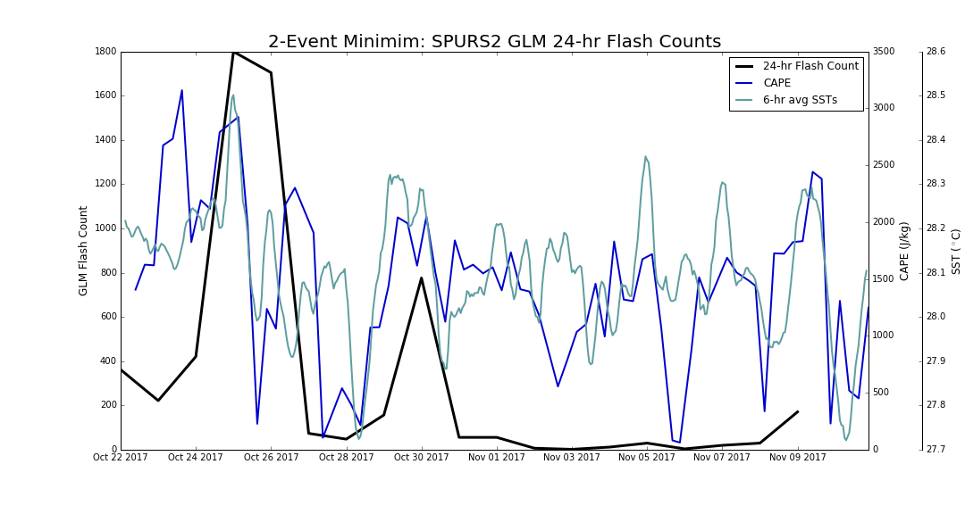
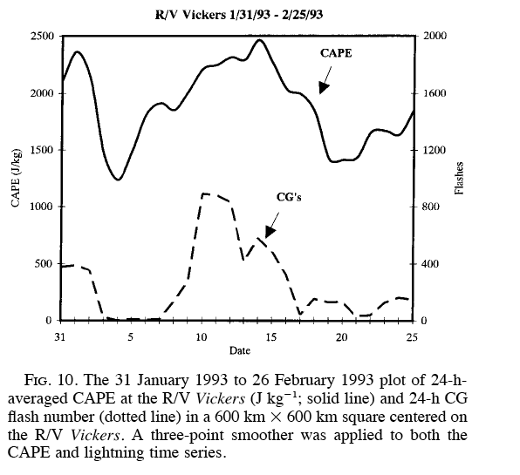
Take a look at flash rate and CAPE….
SPURS CAPE, SST time series
CAPE computed from 4 per day
soundings from R/V Roger Revelle
GLM lightning for 5x5 deg box
centered on the Revelle
Lightning for CAPE exceeding
1500 J/kg
> 1500 J/kg
Similar behavior seen in TOGA COARE
Radar observations
(shown later)
Radar observations
(shown later)
Petersen, Rutledge and Orville (1996)
TOGA COARE, W. Pacific Warm Pool

Slide 7
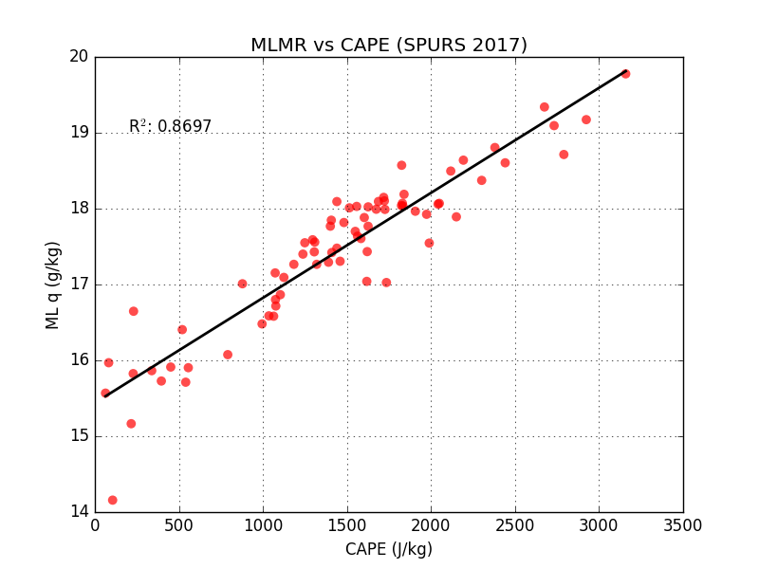
TOGA COARE
SPURS-2
SPURS-2 2017
Petersen (1997)
Relationship between MLMR (g/kg) and CAPE (J/kg) very close between W. and E. tropical Pacific; reflects
underlying SST’s, which are similar in the two basins
Emphasizes relationship between BL moisture and CAPE and therefore, convective intensity
Boundary layer moisture varies with large scale moisture convergence
Locus of lightning flashes centered on peak in moisture convergence
Petersen (1997)
Petersen, Rutledge
and Orville (1996)

Slide 8
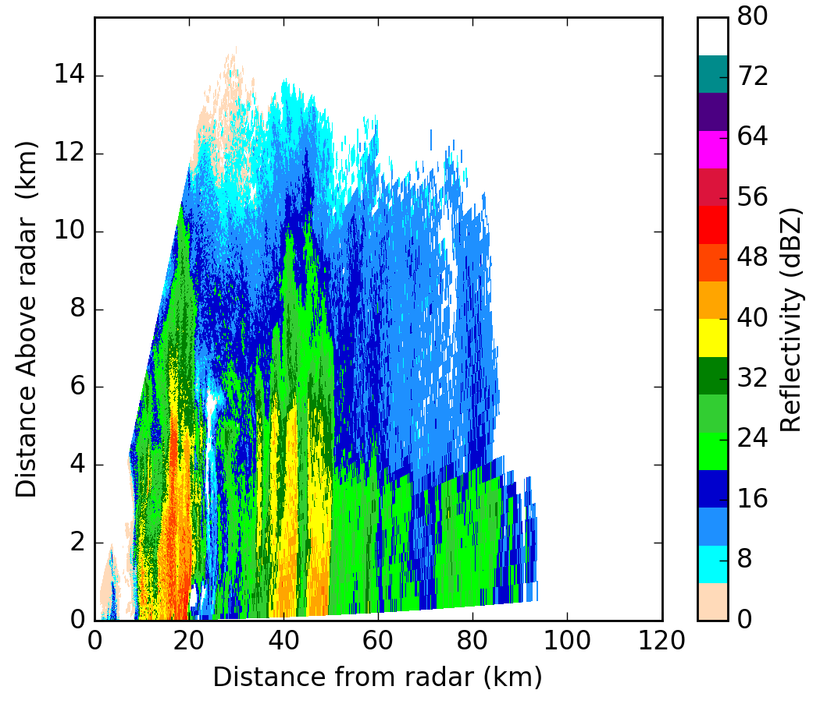
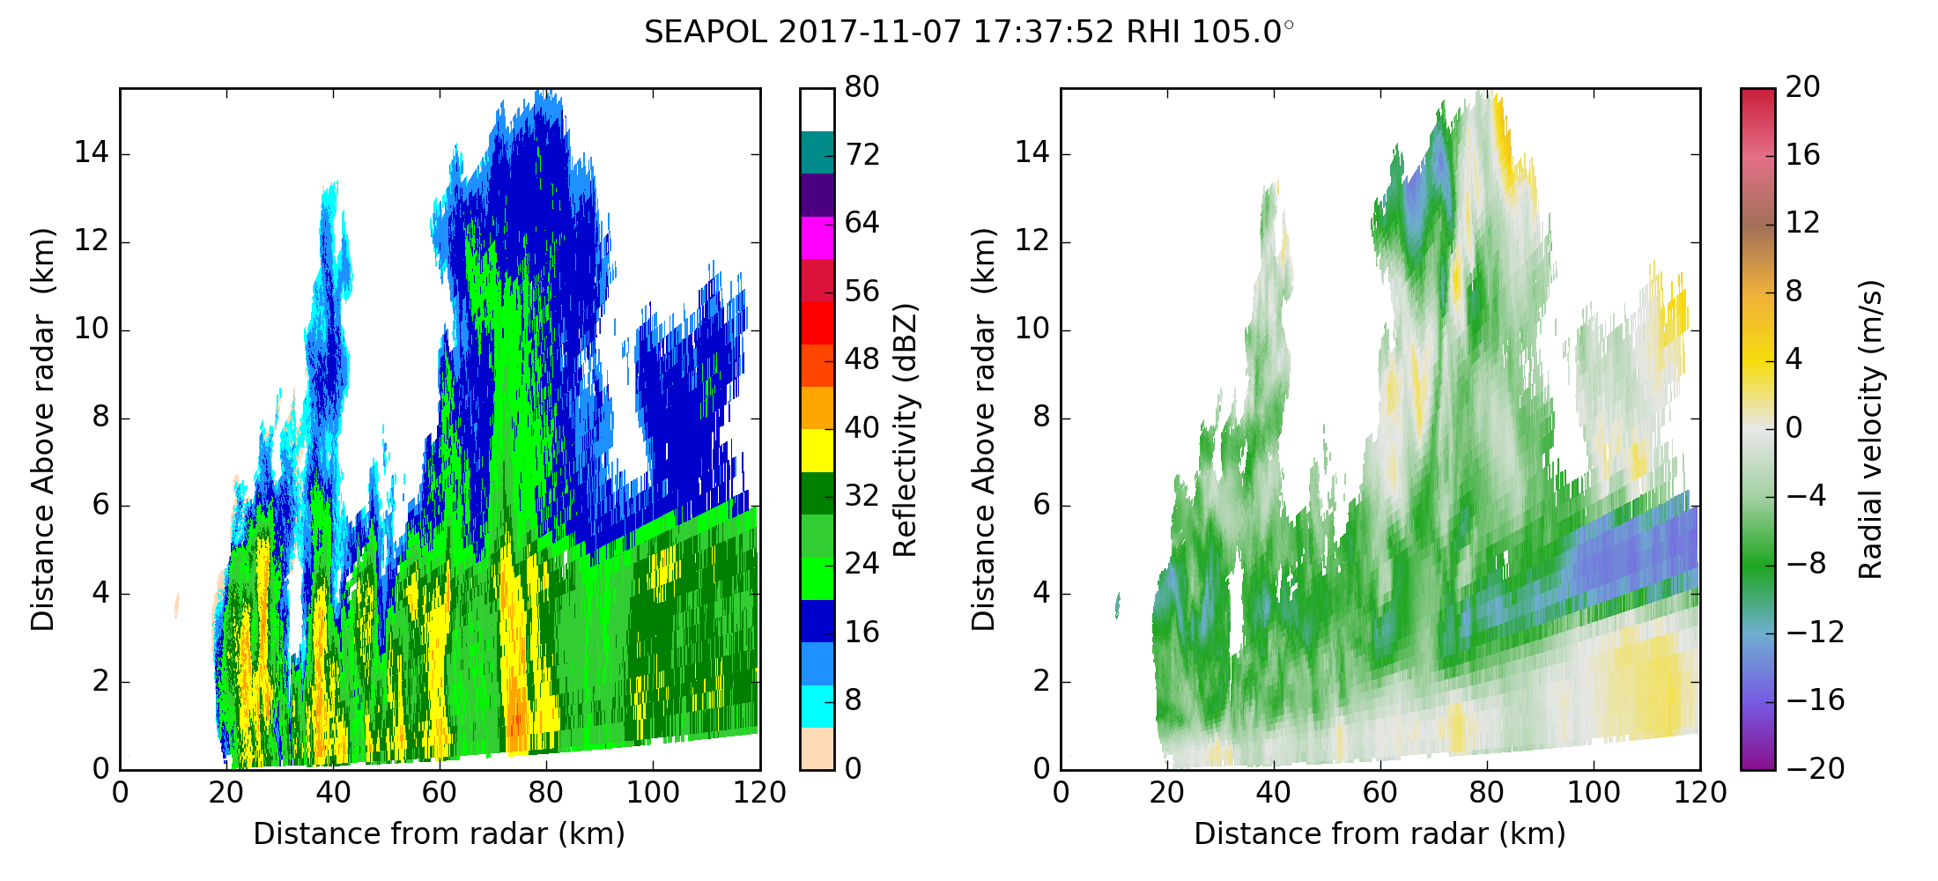
0332 UTC; 25 October 2017
Lightning is probable when 35 dBZ extends to
-10°C or colder (6 km from 0300 Z sounding;
2500 J/kg CAPE); mixed phase microphysics at work
Lightning producing example
Higher CAPE values leads to sufficient vertical motions
to loft raindrops into mixed phase region (Zipser and Lutz, 1994)
Non-lightning example
CAPE < 750 J/kg

Slide 9
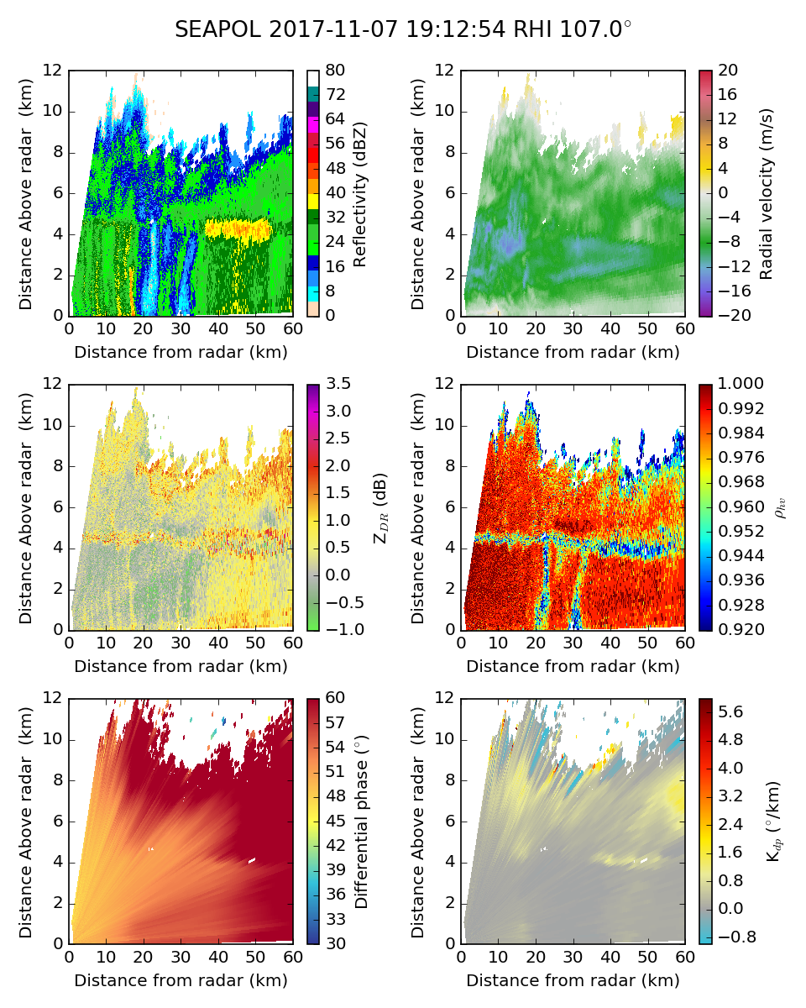
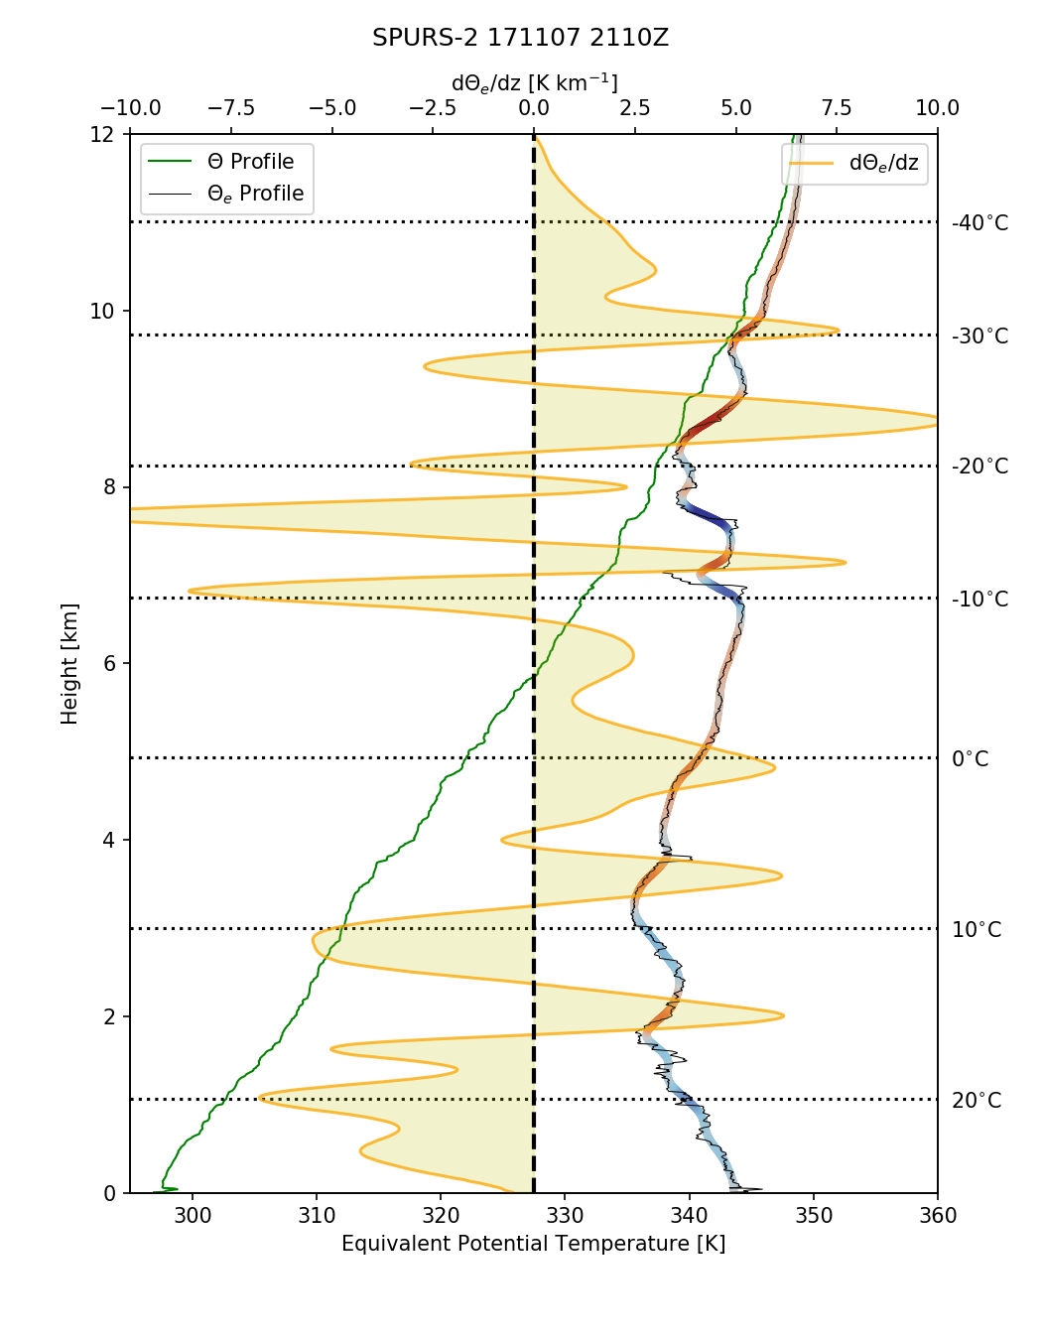
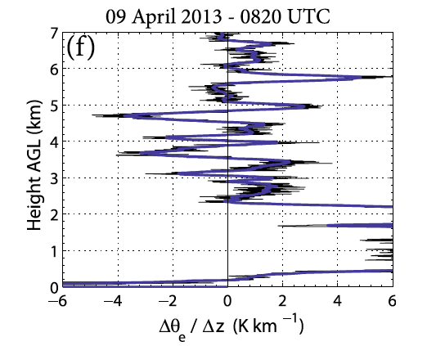
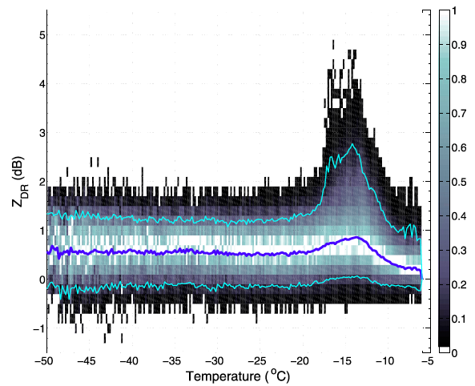
-15°C
Positive Zdr (differential reflectivity)
aloft due to dendritic crystal growth
Do these generating cell-like features contribute to stratiform precipitation?
Is this a rare or common feature?
Kumjian et al. (2014)
Winter storms in Colorado

Slide 10
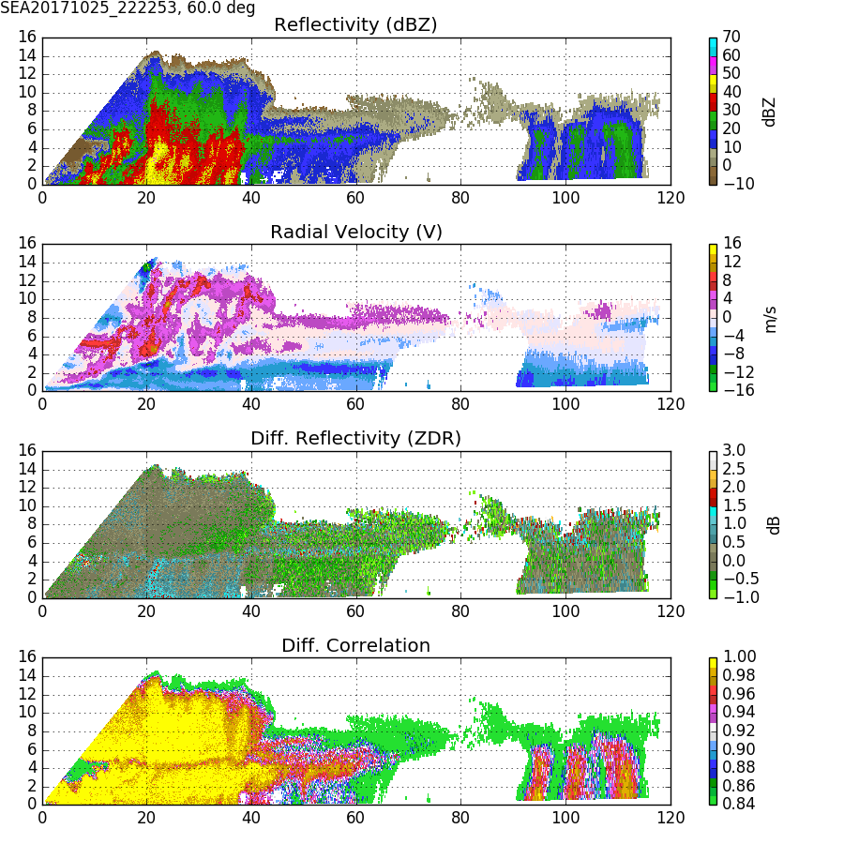
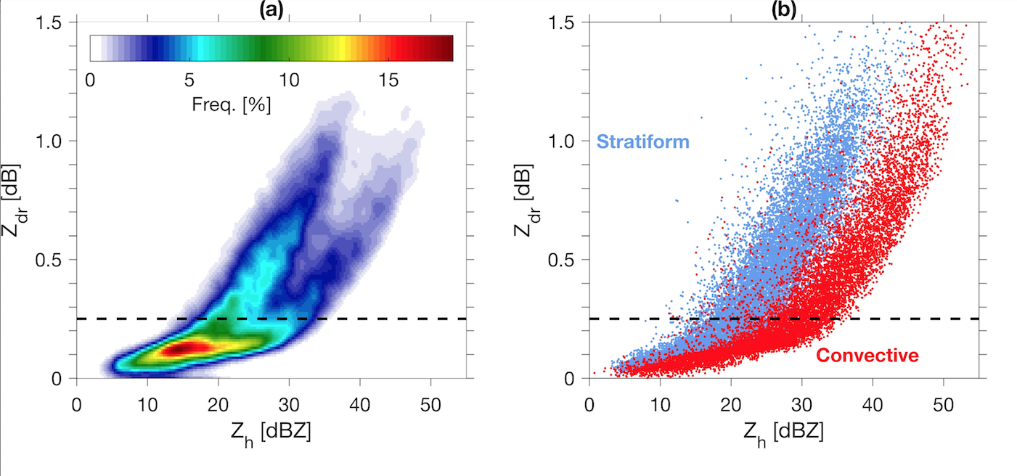
Thompson et al. (2018) JAMC
Gust-front triggered convection has moderate
reflectivity Z and near zero differential reflectivity Zdr;
high concentrations of small drops
Dissipating convection has moderate Z and positive Zdr
due to larger oblate drops; convection often transitioned
to stratiform-like echo with well defined bright band

Slide 11
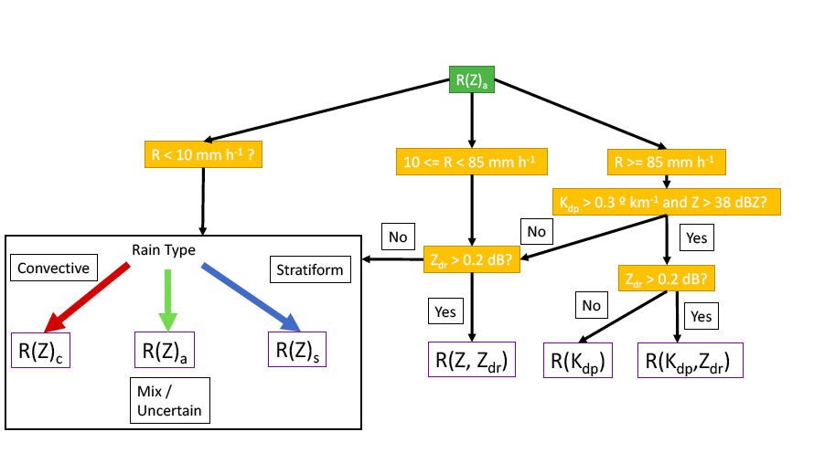
Polarimetric data improves rainfall estimation
CSU Blended Rainfall Algorithm
Follows Thompson et al. (2018) JAMC
Real time rain estimates used to identify fresh water puddles for study of
near surface salinity

Slide 12
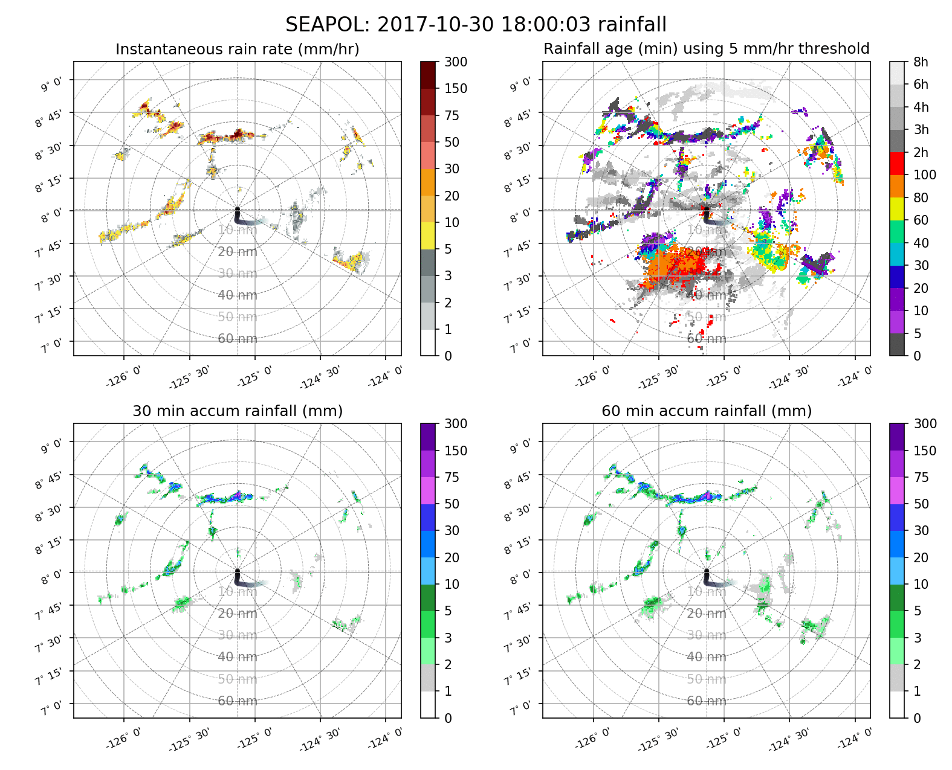

Slide 13
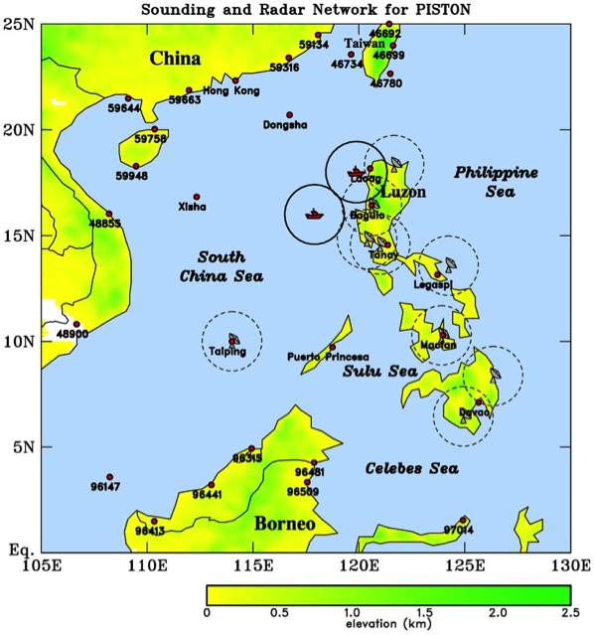
Propagation of Intra-seasonal Tropical Oscillation (PISTON)
“The 2018 PISTON field (August-October) campaign aims to better understand the multiscale, air-sea, and land-atmosphere interaction processes that regulate the BSISO propagation and intensity”
PISTON Experimental Design
CSU SEA-POL radar to be installed on the R/V Thomas Thompson, 8 per day soundings; 2 back to back 30 day cruises will be carried out
Notes:
It is not clear what the actual sounding network will be, or even if we will have a network. All we know for sure is that we will have 8 soundings per day from the ship.

Slide 14
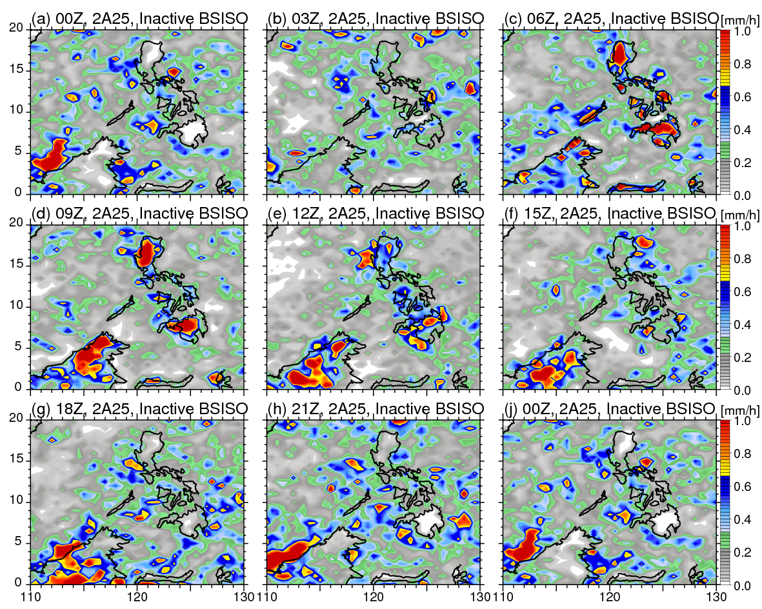
Rainfall diurnal cycle (TRMM PR): Inactive BSISO
Local time
= UTC + 8
Diurnal cycle is well defined in inactive phases:
--Strong diurnal cycle over land, intense convection occurs in the afternoon.
--Offshore convection maximizes from midnight to early morning, similar to WMONEX. Land
breeze triggered or
gravity wave
destabilization?
Houze et al. 1981 (WMONEX)

Slide 15
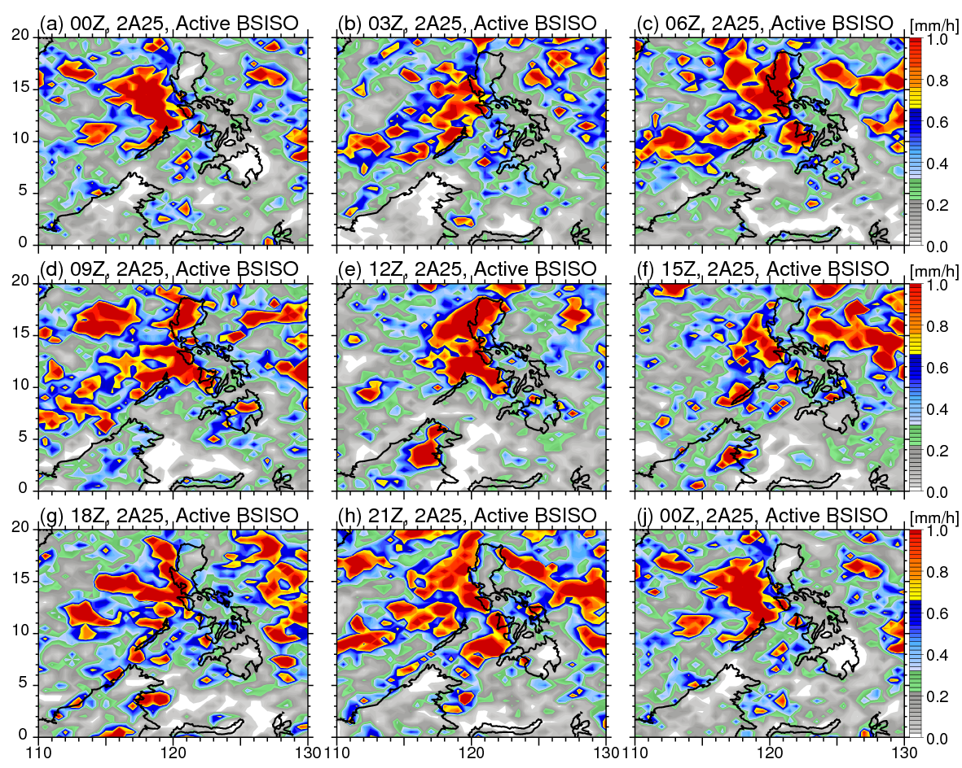
Rainfall diurnal cycle (TRMM PR): Active BSISO
Active periods:
--Weak diurnal cycle over ocean
--Diurnal cycle over land is still strong
Note: cloud-shading proposed to suppress diurnal cycle over land during active phases; our analysis indicates the
diurnal cycle is clearly present.
Precipitation over
Borneo is largely
suppressed; subsidence?
Notes:
Bullet one, changed on to of. Rewrote the second bullet. Rewrote the last point.

Slide 16
Conclusions
SEA-POL is a new instrument for studying microphysics of oceanic rainfall
Large scale moisture convergence drives CAPE which in turn dictates the presence of lightning-producing convection
Convective instability and embedded convection may contribute to statiform rainfall
PISTON will study precipitation in a very complex region
Thanks to NASA and NSF for supporting the SPURS-2 deployment and to ONR for supporting PISTON

