Slide 1
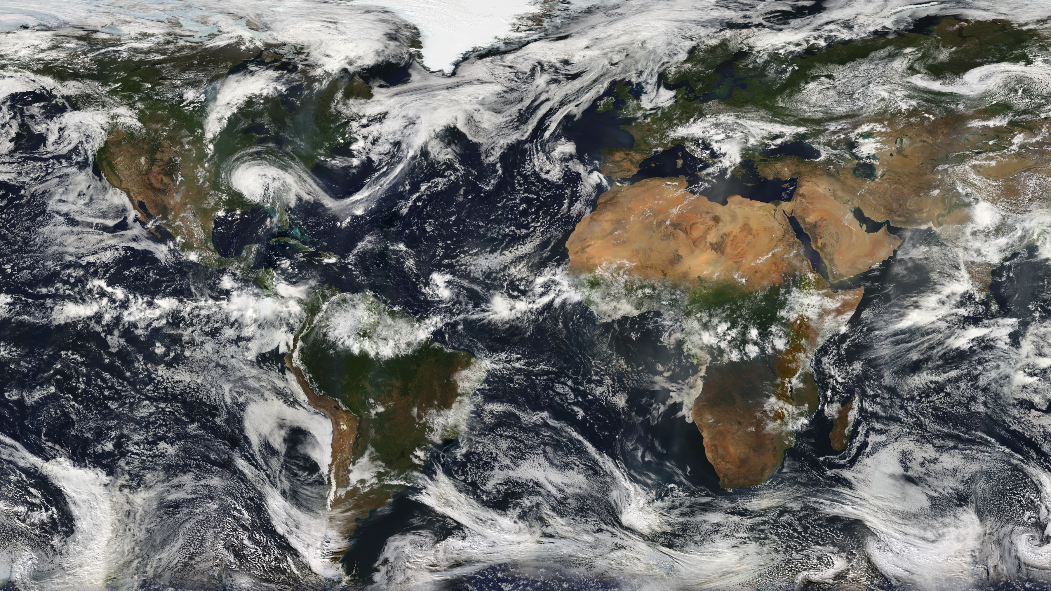

Statistics and Evaluation of Extratropical Cyclones using GPM
Steven A. Rutledge, Kristen L. Rasmussen, and Brenda Dolan
Department of Atmospheric Science, Colorado State University
2020 PMM Science Team Meeting
21 October 2020
Photo credit: NASA

Slide 2
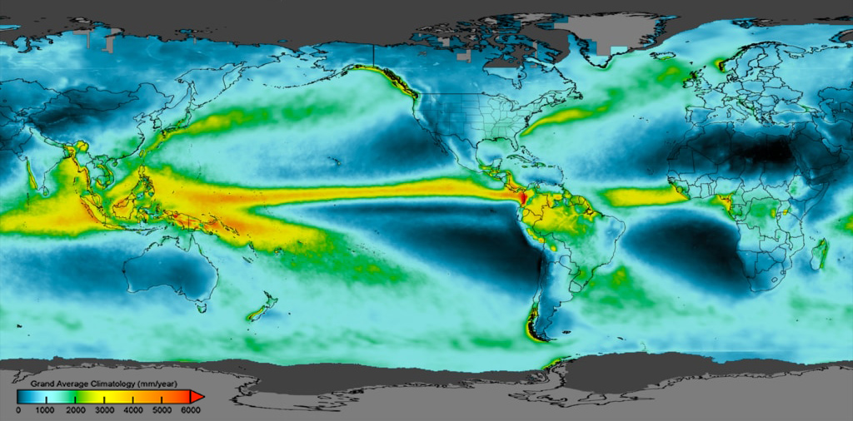
GPM IMERG Precipitation Climatology
TRMM
GPM
Courtesy: NASA PMM
Notes:
Primary reason for TRMM
Now well known from TRMM
Major features: ITCZ, SPCZ, MC, Africa, tropical S. America
NOTE ESP: Amazon and MC in DJF
Only seasonal difference is the addition of the S. Asian monsoon in summer

Slide 3
Extratropical Cyclones
However, detailed three-dimensional information regarding the frequency and structure of ETC precipitation globally was not available until the GPM era
Extratropical cyclones (ETCs) are the dominant weather feature in the mid-latitudes and are driven by thermal contrasts between the equator and poles → primary mechanism for redistributing heat and energy on Earth
The Norwegian Cyclone Model (Bjerknes and Solberg 1922) presented the earliest model of the evolution of an extratropical cyclone that is still relevant today
Many studies on extratropical cyclones have been case studies (e.g., Houze et al. 1976; Matjeka et al. 1980; Rutledge and Hobbs, 1983, 1984; Browning and Roberts 1994; Shapiro and Keyser 1990; Browning 1999; Posselt et al. 2008)
Extratropical cyclone tracking has been used in many studies (Ulbrich et al. 2009; Catto et al. 2010; Naud et al. 2013), allowing statistical sampling of ETCs.
Missing work by Browning, U. Washington, Derek Possalt, etc.
- Kristen will update today, Steve do you have any updates to this slide?
however detailed information about the nature of ETC precipitation in a large number of events over oceans and remote regions of the world was not available until the GPM era

Slide 4
Mid-latitude research opportunities with GPM
Research Objectives
Collect GPM overpasses associated with extratropical cyclones to form an ETC Precipitation Feature database
Evaluate hemispheric differences in ETC climatology and precipitation
Develop a climatology of the horizontal and vertical precipitation characteristics associated with ETCs in the Northern and Southern Hemispheres
Determine latent heating profiles for various ETC phases (pre-frontal, post-frontal, etc.)

Slide 5
Methodology
Use the Precipitation Feature (PF) database (GPM DPR observations; http://atmos.tamucc.edu/trmm/data/) with collocated ERA-Interim reanalysis profile (Courtesy Chuntao Liu)
Identify thresholds associated with extratropical cyclone environments based on the extratropical cyclone atlas (Dacre et al. 2012)
  500-hPa geopotential heights < threshold (i.e., 5100-5900 m)
  850-hPa geopotential heights < threshold (i.e., 1100-1500 m)
Include PFs that have the following characteristics:
  PFs greater than 5 contiguous pixels
  Northern Hemisphere: 30º to 65º N, September through April
  Southern Hemisphere: 30º to 65º S, March through October
Compare to climatological sea surface temperatures (SSTs)
  GPM era (2014-2019) and long term mean SST climatology (1971-2000)
  NOAA Optimum Interpolation (OI) SST V2 dataset

Slide 6
Results
Photo credit: NASA

Slide 7
Number of ETCs observations by GPM
500-hPa geopotential height thresholds
< 5900 m < 5500 m < 5100 m
N.H. 1,175,291 768,062 88,608
S. H. 1,713,706 1,327,620 522,970
Ratio 0.68 (59%) 0.58 (63%) 0.17 (86%)

Slide 8
Comparison of N. and S. Hemisphere ETCs
Monthly distribution of ETC observations (< 5500 threshold)

Slide 9
Comparison of N. and S. Hemisphere ETCs
Latitude distribution of ETC observations (< 5500m height threshold)

Slide 10
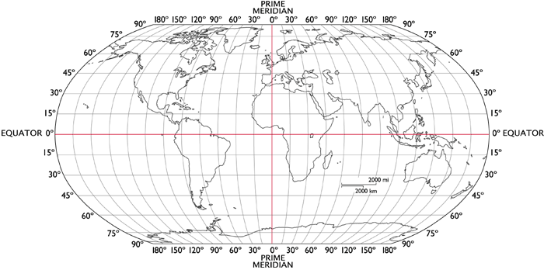
Comparison of N. and S. Hemisphere ETCs
Longitude distribution of ETC observations (< 5500 m height threshold)

Slide 11
Distribution of Northern Hemisphere ETC observations
Relative frequency of PFs associated with ETCs
(a) ETC frequency with < 5900 m 500-hPa geopotential heights
(b) ETC frequency with < 5500 m 500-hPa geopotential heights
(c) ETC frequency with < 5100 m 500-hPa geopotential heights
Climatological sea surface temperatures (ºC)
500 hPa geopotential height thresholds

Slide 12
Results for 850 mb
(a) ETC frequency with < 1500 m 850-hPa geopotential heights
(b) ETC frequency with < 1300 m 850-hPa geopotential heights
(c) ETC frequency with < 1100 m 850-hPa geopotential heights
Climatological sea surface temperatures (ºC)
850 hPa geopotential height thresholds

Slide 13
Distribution of Southern Hemisphere ETC observations
Relative frequency of PFs associated with ETCs
(a) ETC frequency with < 5900 m 500-hPa geopotential heights
(b) ETC frequency with < 5500 m 500-hPa geopotential heights
(c) ETC frequency with < 5100 m 500-hPa geopotential heights
Climatological sea surface temperatures (ºC)
500 hPa geopotential height thresholds

Slide 14
Results at 850 mb
(a) ETC frequency with < 1500 m 850-hPa geopotential heights
(b) ETC frequency with < 1300 m 850-hPa geopotential heights
(c) ETC frequency with < 1100 m 850-hPa geopotential heights
Climatological sea surface temperatures (ºC)
850 hPa geopotential height thresholds

Slide 15
ETC peak months in N. and S. Hemispheres
500 hPa geopotential heights < 5900 m threshold
(a) ETC frequency with < 5900 m 500-hPa geopotential heights - DECEMBER
(b) ETC frequency with < 5900 m 500-hPa geopotential heights - JULY
Climatological sea surface temperatures (ºC)

Slide 16
ETC peak months in N. and S. Hemispheres
500 hPa geopotential heights < 5100 m threshold (deep troughs)
(a) ETC frequency with < 5100 m 500-hPa geopotential heights - DECEMBER
(b) ETC frequency with < 5100 m 500-hPa geopotential heights - JULY
Climatological sea surface temperatures (ºC)

Slide 17
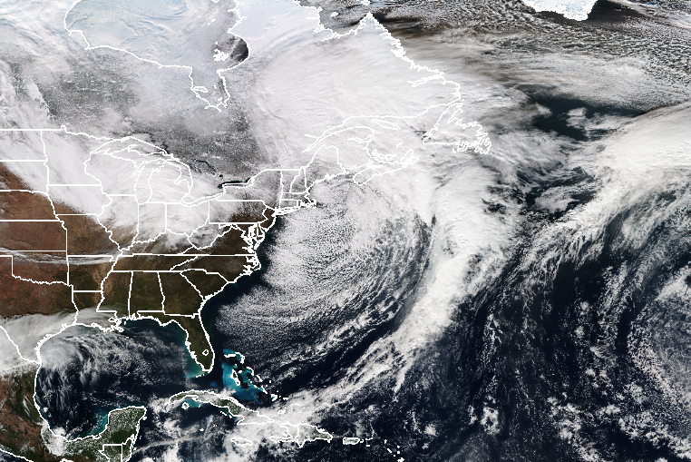
North Atlantic GPM Overpass: CASE 1
Example GPM ETC overpasses were selected based on the highest volumetric rainfall (Ku band)
Volumetric rain: 1,327,900 kg s⁻¹
500-hPa geopotential height:
850-hPa geopotential height:
Courtesy: NOAA NESDIS

Slide 18
North Atlantic GPM Overpass: CASE 1
Example GPM ETC overpasses were selected based on the highest volumetric rainfall (Ku band)
20171213 0203 UTC
Warm frontal ETC precipitation
Volumetric rain: 1,327,900 kg s⁻¹
500-hPa geopotential height: 5465 m
850-hPa geopotential height: 1312 m

Slide 19
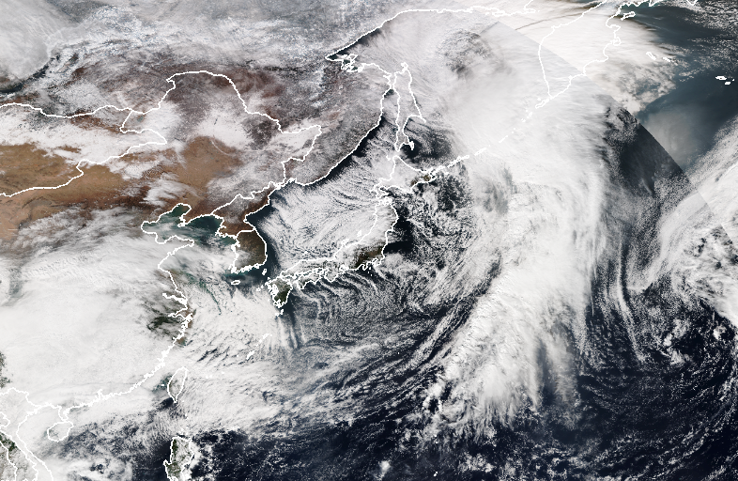
North Pacific GPM Overpass: CASE 2
Example GPM ETC overpasses were selected based on the highest volumetric rainfall (Ku band)
Volumetric rain: 1,327,900 kg s⁻¹
500-hPa geopotential height:
850-hPa geopotential height:
Japan
Courtesy: NOAA NESDIS

Slide 20
North Pacific GPM Overpass: CASE 2
Example GPM ETC overpasses were selected based on the highest volumetric rainfall (Ku band)
20171118 1926 UTC
Cold frontal ETC precipitation
Volumetric rain: 983,740 kg s⁻¹
500-hPa geopotential height: 5461 m
850-hPa geopotential height: 1323 m

Slide 21
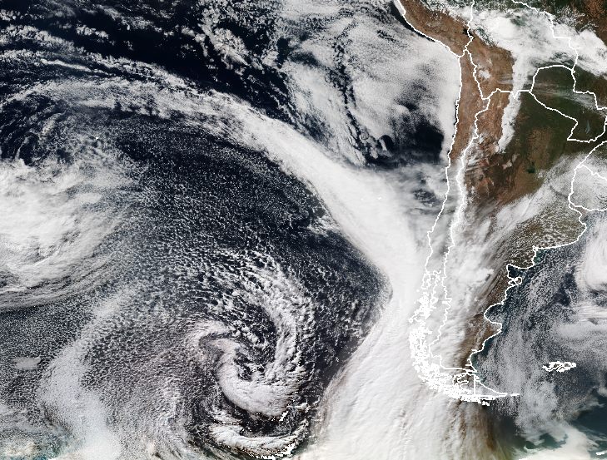
South Pacific GPM Overpass: CASE 3
Courtesy: NOAA NESDIS

Slide 22

South Pacific GPM Overpass: CASE 3
Example GPM ETC overpasses were selected based on the highest volumetric rainfall (Ku band)
20160715 2234 UTC
Cold frontal ETC precipitation (hint of a Narrow Cold Frontal Rainband; NCFR)
Volumetric rain: 1,068,600 kg s⁻¹
500-hPa geopotential height:
850-hPa geopotential height:

Slide 23
Conclusions
The Southern Hemisphere has significantly more ETCs compared to the Northern Hemisphere, primarily due to the large land regions in the N. Hemisphere and broad Southern Ocean in the S. Hemisphere
The strongest troughs and associated GPM ETC observations are located over oceans in both hemispheres
GPM identifies a variety of precipitation features associated with ETCs, including NCFRs, cold fronts, and warm fronts
ETC frequencies may be related to gradients in SSTs?

Slide 24
Comparison of Climatological SSTs
SST climatology differences to determine changes in the GPM era from the historical longterm mean
GPM era mean monthly SST (2014-2019) – longterm mean (1971-2000)
NH (September – April) & SH (March – October)
  NOAA Optimum Interpolation (OI) SST V2 dataset

Slide 25
Future Work
Examine horizontal and vertical structures of precipitating features for ETCs over the ocean, coast, and land regions
Identify phases in ETC development (i.e., Norwegian cyclone model phases) in the database
Examine the evolving latent heating profiles with ETC phase and work on improving these estimates for ETCs
Examine the vertical and horizontal structures of polar lows in the ETC database (primarily over oceans, very limited prior observations of these types of systems)

Slide 26
Questions?
Funding support: NASA PMM

Slide 27
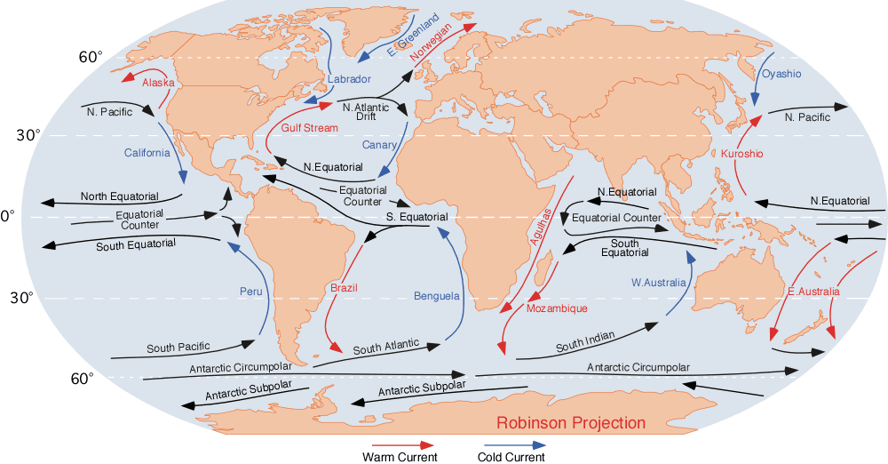
Ocean Currents
Credit: Wikipedia

