Slide 1
Global disdrometer observations and modes of rain drop-size distributions
B. Dolan, B. Fuchs, S. A. Rutledge, E. Barnes, E. Thompson
PMM Science Team Meeting
25 October 2016

Slide 2
Motivation
Knowledge of drop size distributions (DSD’s) underpins radar-based rainfall estimation and attenuation correction. DSD’s also needed for cloud models where size distributions are assumed (so-called bulk models).
Retrieval of rain rates from GPM DPR
Inherent dependence of Z-R relationships on DSD’s
DSD’s are shaped by microphysical processes
Coalescence, accretion (riming), aggregation, break-up, etc.
Characteristics of convective and stratiform precipitation
Goals:
Investigate DSD variability regionally and globally
Relate observed variability of DSD’s to precipitation physics, including convective and stratiform precipitation, and contributions from ice-based and warm rain precipitation

Slide 3
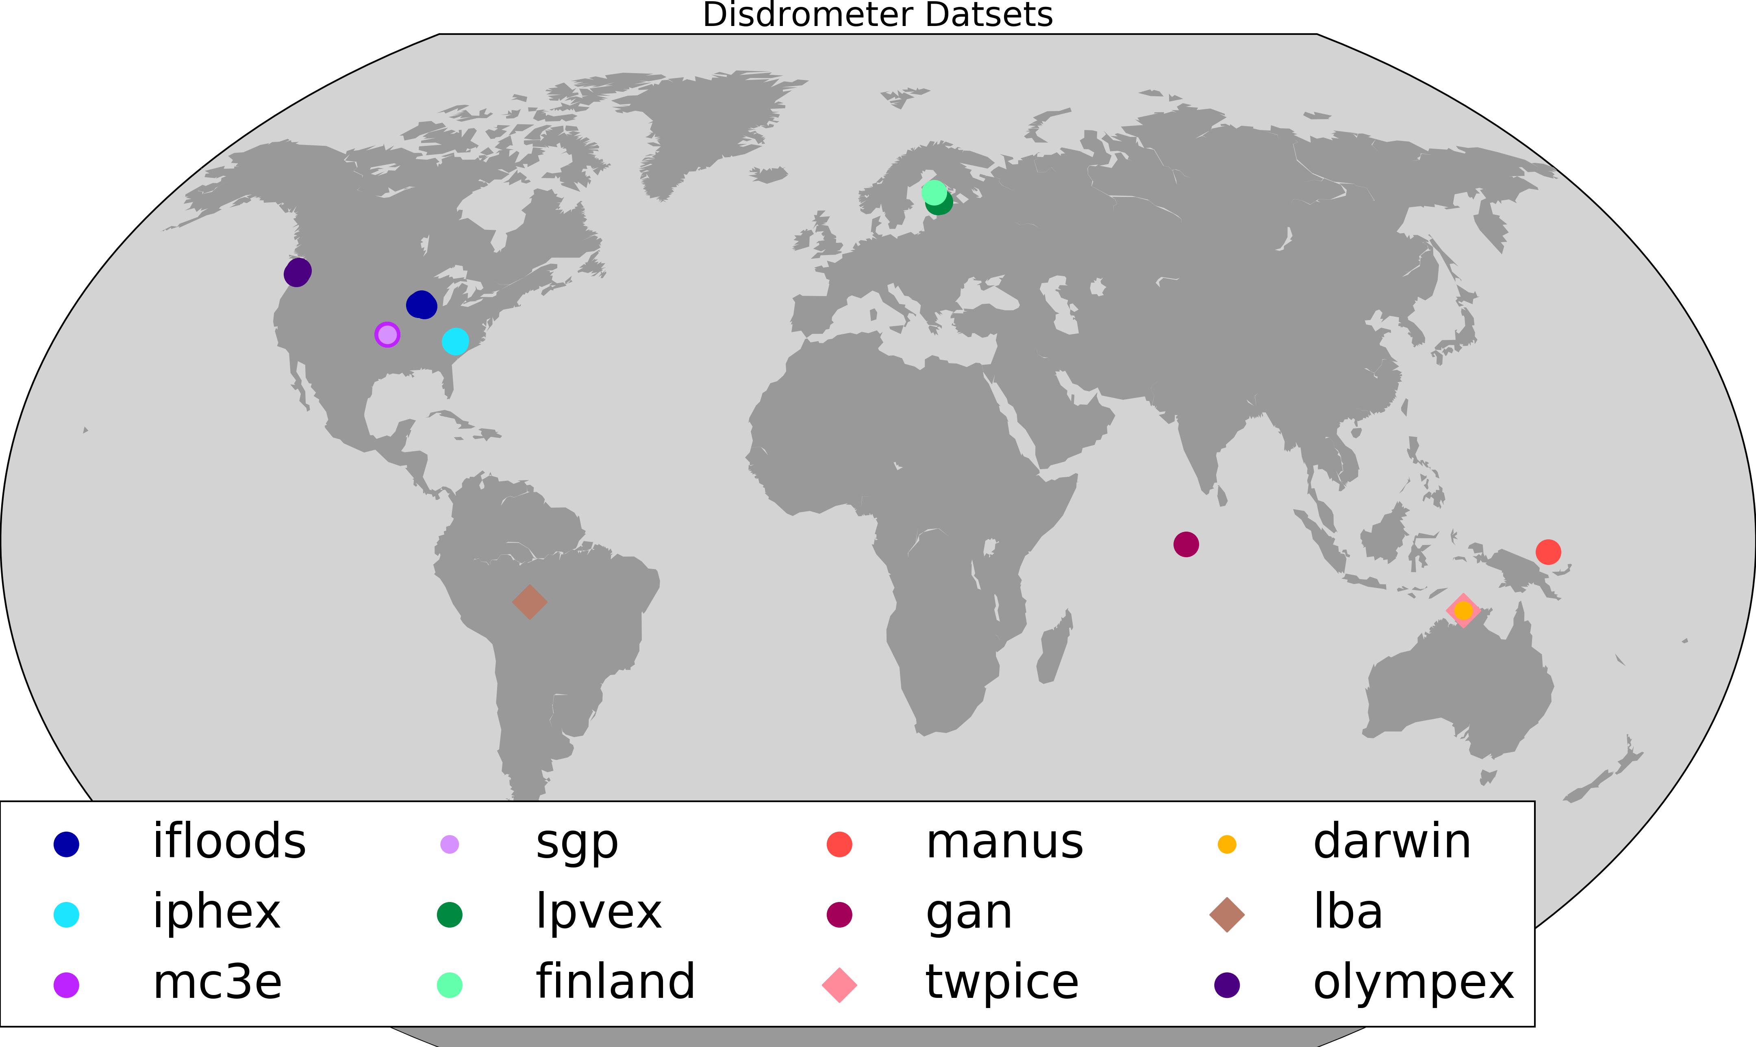
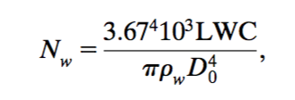
Methods
Employ 12 disdrometer datasets from around the world
Low to high latitude, continental to oceanic
6 NASA field campaigns (TRMM-LBA, LPVEx, MC3E, IFloodS, IPHEx, OLYMPEx)
6 DOE installations/campaigns [Gan, Manus, TWP-ICE, Darwin, Southern Great Plains (SGP), Finland]
Gamma DSD parameters computed including N_{w}, D₀, µ
Nearly 250,000 raining minutes included in dataset (~ 6 months of continuous rain)
N_{w}, normalized intercept parameter

Slide 4
Datasets
Name | Location | Time Frame | # raining points | # disdrometers / type
iFloods | Eastern Iowa | 6 Apr –16 Jun 2013 | 14608 | 6 2DVDs
MC3E | Central Oklahoma | 23 Apr – 1 Jun 2011 | 6043 | 5 2DVDs
SGP | Central Oklahoma | 28 Feb 2011 – 5 May 2016 | 39592 | 1 2DVD
IPHEx | Western North Carolina | 25 Apr – 16 Jun 2014 | 10718 | 5 2DVD
LPVEx | Helsinki, Finland | 9 Sept – 20 Oct 2010 | 5574 | 3 2DVD
Finland | Hyytiala, Finland | 15 Feb – 11 Sept 2014 | 13945 | 1 2DVD
Manus | Manus Island | 01 Dec 2011 – 04 Jul 2014 | 45664 | 1 2DVD
Gan | Gan Island, Maldives | 05 Oct 2011 – 06 Feb 2012 | 4348 | 1 2DVD
TWPICE | Darwin, Australia | 3 Nov 2005 – 10 Feb 2006 | 3669 | 1 JWD
Darwin | Darwin, Australia | 1 Mar 2011 – 04 Jan 2015 | 42248 | 1 2DVD
LBA | Rodonia, Brazil | 17 Jan 1999 – 3 Mar 1999 | 3100 | 1 JWD
OLYMPEX | Olympic Peninsula | 31 Oct 2015 – 16 Jan 2016 | 60091 | 3 DVDs*
Global |  |  | 249600
Valid “raining minute”:
Contains >100 drops
Rain rate > 0.05 mm hr⁻¹
-4 ≤ µ ≤ 15
Snow samples not considered

Slide 5
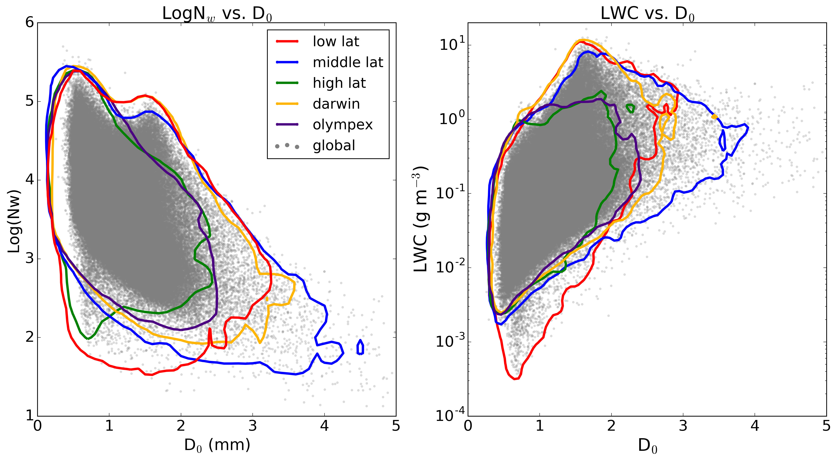
DSD parameters by latitude band
N_{w}-D₀:
Low N_{w}, large D₀ in mid-latitudes, plus Darwin “break” convection
Tropics show a double peak in D₀ at high N_{w} (return to this later). Also evident in mid-latitudes, contributed by the long SGP dataset.
D₀-LWC (g m⁻³):
Peak LWC increases from high to low latitude
Large LWC-D₀ space extends to the far right in middle latitudes
But the important questions are:
How do these DSD parameters and their moments (LWC, RR) vary together?
Accordingly, what can be said about the precipitation characteristics (convective vs. stratiform; ice based vs. warm rain)?
Notes:
This figure is really important!

Slide 6
EOF-Principal Component Analysis-used for detailed analysis
Technique to simplify the analysis of large, complex datasets
Type of cluster or pattern analysis using linear regression to explain main modes of variability
Linear regression of multiple variables simultaneously
Project data onto set of basis vectors
Resulting vectors are EOFs (empirical orthogonal functions)
EOF’s are sorted by the the amount of variability they explain in the DSD behavior
Collectively the EOFs explain the interrelationships between variables
Each EOF has a positive and negative mode (principal components)
Each raining minute data point can be described by linear combination of EOF vectors
Coefficients (principal components, PCs) are a measure of resemblance between a data point and an EOF vector
Here we examine six characteristic quantities: N_{w}, D₀, µ, LWC, RR, N_{tt}
The covariance of these six parameters is revealed

Slide 7
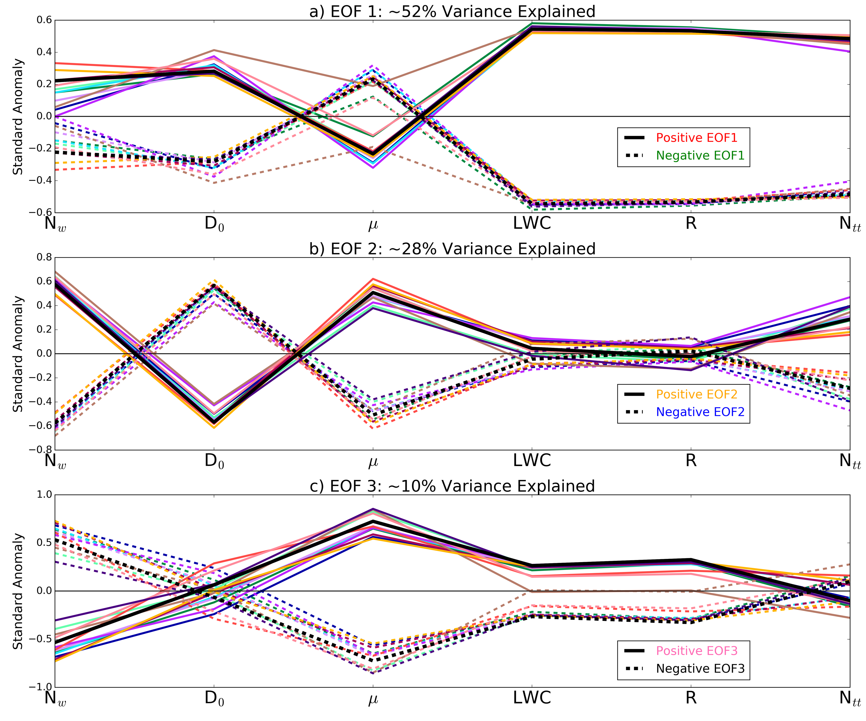
Results
There is systematic behavior of the six DSD parameters across all latitude zones
80% of the variability (or co-variance of the six parameters) explained by first two EOF’s
Experiment | EOF1 | EOF2 | EOF3 | Total
LPVEx | 46 | 25 | 14 | 86
Finland | 50 | 28 | 13 | 92
IFloodS | 51 | 32 | 11 | 94
IPHEx | 57 | 27 | 11 | 94
SGP | 51 | 28 | 11 | 90
MC3E | 51 | 32 | 10 | 93
Manus | 56 | 26 | 7 | 89
Gan | 56 | 26 | 10 | 92
Darwin | 58 | 26 | 9 | 93
TWPICE | 56 | 26 | 12 | 95
LBA | 53 | 28 | 12 | 93
OLYMPEX | 49 | 32 | 13 | 94
Global | 52 | 28 | 10 | 91
Thick black line is the entire (global) dataset

Slide 8
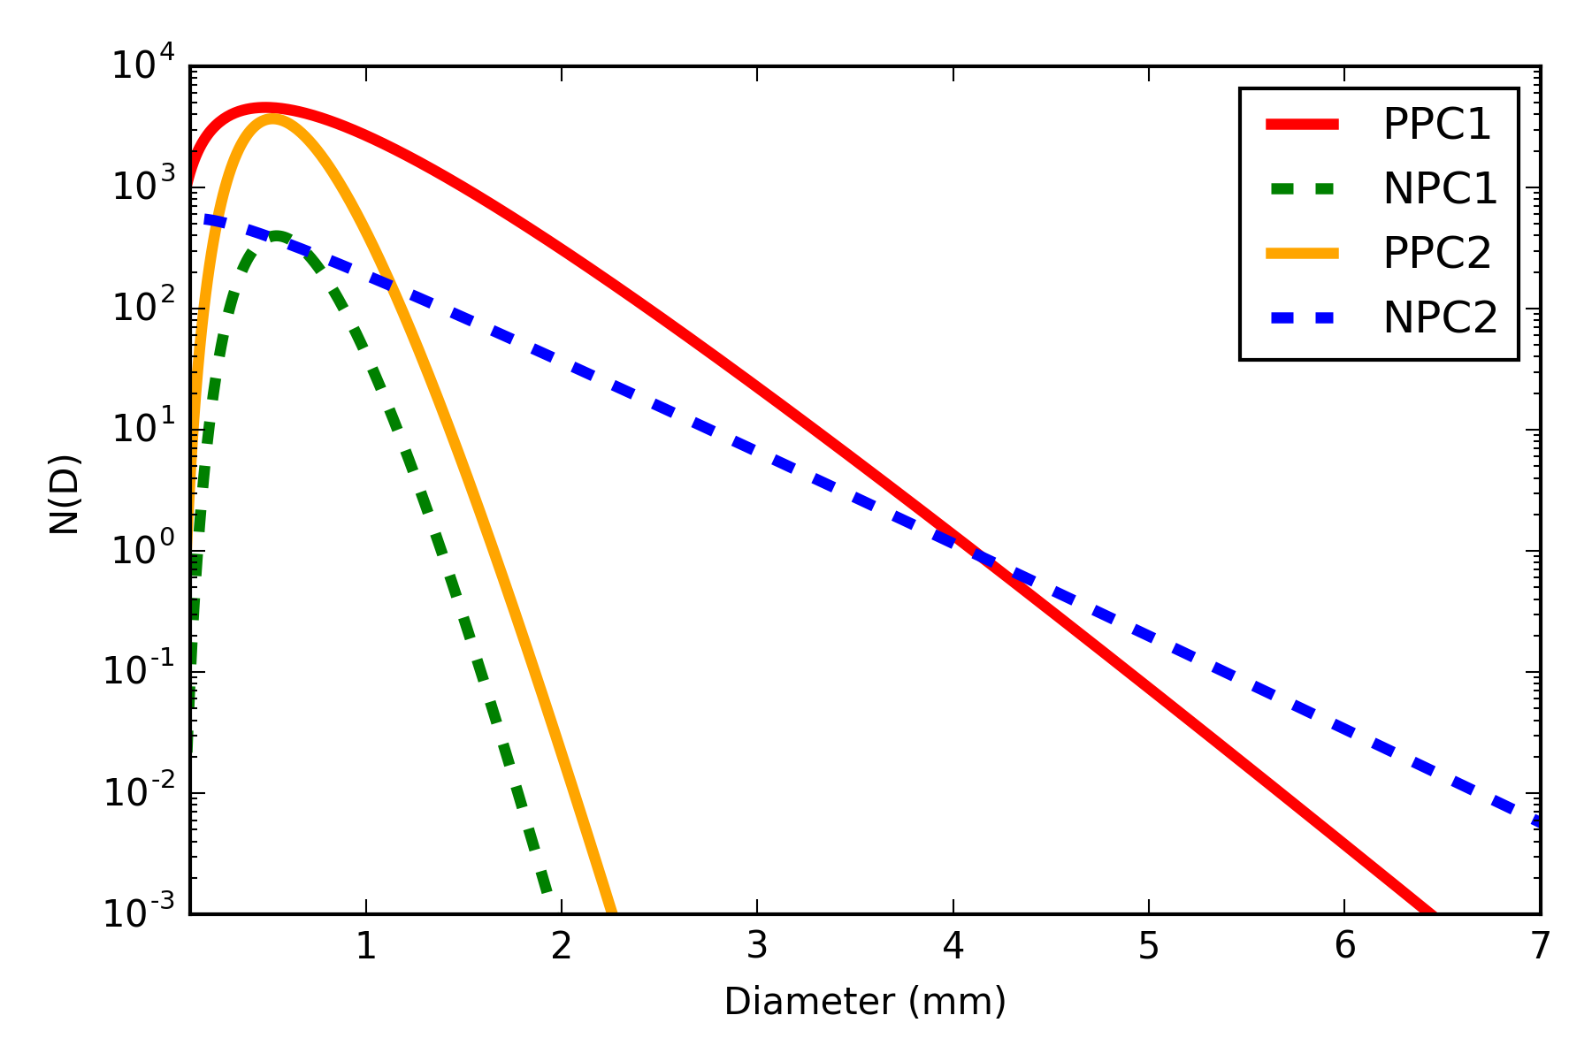
Results—mean DSDs for PC1, PC2
Gather all DSDs that follow the co-variance represented by the individual PC modes and average the data to get mean DSDs. Regional PC’s are normalized by the global dataset to afford an apples to apples comparison.
These are the mean DSDs that fall out of the first 2 EOF’s.
Are these DSD’s associated with specific microphysical processes like convective vs. stratiform rain, ice-based vs. warm rain?
Examine snapshots of radar data along with N_{w}, D₀ pairs.
Notes:
EOFs are normalized by the global dataset for apples-to-apples comparisons
PC thresholds are arbitrary, but we selected them to have clear separation between modes (1.5 for all but NPC1 = -0.5)

Slide 9
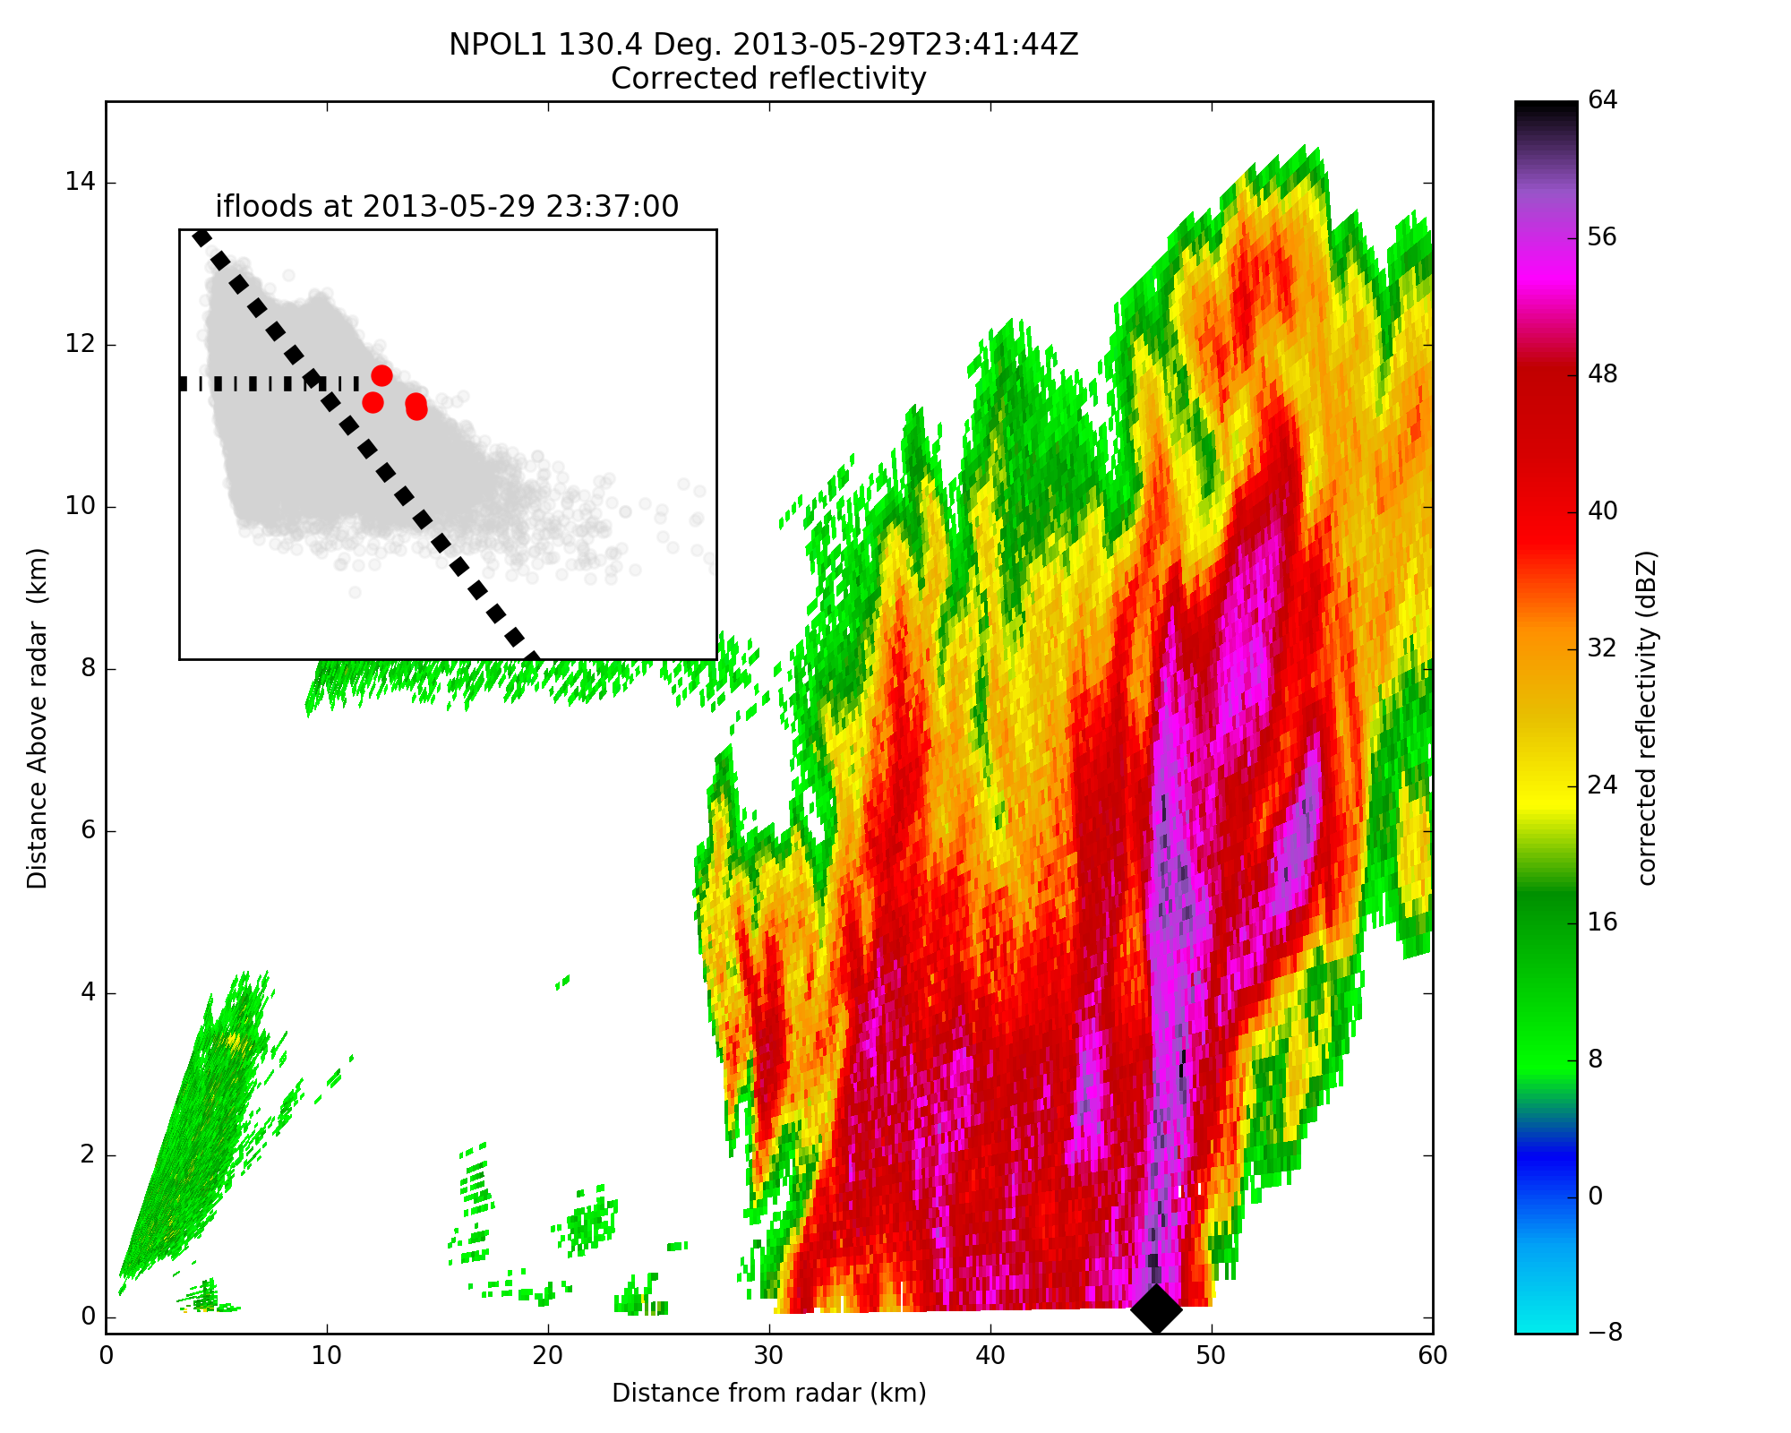
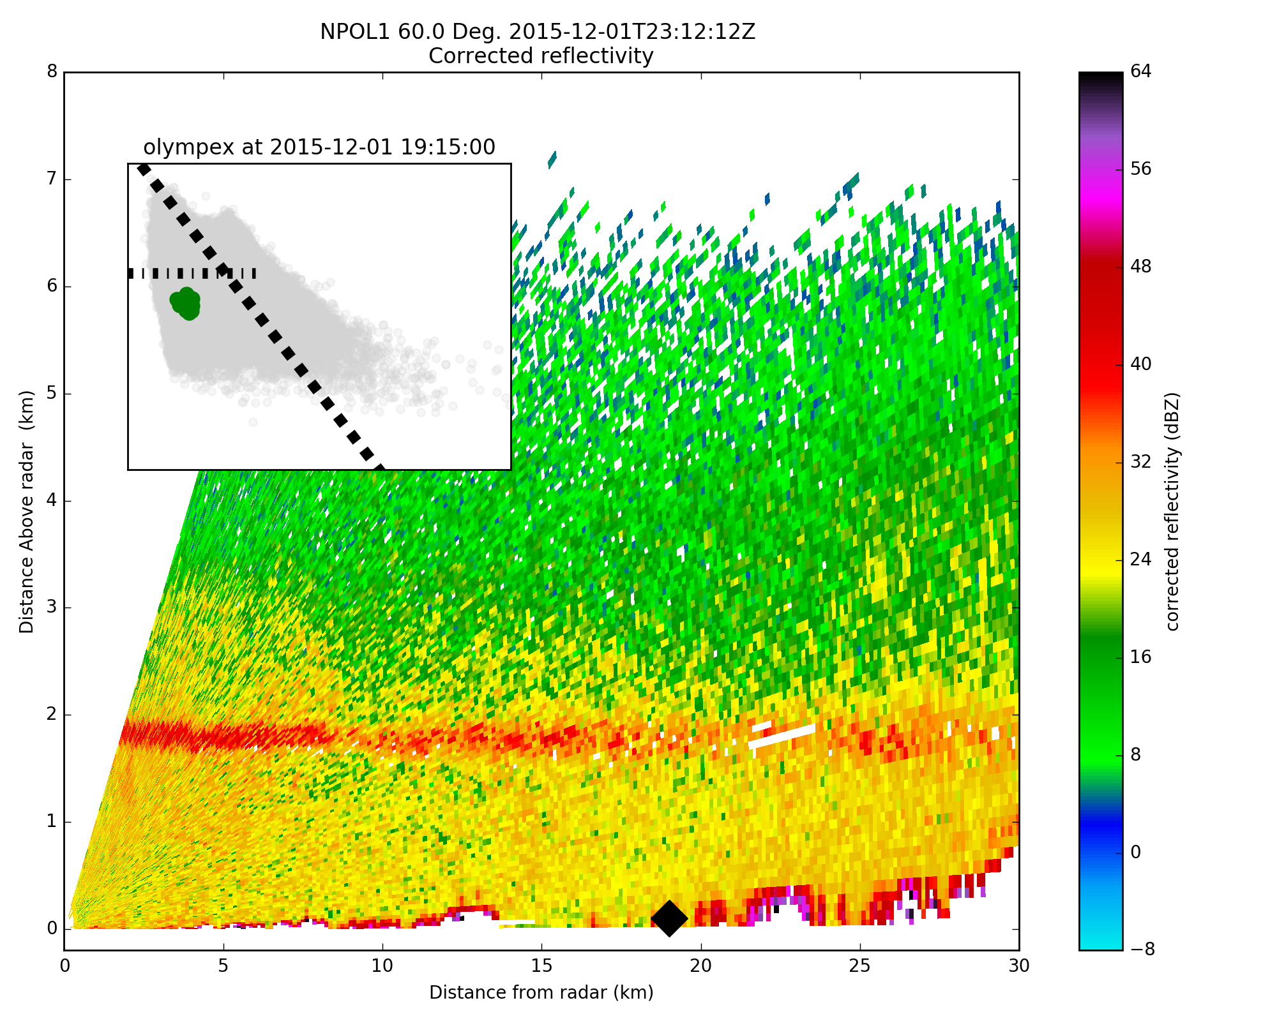
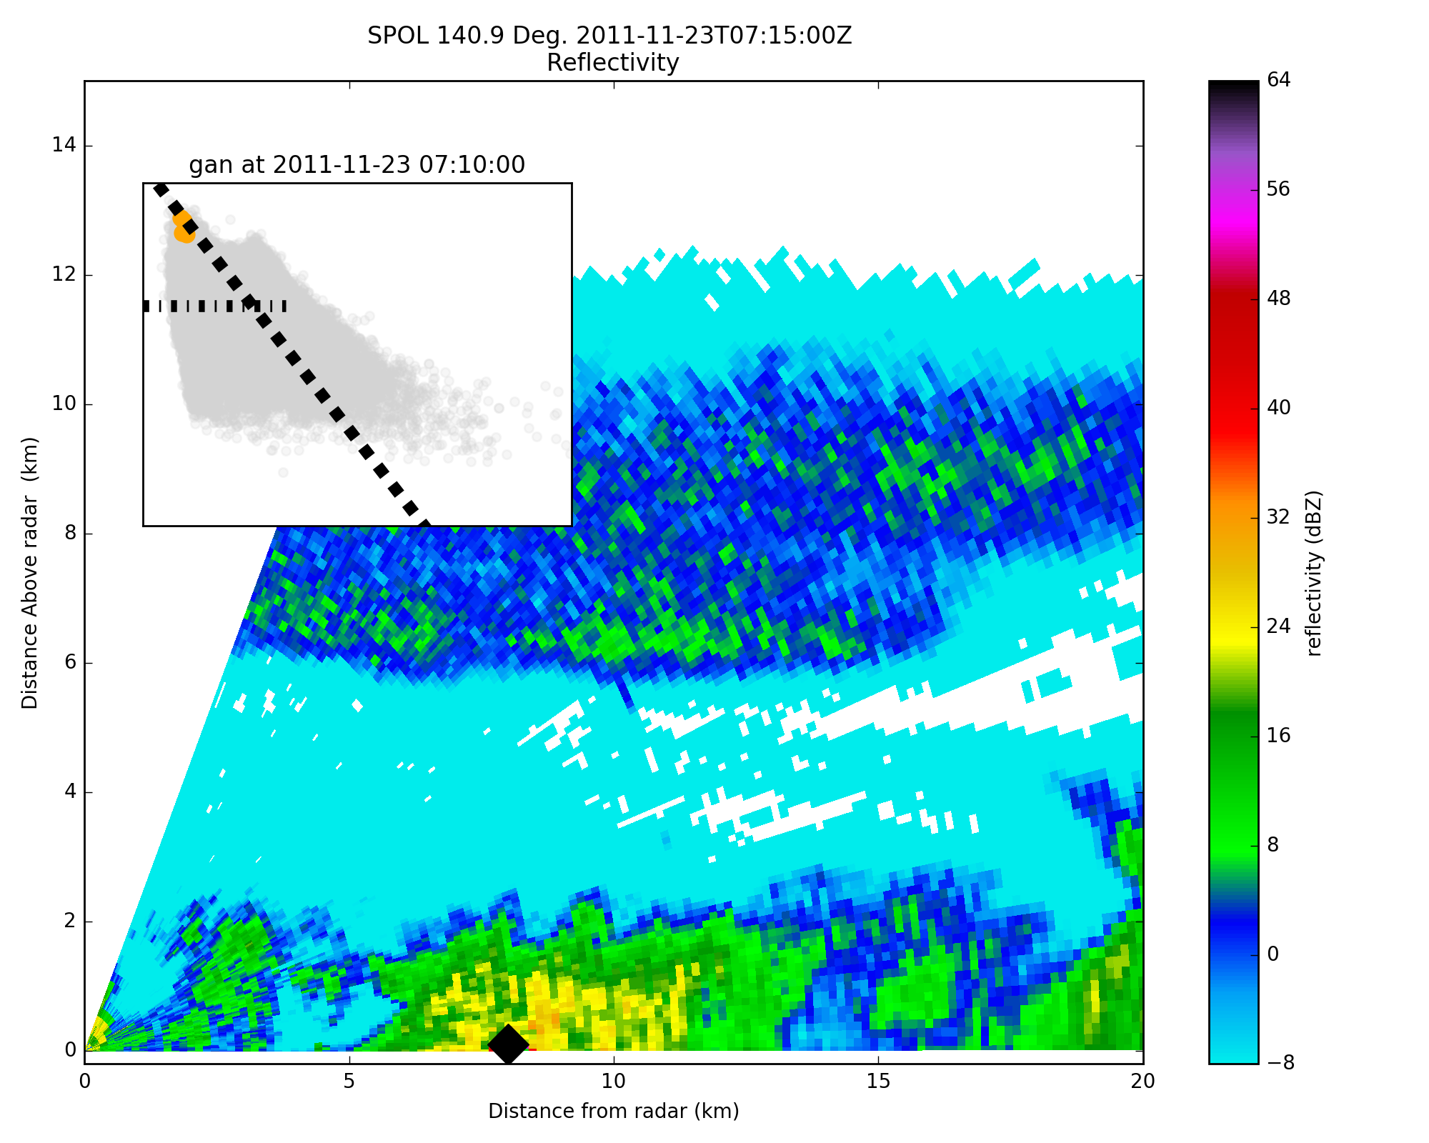
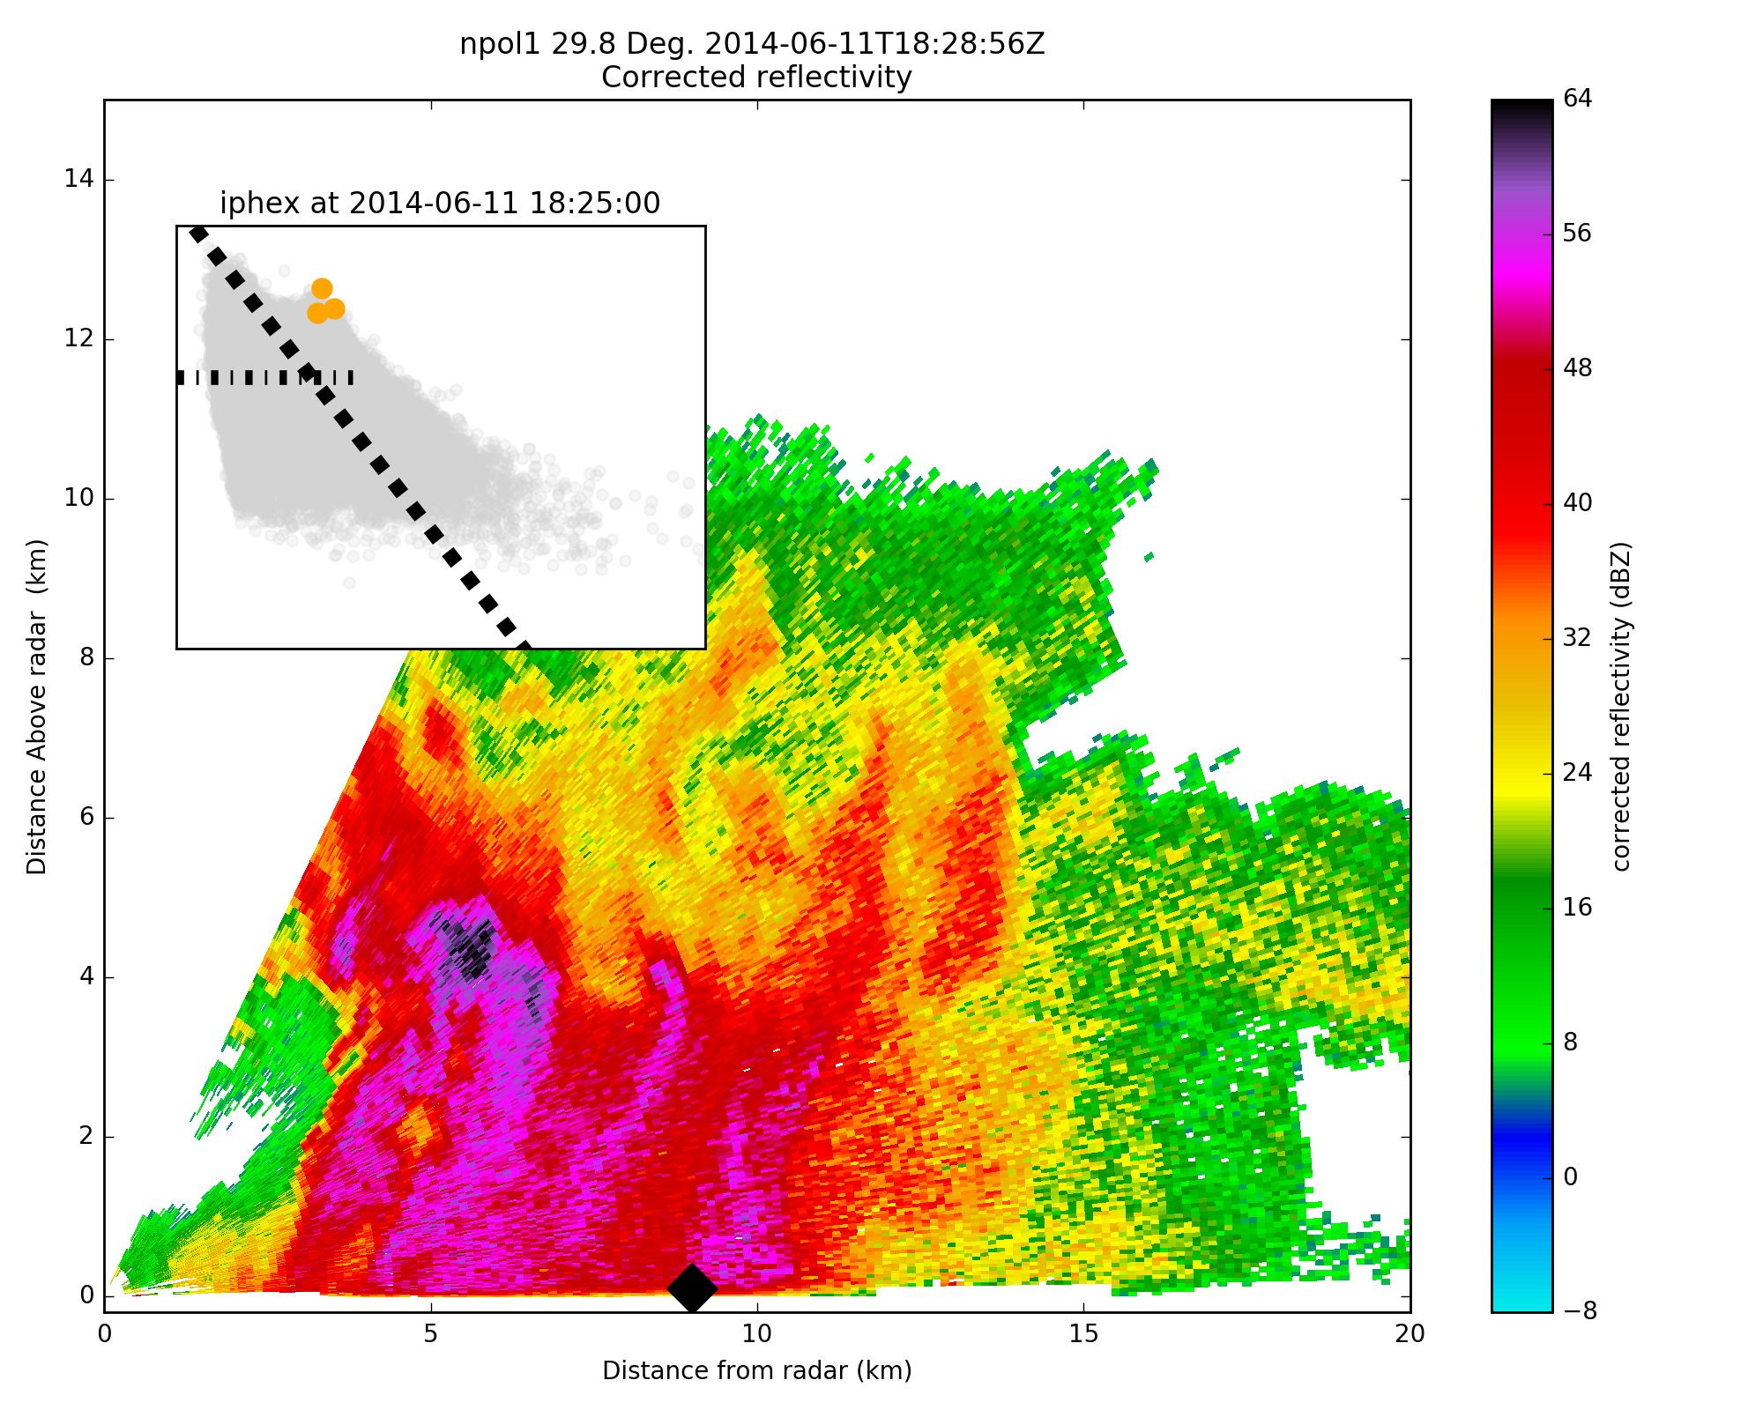
IFloodS
OLYMPEX
Stratiform
Inset illustrates corresponding disdrometer data in logN_{w}-D₀ space
Points color-coded by PCs
Dashed line is Bringi et al. 2009 C-S line
Dash-dot line is Thompson et al. 2015 C-S line
NPC1
PPC1
Convective
Convective and stratiform modes are revealed by PPC1, NPC1
IPHEX
Gan
PPC2 reveals two ‘types’ of warm rain, separated by D₀:
Weak, shallow convection
High concentrations, small drops
Deep warm cloud
Efficient coalescence process
Possibly equilibrium distribution (balance between collision/coalescence and breakup)
Warm Rain
Weak, Shallow
PPC2
PPC2
Notes:
Thicken lines

Slide 10
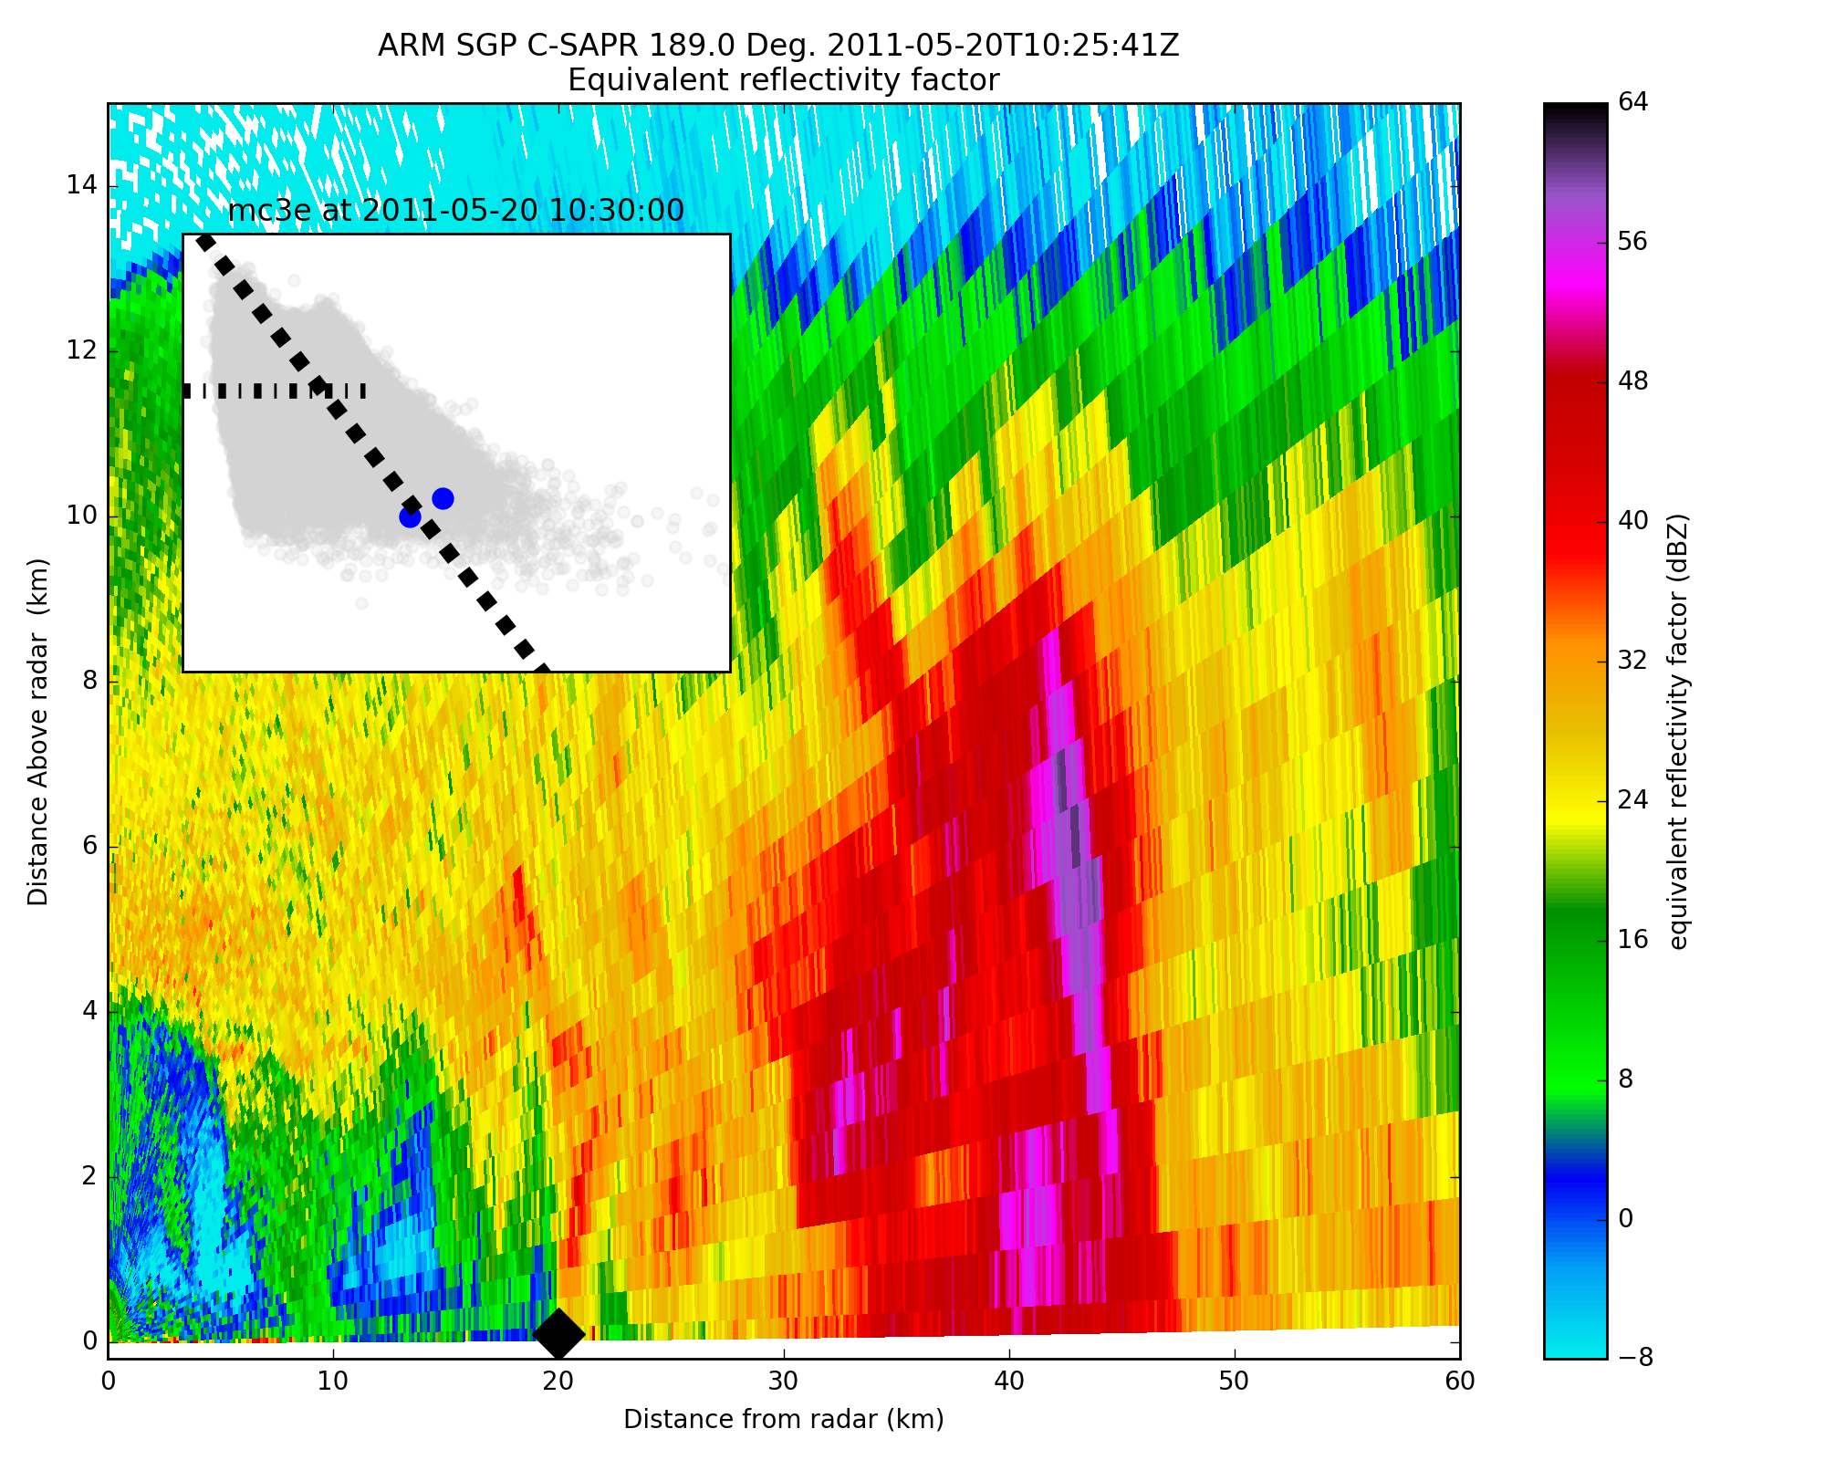
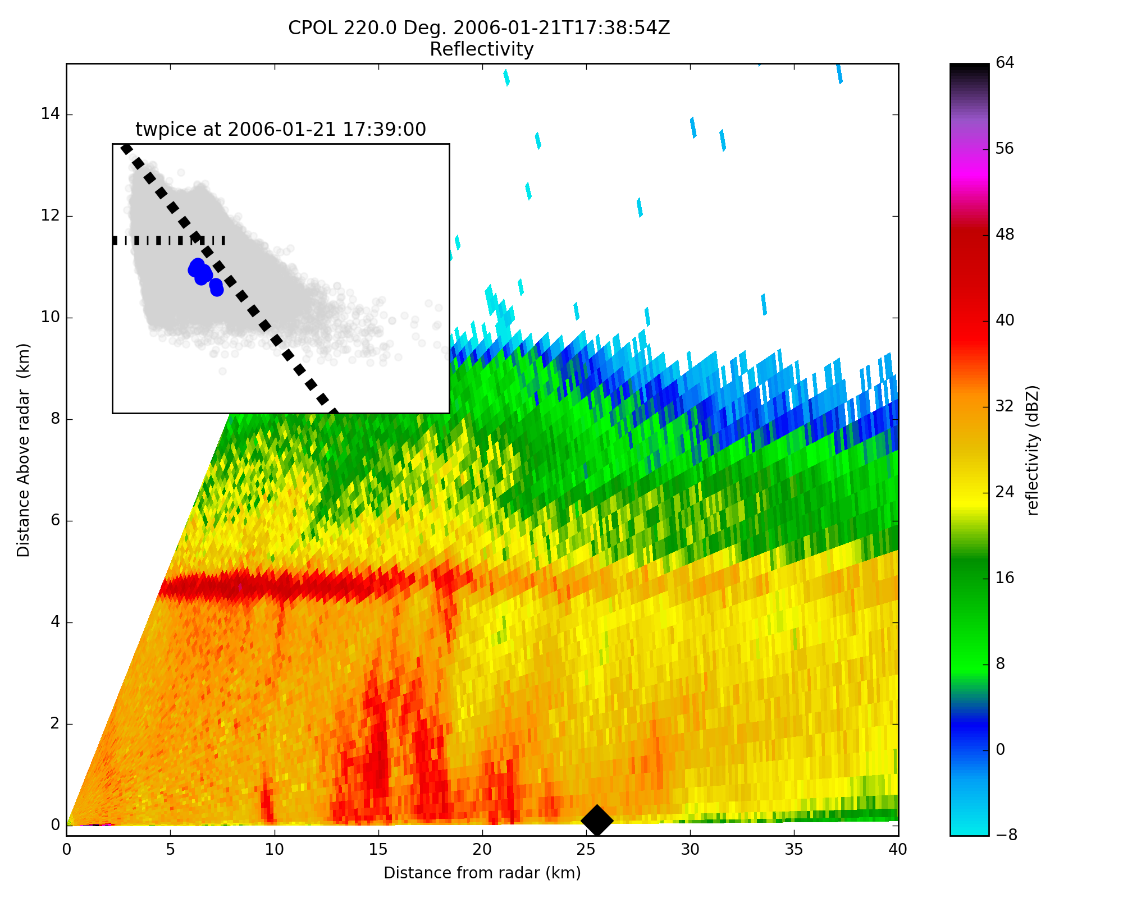
Large drop, low concentration modes indicated by NPC2
MC3E
TWP-ICE
Strong stratiform
NPC2
NPC2
Some cases are strong convection
Large drops falling adjacent to strong updrafts in other cases
Still seeking full explanation
Strong stratiform (aggregation, coalescence)

Slide 11
EOF1
EOF2
Negative PC1
Positive PC1
Negative PC2
Positive PC2
Stratiform
Convective
Large diameter, low concentration
Weak, Shallow
Warm Rain
Intense Warm
Rain
Heavy Stratiform
“Other” Ice-based
Stratiform
Ice–based Convection
Warm Rain
Notes:
Remove thresholds

Slide 12
Rain type “Separation”
(Normalized) Negative and positive principal components PC1 and PC2 lie in different quadrants of the N_{w}-D_{o} spectrum
Convection in OLYMPEX clearly distinguished from SGP and tropical convection in N_{w}-D₀ space; warm rain with larger D₀ values emerges at Manus (and other deep tropical locations)
Some overlap (e.g. stratiform, warm rain), hence some ambiguity in rain type
It appears that merging Thompson et al. (2015) and Bringi et al. (2009) boundaries for global convective-stratiform rain separation is a good approach
Better captures weak, shallow convection (tropical maritime) and intense convection (mid-latitudes)
CONVECTIVE
STRATIFORM
Convective Stratiform Warm rain Strong stratiform “Other” ice-based
Notes:
See now we have a stratiform/strong stratiform parts and convection/strong convection part
Does the grey area represent uncertainty (noise)?

Slide 13
Reflectivity – Rain rate
Precipitation processes identified by EOF’s are clearly separated in Z-R space
Stratiform-convective rain rate transition appears to increase from high to low latitudes
Overlap between stratiform and warm rain DSD’s again seen in Z-R
Convective Stratiform Warm rain Strong stratiform “Other” ice-based
Notes:
Brenda: Note the rain rates for strong convection are no larger than ordinary ice based convection bit Z is larger---few large drops vs. more numerous moderate size drops!!

Slide 14
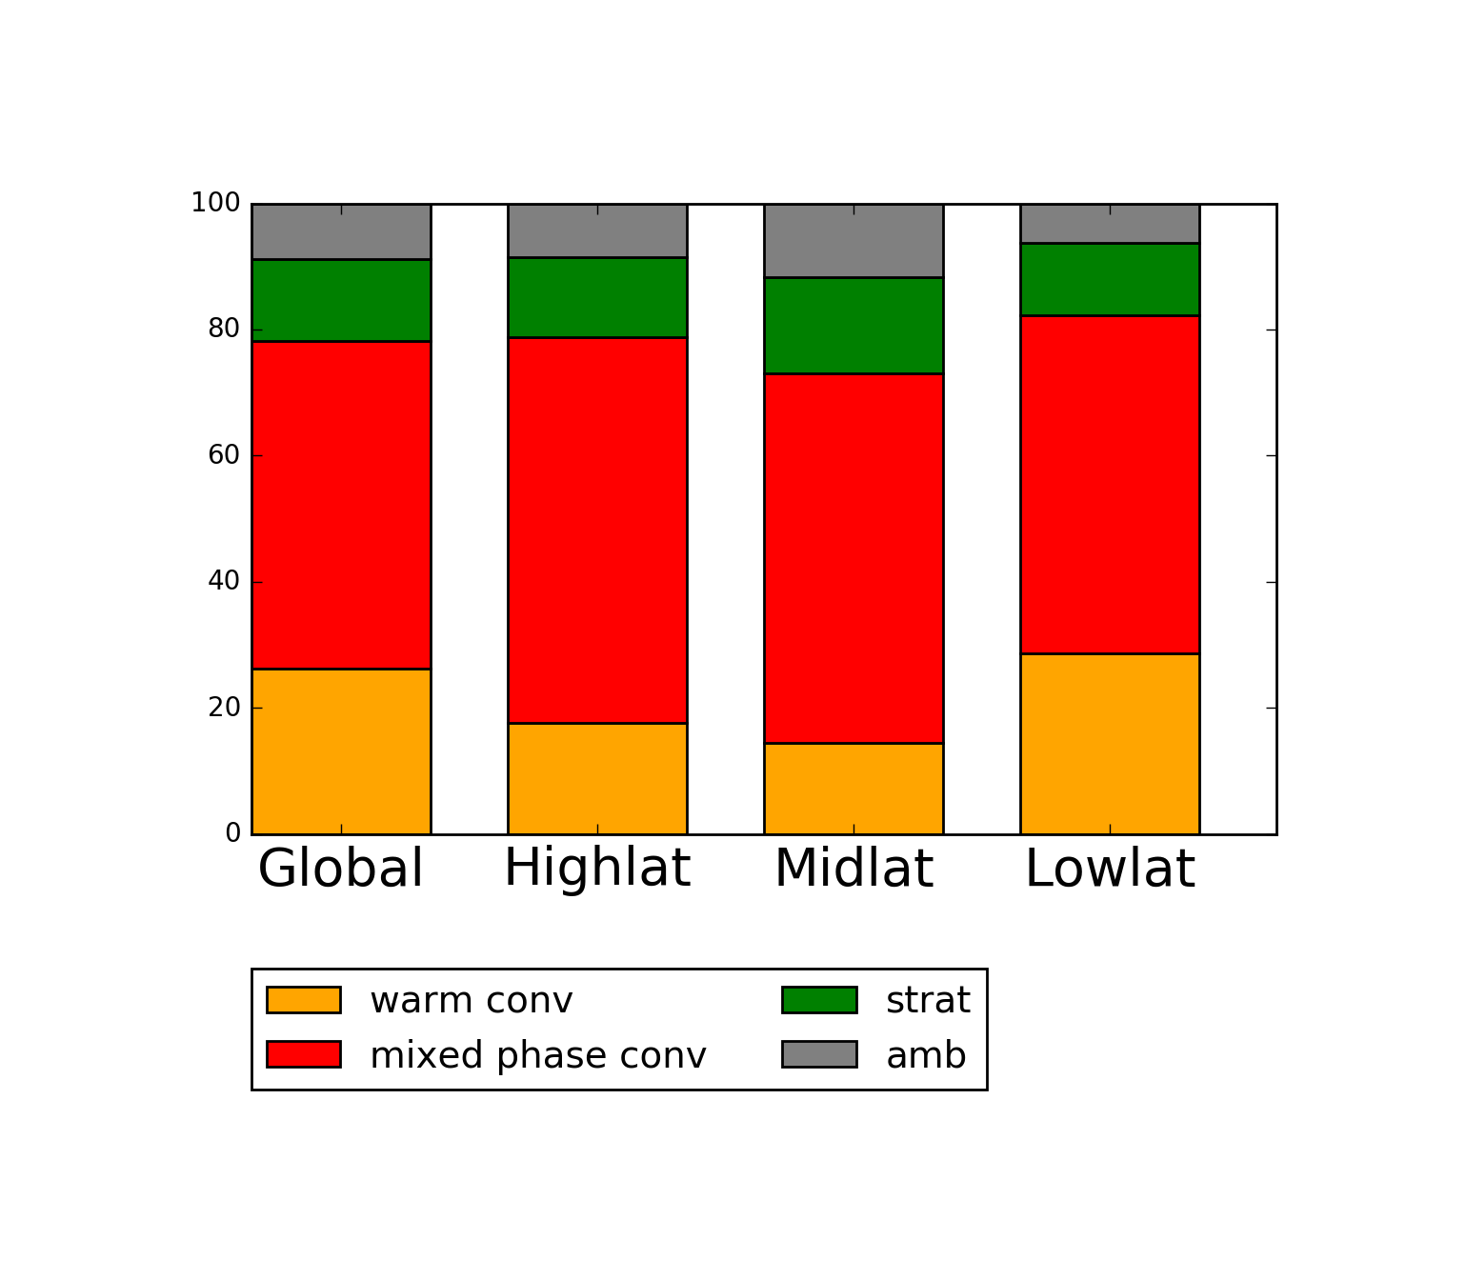
Rain Volume
Globally:
13% stratiform
52% ice based convection
26% warm rain (shallow and intense)
9% ambiguous
Largest warm rain component in the tropics; expected but this is a good physical check on results
Rain volumes by precipitation type are not widely different across regions

Slide 15
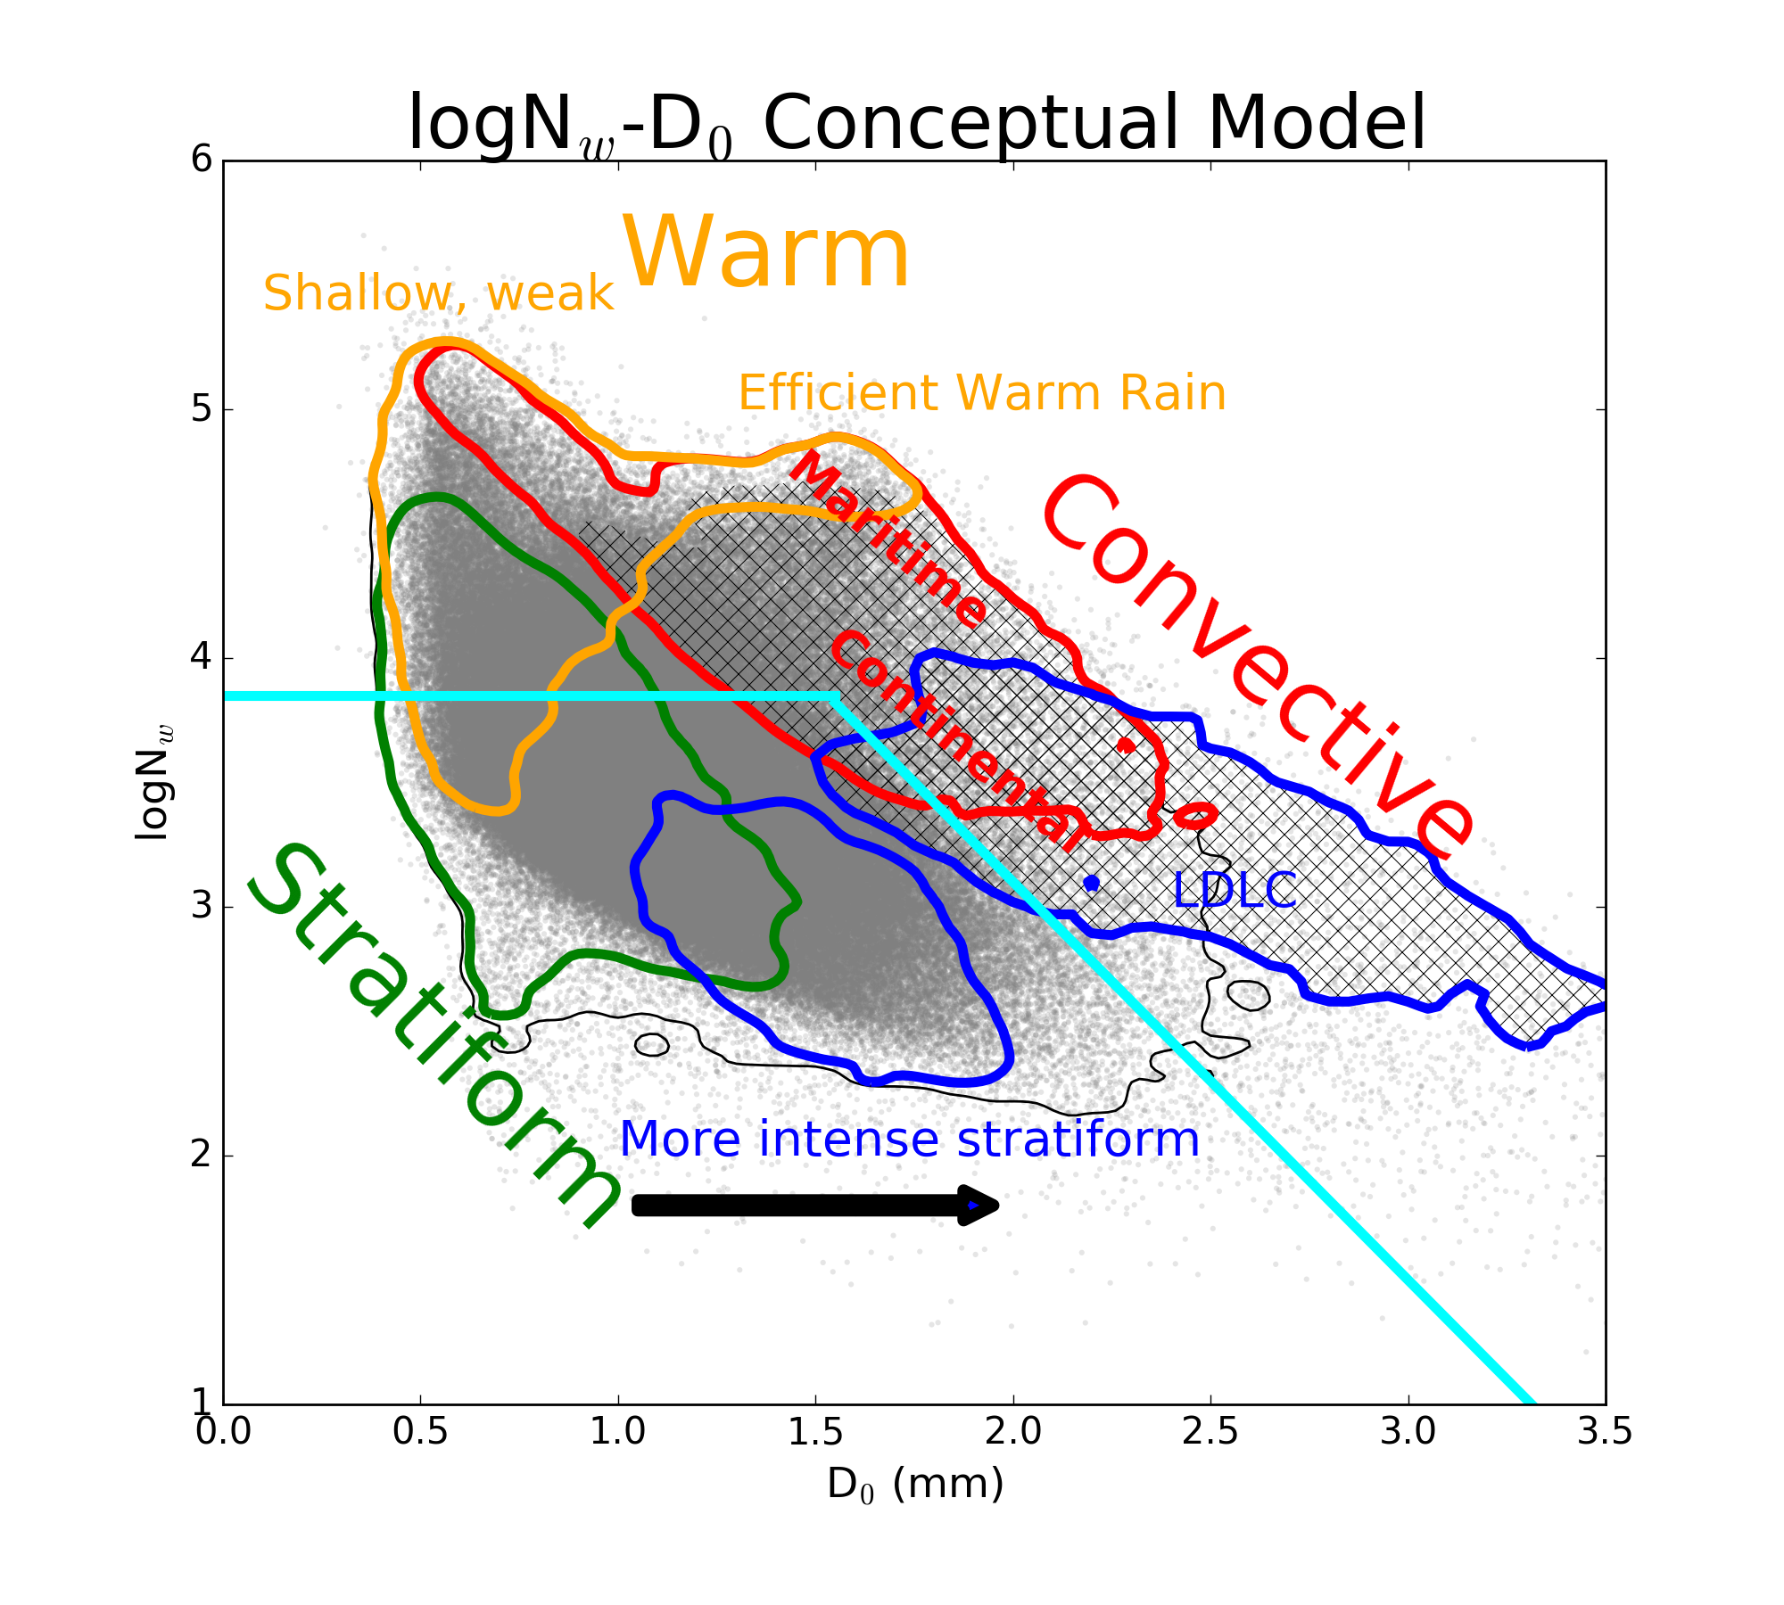
Conclusions
No a priori assumptions made about the DSD for convective and stratiform precipitation
We related D₀-N_{w} pairs to microphysical processes and precipitation type
This information can be used to refine Z-R relationships and improve reflectivity-based rainfall from satellites
Results suggest DSD variables can be constrained within different rain types
Overlap between warm rain and stratiform DSDs is something we have been struggling with for year in terms of convective-stratiform partitioning
Notes:
Brenda: Change the size sorting label to Strong convection

Slide 16
Acknowledgements
Thanks to many NASA and DOE folks who made this research possible. We are grateful for PMM and GV financial support, as well as support from DOE.
We would like to acknowledge Dr. Walt Petersen for leading the NASA GV activities.
Personally I wish to acknowledge Dr. Matt Schwaller for his leadership and dedication to the NASA GV program. Matt, you have been absolutely fantastic to work with and I will miss our interactions over the years. I wish you much happiness in your retirement.

