Slide 1

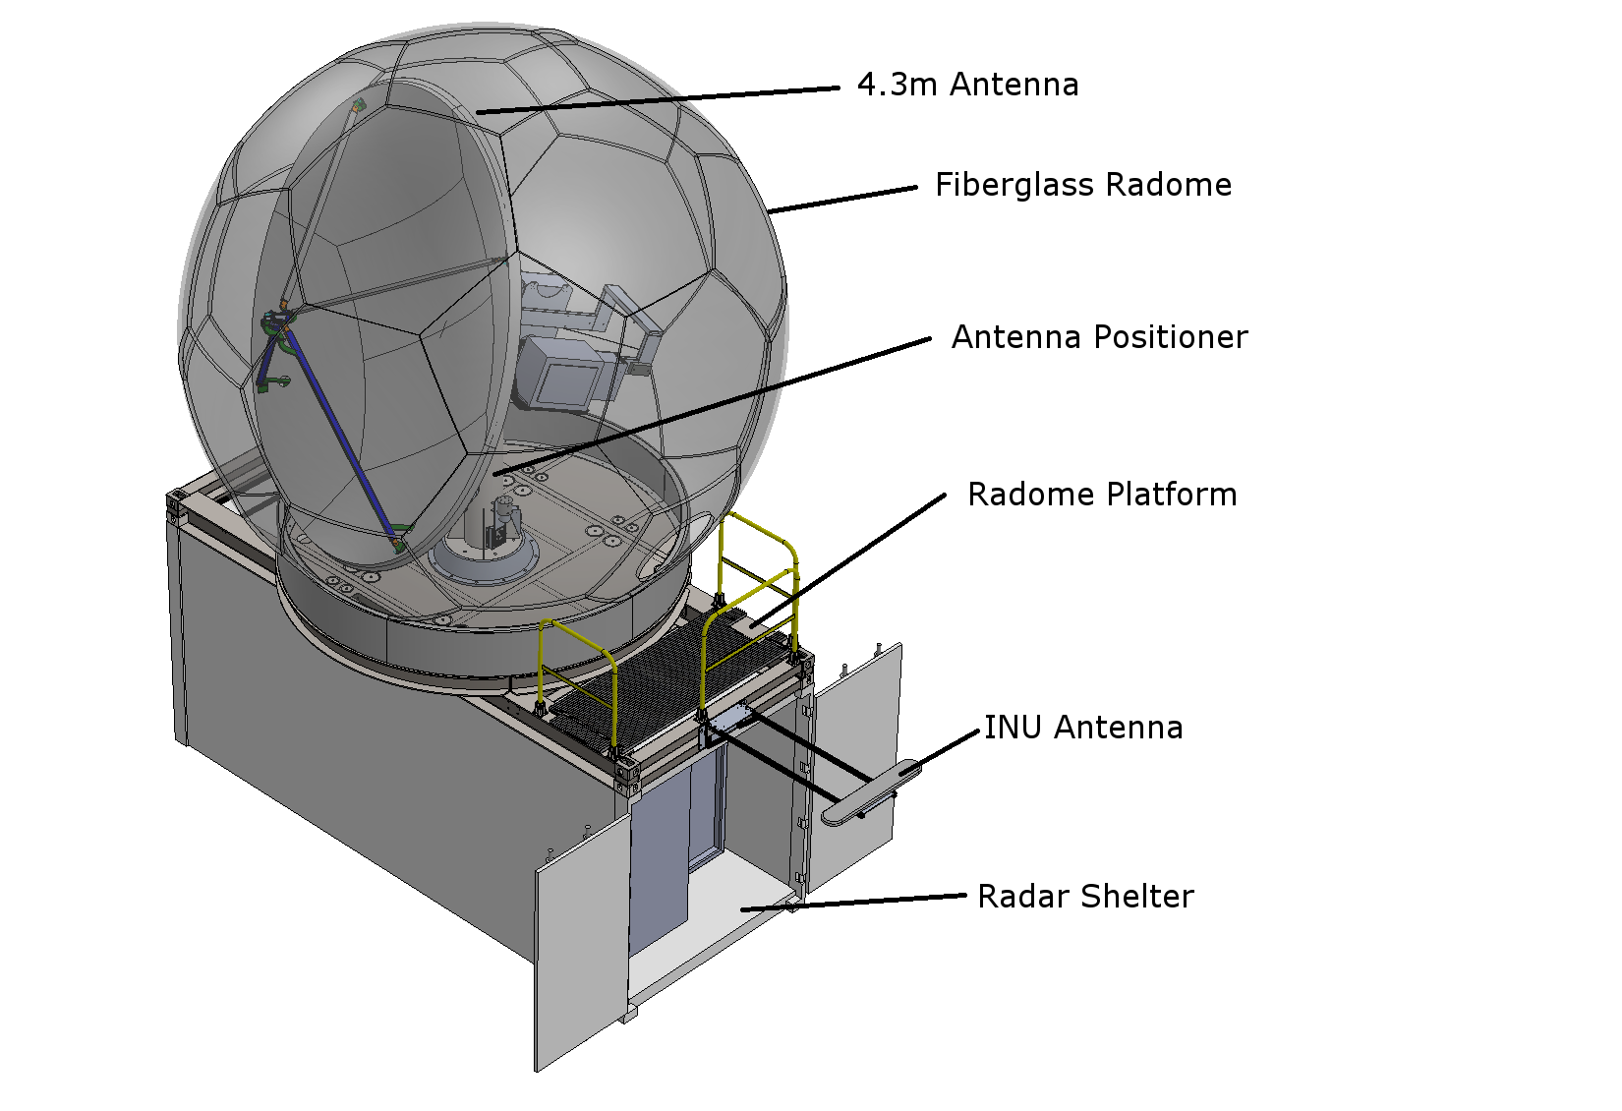
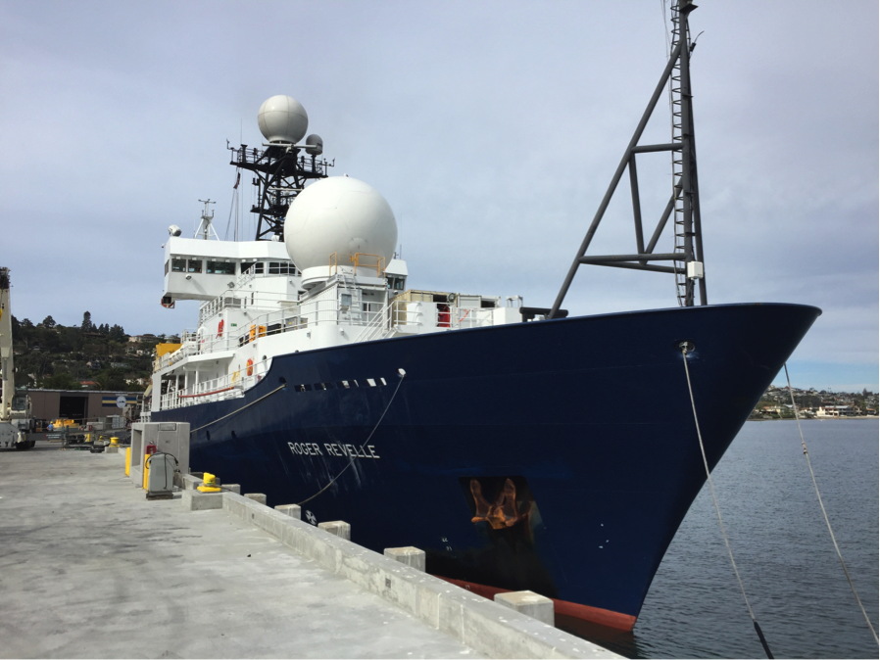
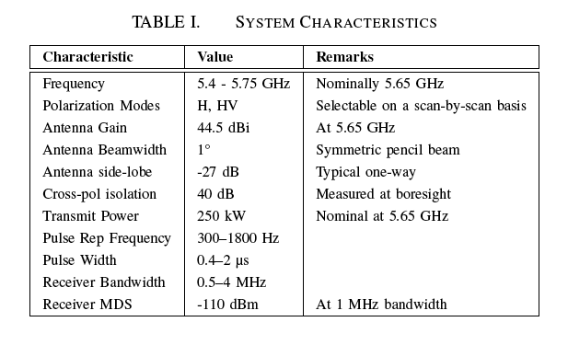
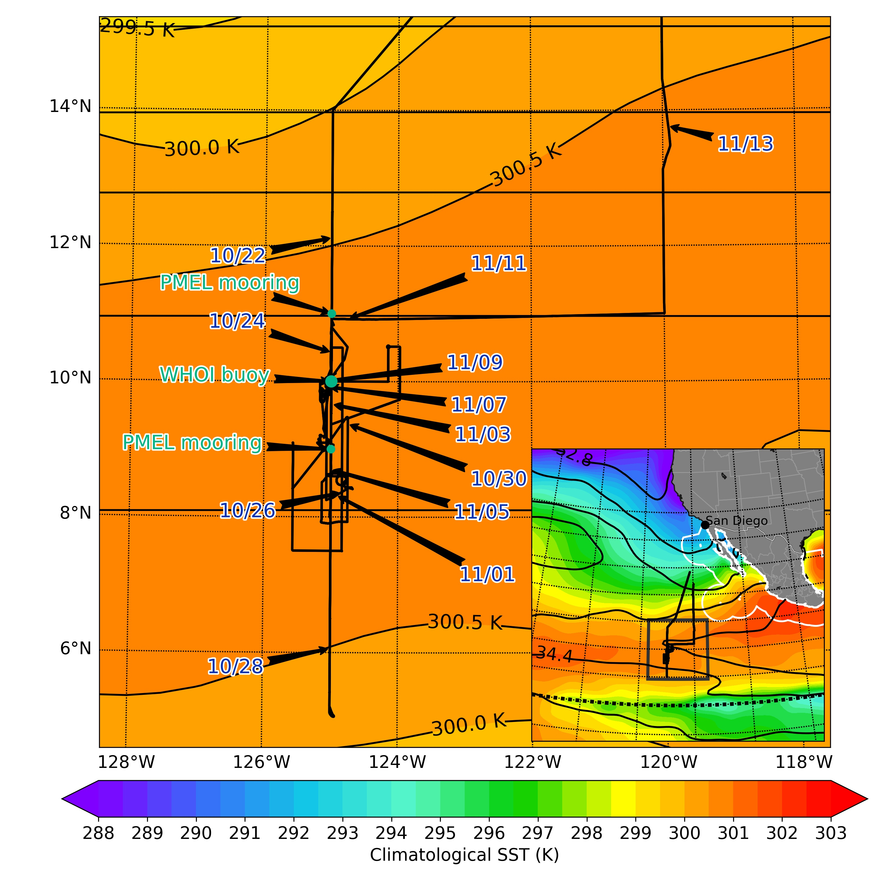
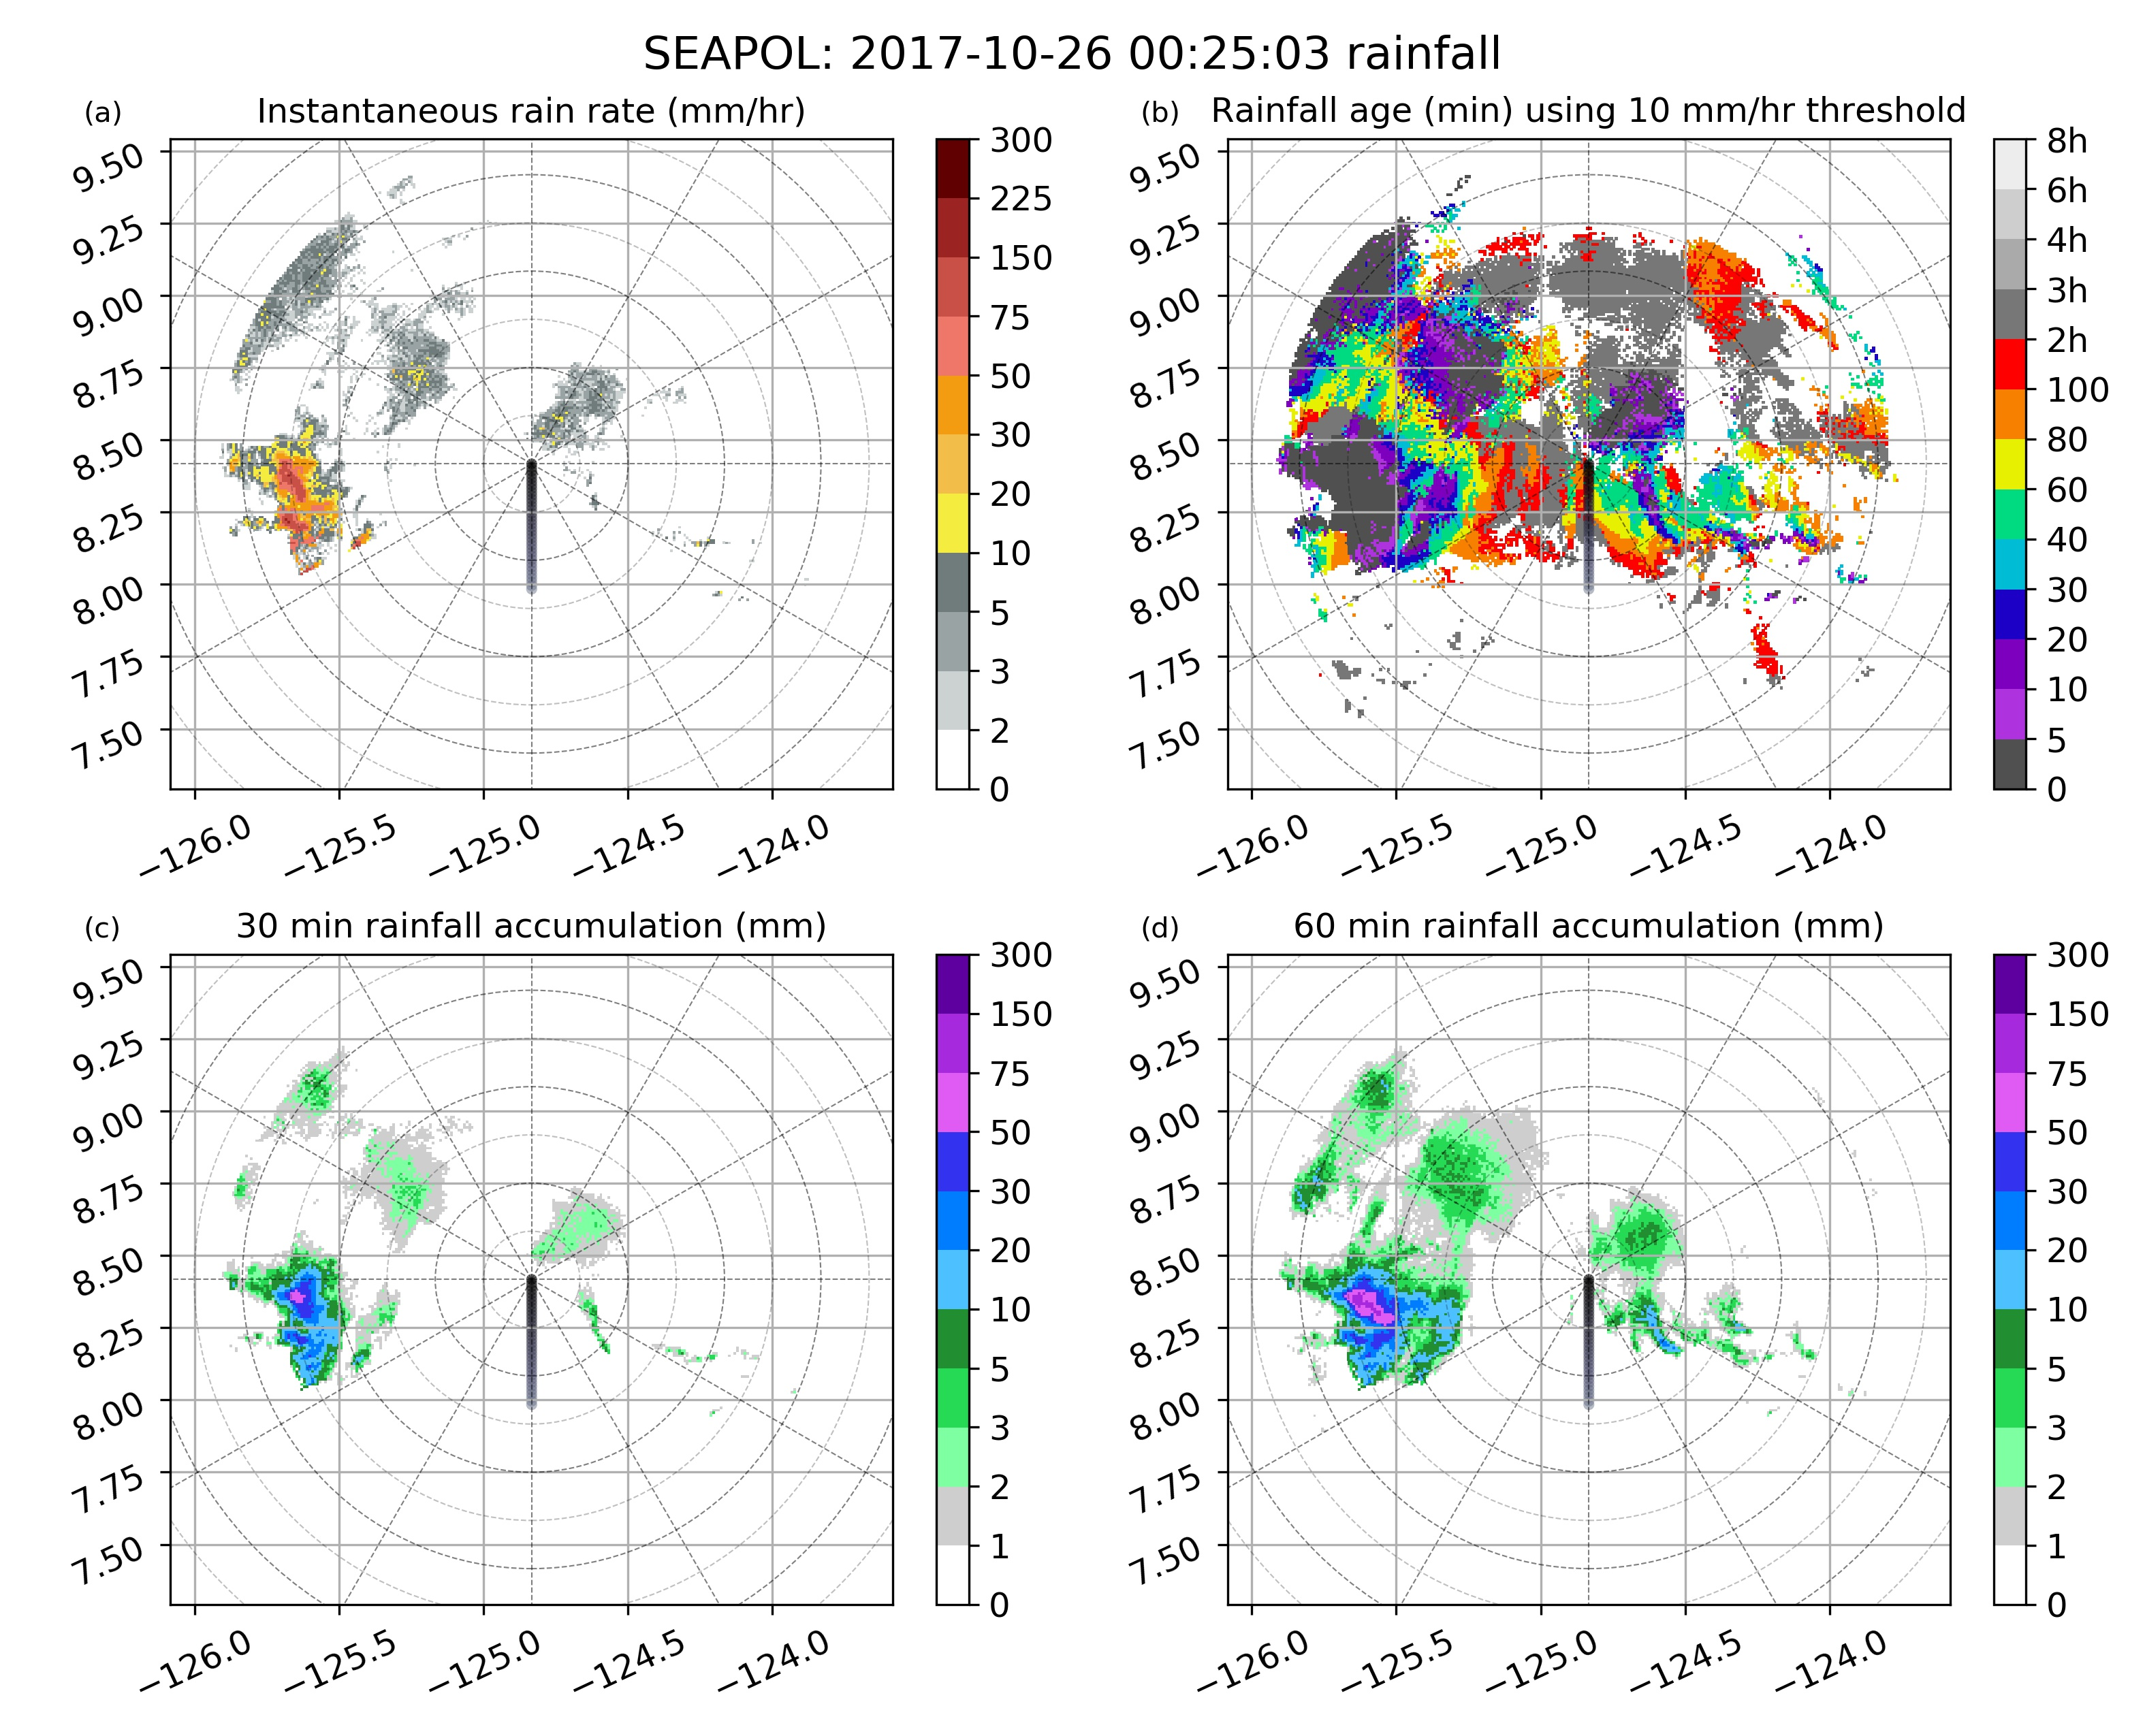
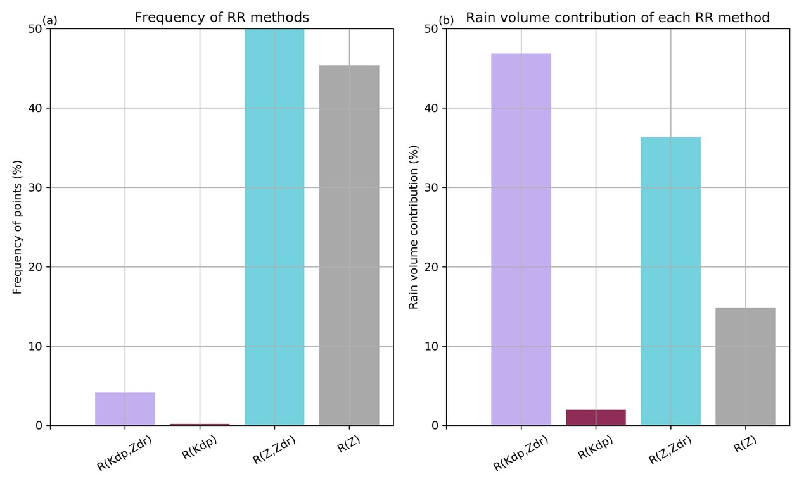
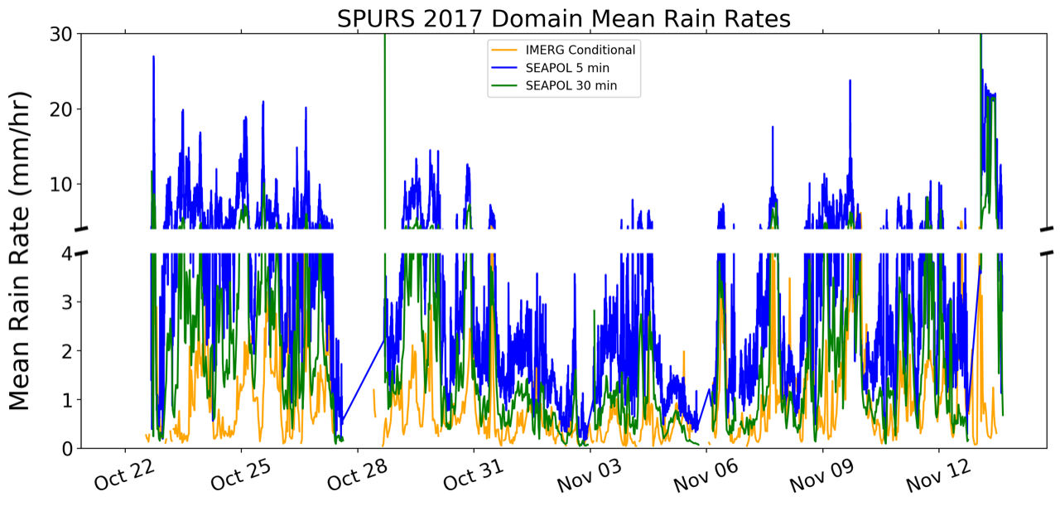
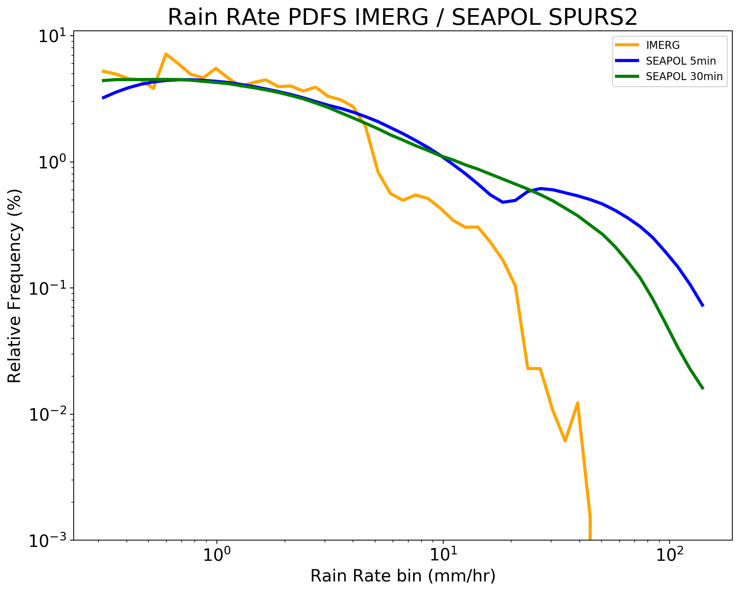
Polarimetric Radar Observations over the Tropical Oceans using SEA-POL
Steven A. Rutledge¹ and V. Chandrasekar²
¹Department of Atmospheric Science, Colorado State University, Fort Collins, CO
²Department of Electrical and Computer Engineering, Colorado State University, Fort Collins, CO
Poster 1.27
The
SEA-POL was derived from the previous R/V Ronald H. Brown (RHB) C-band Doppler radar. The transmitter and antenna positioner were used from the RHB radar. All other components were either designed and built in-house or acquired from Vaisala, Inc. Vaisala supplied an antenna mounted receiver, rotary joint and RVP9000 signal processor. Antenna motions are fully stabilized for ship motions using a INU/GPS receiver system.
SEA-POL is housed in a seatainer which also serves as the base for the antenna, positioner and radome. A custom interface to mate the antenna/radome assembly to the top of the seatainer was designed and fabricated. The system is designed to withstand > 100kt winds. SEA-POL scans a 240 degree sector centered on the ship’s bow. This configuration allows SEA-POL to operate on multiple ships within the U.S. fleet. SEA-POLcan be shipped world-wide in three seatainers.
Radar Development
A new, advanced radar has been developed at Colorado State University (CSU). SEA-POL is a stabilized C-band, polarimetric Doppler radar specifically designed to deploy on research ships. SEA-POL is the first such weather radar developed in the U.S. Ship-based weather radars have a long history, dating back to GATE in 1974. The GATE radars measured only reflectivity. After GATE, ship radars also provided Doppler measurements. SEA-POL represents the next advancement by adding dual-polarization technology, the ability to transmit and receive both horizontal and vertical polarizations. This configuration provides information about hydrometeor size, shape and phase. As a result, superior rain rate estimates are afforded by the dual-polarization technology and microphysical insights can be obtained from the polarimetric measurements. SEA-POL made its first deployment as part of the SPURS-2 Fall 2017 cruise to the eastern tropical Pacific, sailing on the R/V Roger Revelle. SEA-POL’s second deployment was onboard the R/V Thomas G. Thompson to the tropical W. Pacific as part of the PISTON project in late summer/early fall 2018. SEA-POL collected high quality data in both field campaigns. SEA-POL will deploy on the R/V Sally Ride for PISTON 19.
R/V Roger Revelle
SEA-POL can also be easily deployed on land.
SEA-POL rain mapping and polarimetric observations
Vertical
SPURS-2 cruise domain
Examples of SEA-POL data
Rain Products Example:
Instantaneous rain rate and accumulation
over various
intervals plus
“age” of rain
The SPURS-2 cruise took place between mid-October to mid-November 2017 in the E. tropical Pacific. One of the goals of the SPURS-2
cruise was to map patches of convective rainfall that create fresh water lenses on the ocean’s surface. These lenses stabilize the upper
ocean under light wind conditions causing local SST’s to increase which may lead to further storm formation. Quality-controlled SEA-POL data
were input to the Thompson et al. (2018; J. Atmos. Sci.) rain rate algorithm which uses SEA-POL reflectivity and polarimetric fields specific
differential phase (K_{DP}) and differential reflectivity (ζ_{DR}).
Vertical cross sections of SEA-POL data for two precipitation events. The left panel shows a strong convective cell which
produced lightning. CAPE ranged from 1500-2000 J kg⁻¹ this day. New cell development is evident near 15-20 km range. Mature
convection is located at 30-35 km range. Cells are highly sheared with the transition from easterly to westerly flow near 2.5 km MSL.
Large Z, Z_{DR} and K_{DP} are situated at 30 km range where rain rates exceed 60 mm h⁻¹. Microphysical processes can be inferred from
the polarimetric variables. The center of the mature convective core contains graupel marked by relatively high Z and near zero
values of Z_{DR} and K_{DP}. This core is enshrouded by aggregates and ice crystals marked by positive K_{DP} and Z_{DR}. The identification
of graupel aloft is consistent with lightning production.
The panels on the right show a young convective cell at 5 km range, with mature convection between 20-30 km. A large area of stratiform
rain is also present. The stratiform echo formed as earlier convection dissipated. Regions were ice particles continue to be generated
aloft by residual updrafts are seen near 60 and 80 km range, marked by areas of positive K_{DP} and Z_{DR}, presumably associated with
oriented ice particles such as plates and dendrites undergoing depositional growth. So this stratiform precipitation forms by
dissipating convection opposed to the detrainment and advection of ice particles from the active convection. SEA-POL is a new, valuable instrument for studying oceanic precipitation systems.
SEA-POL provides an excellent opportunity to compare to IMERG,
a multi-satellite technique to map rainfall. The above figures
compare IMERG mean rain rates (sub-sampled over the SEA-POL
coverage area) to rain rates from SEA-POL at 5 and 30 min temporal
resolutions (the latter being the time scale of the IMERG product). The comparison is done for the period from 22 October to 12 November, which represented the research component of the SPURS-2 cruise (less 10 days for ferry time). IMERG areal mean rain rates are generally lower than those from SEA-POL. Likewise the PDF of rain rates shows that peak IMERG rain rates are roughly 60 mm h⁻¹ whereas SEA-POL peak rain rates exceed 100 mm h⁻¹. IMERG is unable to identify intense raining convective cores that
SEA-POL maps at higher resolution. However, IMERG generally shows larger areal coverage of rain, particularly light rain, compared to SEA-POL.
References
SEA-POL allowed mapping of oceanic rainfall using polarimetric observations. Polarimetric rain mapping avoids the need for convective/stratiform partitioning which is required when traditional Z-R estimators are applied. For SPURS-2, 45% of the raining grid points required a Z-R estimator. However, these same points contributed just 15% of the total rain volume. On the other hand, heavy rain mapped by the R-Z_{DR}-K_{DP} estimator was present at only 4% of the grid points but these few points represented nearly 50% of the rain volume. Polarimetric based rain estimates applied to 55% of the raining grid points and ~80% of the rain volume.
Acknowledgements: First, we acknowledge the National Science Foundation and Colorado State University for providing the financial support for designing and constructing the SEA-POL radar. NSF support was provided by the MRI grant, AGS-1531714. Also, we thank NOAA for donating the former R/V Ronald H. Brown radar to CSU to motivate the SEA-POL development project. NASA and NSF provided support to CSU for the SPURS-2 deployment via a NASA Rapid Response award (80NSSC17K0239) and a NSF Eager award (AGS-1742760). Our sincere thanks and appreciation go to the shore staff and ship’s crew of the R/V Roger Revelle ably led by Capt. David Murline. Finally we thank the external review committee that visited CSU during the critical design phase of SEA POL, R. Carbone (NCAR), N. Bharadwaj (DOE/PNNL) and T. Lyly (Vaisala-Helsinki). The PISTON cruise was supported by the Office of Naval Research. We thank the capable crew of the R/V Thomas G. Thompson for their excellent support during PISTON.
References
Deployment of the SEA-POL C-band polarimetric radar to SPURS-2. (S. A. Rutledge, V. Chandrasekar, B. Fuchs, J. George, F. Junyent, P. Kennedy and B. Dolan). Oceanography Magazine, In press.
SEA-POL goes to sea. (S. A. Rutledge, V. Chandrasekar, B. Fuchs, J. George, F. Junyent, B. Dolan, P. Kennedy and K. Drushka). Bull. Amer. Meteor. Soc., Submitted.

