Slide 1
CSU GLM work summary S. A. Rutledge, K. Hilburn, A. Clayton and B. Fuchs Colorado State University
Have relied upon LMA flash rates in comparison to GLM flash rates to assess DE
Generally find that DE decreases with decreasing flash size and increasing IWP (low flash heights). Attributed to scattering by hail perhaps.
Currently our IWP analysis is for precipitation sized particles only which leaves the analysis incomplete in terms of the cloud ice and cloud water fields (precipitation concentration 1-10 L⁻¹; cloud droplet concentration 10⁵⁻⁶ L⁻¹) and their impact on scattering; about an order of magnitude more surface area for cloud particles compared to (graupel) precipitation particles
As we and others have shown, for a given IWP (precipitation-sized particles) and flash size, the DE is markedly lower in CO compared to AL. Is this possibly due to higher SLW contents in CO (inverted) storms?
Investigation of additional cases from CO, W. TX and AL. Differences in group rates between GOES 16 and GOES 17.
Realization that DE evaluated using LMA flash rate is sensitive to how flashes are estimated from LMA sources (10 vs. 75 source minimum; personal communication with Ron Thomas)

Slide 2
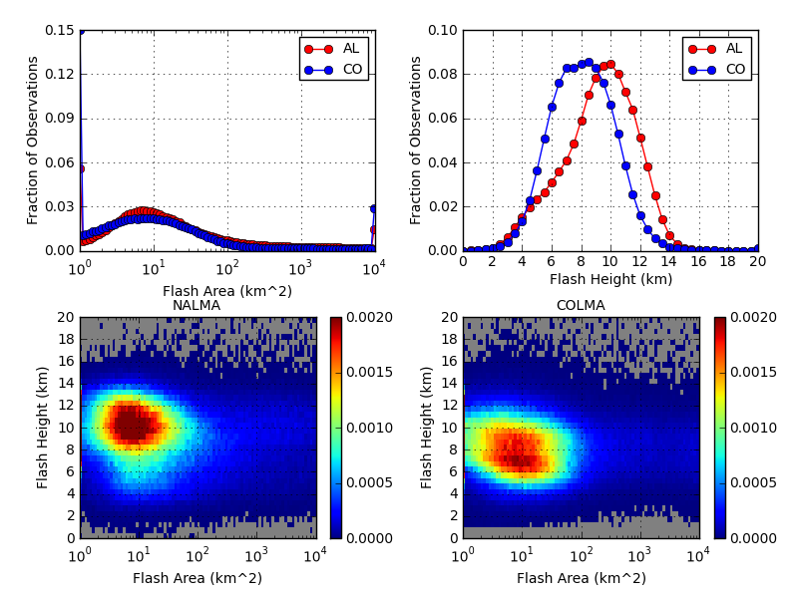
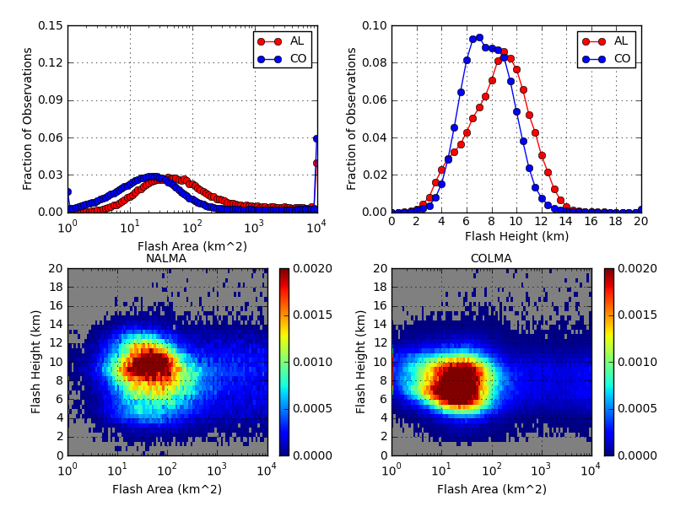
Flash Height/Area Histograms
Top: previous results using 10 sources/flash threshold
Bottom: new results using 75 sources/flash threshold
Shift to larger flash areas; now find AL histogram shifted to larger flashes relative to CO
Shift to lower flash heights in CO

Slide 3
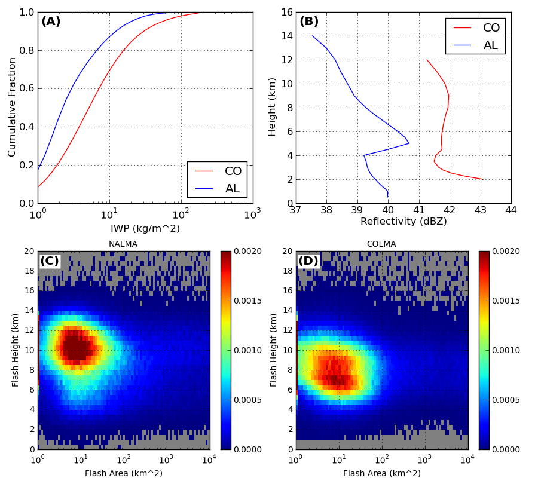
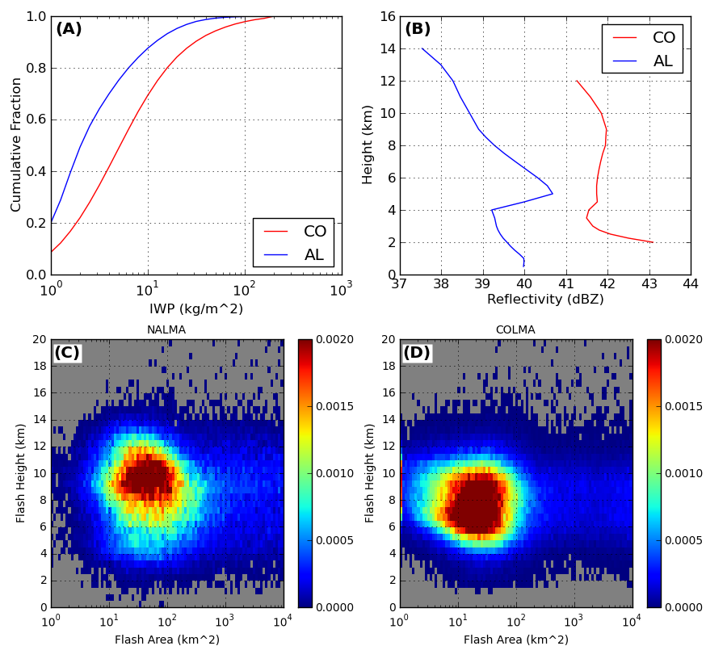
A: IWP cumulative fraction
This is IWP above the flash
B: Mean profile radar reflectivity
This is mean over all locations with reflectivity > 35 dBZ
C: Joint histogram by height/area for NALMA
D: same as C for COLMA
Very small shift in AL IWP to lower values
Left: Previous results (10 sources)
Right: New results (75 sources)
Bottom panels same as previous slide

Slide 4
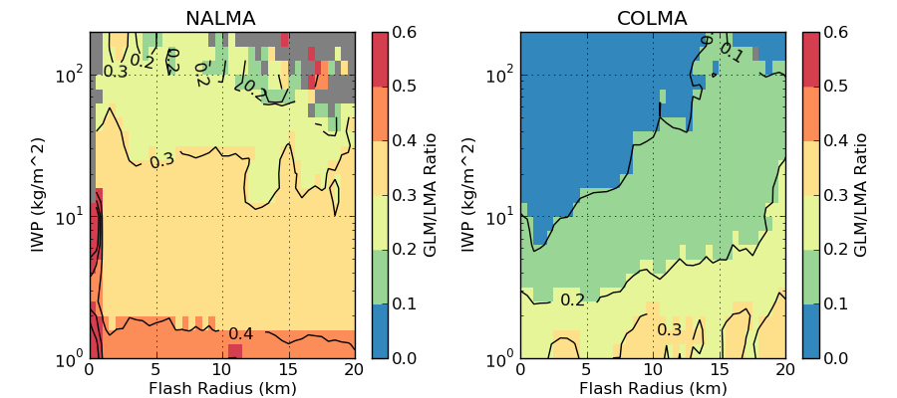
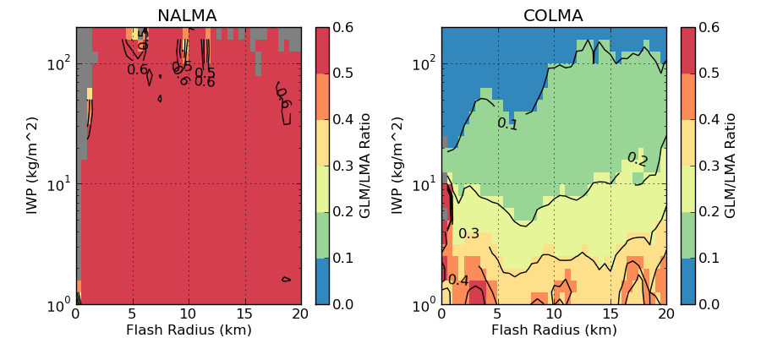
Detection efficiency
DE (GLM/LMA flash rate ratio) vs IWP/radius for (a) NALMA and (b) COLMA
Top: previous results (10 sources)
Bottom: new results (75 sources)
Much higher DE for AL
Slightly higher DE for CO, mostly at lower IWP
DE in CO still very low compared to AL (inverted storms vs. normal polarity storms)
How do we explain lower DE in CO compared to AL for a given IWP/flash size?
??

Slide 5
ABI for Cloud Water Path
Cloud products were not run for ABI during 2017 period of interest
Kyle Hilburn working with Matt Rogers (CIRA) to run CLAVR-x (Clouds from AVHRR Extended) processing system
CLAVR-x algorithms are analogs of those developed for GOES-R Algorithm Working Group (AWG) Cloud Applications Team
Looking for GFS Grid 4 forecast grib files that are input to system
Cloud ice water path uses ABI 0.64 micron visible and 2.25 micron near-infrared bands during daytime
Liquid and ice water paths calculated from Cloud Optical Depth (COD) and Cloud Particle Size (CPS) retrievals
Cloud optical depth comes mainly from 0.64 micron
The 2.2 micron channel provides additional CPS information and improves COD estimate by adjusting differences in phase function due to particle size
Algorithm most accurate for COD 1-50, but has reasonable-looking retrievals up to 150
Nighttime: uses 3.9, 11.2, and 12.3 micron bands
Algorithm most accurate for COD 1-8
COD saturation means nighttime data unlikely to be useful for our study

Slide 6
W. Texas case 23 April 2018

Slide 7
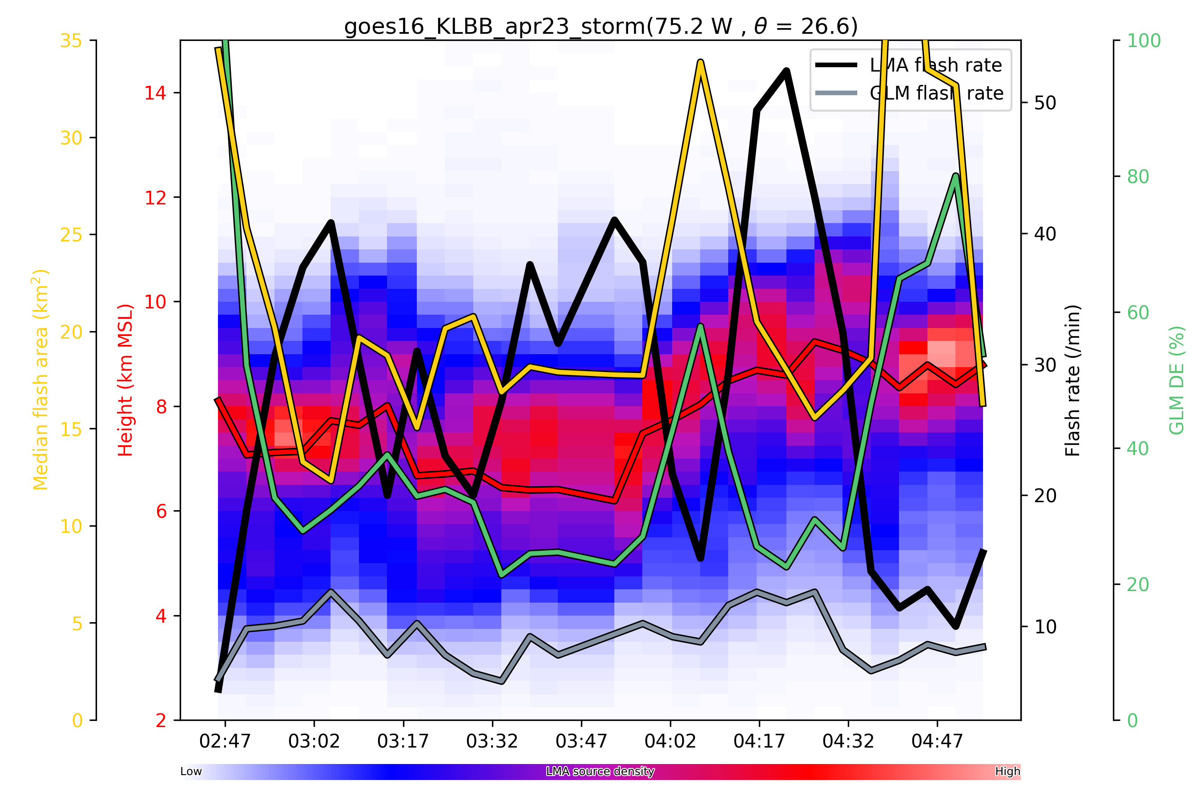
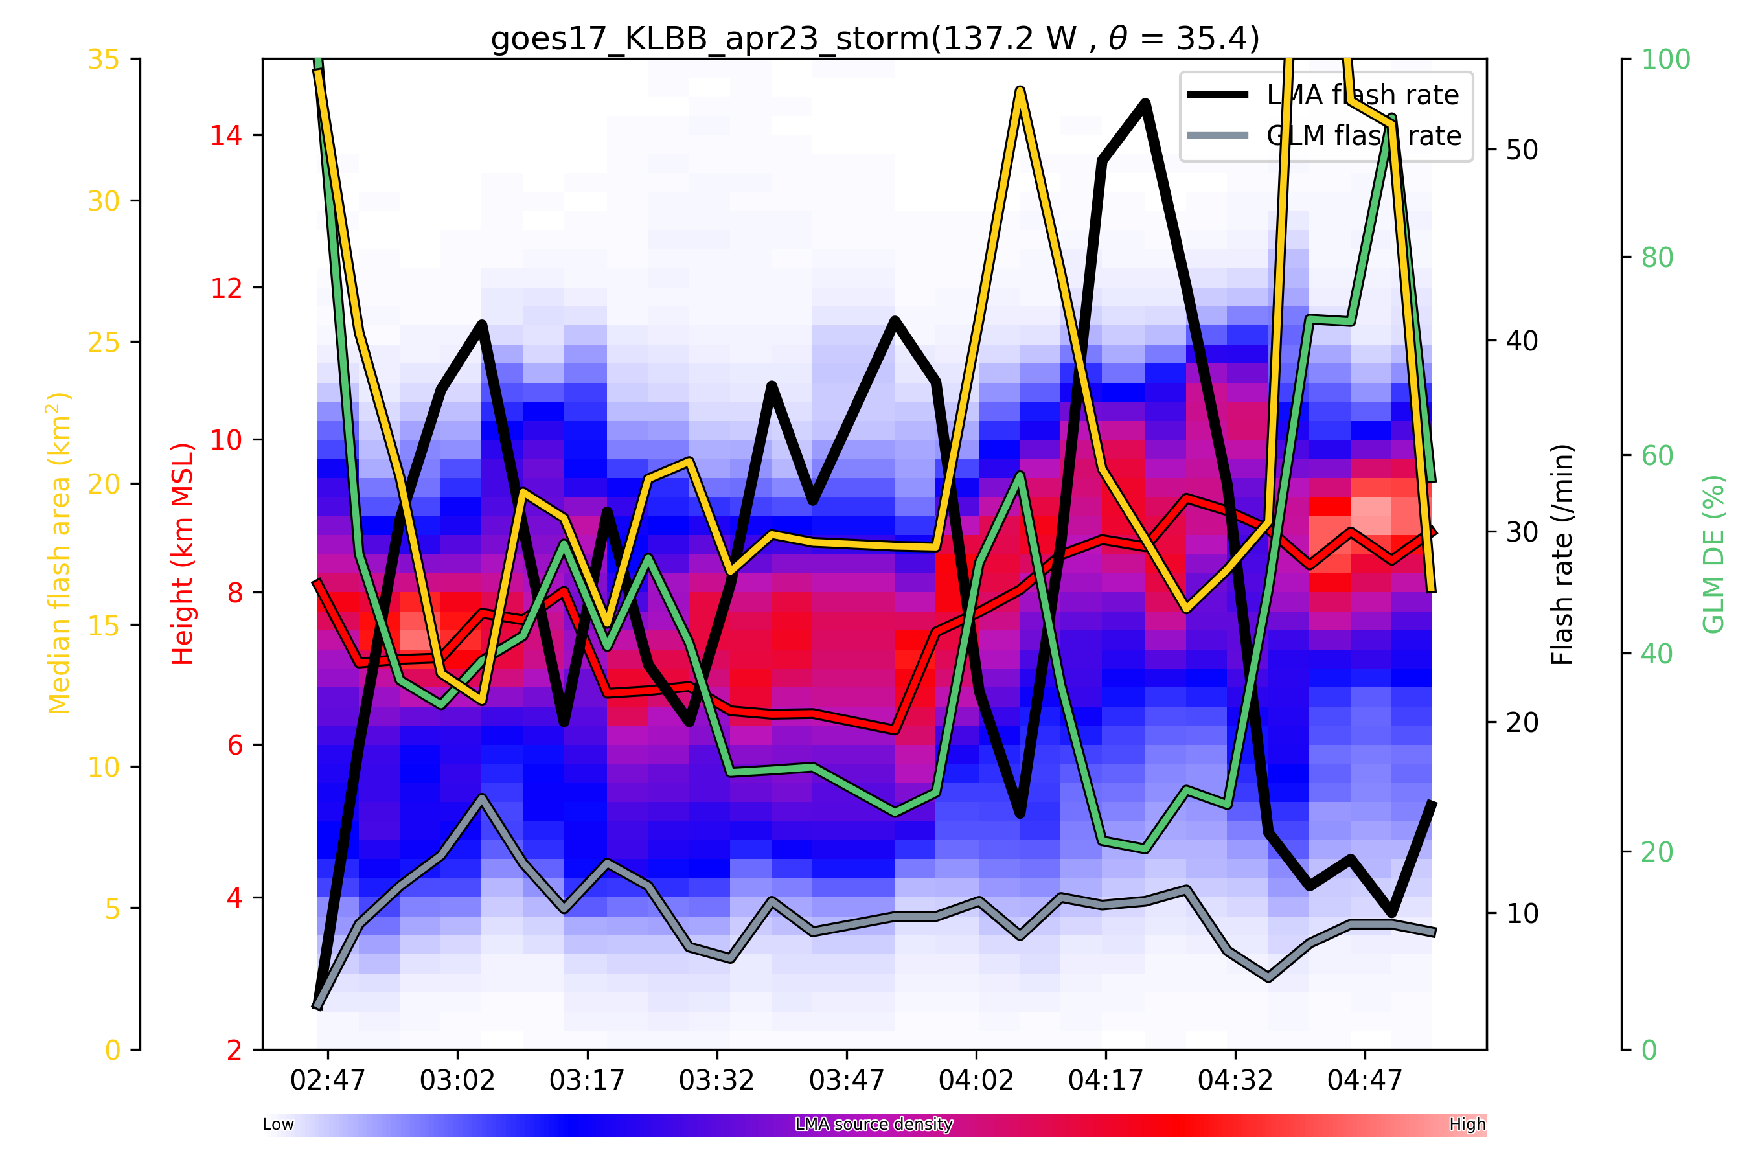
W. Texas 23 April 2018
Thanks to E. Bruning et al. for the LMA
data
Based on a minimum of 75 sources
per flash
Strong inverse correlation between
flash size and flash rate
GOES 16
GOES 17

Slide 8
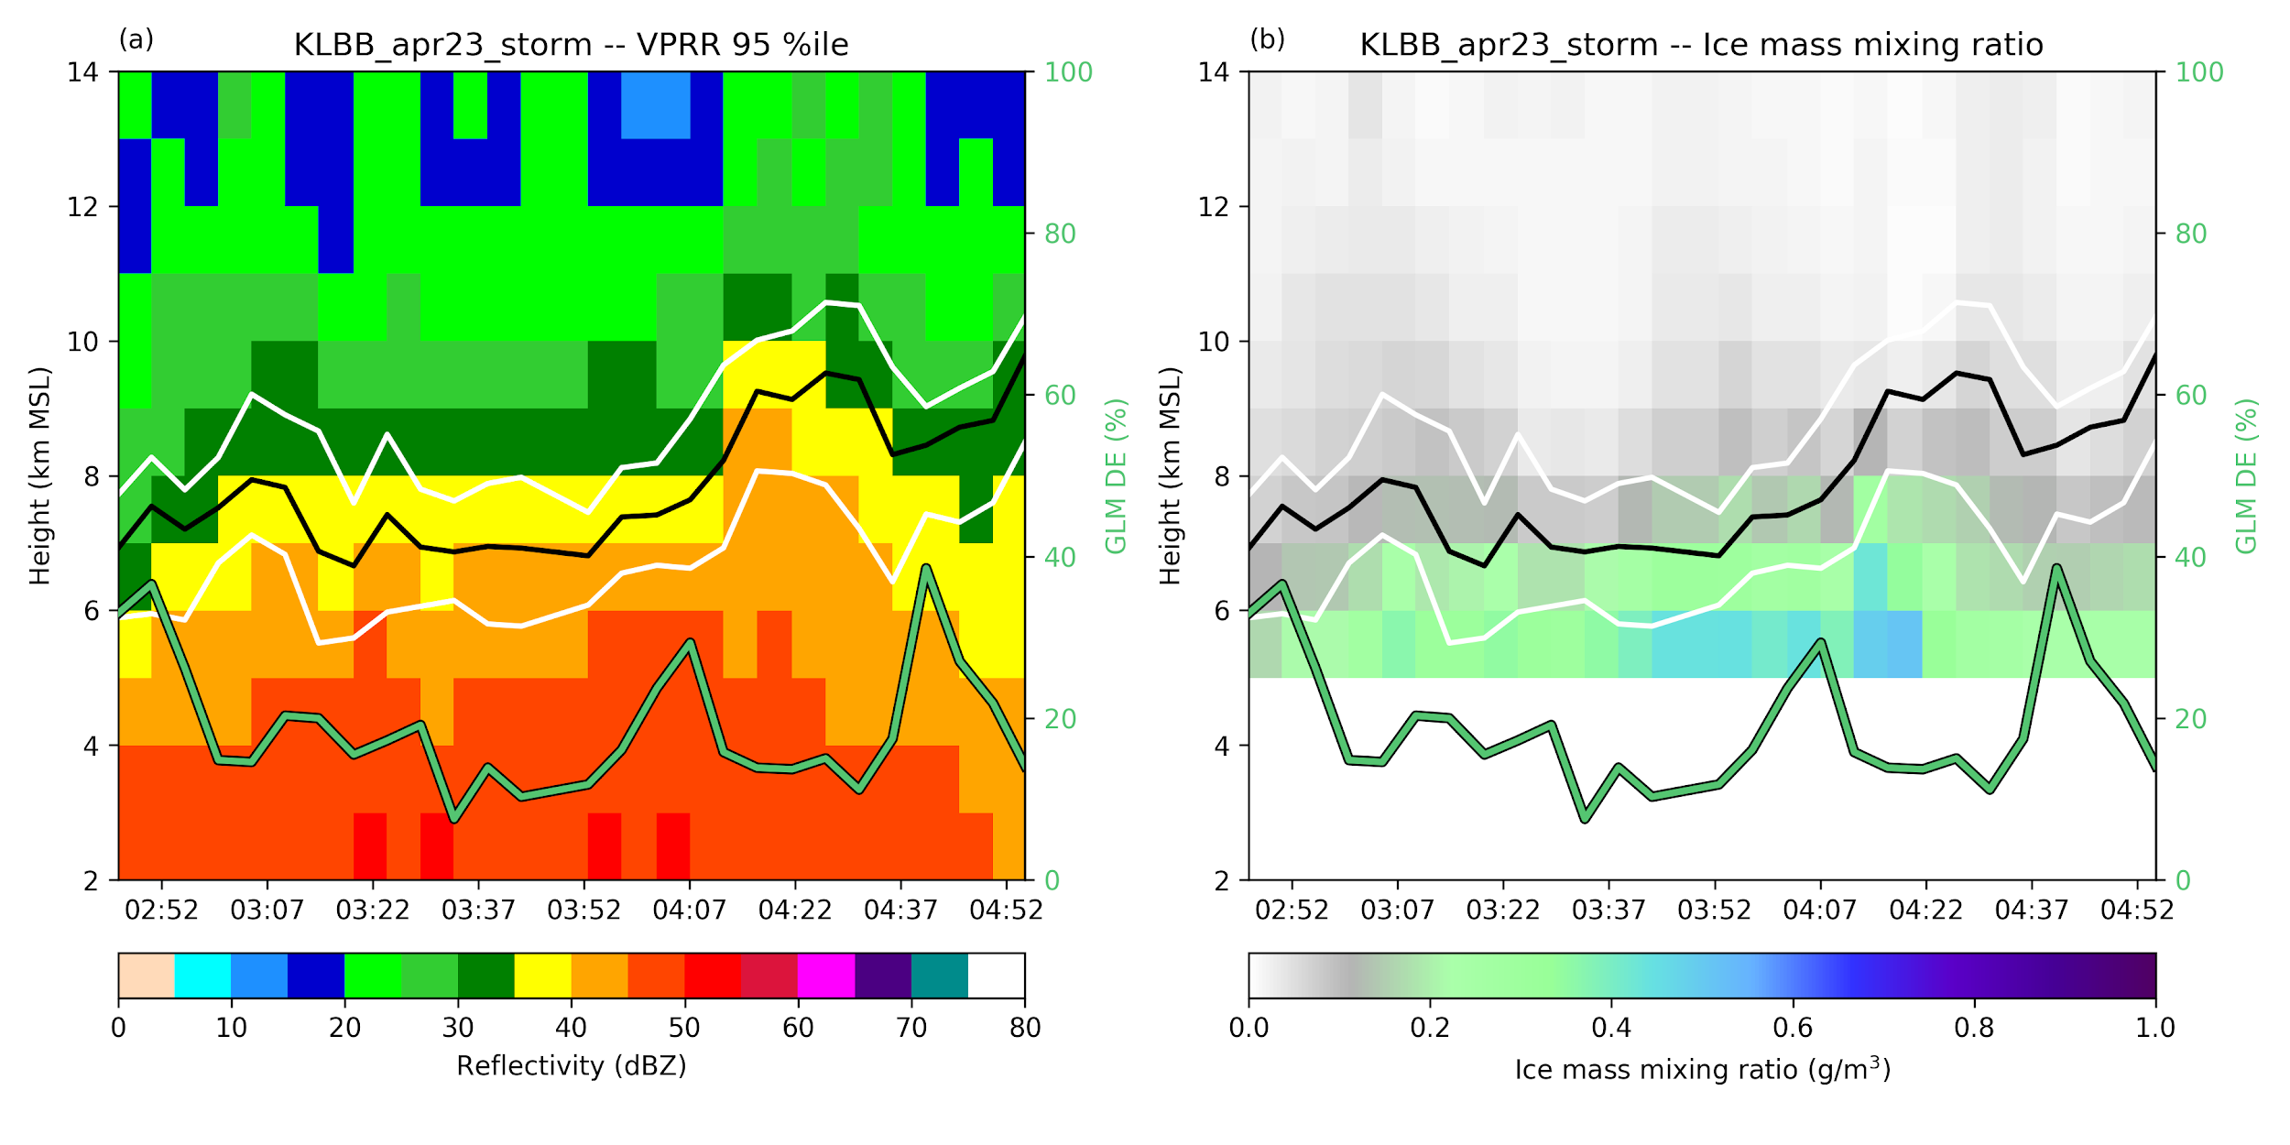
25th, 50th and 75th percentile flash heights shown; significant fraction of the
lightning channels are situated within strong reflectivity

Slide 9
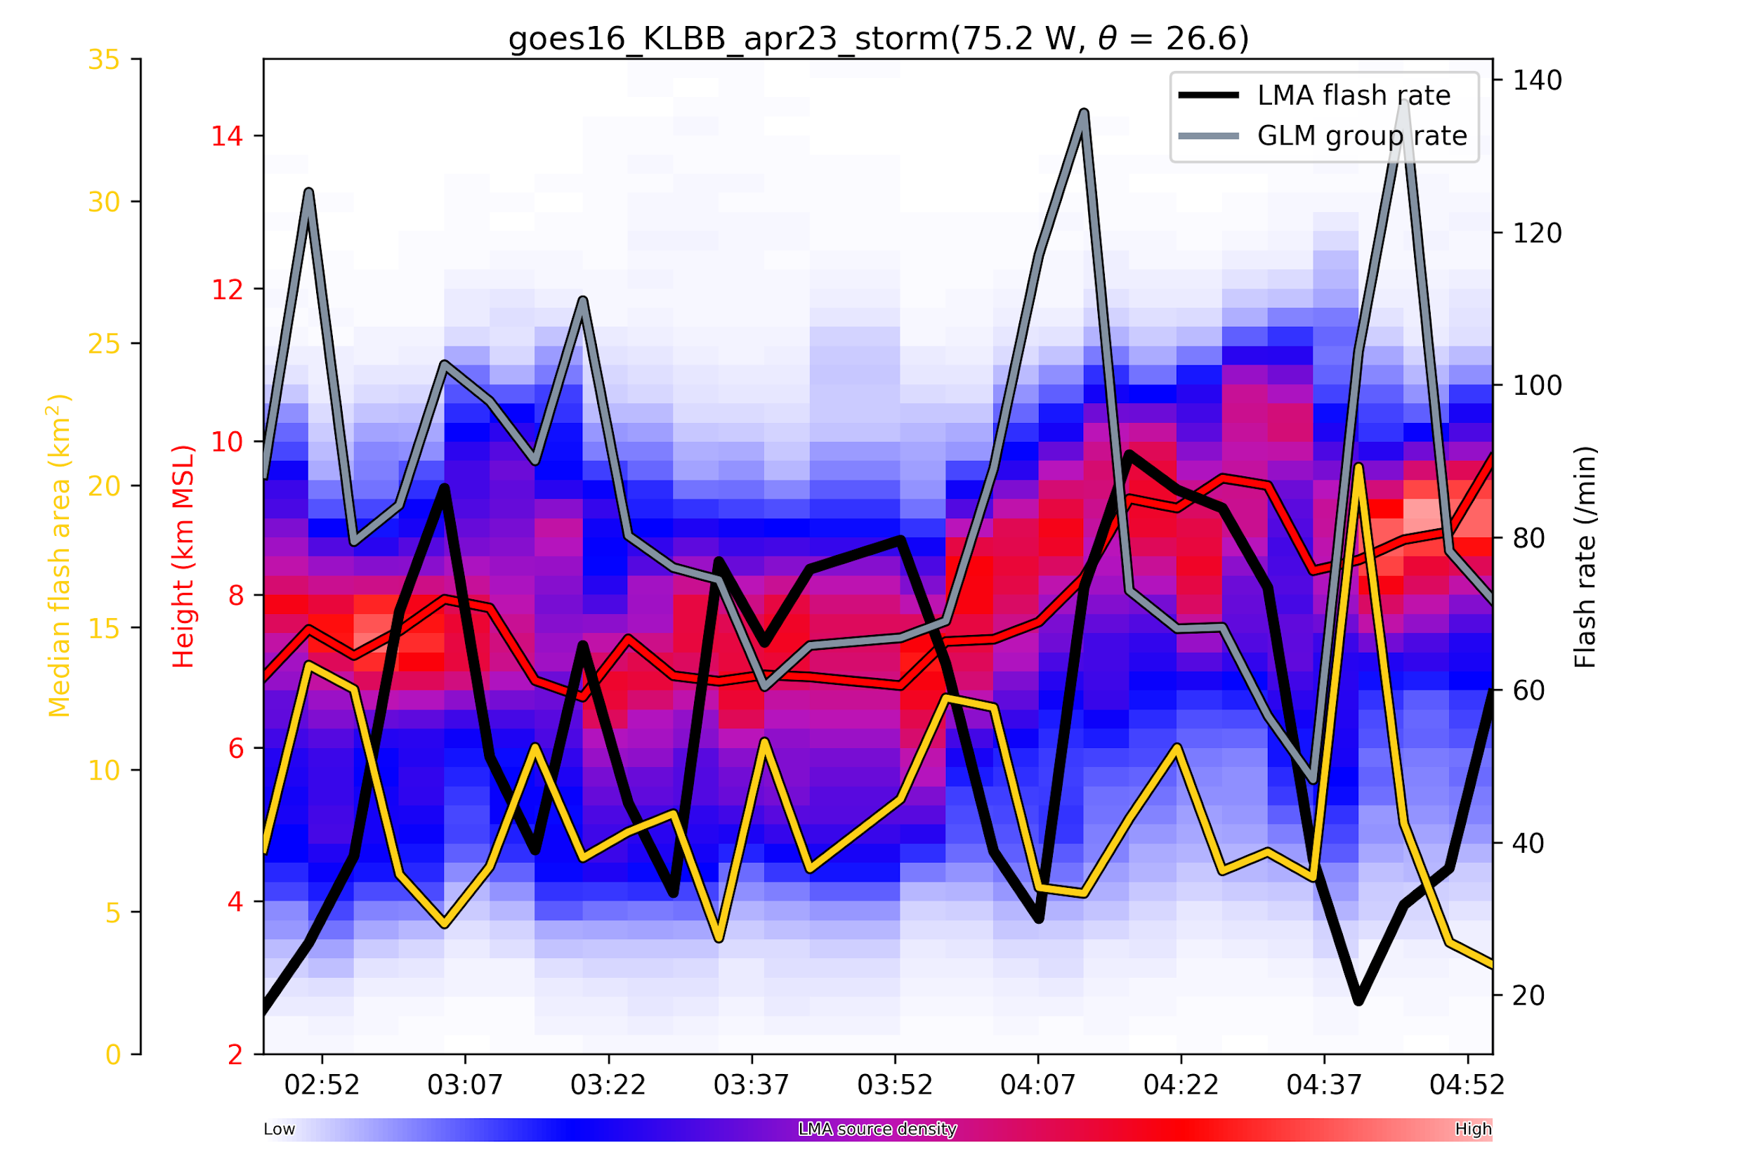
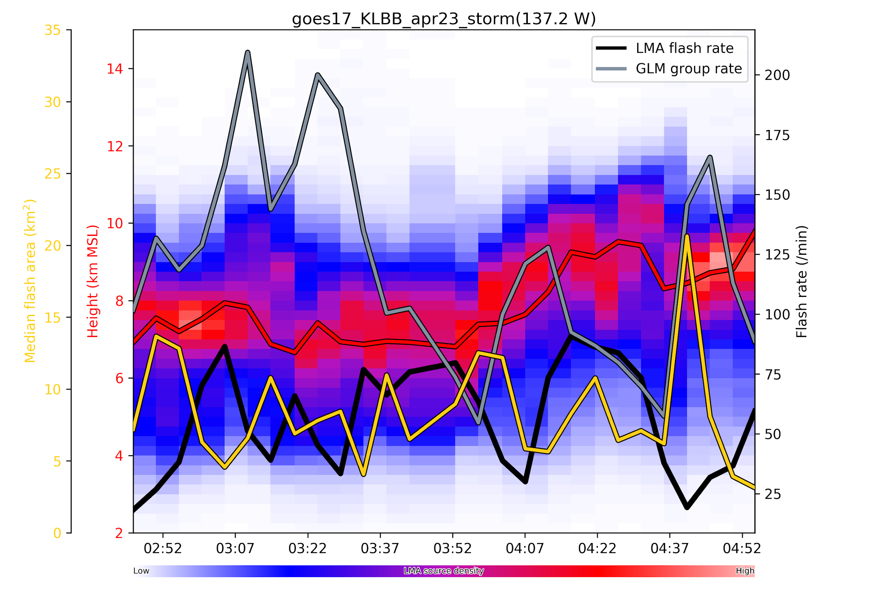
Differences in Group Rates between
GOES 16 and 17

Slide 10
06012018 GLM Group Time series LBB storm, W. TX LMA

Slide 11
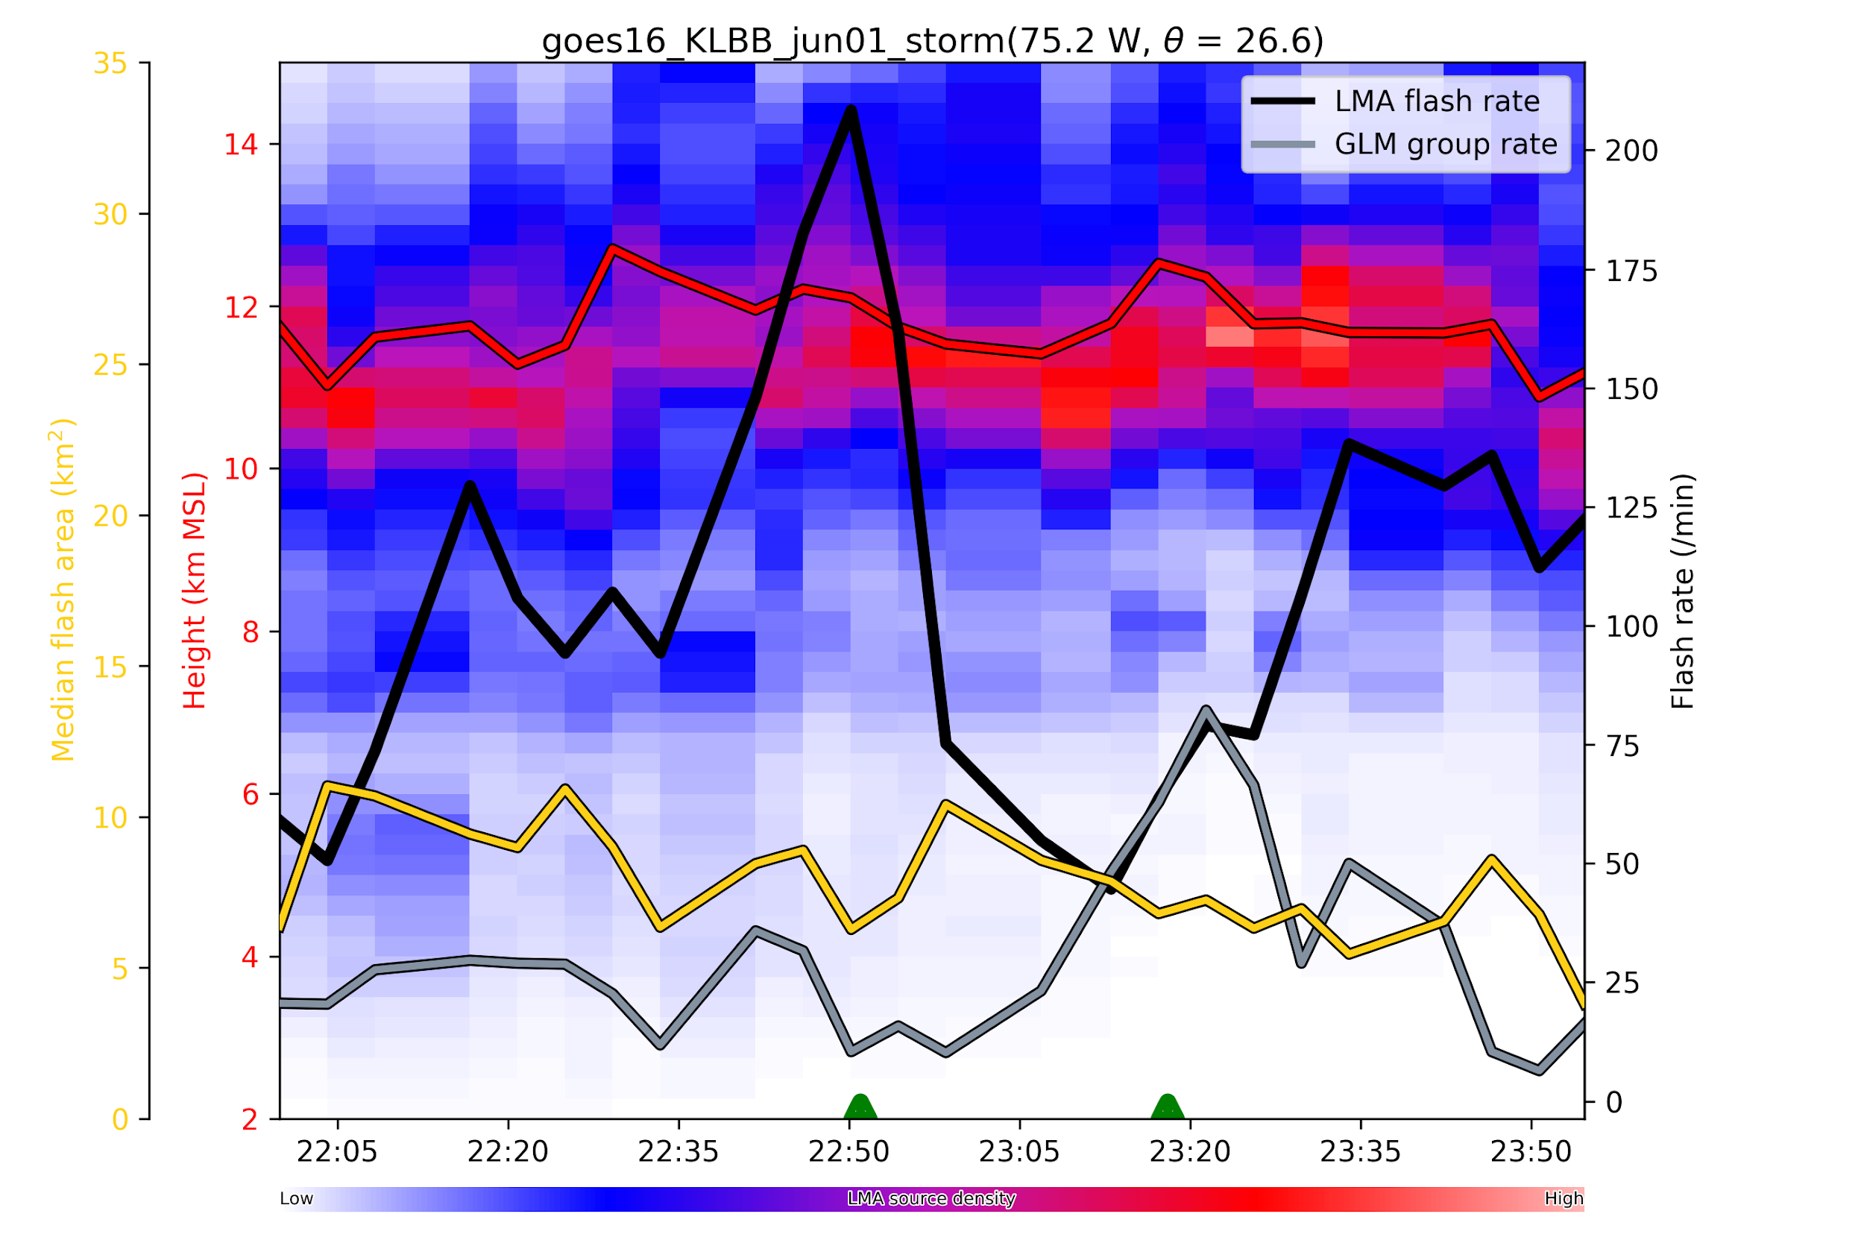

Slide 12
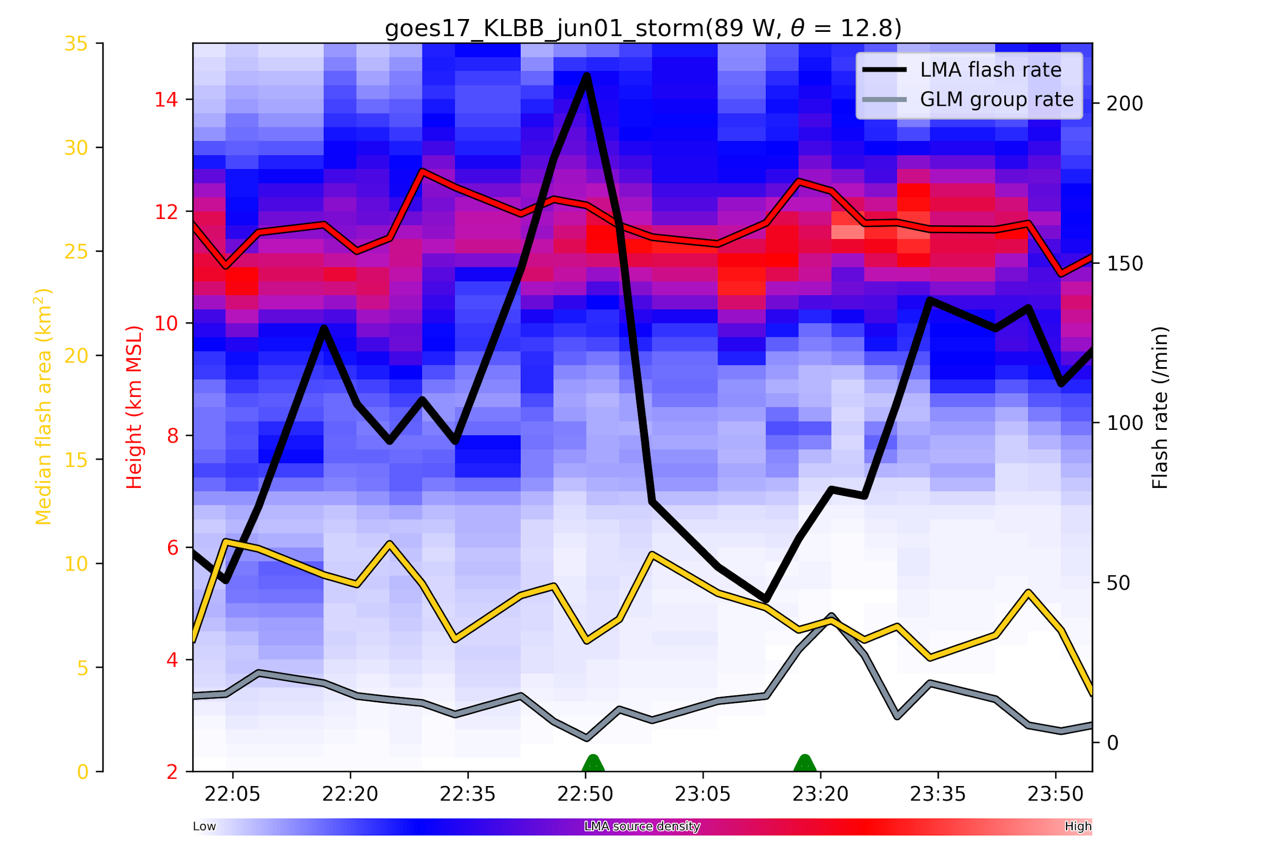

Slide 13
06012018 GLM Event Time series for same storm

Slide 14
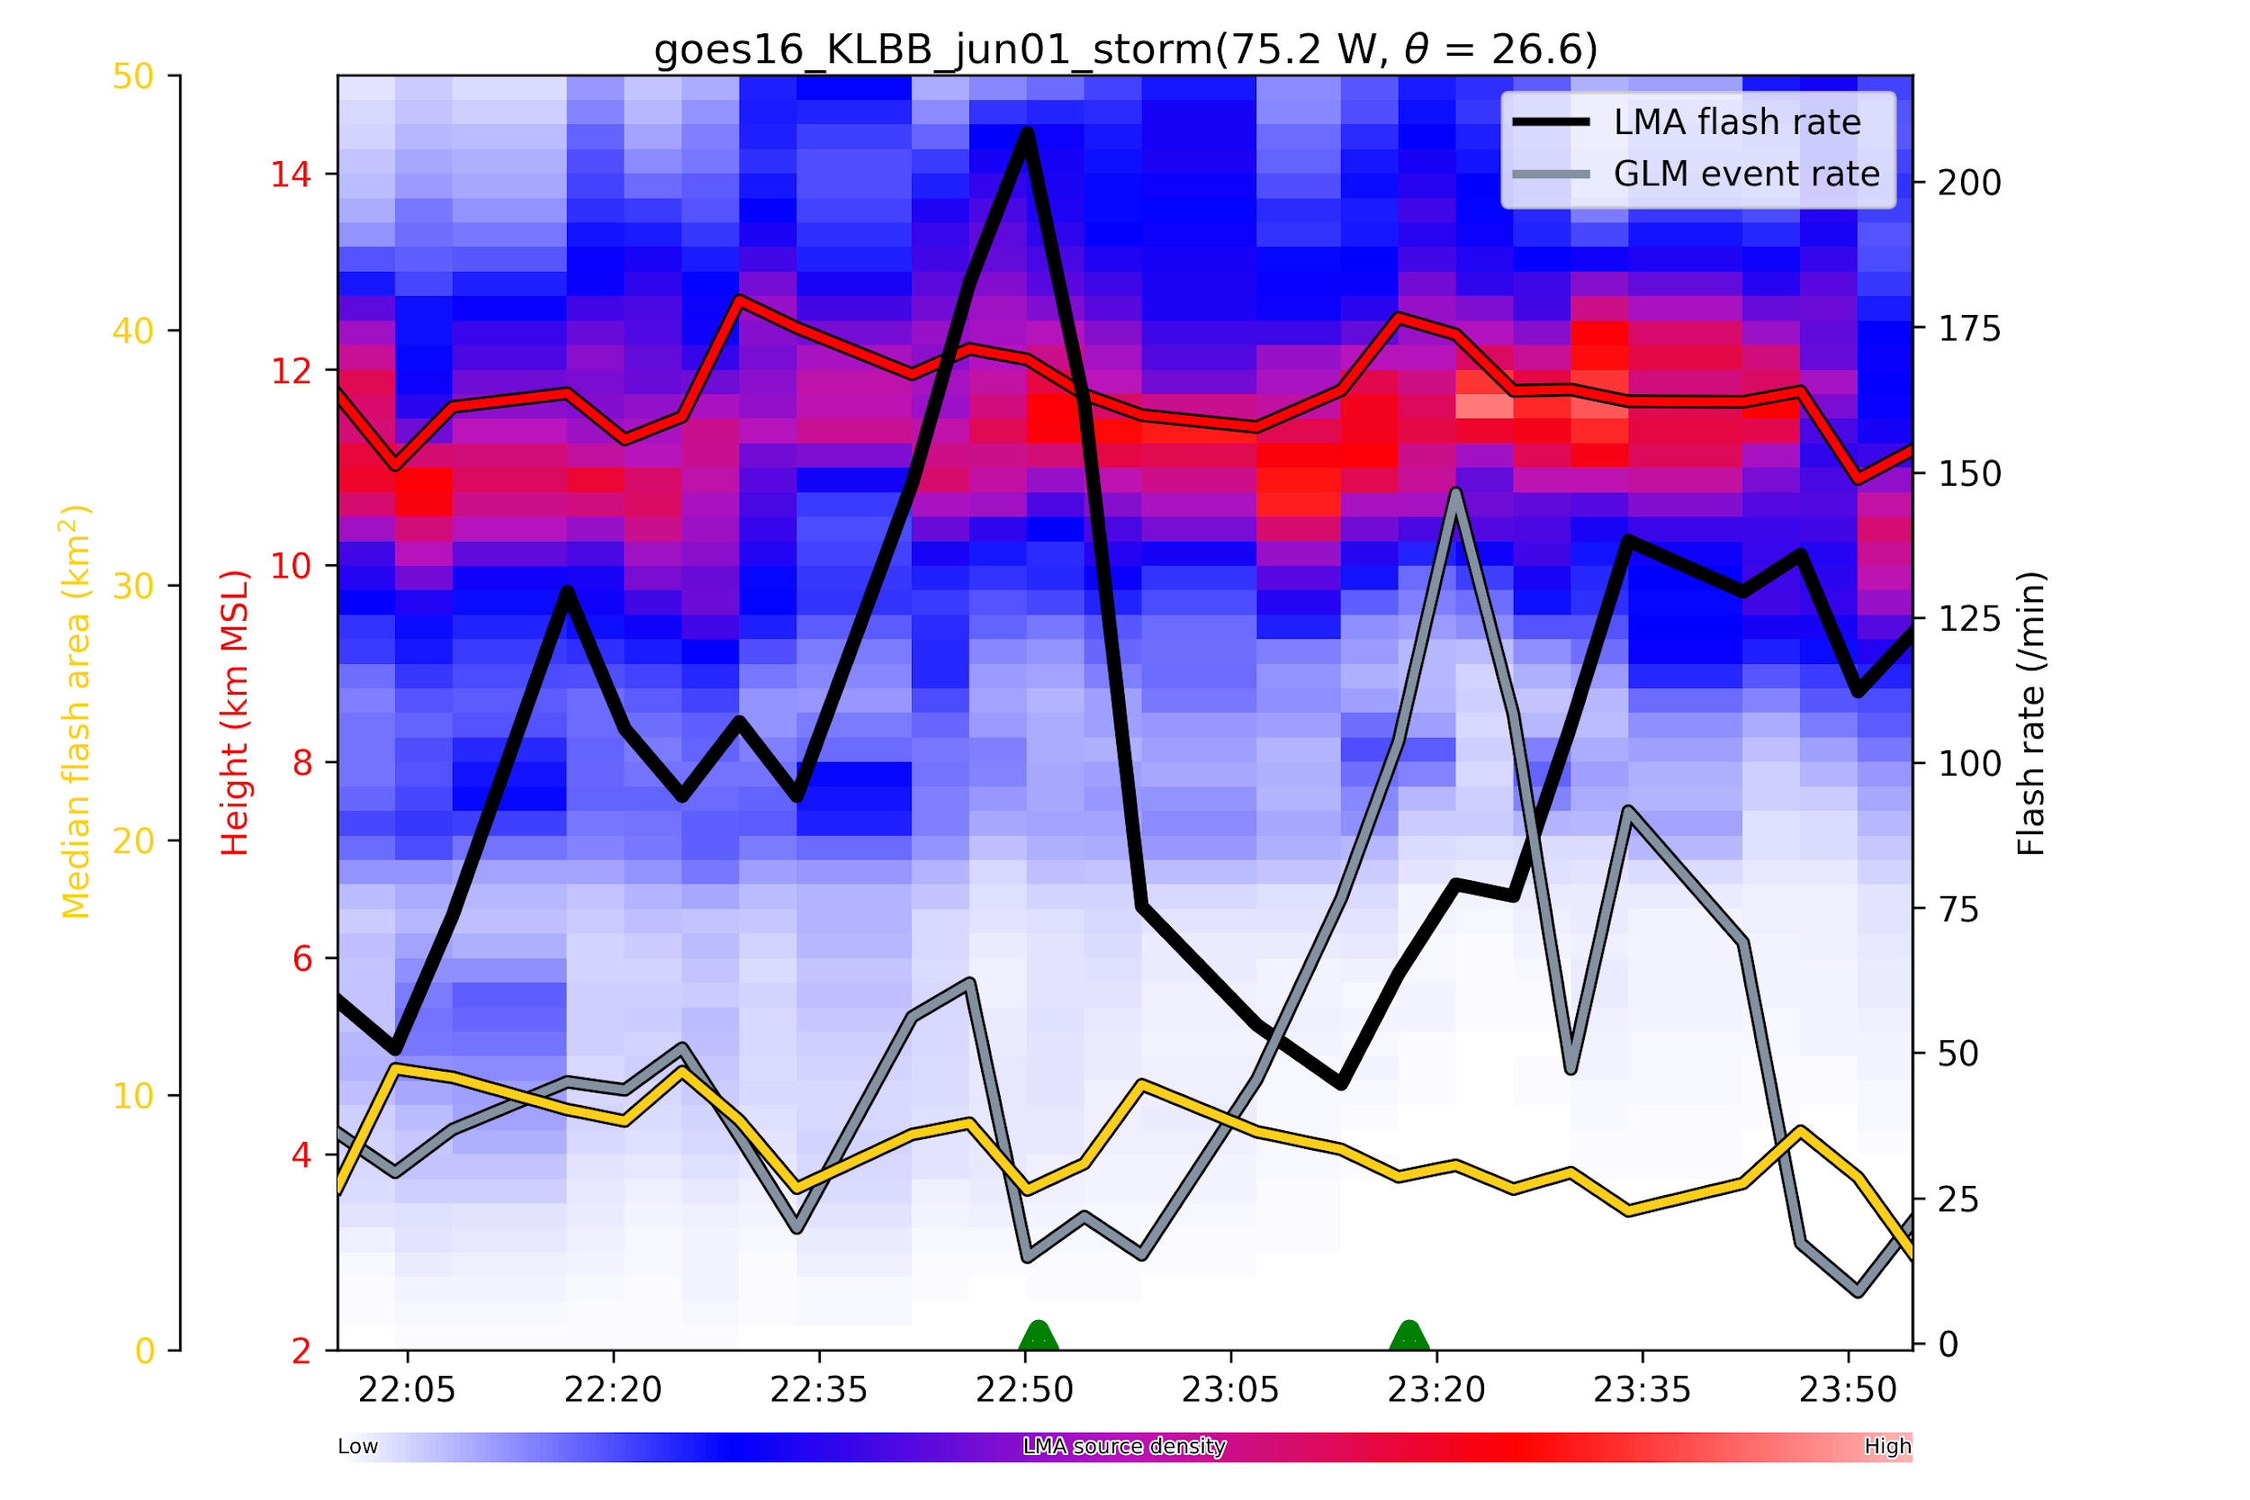
GOES 16
10 point
flash
estimates
in this case

Slide 15
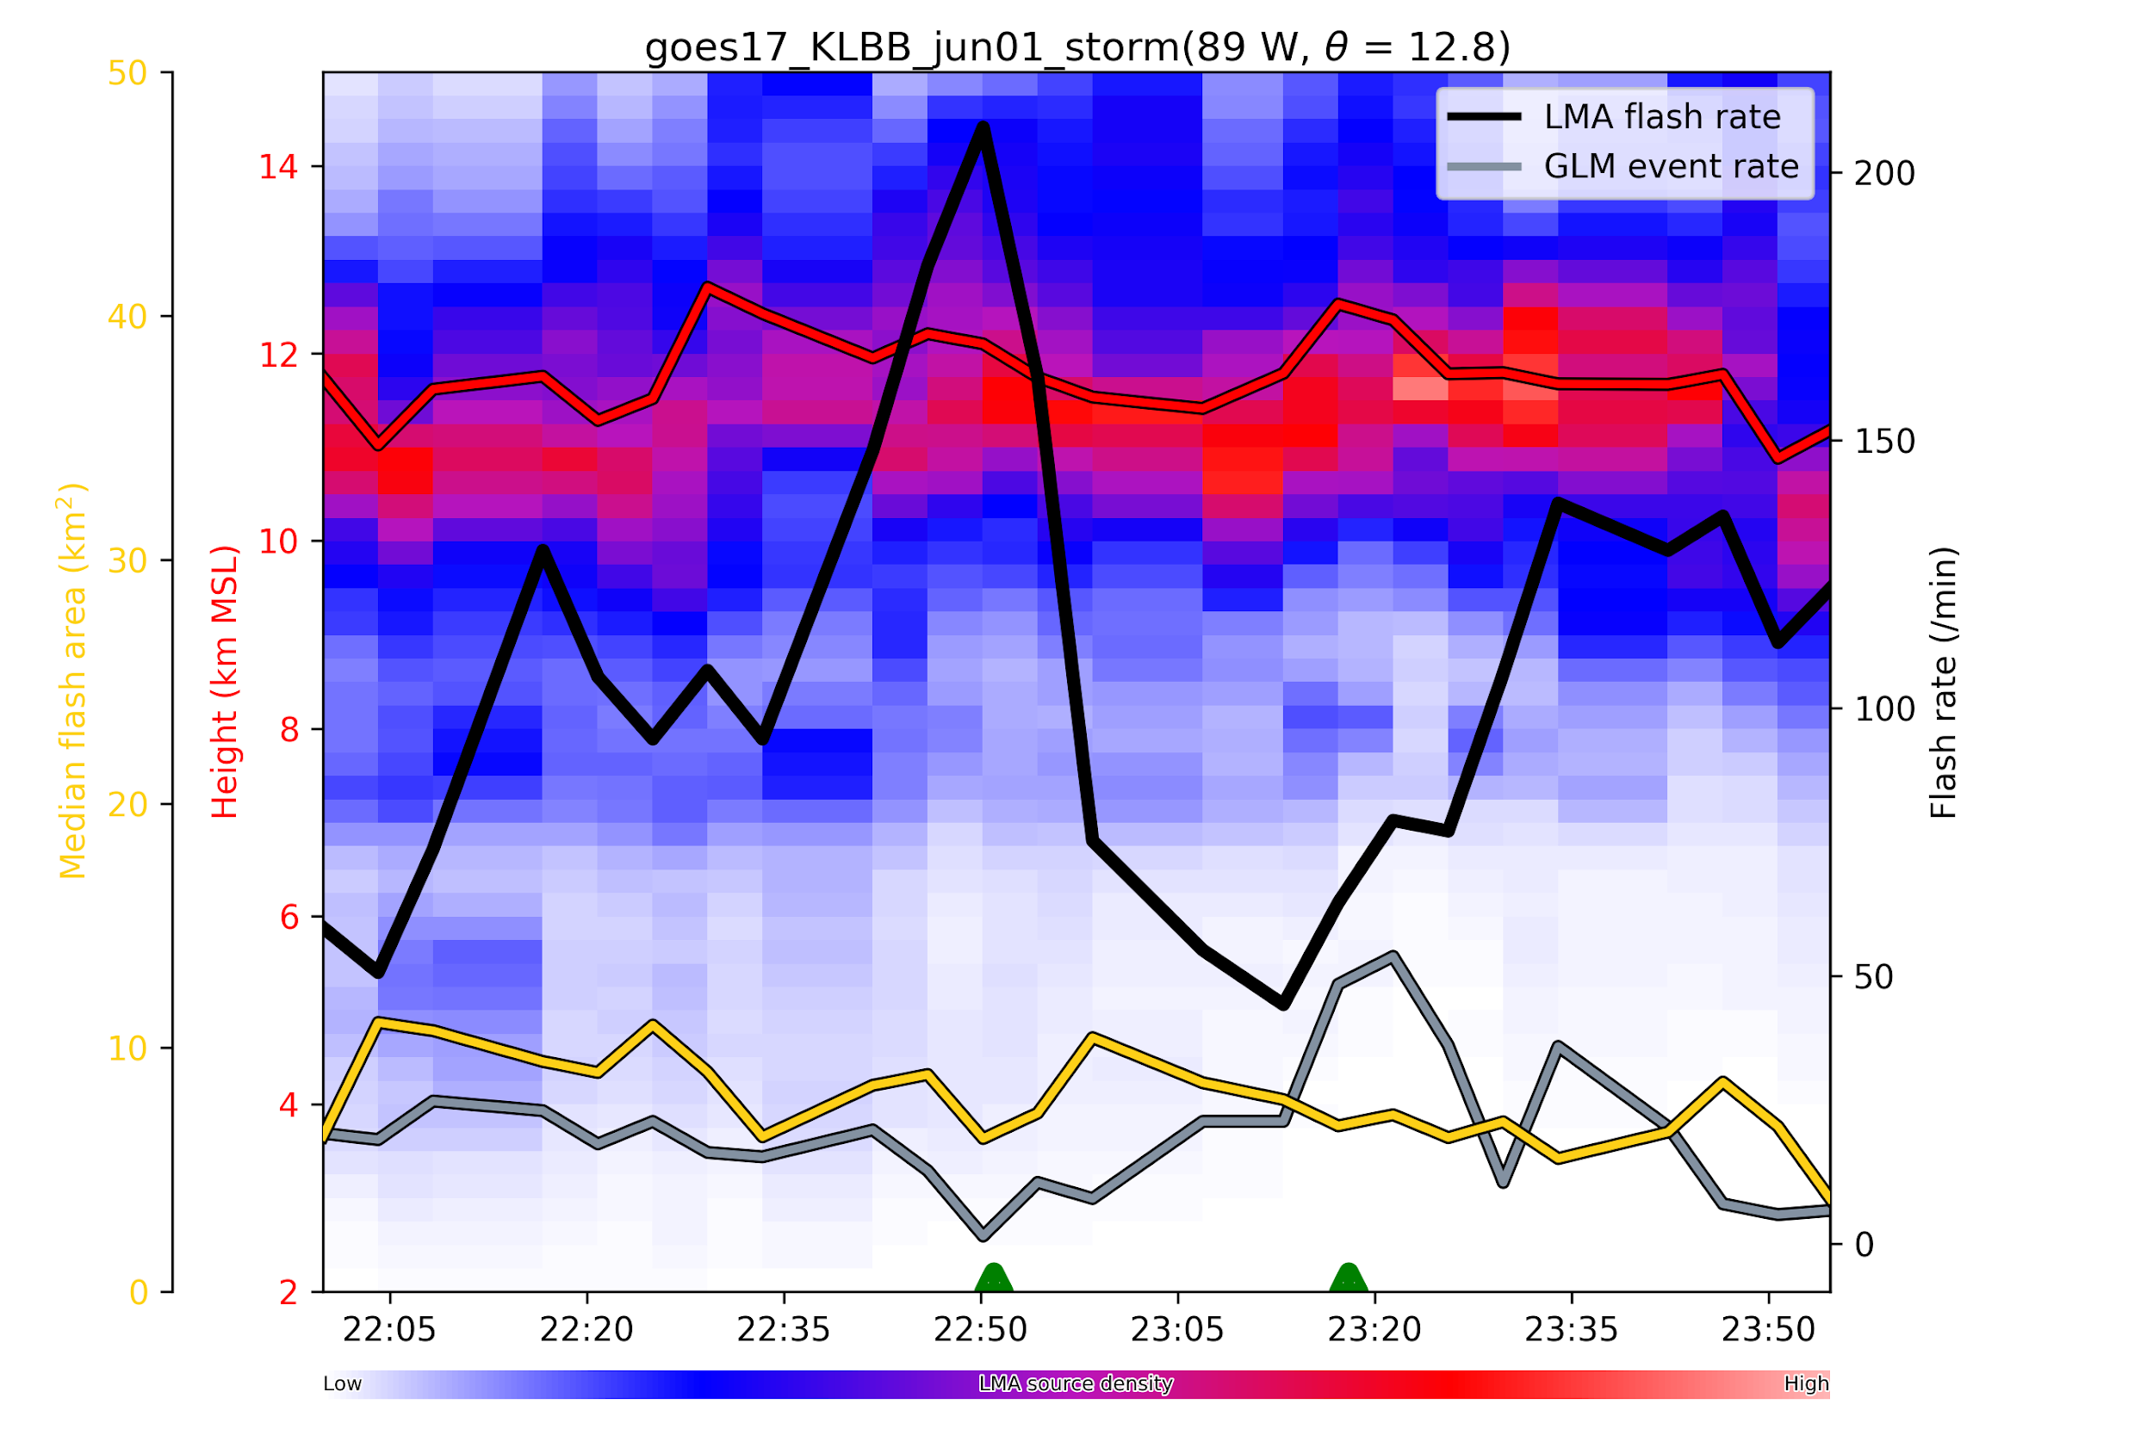
GOES 17

Slide 16
June 19, 2018 CO event

Slide 17
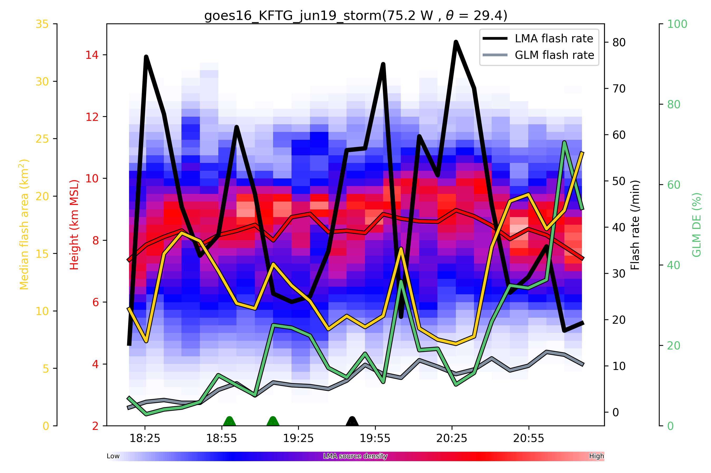
GOES 16
75 point threshold, strong inverse correlation between flash rate and flash size
noted again

Slide 18
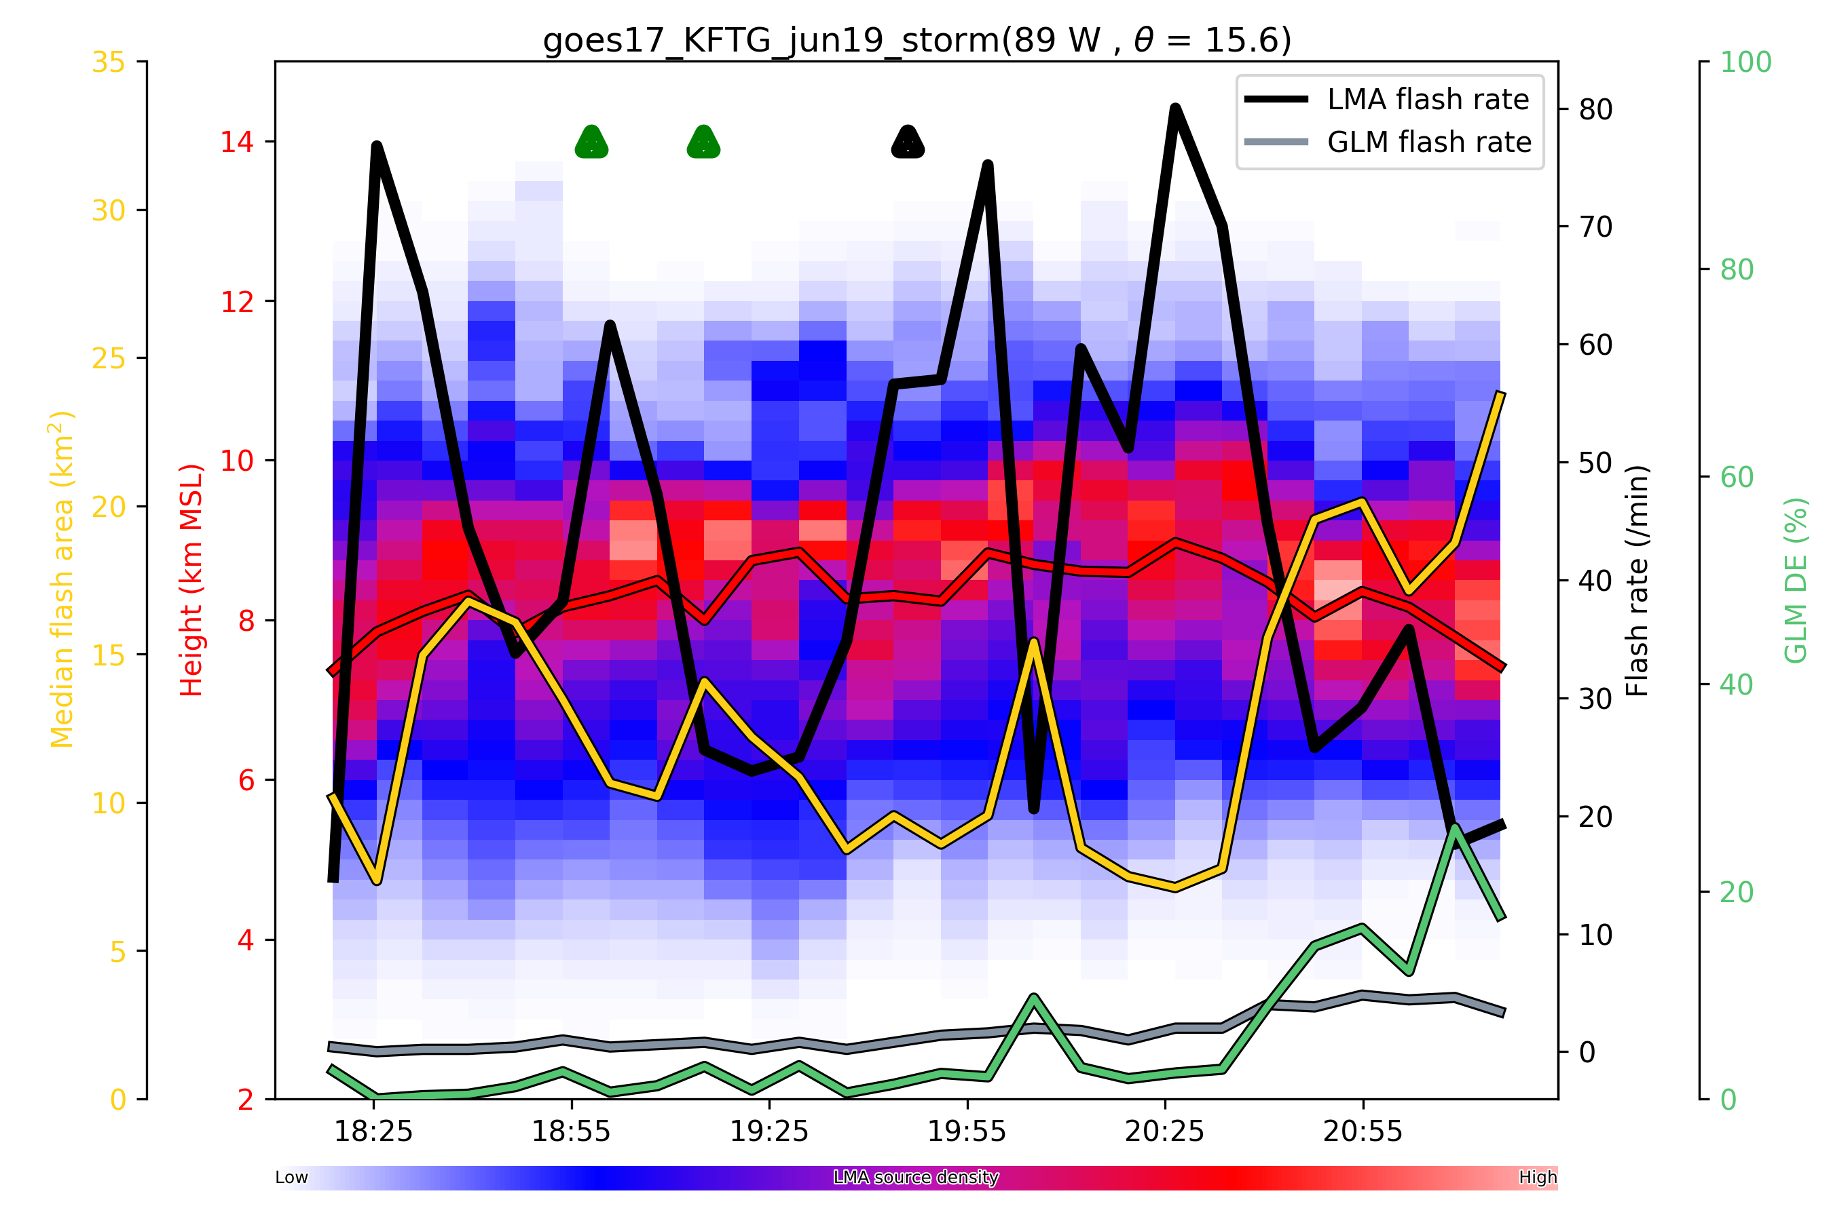
GOES 17

Slide 19
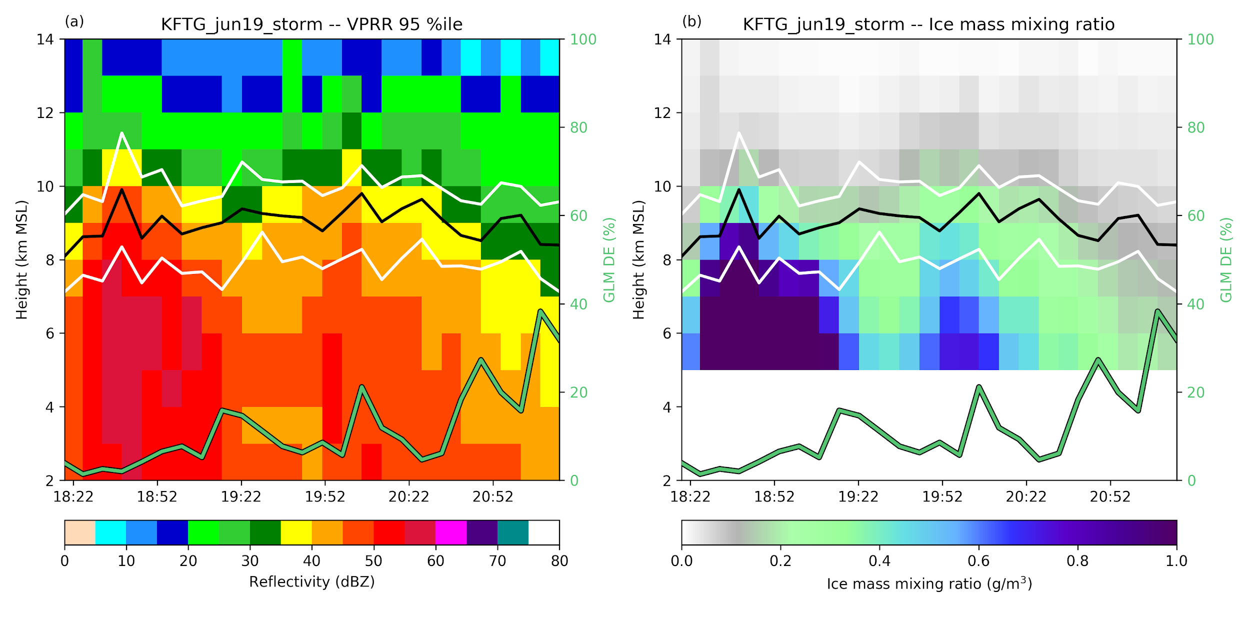

Slide 20
Summary
DE re-evaluated using 75 pt. flash estimates
DE in AL (normal polarity storms) ~ 0.7
DE in CO (inverted storms) ~ 0.2-0.3
Is this difference attributable to scattering by cloud water and cloud ice that are not detected by radar?
Differences in group rates between GOES 16 and 17

