Slide 1
Colorado Front Range Update by S. A. Rutledge, Brody Fuchs and Karly Reimel Colorado State University
Instrumentation
Lightning in Colorado storms, some unique opportunities for GLM cal/val
Non-supercellular tornadoes

Slide 2
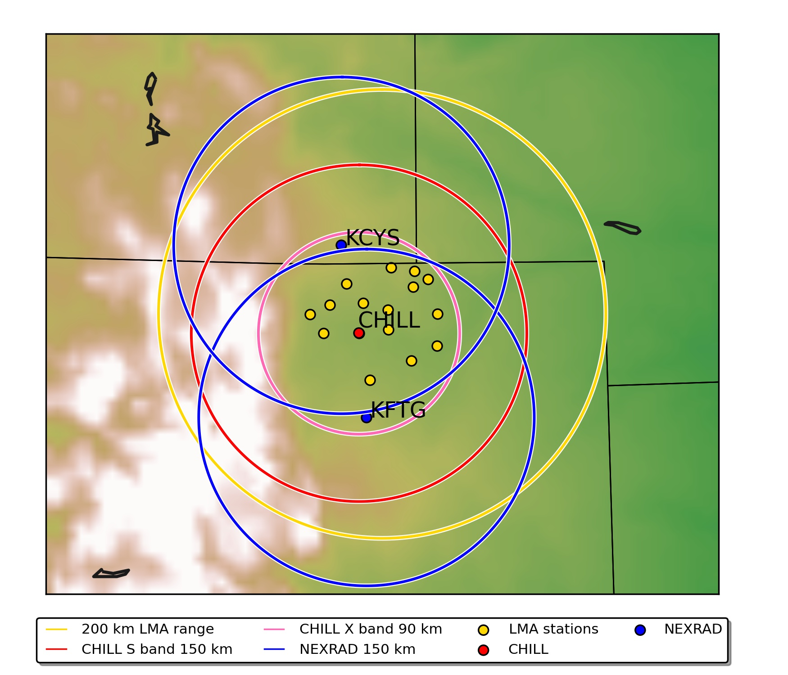
Colorado LMA/Radar network
2 NEXRADs plus CSU-CHILL S/X-band radar
NE Colorado Lightning Mapping Array (LMA), 15 stations
Plenty of storms in northeastern plains, in prime coverage
Notes:
Need to add labels here

Slide 3
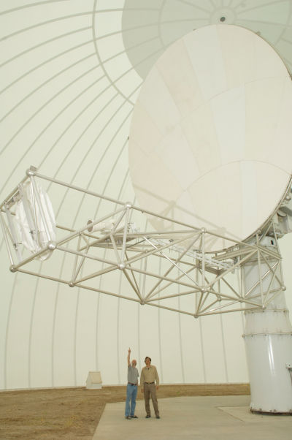
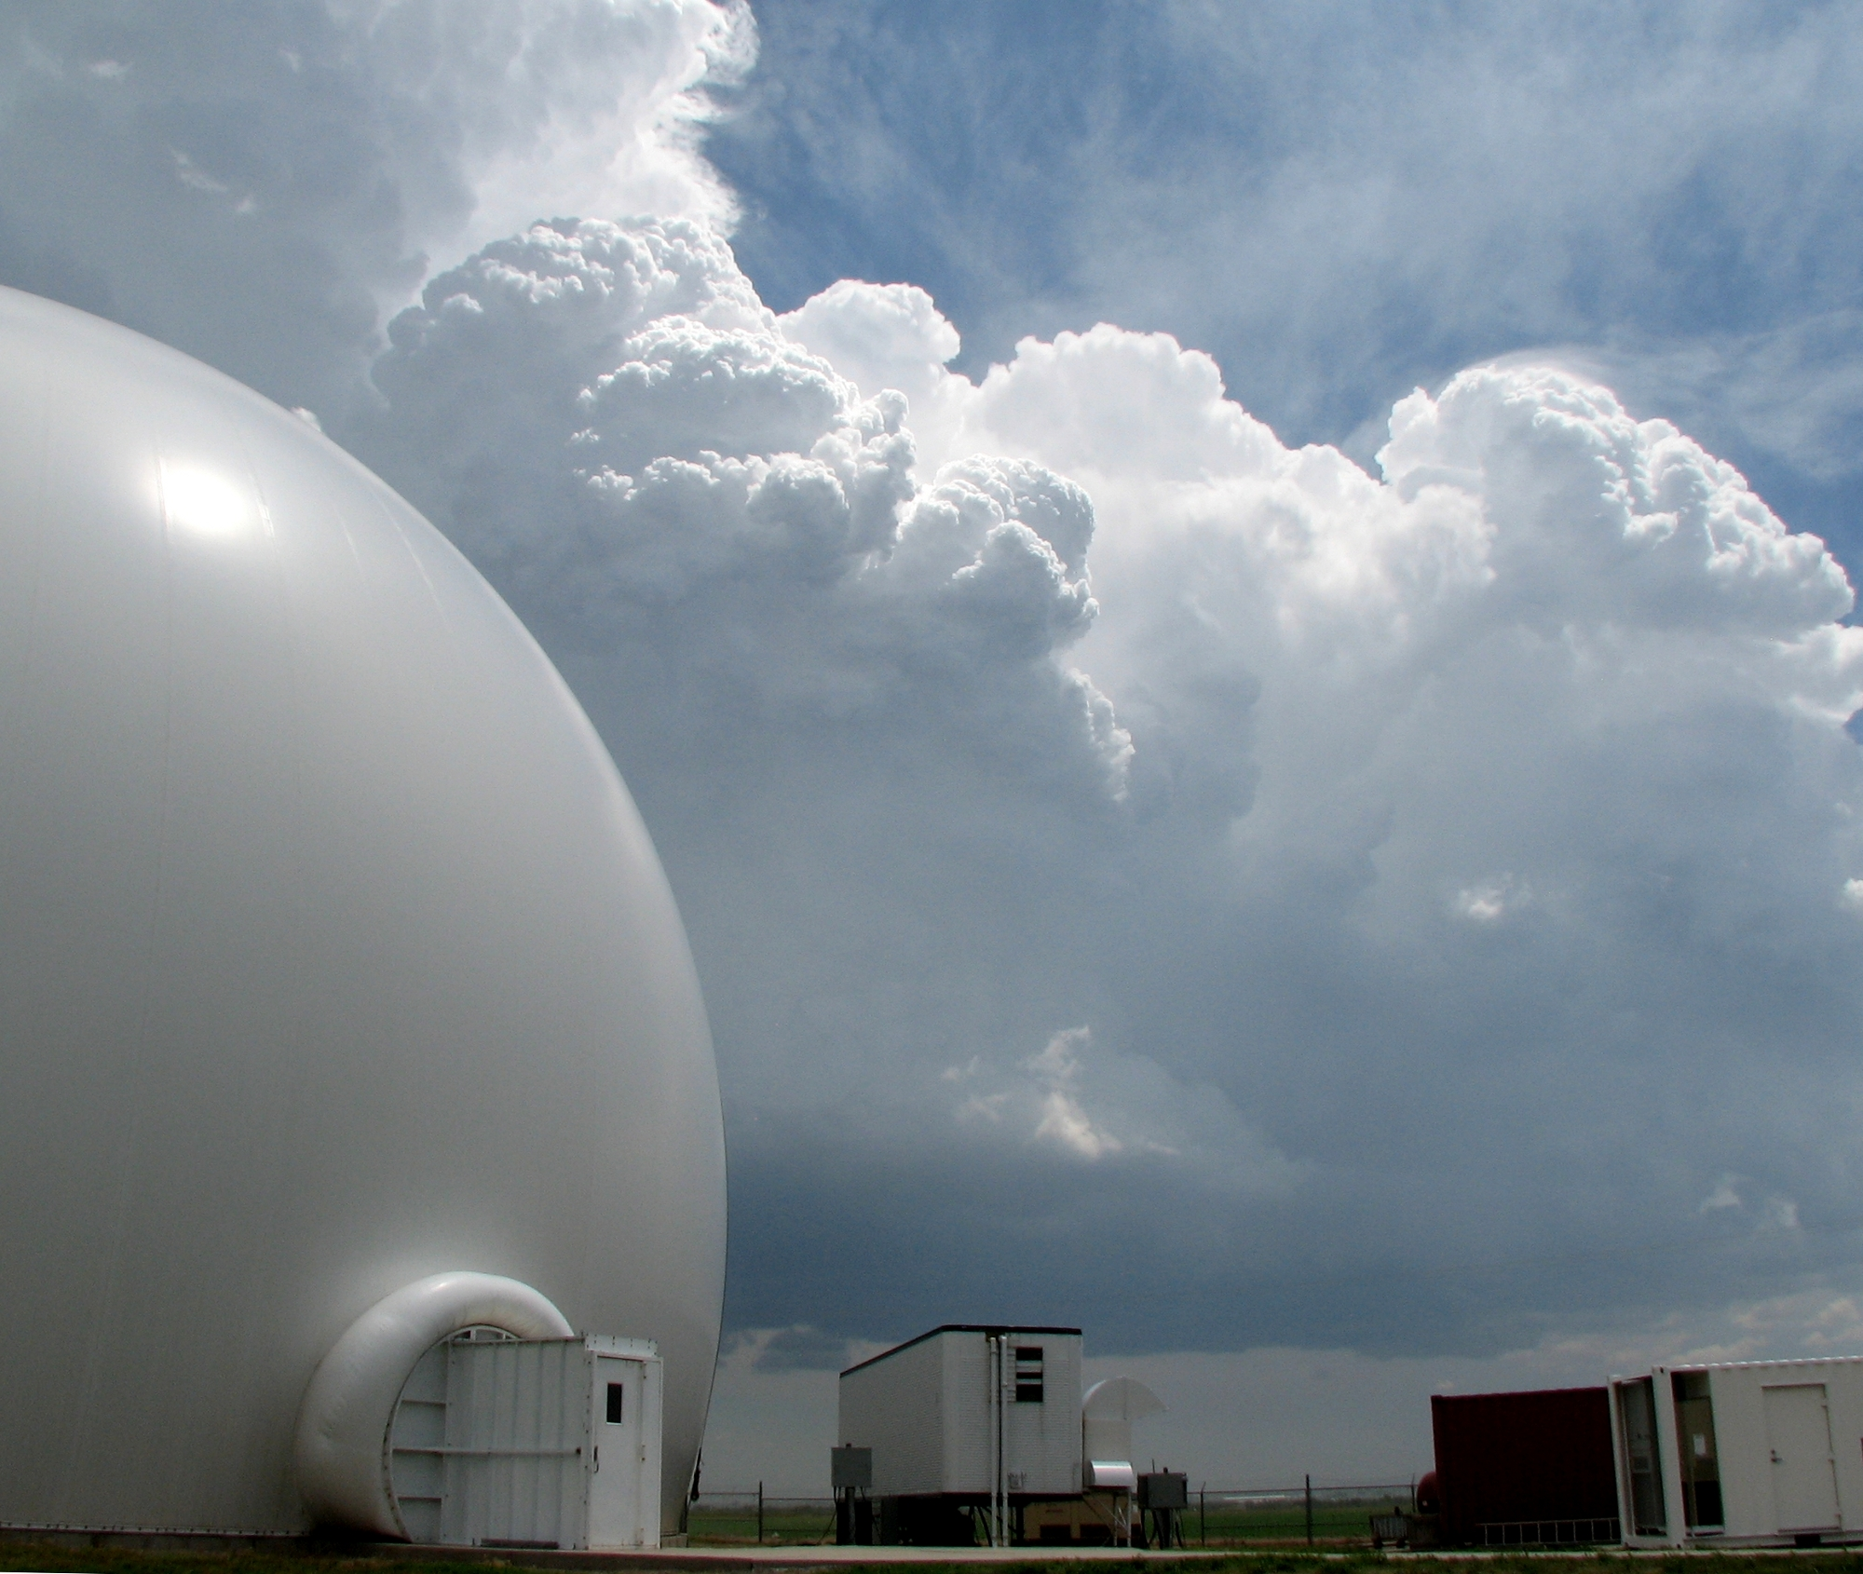
CSU-CHILL
Inside
Notable specs
8.5 m Gregorian offset parabolic antenna
Polarimetric and dual frequency (S/X)
1.0° beam at S band, 0.3° beam at X band
High performance antenna, approx. -35 dB sidelobes
Solid state transmitter with pulse compression (S-band)
1 MW effective power at S band
25 kW effective power at X band
Available via 20 hour project mode
Outside
Courtesy Pat Kennedy; Junyent et al. (2015)
Notes:
Grab some data, too

Slide 4
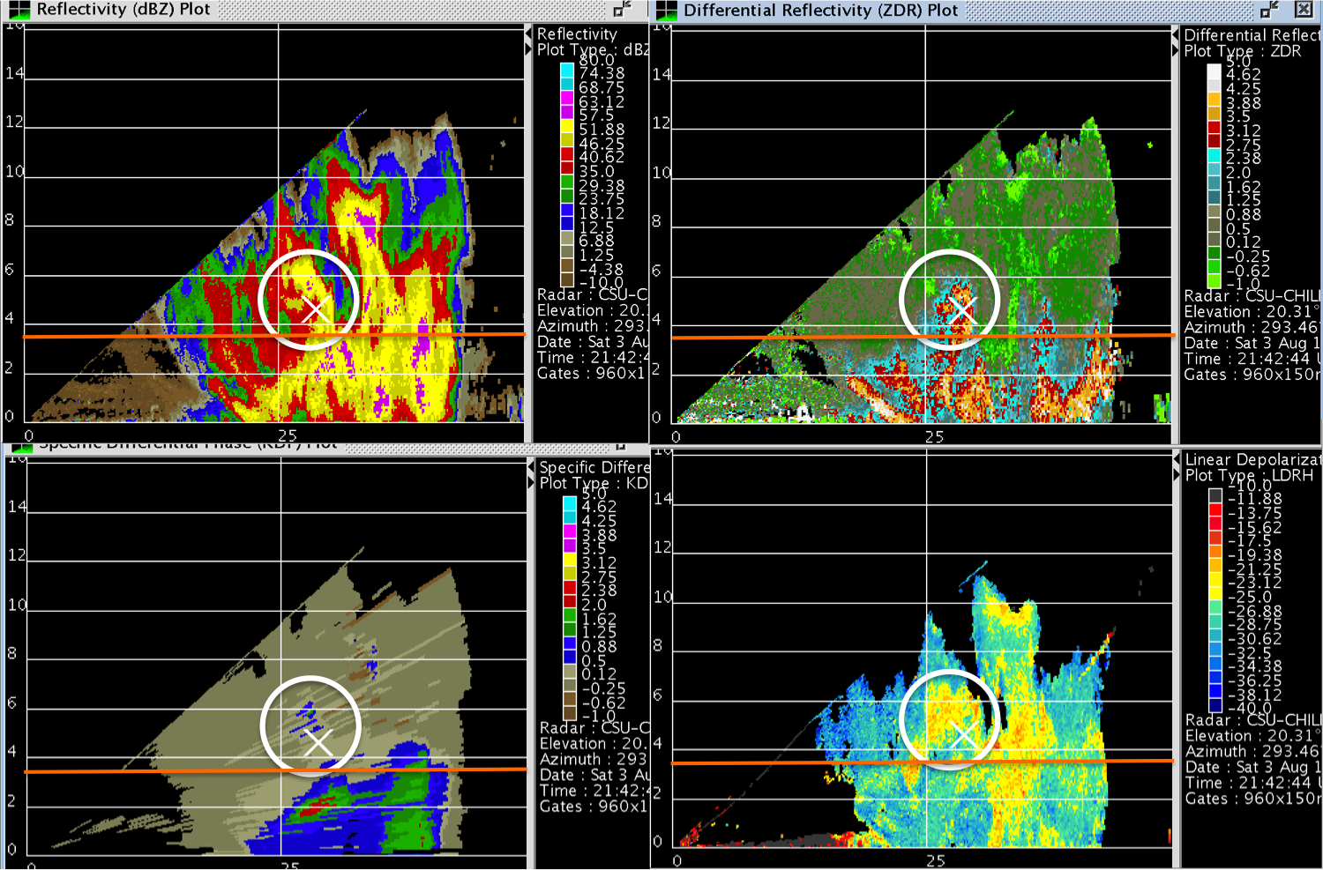
3 August 2013 CHILL case for severe, anomalous storm

Slide 5
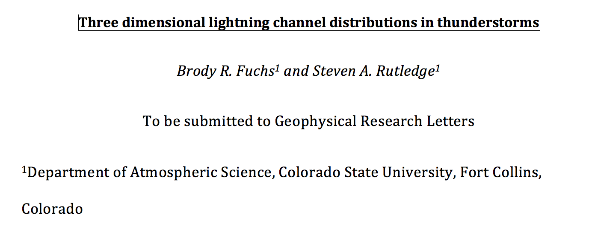
Recent work
NE CO LMA deployed in
advance of the DC3
project in 2012, thanks to
Paul Krehbiel and colleagues
plus NSF
Use LMA to understand storm processes
Flash rates
Charge structures
Use the LMA data to provide new information on lightning
Flash sizes, channel locations
Comparison to satellite-based lightning observations
NOx production and transport implications
NE CO LMA demonstrates the uniqueness of Colorado storms
Notes:
- Talk about flash counting algorithm paper and the new GRL paper in review
- Just introduce them and the broad impacts that they may have

Slide 6
LMA performance
Alabama
Colorado
Colorado network
High detection efficiency
Latest station design
15 stations
Remote station locations
Low noise floors
More consistent flash characteristics with increasing range in Colorado; NE CO LMA network uniquely detects weak flashes at far range
Many more points per flash, preserving flash duration and flash area with range
Fuchs et al. (2016)

Slide 7
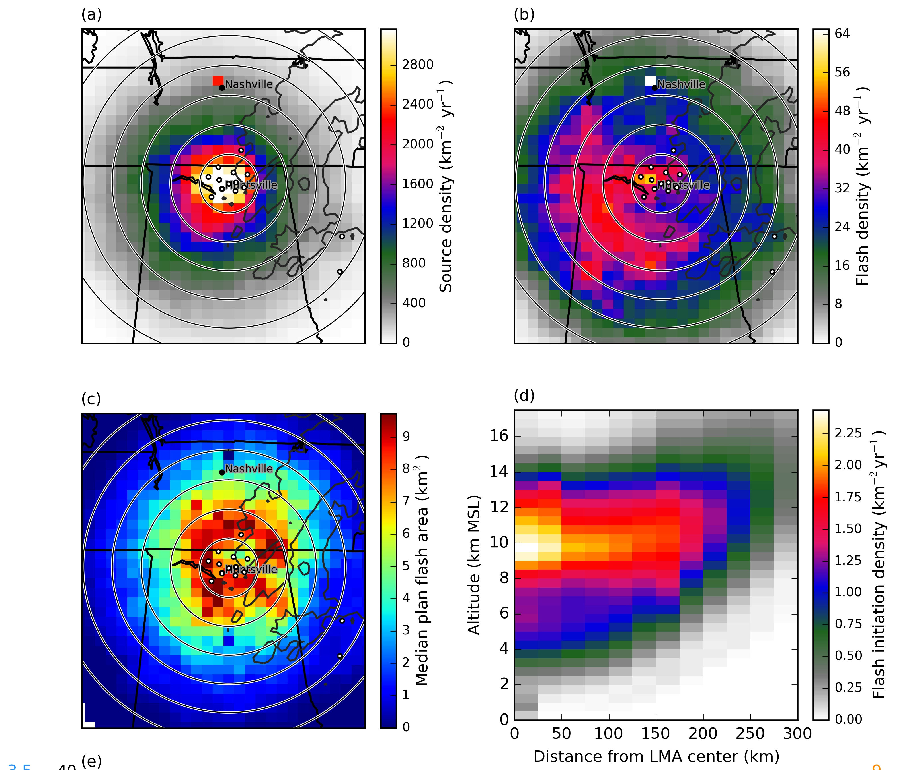
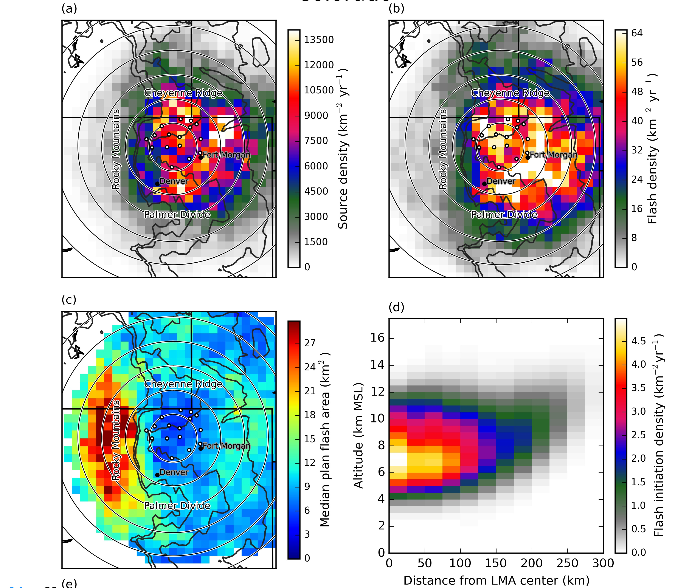
LMA derived flash climatologies
Alabama
Colorado
Much larger flash rates on Colorado plains compared to Alabama
Much higher IC:CG values in CO, characteristic of intense storms with high cloud base heights
Lower initiation heights in Colorado (MSL; return to this in a few slides)
Fuchs et al. (2016)
Notes:
Find the Cecil (2014) figure for comparison purposes.

Slide 8
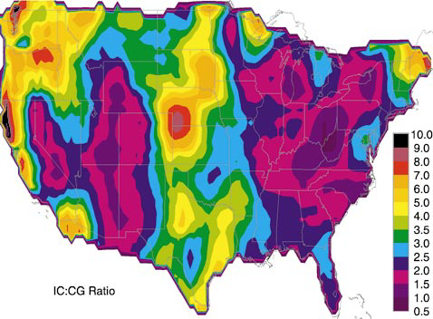
Comparison with satellite estimates
Flash density
IC/CG ratio
15-30
20-30
5-9
40-75
25-45
12-25
2-3
3-5
Alabama mostly in line with satellite estimates
For Colorado, LMA-derived values for flash density ~ 3 times larger than corresponding satellite values; IC/CG ratio about 2-3 times larger
Reasons for this behavior?
Boccippio et al. (2001); Cecil et al. (2014); Fuchs et al. (2016)

Slide 9
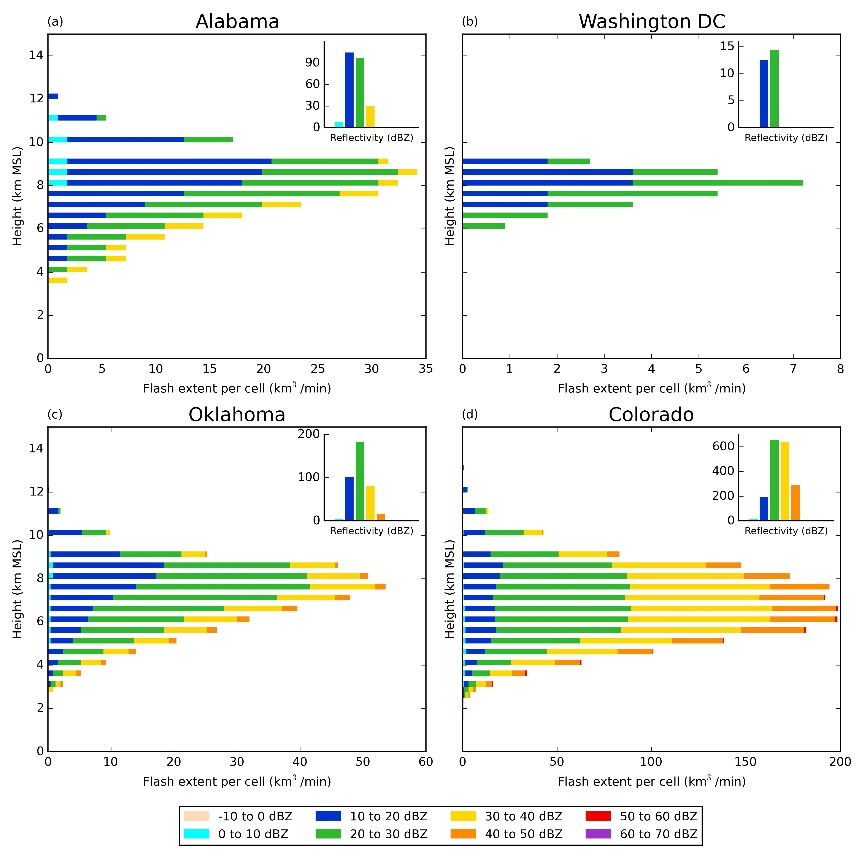
Representative flash channel distributions
Location of lightning channels within ~ 4000 storms
Grid LMA sources from flashes
Sum x,y grid boxes that contain sources and find flash volume for 1 km height bins
Collocate with reflectivity
Colorado flash channels are situated at lower altitudes and within significantly higher radar reflectivities compared to AL storms
Are there implications for detecting flashes by GLM?
Fuchs and Rutledge (2016) in review

Slide 10
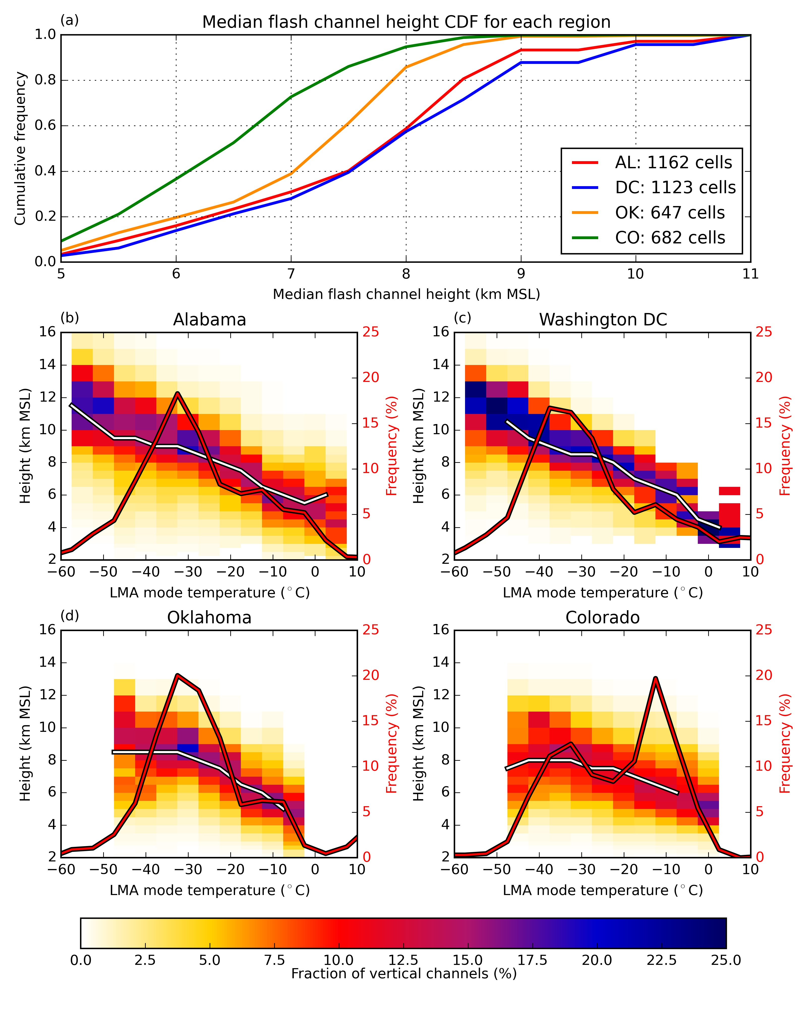
Flash channel heights
Lowest median channel heights in CO
Lightning follows strong positive charge (LMA mode)
Colorado has much higher fraction of anomalous storms (low LMA mode favored in CO)
With markedly high flash rates, low altitude lightning channels and “warm” LMA mode temperatures
Fuchs and Rutledge (2016) in review

Slide 11
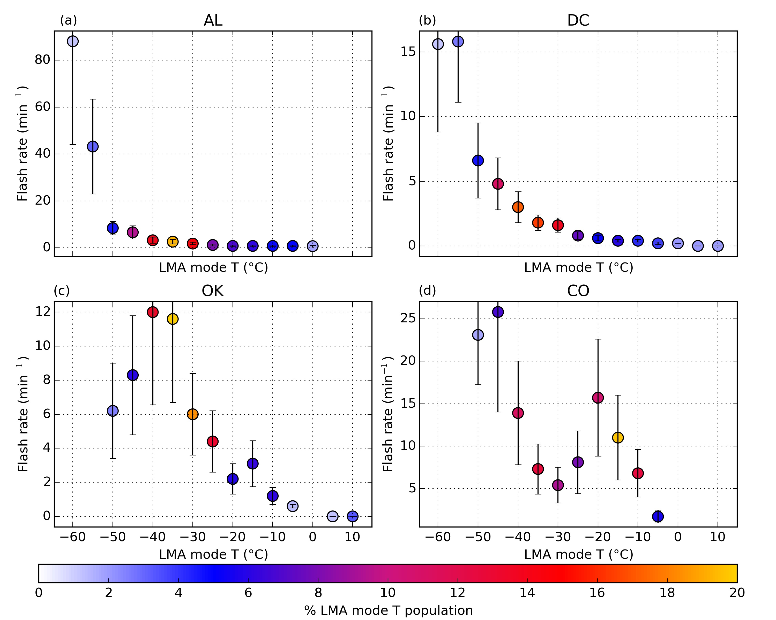
Flash rates and charge structures
normal
anomalous
normal
anomalous
AL dominated by normal polarity storms and high altitude flash channels; warm LMA modes associated with decaying convection (EOSO events)
CO storms appear to have a strong dipole charge structure at low levels producing large flash rates, high IC/CG ratios and low flash channels
Fuchs et al. (2015)

Slide 12
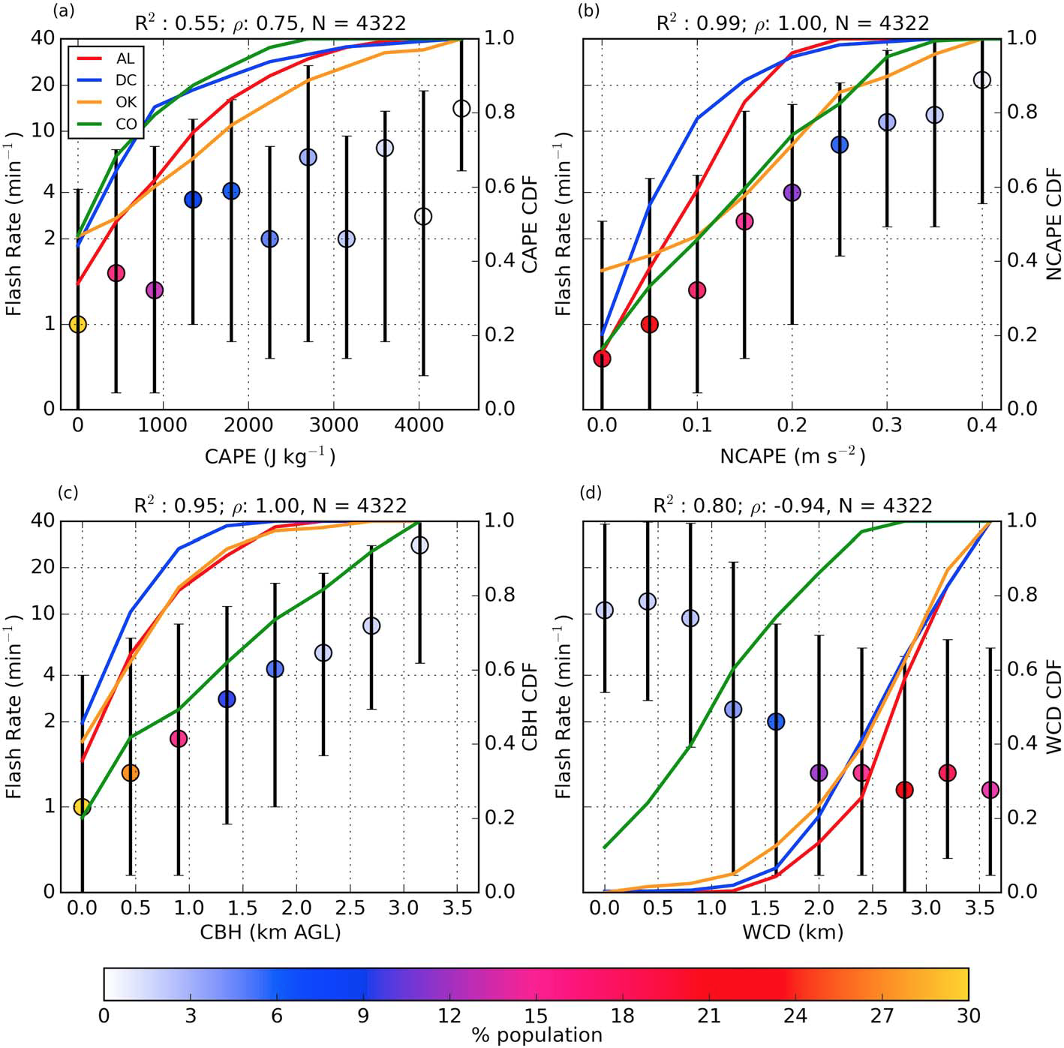
Environmental role
Dots are median flash rates for storms in parameter bin
Lines are environmental parameter CDFs
Colorado stands out with high cloud bases and shallow warm cloud depths leading to high supercooled water contents and positive charging of large ice particles
High flash rates, large IC/CG ratios and low flash channels result
Fuchs et al. (2015)

Slide 13
Summary
Alabama storms
Temperature (°C)
Colorado storms
-40
Large liquid water contents
Typical liquid water contents
-30
-20
-10
0
Higher cloud bases/shallow WCDs in Colorado shut down warm rain
More liquid reaches mixed phase region, charge reversal
Strong charge density at lower heights -> lower altitude flashes
Flashes missed by satellite optical detectors
Lower NOx “venting efficiency”?
Other regions where this may be the case?

Slide 14
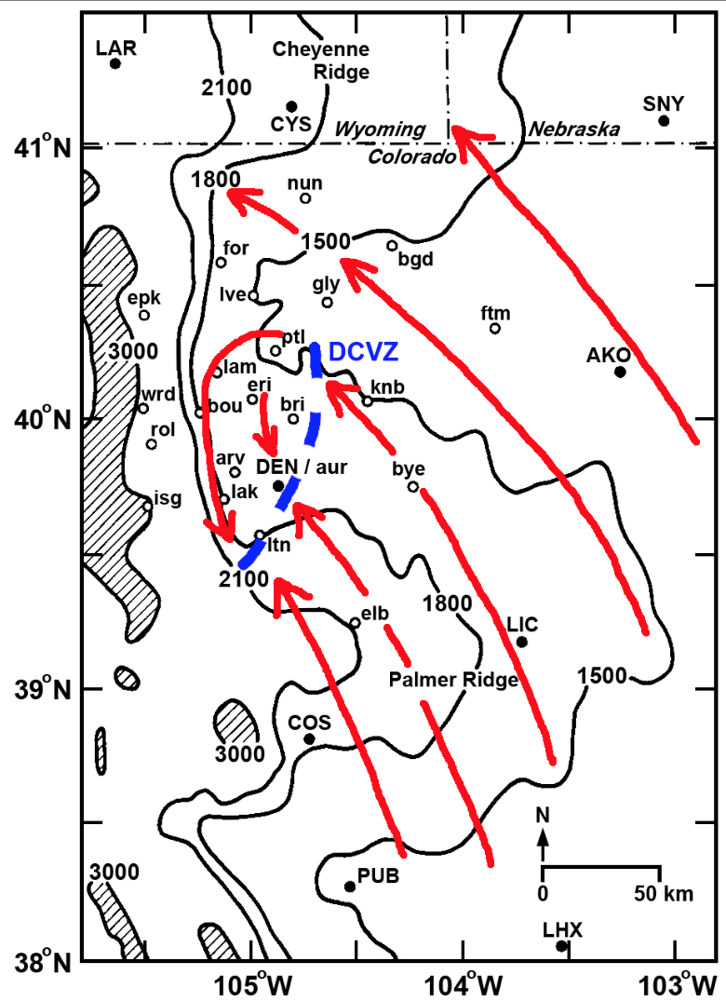
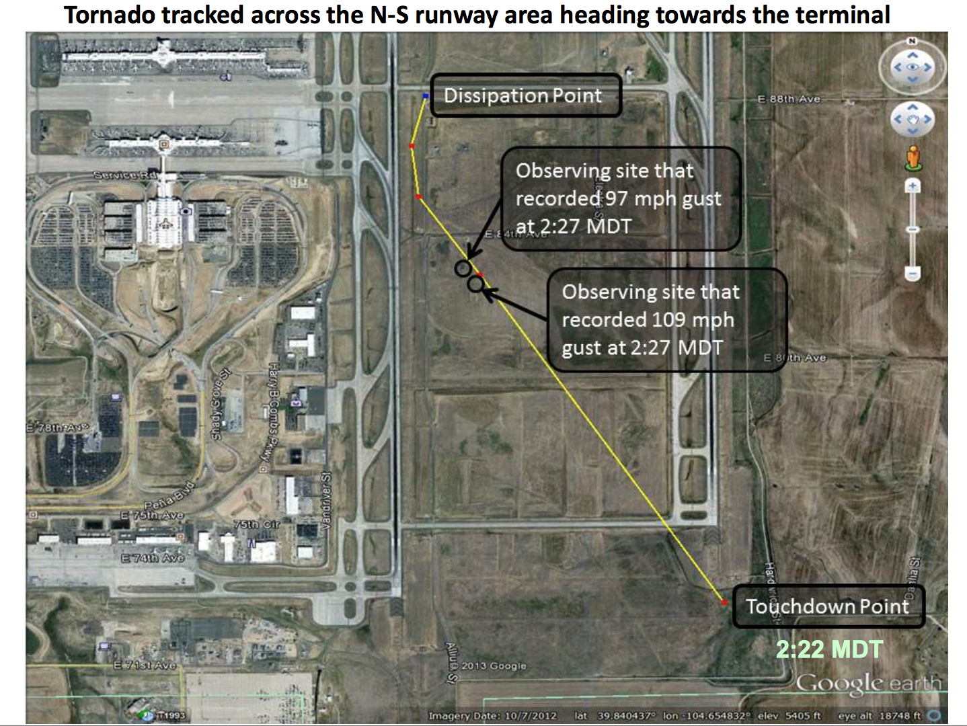
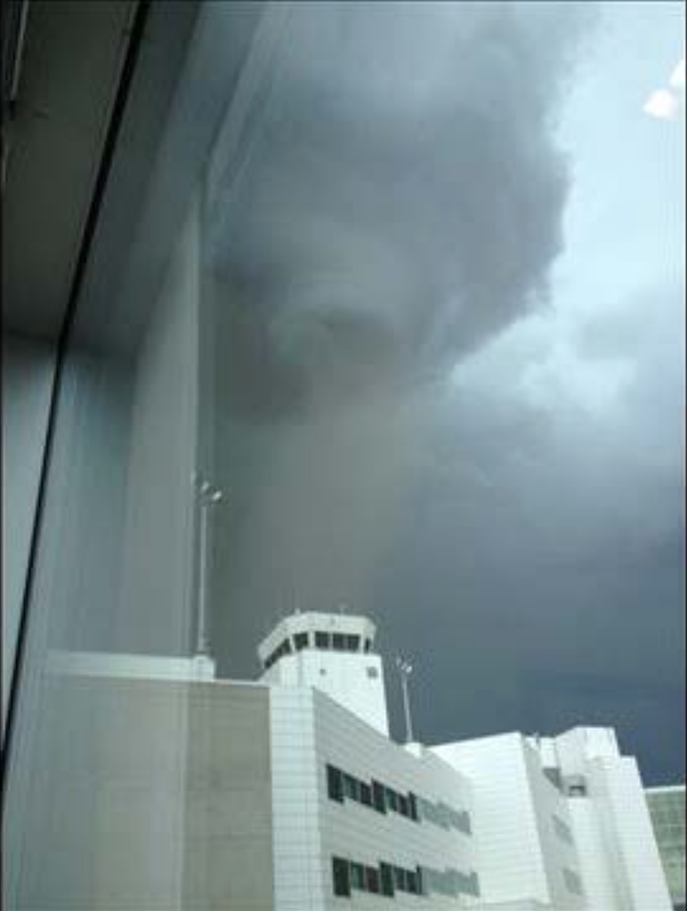
Denver Convergence Vorticity Zone (DCVZ)
Southeasterly flow moves over the Palmer Divide and is deflected westward. Some flow continues to bend as it reaches the Cheyenne Ridge causing small scale vortices
Air moving down the mountains from west to east converges with southeasterly flow, causing a convergence zone
The DCVZ tends to form over or near the Denver International Airport, causing non-supercellular tornadoes to frequently form in this area
For example, June 18, 2013 a tornado touched down on DIA runways
Photos and figure courtesy of Ed Szoke

Slide 15
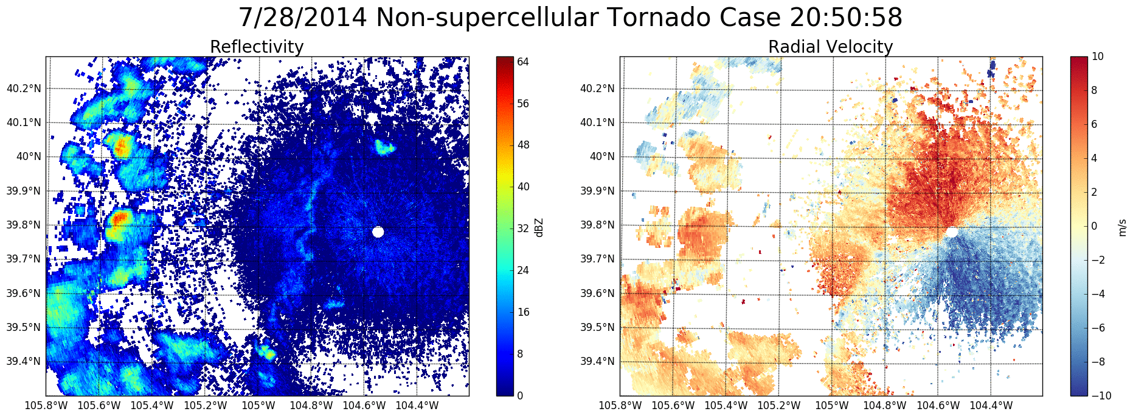

Slide 16
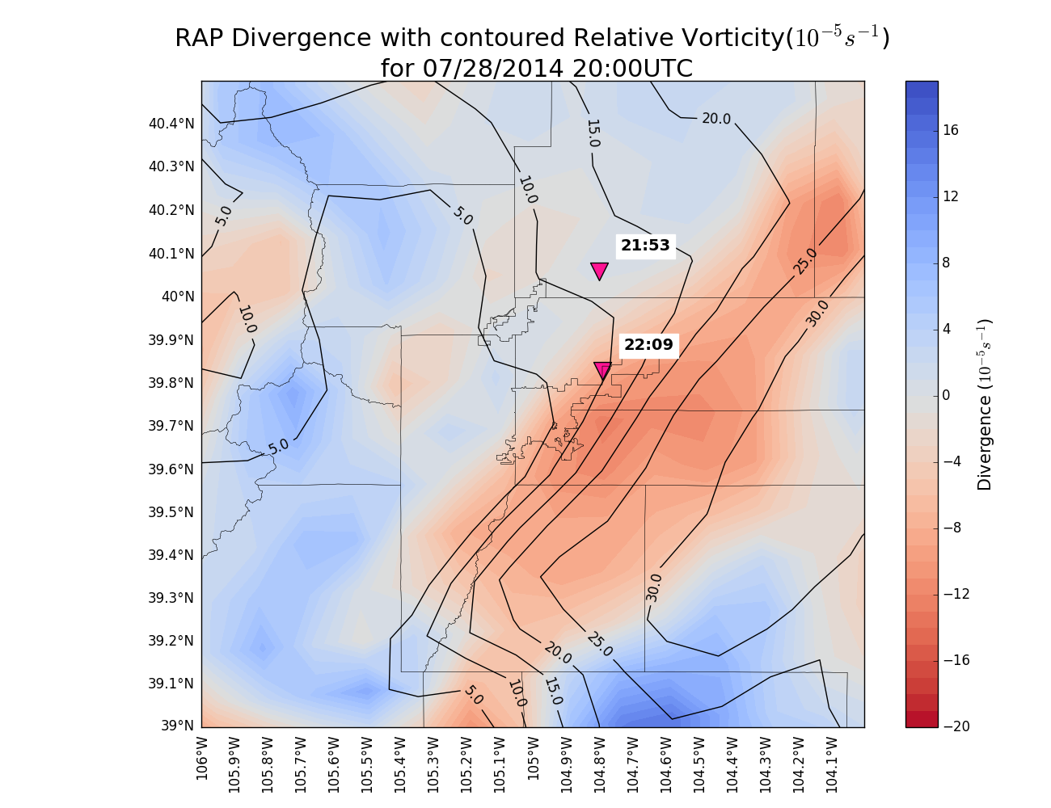
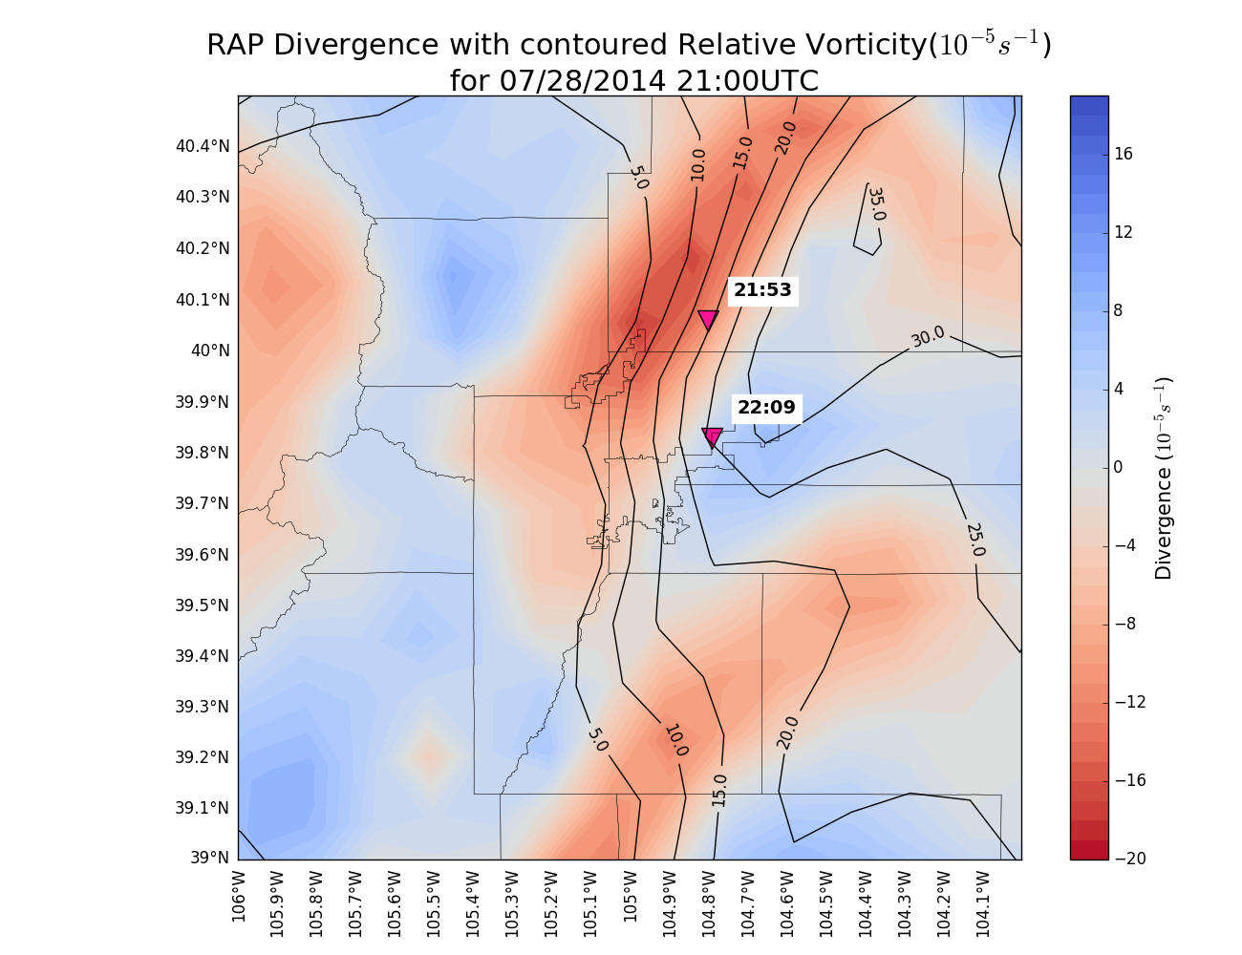
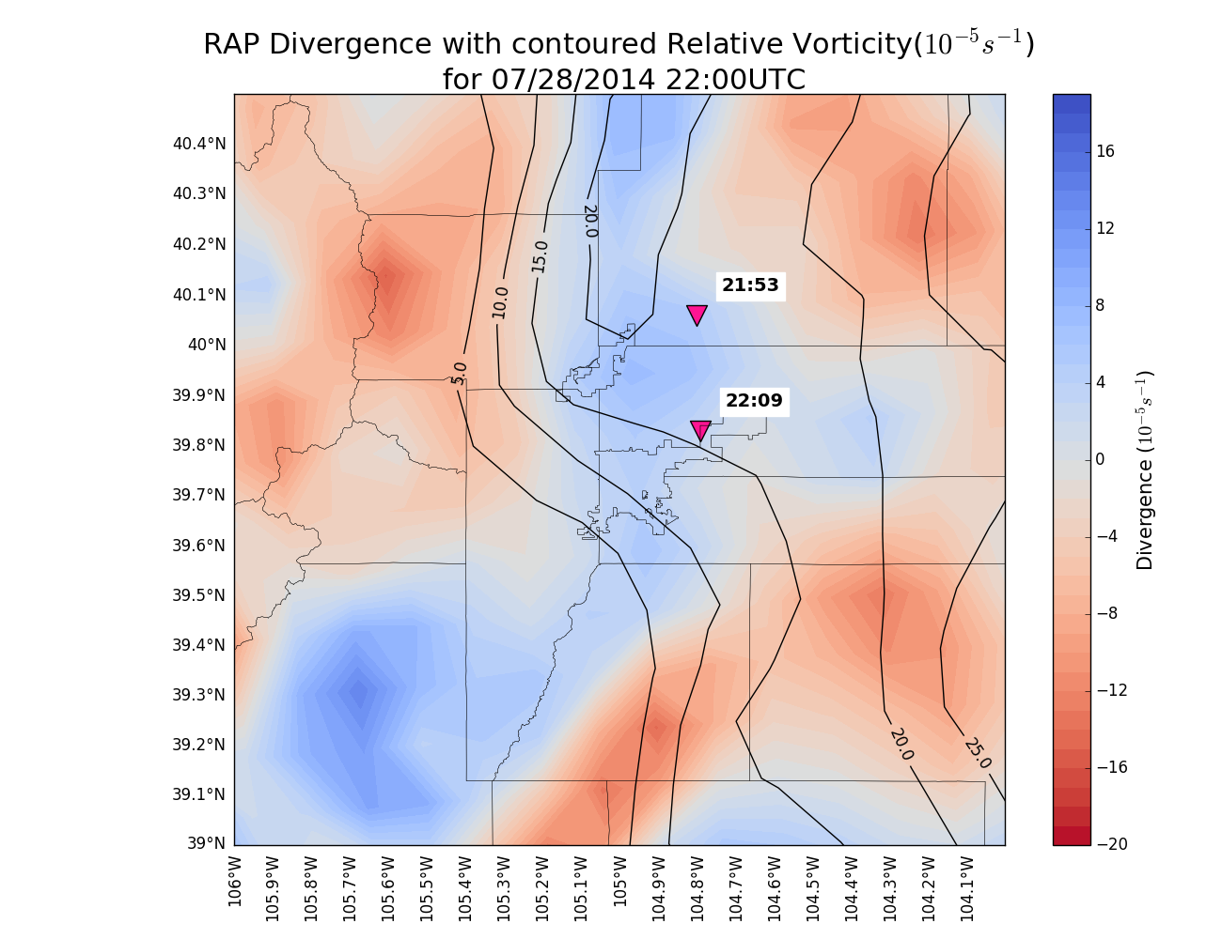
RAP Divergence with Contoured Relative Vorticity (10⁻⁵s⁻¹)
20:00Z
21:00Z
22:00Z

Slide 17
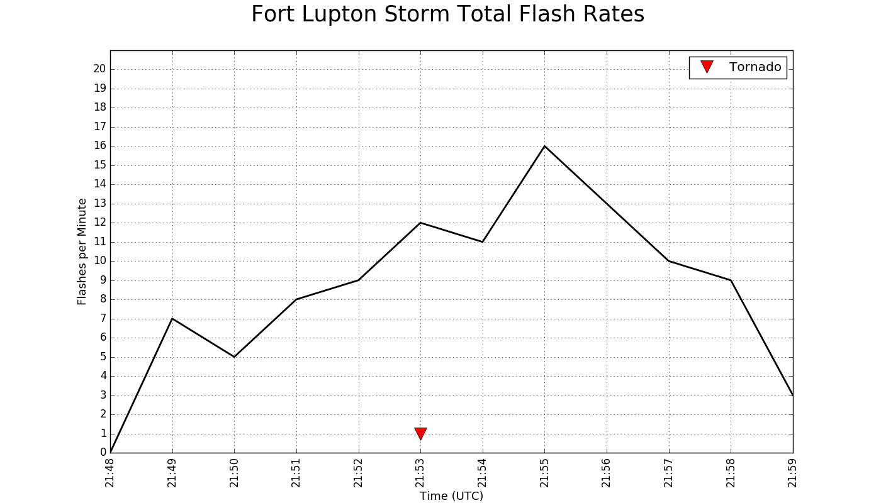
Updraft forms and storm intensifies-- evident through K_{dp}/Z_{dr} columns and increasing reflectivity values
Reflectivity core descends as precipitation falls out

Slide 18
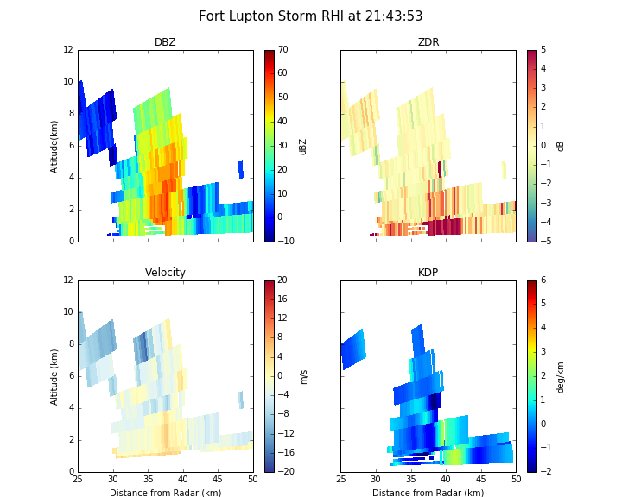
0° C level

Slide 19
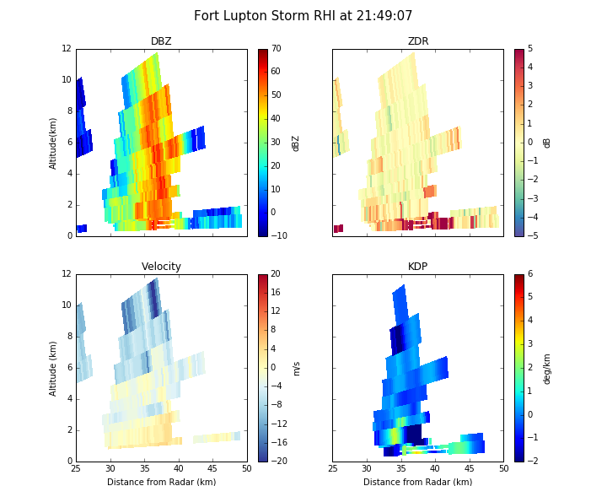

Slide 20
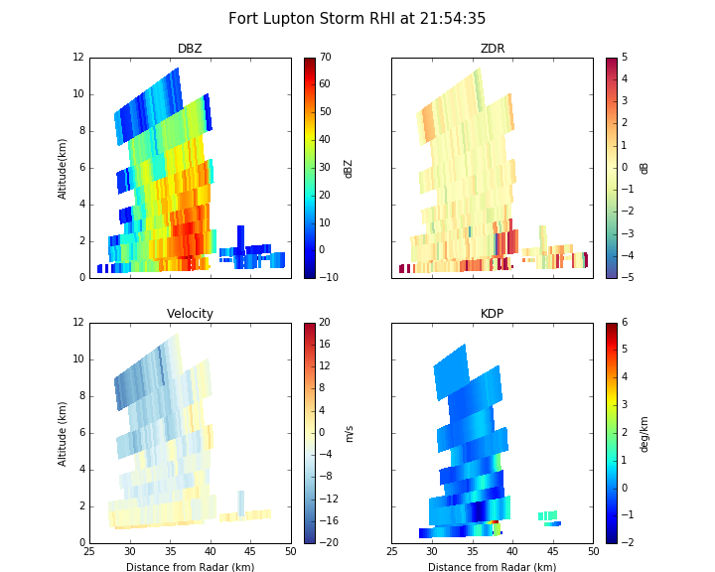

Slide 21
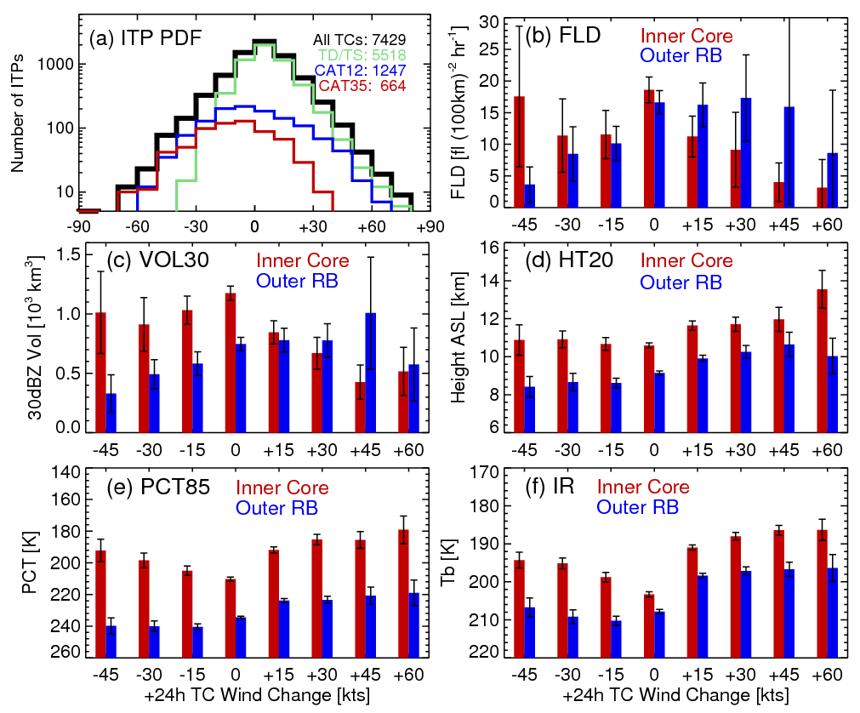
TC intensity changes and lightning
Xu and Rutledge, 2016 (In review)

Slide 22
Summary
High flash rates, large IC/CG ratios and the low centroid of flash channels for Colorado storms present interesting challenges for GLM cal/val
Synoptic setup conducive to non-supercell tornadoes around populated areas
GLM cal/val: recommend conducting one or two flights over NE Colorado to sample these unique storms; climatology suggest late May through mid-June would be optimal timing for CO storms
Exciting use of GLM data within TC’s for improving intensification forecasts

