Slide 1

An Integrated View of Convection from MC3E
Brenda Dolan, Steven Rutledge, Weixin Xu
DOE ASR PI Meeting
18 March 2015
With thanks to Alyssa Matthews, Brody Fuchs, Elizabeth Thompson, Merhala Thurai (CSU), Angela Rowe (UW), Toshi Matsui, Taka Iguchi, W.-K. Tao (NASA)

Slide 2
Thrust
Using state of the art Doppler and polarimetric radar analysis techniques to help validate cloud models—both microphysics and kinematics
Illustrate only a few examples here
Study both warm and cold season precipitation

Slide 3
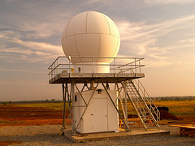
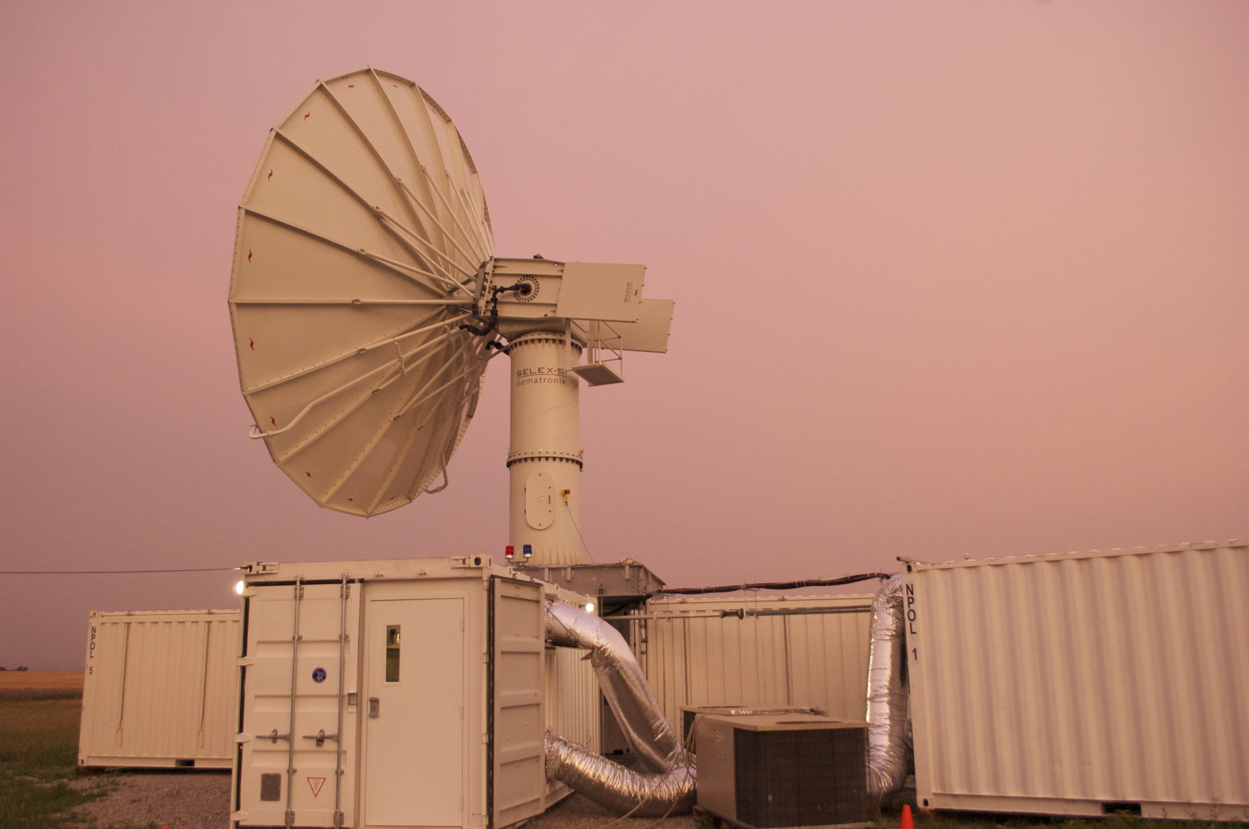
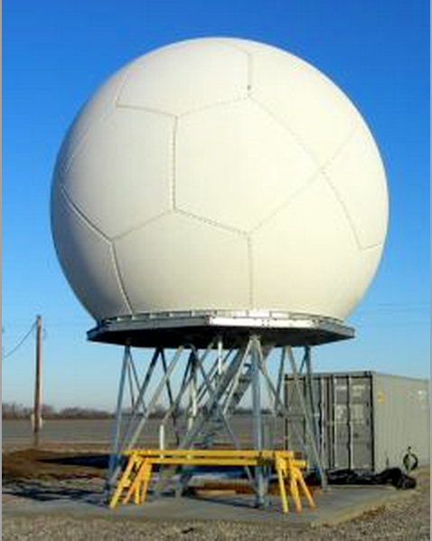
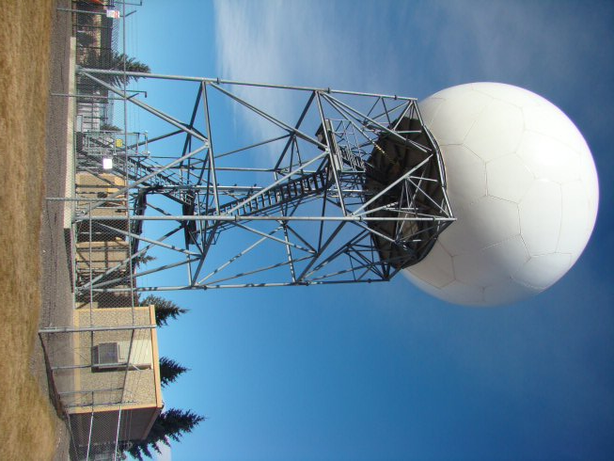
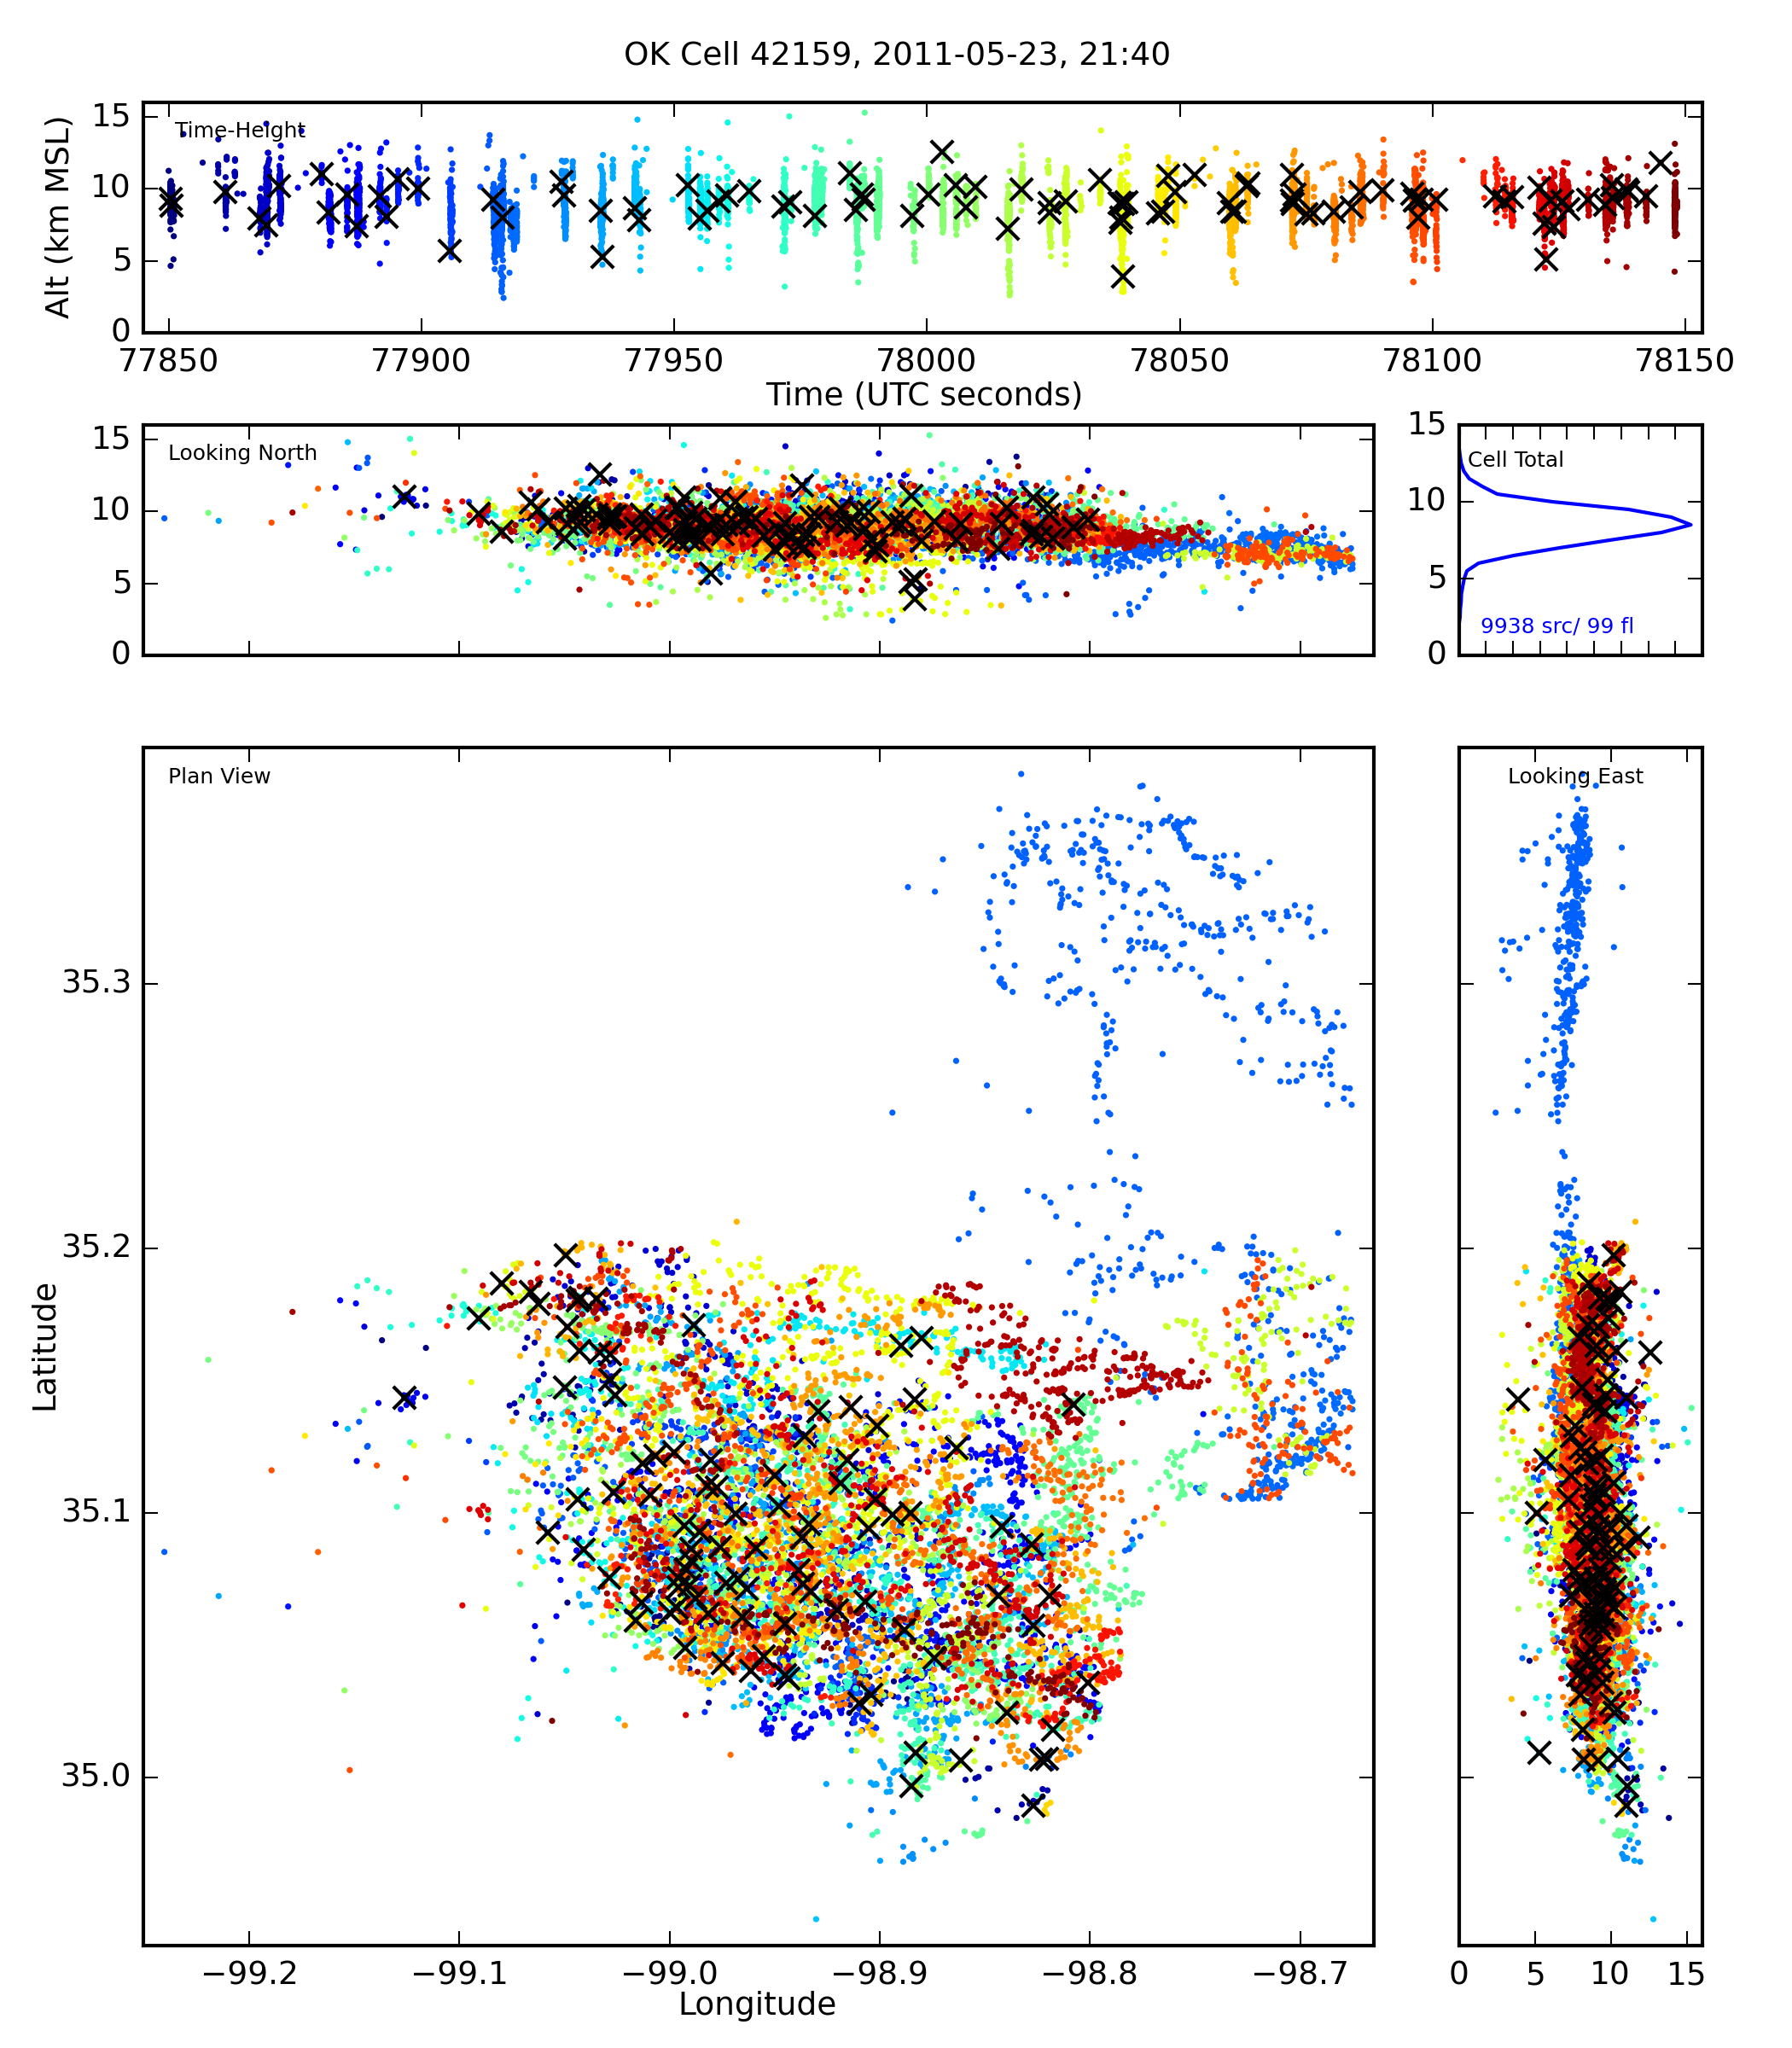
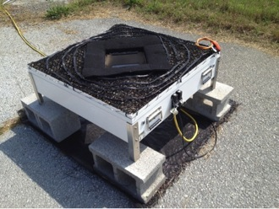
MC3E-SGP: Affording a Comprehensive View of Convection
April-May 2011
XSAPRs (SE, SW, NW)
  X-band (3 cm wavelength)
  Network = dual-Doppler retrievals of 3D wind
  22 tilts reaching 50 degrees in 6 minutes
  Range: 40 km
  Nyquist Velocity: 16.8, 17.2 m/s
NPOL
  S-band (10.6 cm)
  Variable scanning; aircraft support, RHIs, sector scans
  Range: 150 km
X-SAPR, courtesy DOE
CSAPR
  C-band (5 cm wavelength)
  17 tilts in 6 minutes
  Range: 120 km
  Nyquist Velocity: 16.5 m/s
KVNX (NEXRAD)
  S-band (11 cm wavelength)
  4.5 min scans
  Range: 150 km
  Nyquist Velocity: 26.75 m/s
C-SAPR, courtesy DOE
KCYS, courtesy crh.noaa.gov
Radar Retrievals:
-3D wind via dual-Doppler techniques
-Bulk microphysics from hydrometeor identification algorithms
-Drop size distributions, rain rate and LWC from distrometers
Lightning Mapping Array
Disdrometers
5 2DVD
  Measures drops to 10 mm; 50 0.2 mm bins
  16 Autonomous Parsivel Units
    Measures particles up to 25 mm in 32 bins
-11 Stations providing time-of-arrival 3D mapping of lightning sources via VHF source data
Image courtesy of http://wallops-prf.gsfc.nasa.gov/Disdrometer/
Notes:
Obviously there was significantly more instruments deployed, including aircraft, cloud radars, profilers, etc. This is just what we use in this study

Slide 4
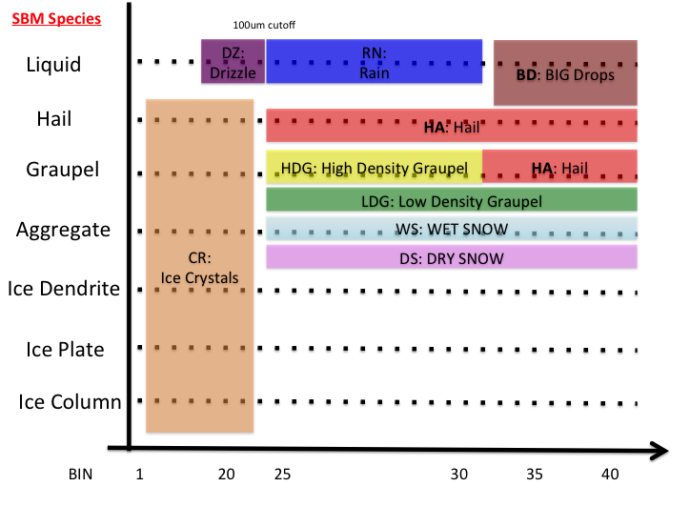
NASA/WRF Spectral Bin Model
Toshi Matsui, W. K. Tao
43 mass bins covering sizes from small cloud particles to hailstones, uses so-called 4 ice scheme (hail, graupel, aggregates and pristine ice) plus 4 water categories
Riming fractions for aggregates are computed—allowing transition to graupel, melt fraction computed as well allowing transition to wet snow, similar for graupel and hail
  As a first attempt at model / radar microphysical comparisons, the NASA WRF hydrometeor fields are subdivided into HID-consistent categories with respect to size, density and phase. HID algorithm developed by Dolan and Rutledge (2009) and Dolan et al. (2013) is used. For example for rain, specific size bins define drizzle, light rain and big drops (> 5 mm diameter). Aggregates are defined as graupel when riming fraction exceeds 30%. The “matrix” below is therefore realized.
  At each model grid point the hydrometeor type that dominates the radar reflectivity is identified and assigned to that grid point (hail, rain, etc.)
  Big drops were an interesting observation from MC3E, D > 5 mm.

Slide 5
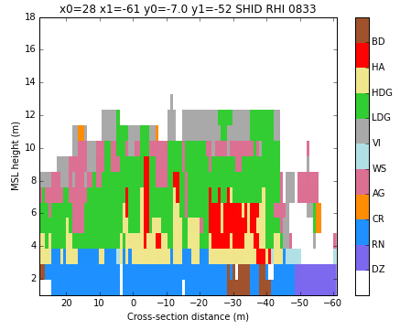
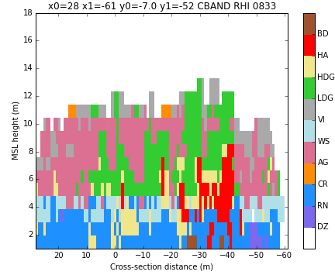
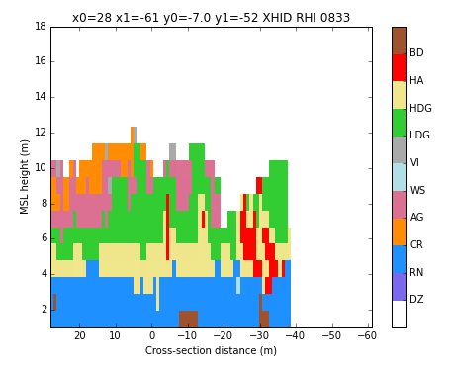
Multi-wavelength HID (MWHID)
Combine the available cm radars (KVNX, C-SAPR, X-SAPR) into a single classification to leverage the strengths of each wavelength
KVNX
C-SAPR
X-SAPR
  S-band: Insignificant attenuation and Mie scattering
  C-band: Resonance effects (big drop detection)
  X-band: Greater sensitivity in light precipitation and ice region (K_{dp} proportional to wavelength⁻¹)
Fuzzy logic classifications for each hydrometeor type is a function of radar wavelength
  For example, hail and graupel weighted heavily at S-band, big drops more at C-band, pristine ice species weighted at X-band
Combine HID from each wavelength using a ‘weighted mode scheme’ at each grid point—weights based on scattering simulations and empirical data
MWHID=Mode[W_{S}*HID_{S},W_{C}*HID_{c},W_{X}*HID_{x}]
Notes:
Each see different things, so which to trust??

Slide 6
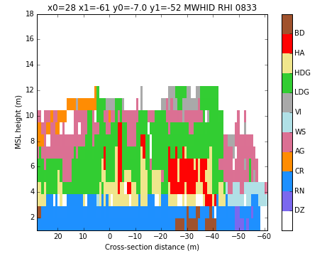
Multi-wavelength HID (MWHID)
Fairly coherent picture and less noisy than individual radars
Ice in the upper levels
Layer of wet snow in the stratiform with aggregates above and rain/drizzle below
Hail core and big drops below
MWHID
Conducted sensitivity tests by removing wavelengths and comparing to the 3-wavelength MWHID
X-band best at resolving pristine ice particles and vertically aligned ice
C-band best at resolving “big drops”, drizzle, wet snow and vertically aligned ice
S-band best at resolving graupel and hail, and heavy rain
But ambiguities exist…..the picture is not always crystal clear……
Notes:
Each see different things, so which to trust??

Slide 7

A particular example…….
S-band (NPOL)
C-band (CSAPR)
X-band (XSAPR)
KVNX CSAPR XSAPR
Mie Effects
Total Attenuation
Large region of big drops; no hail
Ambiguity between hail and big drops
Regions of big drops, but totally attenuated behind core
Notes:
Each see different things, so which to trust??

Slide 8
MWHID----Cold Season
Shorter wavelengths (X- and C-band) valuable for discriminating ice species in winter, S-band adds little additional information for cold season precipitation
  Due to increased phase shifts, K_{dp} (scales with 1/λ)
  Less attenuation in cold-season storms
From Thompson et al. 2014
CASA X-band data from 24 Dec. 2009
OU-Prime C-band data from 28 Jan. 2010
Zh
Zdr
Dendrites
Aggregation layer
Dendrites
Aggregation layer
Kdp
HID
Dendrites
Dendrites
Aggregation layer
Aggregation layer
Aggregation layer
Dendrites
Dendrites
Aggregation layer
Notes:
Each see different things, so which to trust??

Slide 9
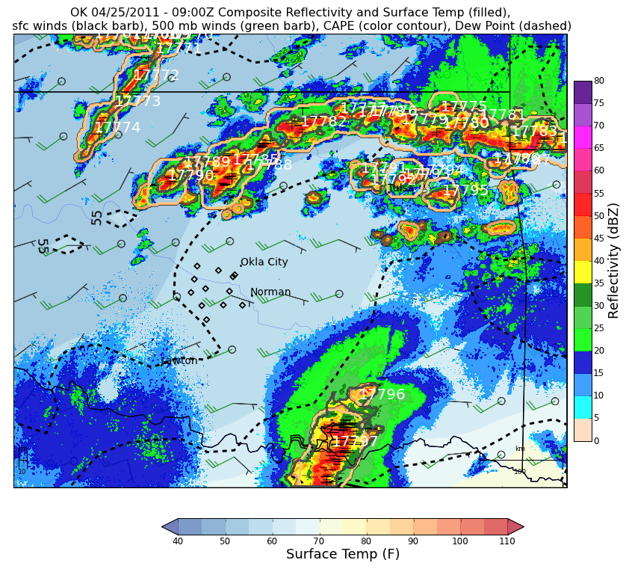
25 April 2011
Elevated nocturnal convection
  East-west MCS
  Moved toward NE
  2DVDs observed numerous drops > 5 mm
08-1130 UTC
Frequent lightning activity (up to 60 flashes/min)

Slide 10
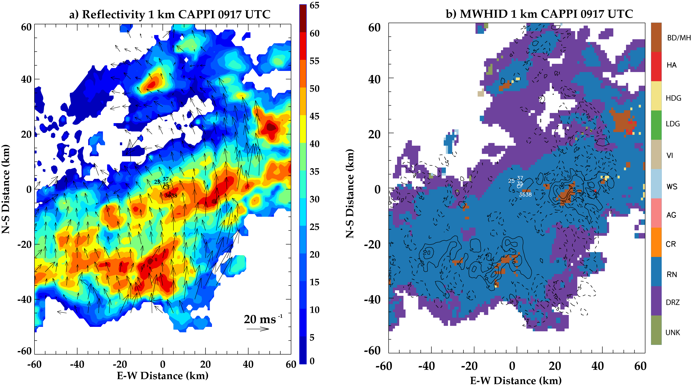
Horizontal cross-section at 0917 UTC
Origin of big drops (> 5 mm)?
  Almost exclusively associated with strongest reflectivity and beneath main updraft cores
  Melting hail rather than collision-coalescence produces big drops
Contoured
VV
Column Maxima integrated over 08-1130 UTC
Points identified as BD from 08-1130 UTC
Notes:
Note! Big Drops > 5mm!
Big drops important because large number of them shows high reflectivity, but the rain rates in these areas of high BD are lower
Frequency of these is what is important!
Why so many big drops? Melting Hail?
Big drops occuring in upward motion cores (black contours)

Slide 11
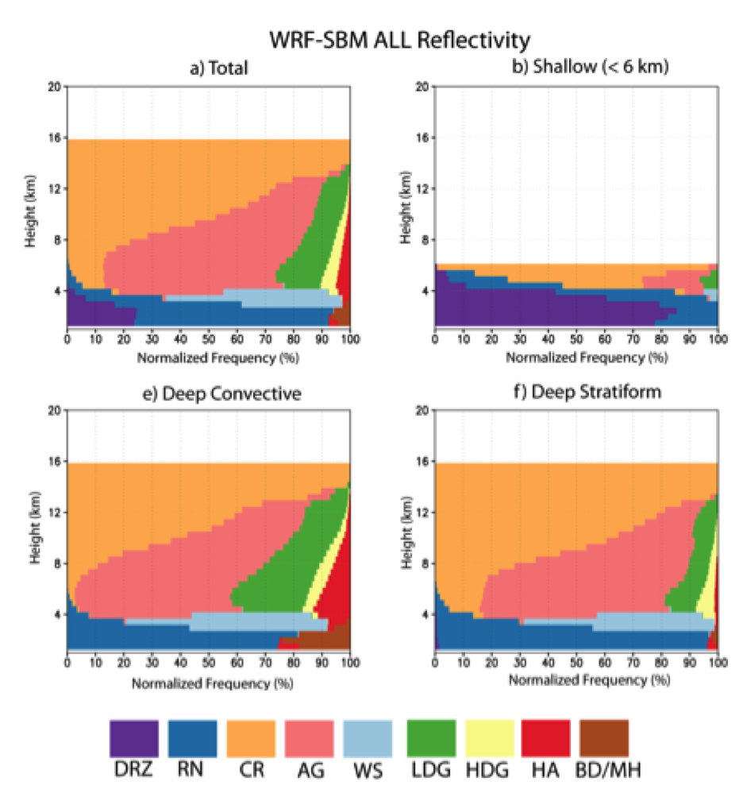
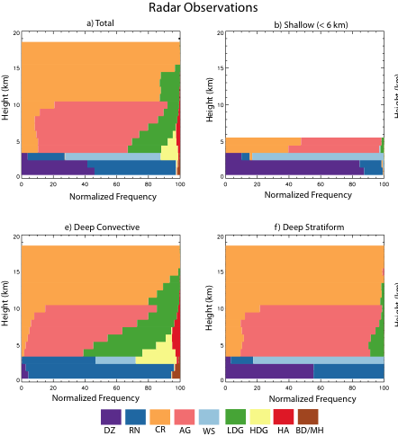
Model and Radar Bulk Microphysics
Layer of rain above ML, no wet snow
Clear WS layer
Deep Stratiform:
Steiner et al. (1995) Convective / Stratiform used in both model and radar; some aliasing of convection in model space leading to more graupel and a small amount of hail in deep stratiform region
Deep Convection and Deep Stratiform Regions:
Upper levels similar with ice crystals and aggregates
Deep Convection:
More graupel, hail, big drops in model, but comparison is not bad

Slide 12
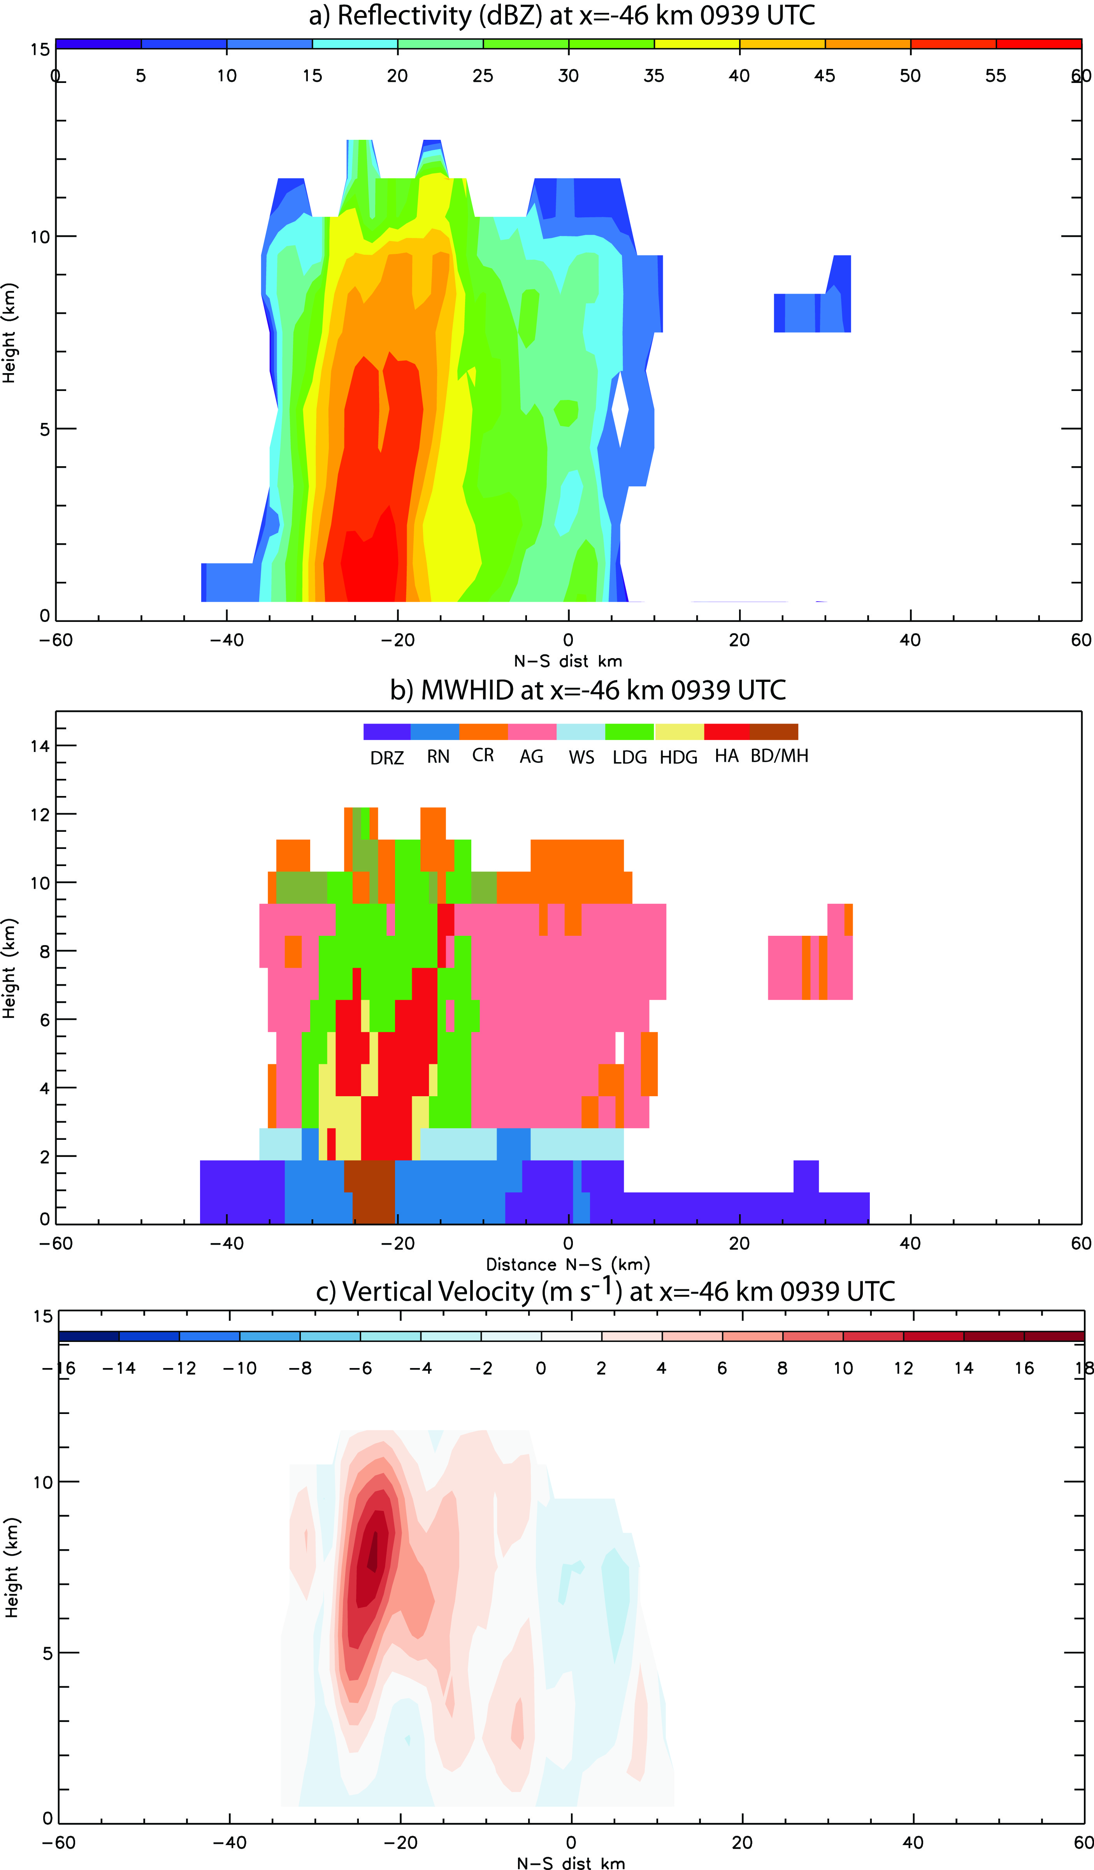
Model /Radar: Cross-section Comparison
Reflectivity Profile
WRF
Obs
Kinematics:
  Updraft cores in model and obs are > 10 ms⁻¹
  Model has stronger updrafts and weaker downdrafts—this is a common pattern, not just in this model/radar comparison study
  Model and observations peak around 7-8 km
Microphysics:
  Similar vertical structure, although model noisier due to reflectivity-weighted HID mapping
  Continuity between hail / graupel aloft and big drops at the surface in cores
    All big drops in model originate from hail
Notes:
In this cross sectional comparison, cross sections are not the same, as the simulation locations did not exactly match up. However, similar cores were examined, with similar reflectivities.
This shows that there is a vertical relationship between hail and big drops, with hail above the melting layer and big drops below. This implies that the big drops are forming from melting hail.
----- Meeting Notes (1/13/15 22:28) -----
Identify 'WRF' and "OBS' in figures?

Slide 13
Next steps
Apply a sophisticated polarimetric radar simulator for model output
  Simulate polarimetric moments at S, C and X cm-wavelengths from model output, then apply radar-based fuzzy logic HID
  Provide a more direct comparison between model and radar microphysics
Process additional cases (MC3E and TWP-ICE)

Slide 14
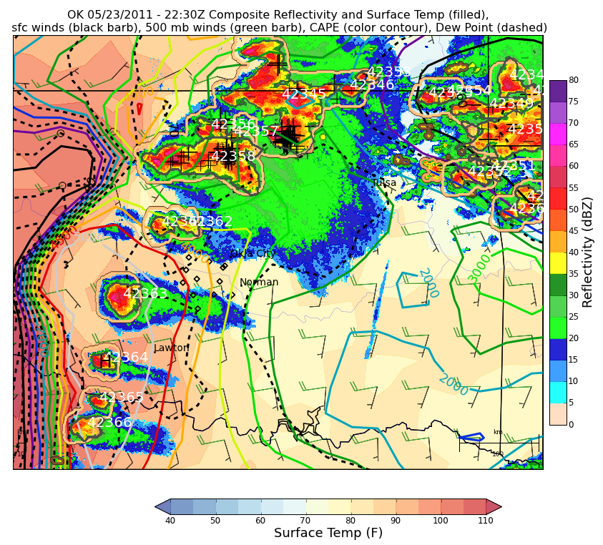
23 May 2011
Dry line initiated convection, supercells
21-24 UTC
  Convection lasted longer (into 24th) but was out of X-band coverage
Intense, electrically active storms with upwards of 200 flashes / min at the peak

Slide 15
Integrated view
CSAPR hi-res RHI, dual-Doppler winds, lightning strikes from LMA
Strong, hail-filled reflectivity core
Lightning flashes clustered in and around strong updraft and graupel
  Some flashes in the stratiform region
Plethora of big drops /melting hail below the hail core and updraft region
Are the large drop / melting hail regions unique to this region?
What is the relationship between big drops and environmental parameters such as freezing level and warm cloud depth?

Slide 16
Is there a relationship between DSD and environmental variables?
9 cases from MC3E
RUC closest point to each 2DVD was selected and ‘matched’ to disdrometer times; parameters taken at surface
Storm means of each variable were calculated; convection only
Data were then correlated using Spearman correlations

Slide 17
Correlations with DSD and Environment
Disdrometer data *Simulated | Warm Cloud Depth | Dew Point | Relative Humidity | Sfc Temp. | Cloud Base Height
D₀ | 0.75 | 0.6 | 0.0 | 0.48 | -0.07
Log₁₀(N_{w}) | 0.50 | -0.37 | 0.67 | -0.6 | -0.48
LWC | 0.72 | 0.31 | 0.45 | 0.05 | -0.27
RR | 0.80 | 0.28 | 0.45 | 0.0 | -0.38
DBZ* | 0.77 | 0.63 | 0.07 | 0.43 | -0.18
Zdr* | 0.68 | 0.55 | -0.15 | 0.45 | 0.02
Kdp* | 0.85 | 0.42 | 0.25 | 0.15 | -0.33
Warm Cloud Depth
-Deeper warm cloud depth results in larger particle sizes, heavier rain rates, larger liquid water contents
Higher T_{d}_sfc:
-Larger drops, lower Log(N_{w}), increased LWC and RR
Higher T_sfc:
-Slightly larger D0, lower Log(Nw)
-No correlation to LWC or RR
Higher Cloud base height:
-Slightly smaller D₀, lower LWC, lower RR
Deeper warm cloud depths (through higher freezing levels, higher surface dew points, and lower cloud base heights) allow hail to melt faster (less evaporative cooling; less exposure to sub-cloud dry air) resulting in large drops exiting the base of cloud
Large hail in cloud will result in hail at surface
Small hail can fully melt producing rain at the surface
Intermediate hail results in big drops at the surface
  5.75 mm particle with 900 kg m⁻³ will melt into a 5 mm drop

